Slide 1

Expected utility theory
Notes on Behavioural Economics
Jason Collins

Slide 2
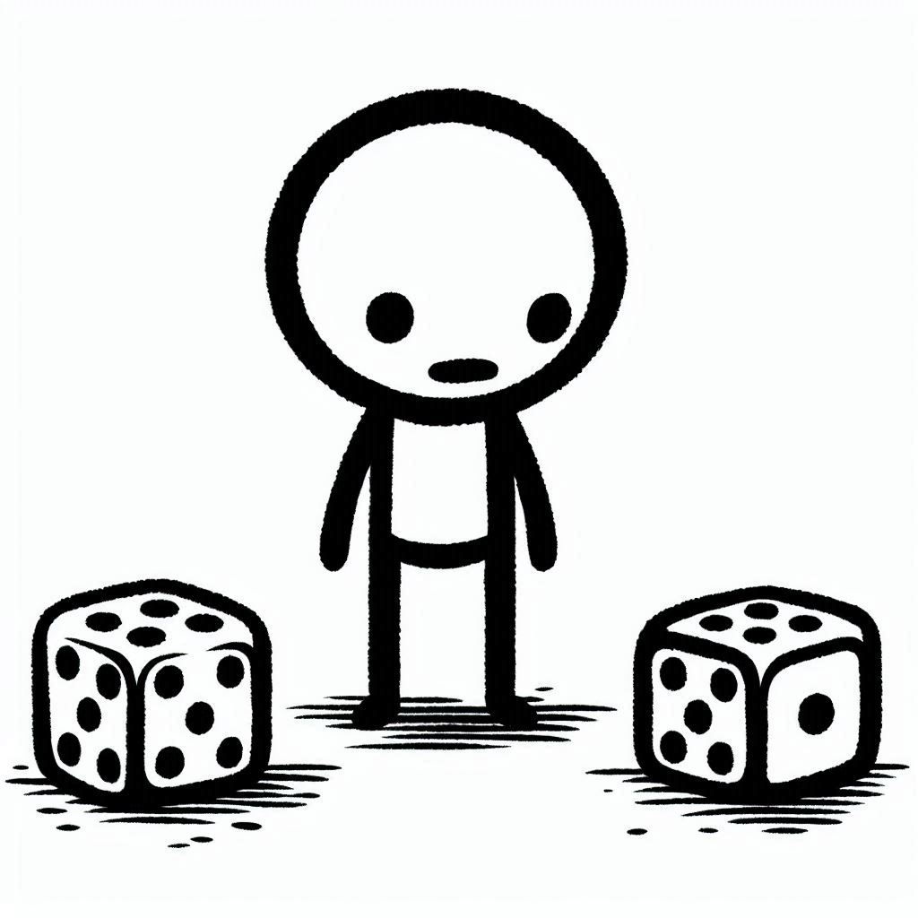

Slide 3

Expected utility theory
$$X=\left(p_{1},x_{1}; {p_{2},x}_{2}; … ; p_{n}x_{n}\right)$$

Slide 4


Expected utility theory
$$X=\left(p_{1},x_{1}; {p_{2},x}_{2}; … ; p_{n}x_{n}\right)$$
$$X=\left(0.5,\$10; 0.5,−\$10\right)$$

Slide 5
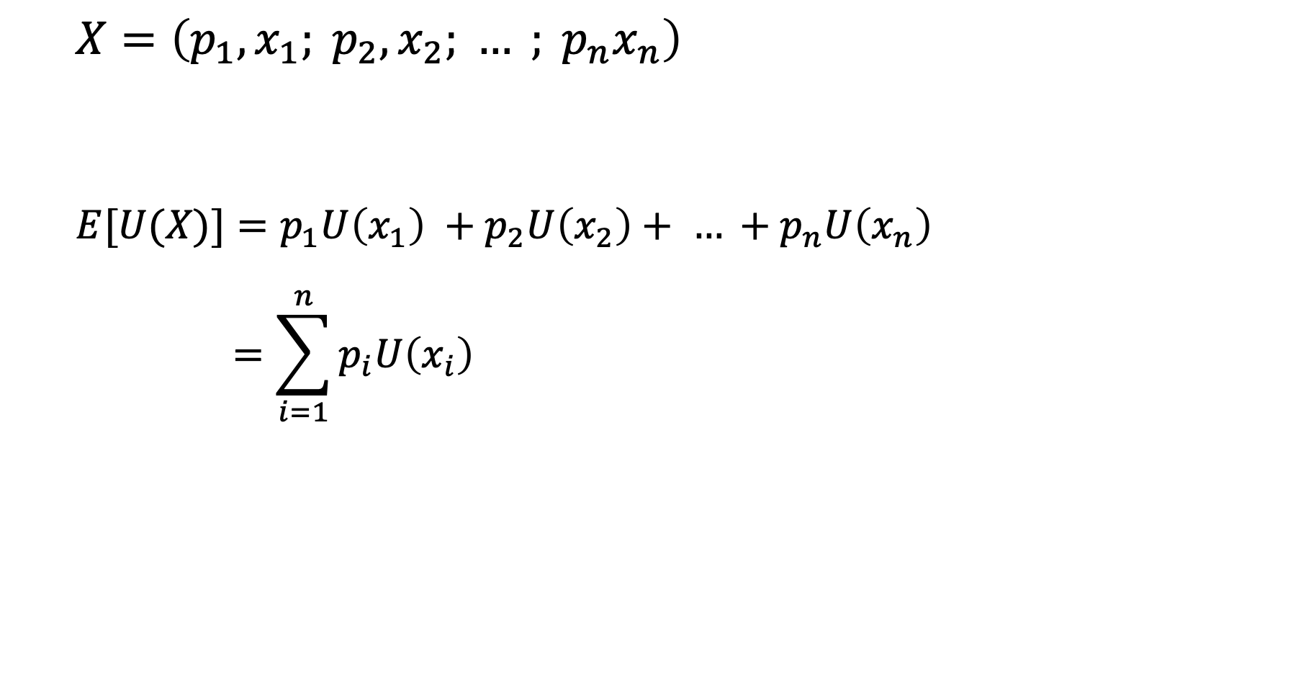
Expected utility theory
$$X=\left(p_{1},x_{1}; {p_{2},x}_{2}; … ; p_{n}x_{n}\right)$$
$$E[U(X)]=p_{1}U\left(x_{1}\right) +p_{2}U\left(x_{2}\right)+ … +p_{n}U\left(x_{n}\right)$$
$$=\sum_{i=1}^{n}{p_{i}U\left(x_{i}\right)}$$

Slide 6
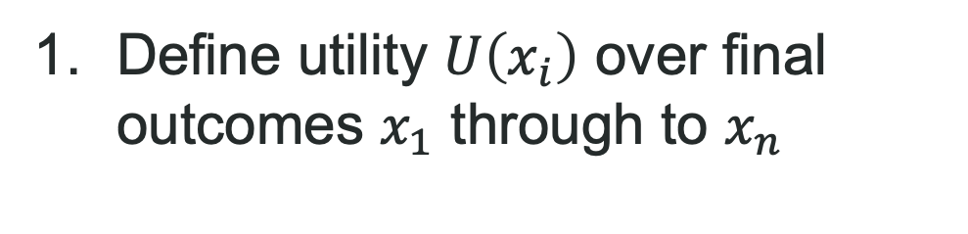
Expected utility theory
$$X=\left(p_{1},x_{1}; {p_{2},x}_{2}; … ; p_{n}x_{n}\right)$$
$$E[U(X)]=p_{1}U\left(x_{1}\right) +p_{2}U\left(x_{2}\right)+ … +p_{n}U\left(x_{n}\right)$$
$$=\sum_{i=1}^{n}{p_{i}U\left(x_{i}\right)}$$
Define utility $U\left(x_{i}\right)$ over final outcomes $x_{1}$ through to $x_{n}$

Slide 7
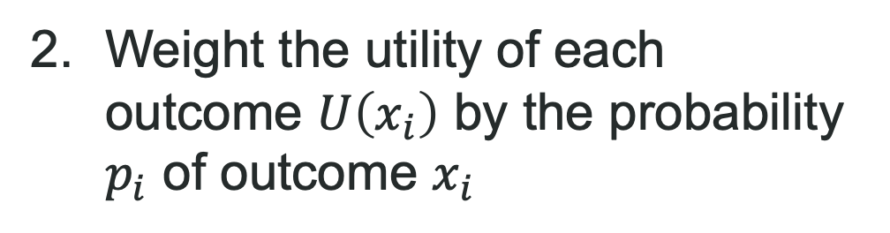
Expected utility theory
$$X=\left(p_{1},x_{1}; {p_{2},x}_{2}; … ; p_{n}x_{n}\right)$$
$$E[U(X)]=p_{1}U\left(x_{1}\right) +p_{2}U\left(x_{2}\right)+ … +p_{n}U\left(x_{n}\right)$$
$$=\sum_{i=1}^{n}{p_{i}U\left(x_{i}\right)}$$
Weight the utility of each outcome $U\left(x_{i}\right)$ by the probability $p_{i}$ of outcome $x_{i}$

Slide 8
Expected utility theory
$$X=\left(p_{1},x_{1}; {p_{2},x}_{2}; … ; p_{n}x_{n}\right)$$
$$E[U(X)]=p_{1}U\left(x_{1}\right) +p_{2}U\left(x_{2}\right)+ … +p_{n}U\left(x_{n}\right)$$
$$=\sum_{i=1}^{n}{p_{i}U\left(x_{i}\right)}$$
Add the weighted utilities.

Slide 9

Expected utility theory
$$X=\left(0.5,\$10; 0.5,−\$10\right)$$
$$E\left[U\left(X\right)\right]=0.5 × U\left(\$10\right) +0.5 × U\left(−\$10\right)$$

Slide 10
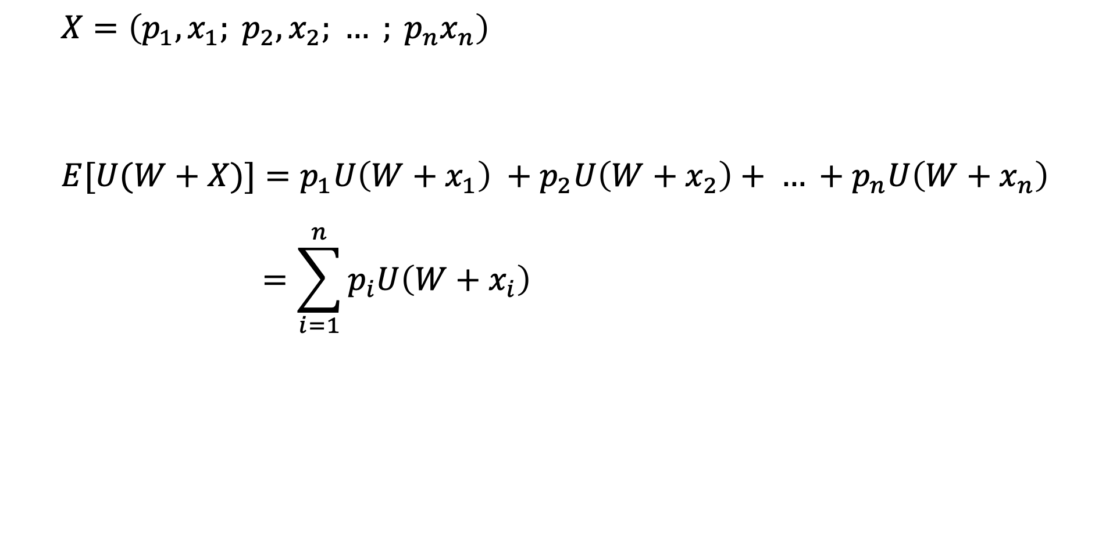
Expected utility theory
$$X=\left(p_{1},x_{1}; {p_{2},x}_{2}; … ; p_{n}x_{n}\right)$$
$$E[U(W+X)]=p_{1}U\left({W+x}_{1}\right) +p_{2}U\left({W+x}_{2}\right)+ … +p_{n}U\left(W+x_{n}\right)$$
$$=\sum_{i=1}^{n}{p_{i}U\left({W+x}_{i}\right)}$$

Slide 11

Expected utility theory
$$X=\left(0.5,\$10; 0.5,−\$10\right)$$
$$E\left[U\left(X\right)\right]=0.5 × U\left(\$90\right) +0.5 × U\left(\$110\right)$$

