Slide 1

Expected value
Notes on Behavioural Economics
Jason Collins

Slide 2

Expected value

Slide 3

Expected value
$E\left[X\right]$: the probability-weighted sum of the potential outcomes

Slide 4
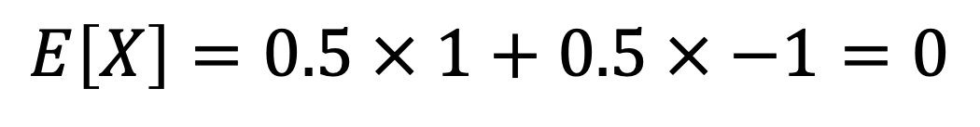
Expected value
Probability | Outcome
50% | +$1
50% | -$1
$$E\left[X\right]=0.5 × 1+0.5 × −1=0$$

Slide 5
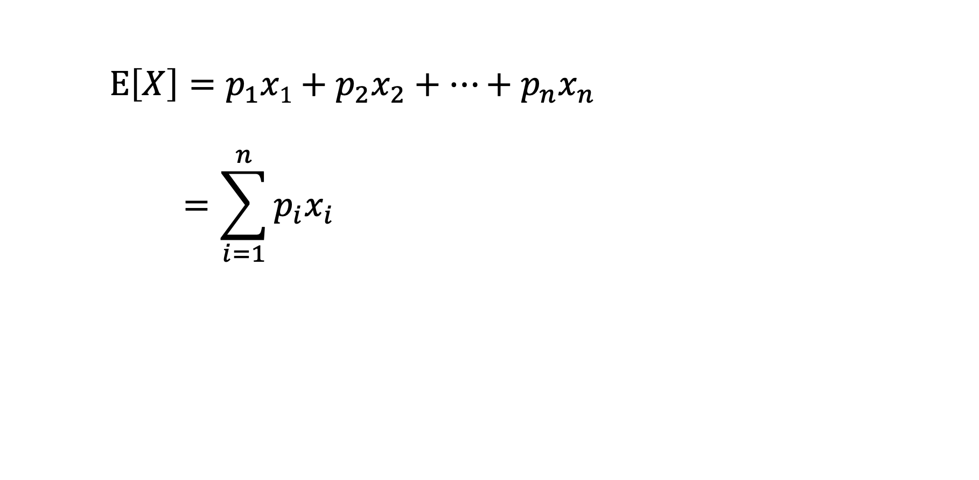
Expected value
$E\left[X\right]=p_{1}x1+p_{2}x_{2}+…+p_{n}x_{n}$
$$=\sum_{i=1}^{n}{p_{i}x_{i}}$$

Slide 6
Expected value
You are offered bet with a 50% chance of winning $10 and a 50% chance of losing $8.

Slide 7
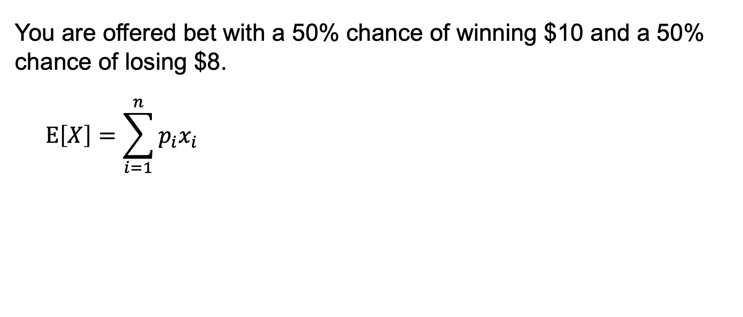
Expected value
You are offered bet with a 50% chance of winning $10 and a 50% chance of losing $8.
$$E\left[X\right]=\sum_{i=1}^{n}{p_{i}x_{i}}$$

Slide 8
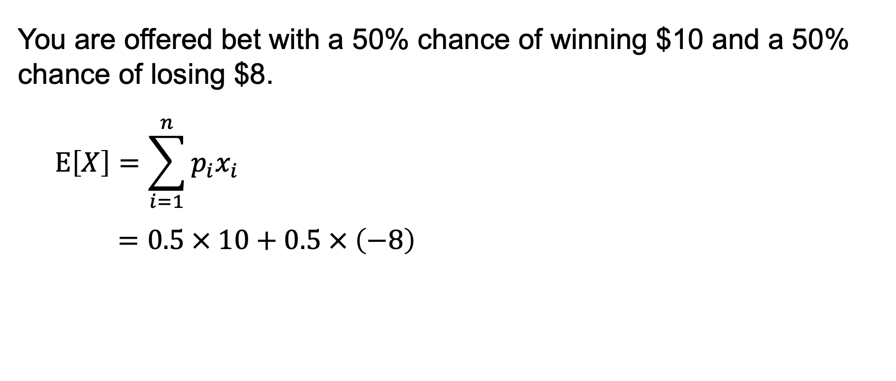
Expected value
You are offered bet with a 50% chance of winning $10 and a 50% chance of losing $8.
$$E\left[X\right]=\sum_{i=1}^{n}{p_{i}x_{i}}$$
$$=0.5 × 10+0.5 × \left(−8\right)$$

Slide 9
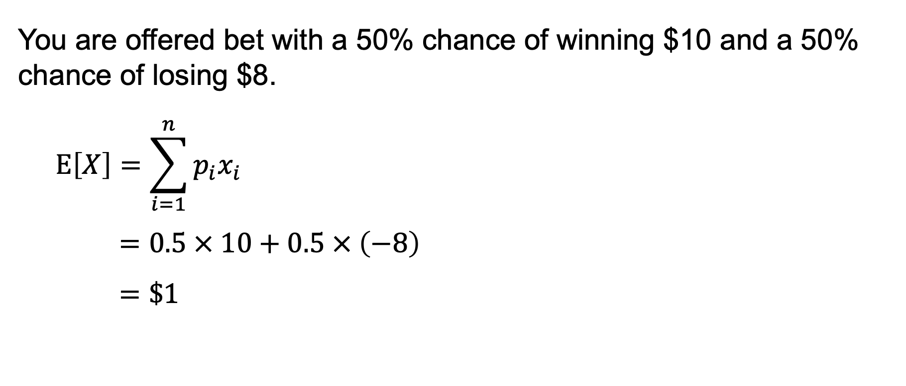
Expected value
You are offered bet with a 50% chance of winning $10 and a 50% chance of losing $8.
$$E\left[X\right]=\sum_{i=1}^{n}{p_{i}x_{i}}$$
$$=0.5 × 10+0.5 × \left(−8\right)$$
$$=\$1$$

Slide 10
Expected value
Your chance of winning increases to 60%.

Slide 11
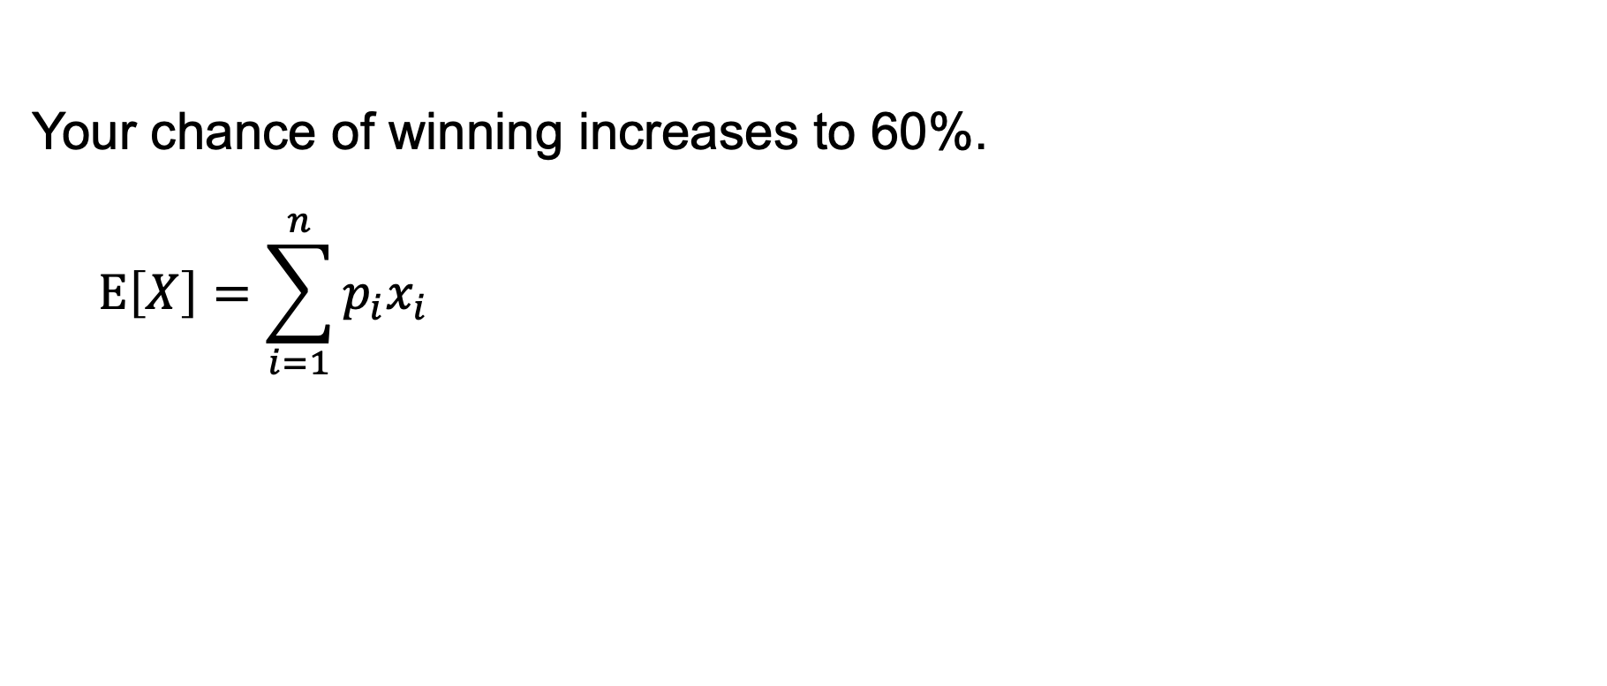
Expected value
Your chance of winning increases to 60%.
$$E\left[X\right]=\sum_{i=1}^{n}{p_{i}x_{i}}$$

Slide 12
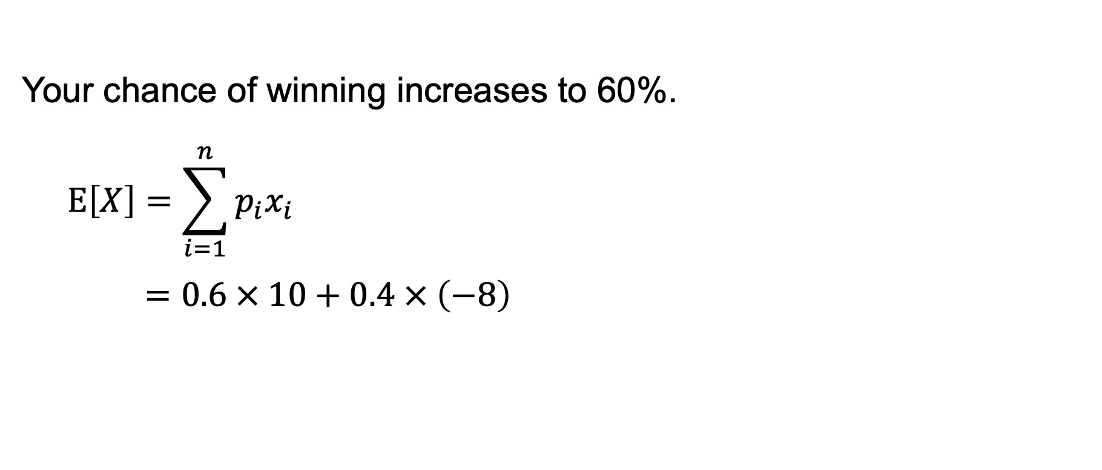
Expected value
Your chance of winning increases to 60%.
$$E\left[X\right]=\sum_{i=1}^{n}{p_{i}x_{i}}$$
$$=0.6 × 10+0.4 × \left(−8\right)$$

Slide 13
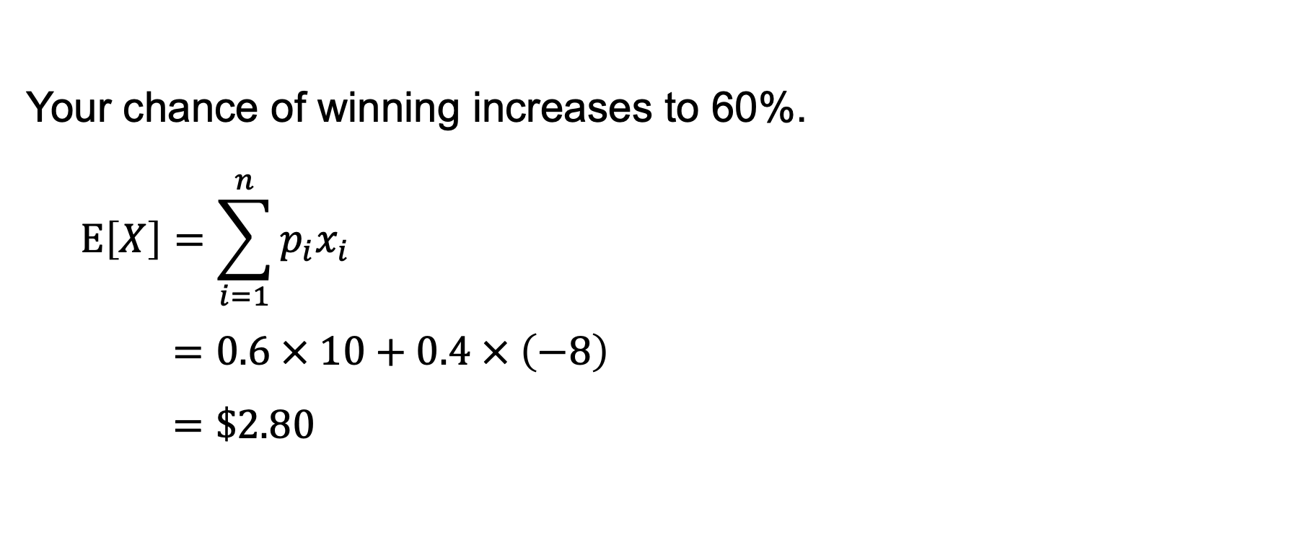
Expected value
Your chance of winning increases to 60%.
$$E\left[X\right]=\sum_{i=1}^{n}{p_{i}x_{i}}$$
$$=0.6 × 10+0.4 × \left(−8\right)$$
$$=\$2.80$$

Slide 14
Expected value
You are offered a bet with a 50% bet chance of winning 50% of your wealth and a 50% of chance of losing 40% of your wealth.

Slide 15
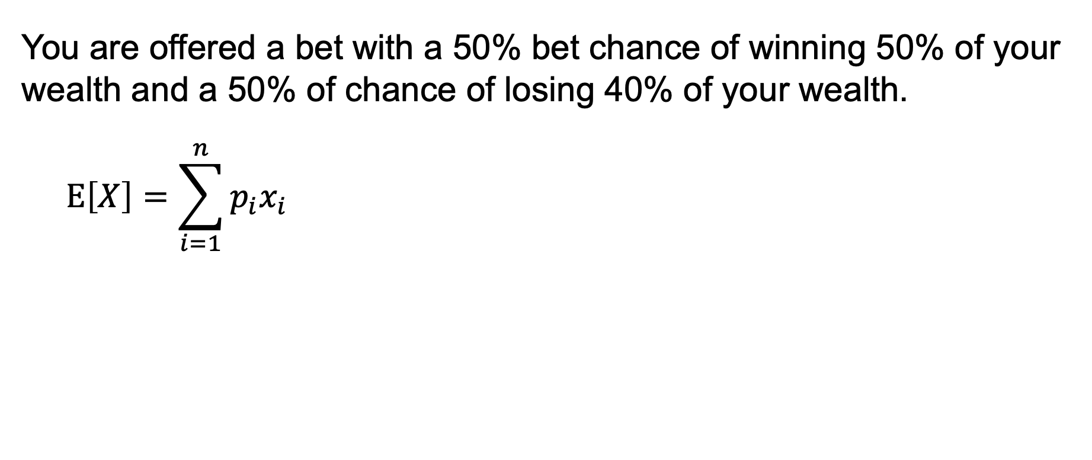
Expected value
You are offered a bet with a 50% bet chance of winning 50% of your wealth and a 50% of chance of losing 40% of your wealth.
$$E\left[X\right]=\sum_{i=1}^{n}{p_{i}x_{i}}$$

Slide 16
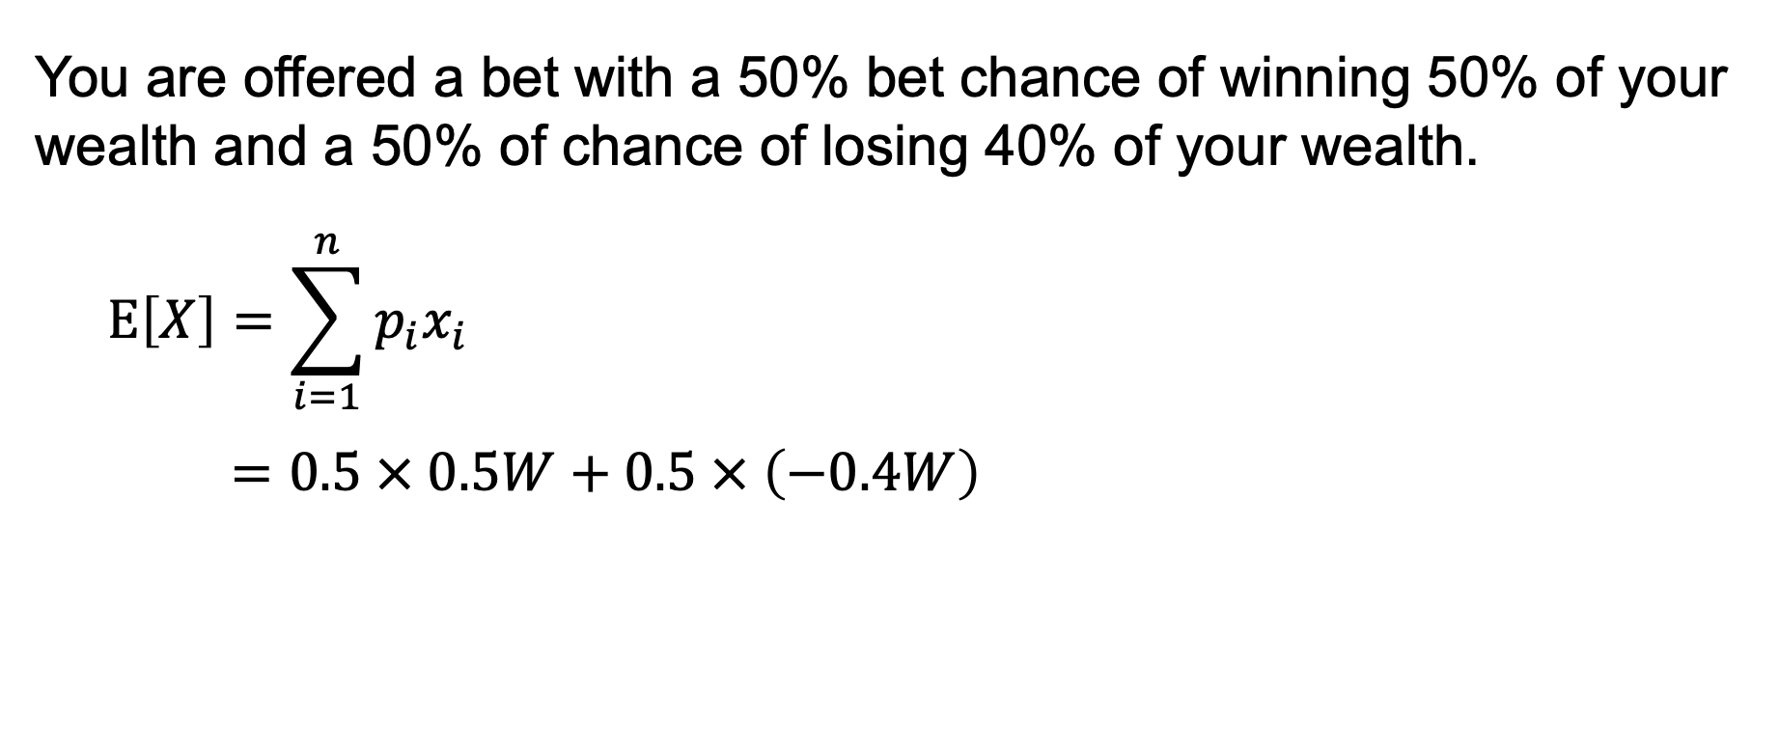
Expected value
You are offered a bet with a 50% bet chance of winning 50% of your wealth and a 50% of chance of losing 40% of your wealth.
$$E\left[X\right]=\sum_{i=1}^{n}{p_{i}x_{i}}$$
$$=0.5 × 0.5W+0.5 × \left(−0.4W\right)$$

Slide 17
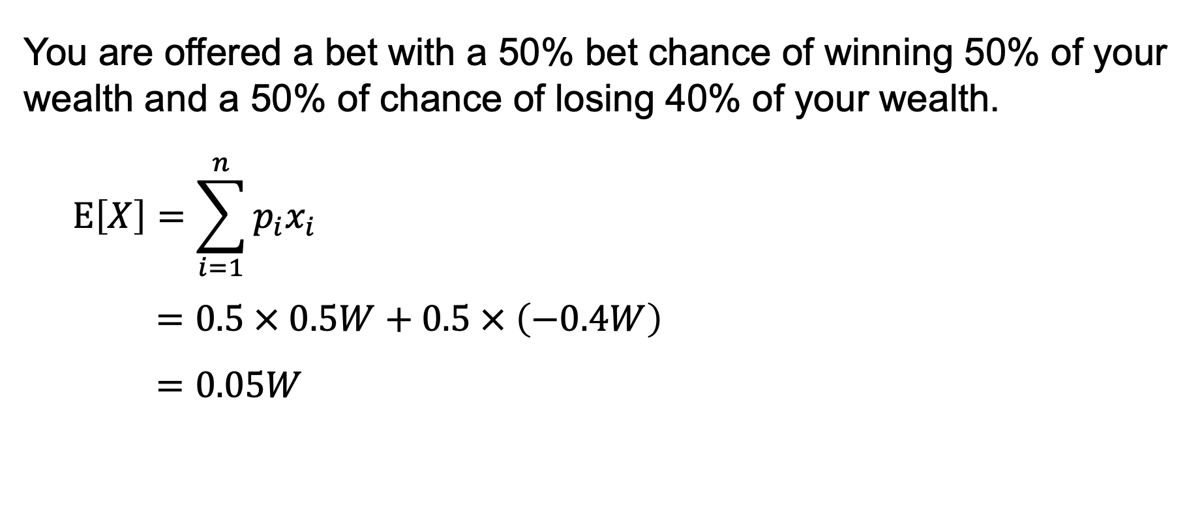
Expected value
You are offered a bet with a 50% bet chance of winning 50% of your wealth and a 50% of chance of losing 40% of your wealth.
$$E\left[X\right]=\sum_{i=1}^{n}{p_{i}x_{i}}$$
$$=0.5 × 0.5W+0.5 × \left(−0.4W\right)$$
$$=0.05W$$

