Slide 1

Independence
Notes on Behavioural Economics
Jason Collins

Slide 2

$$orange≻apple$$

Slide 3
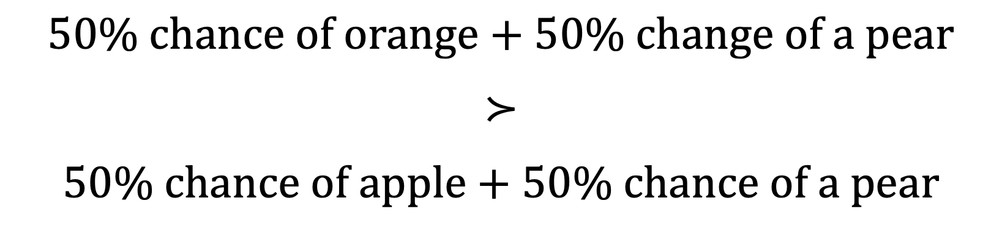
$$50\% chance of orange+50\% change of a pear$$
$$≻$$
$$50\% chance of apple+50\% chance of a pear$$

Slide 4
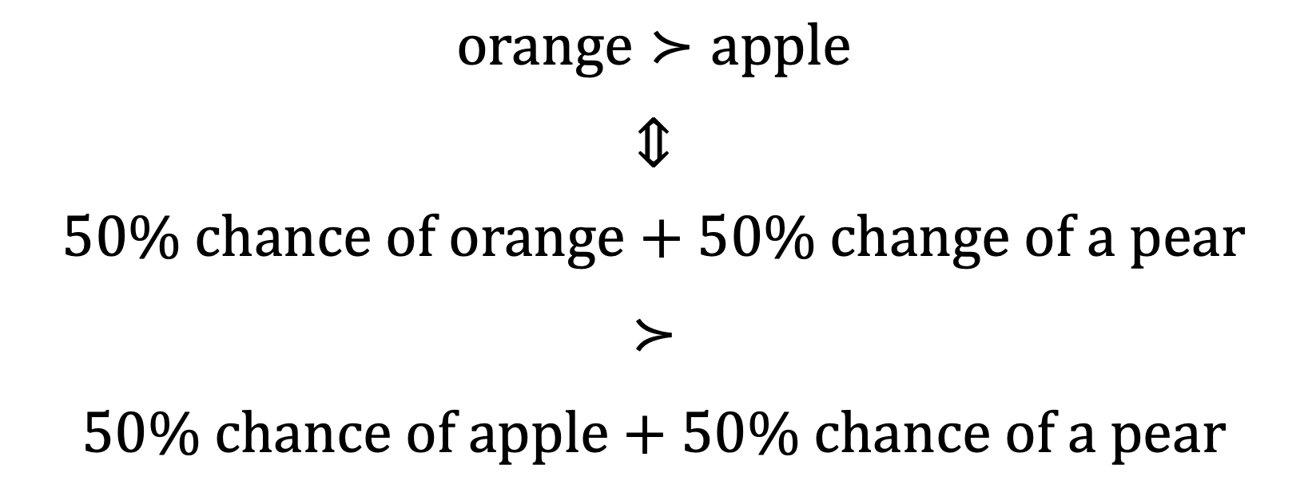
$$orange≻apple$$
$$⇕$$
$$50\% chance of orange+50\% change of a pear$$
$$≻$$
$$50\% chance of apple+50\% chance of a pear$$

Slide 5
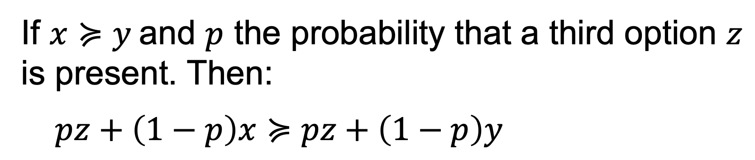
Independence
If $x≽y$and $p$ the probability that a third option $z$ is present. Then:
$$pz+\left(1−p\right)x≽pz+\left(1−p\right)y$$

Slide 6
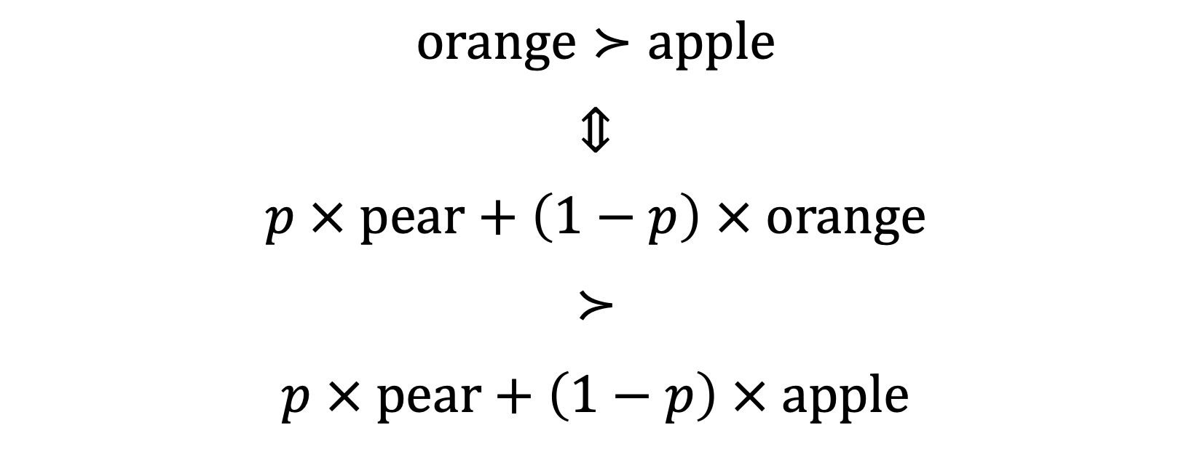
$$orange≻apple$$
$$⇕$$
$$p × pear+\left(1−p\right) × orange$$
$$≻$$
$$p × pear+\left(1−p\right) × apple$$

Slide 7


Slide 8


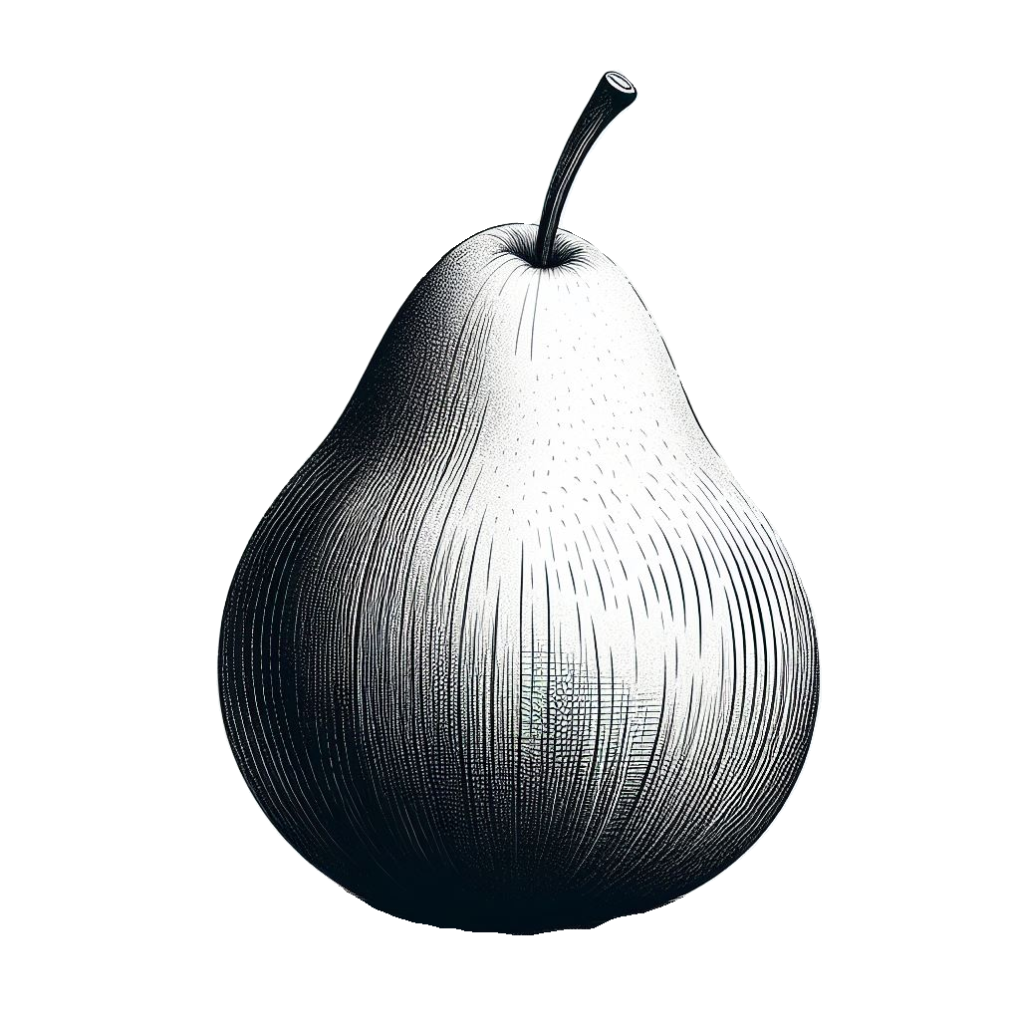
$$p × pear+\left(1−p\right) × orange≻p × pear+\left(1−p\right) × apple$$

Slide 9
