Slide 1

Mathematical background Differentiation
Notes on Behavioural Economics
Jason Collins

Slide 2

Differentiation
$\frac{d}{dx}f\left(x\right)$ $\frac{dy}{dx}$ $f′\left(x\right)$

Slide 3

Differentiation
$$\frac{d}{dx}c=0$$

Slide 4

Differentiation
$$\frac{d}{dx}x^{a}={ax}^{a−1}$$

Slide 5

Differentiation
$$\frac{d}{dx}x^{2}=2x$$

Slide 6

Differentiation
$$\frac{d}{dx}x^{0.5}=0.5x^{−0.5}$$

Slide 7
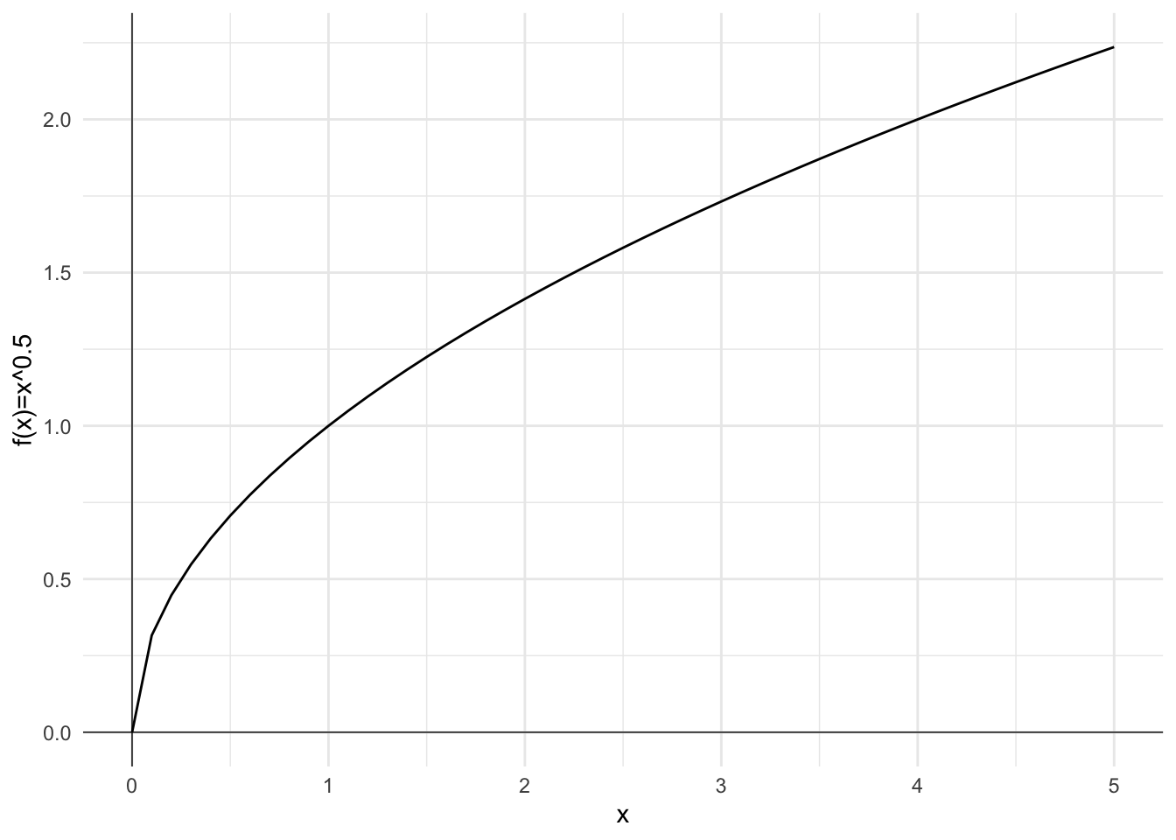

Slide 8

Differentiation
$$\frac{d}{dx}ln\left(x\right)=\frac{1}{x}$$

Slide 9
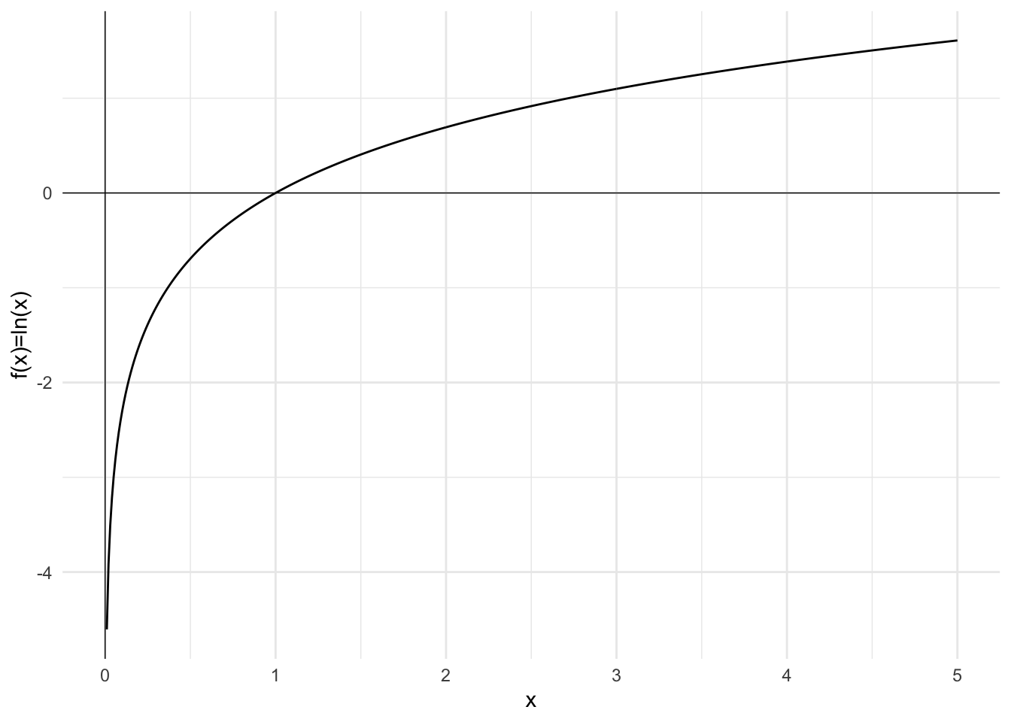

Slide 10
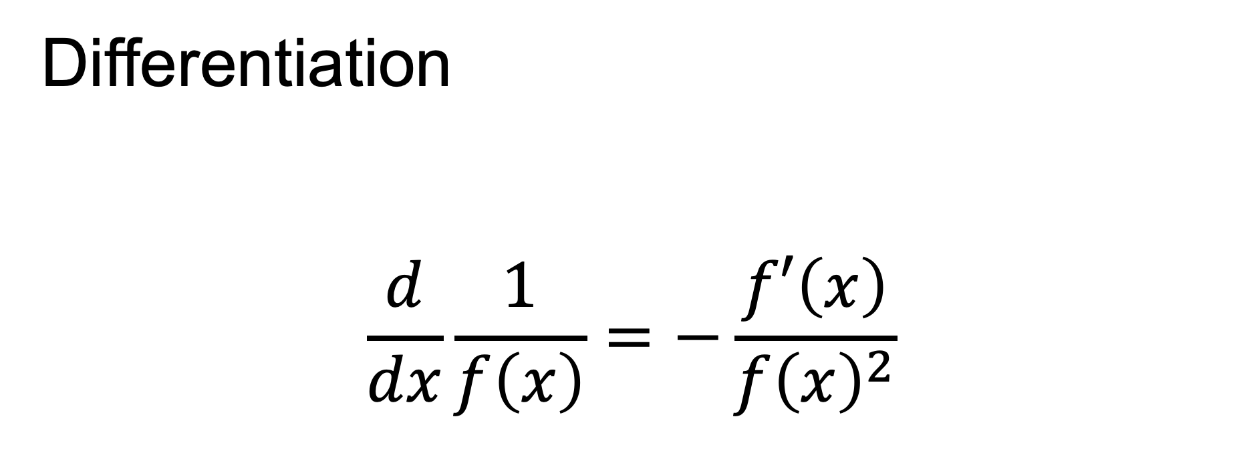
Differentiation
$$\frac{d}{dx}\frac{1}{f\left(x\right)}=−\frac{f′\left(x\right)}{{f\left(x\right)}^{2}}$$

Slide 11

Differentiation
$$\frac{d}{dx}\frac{1}{x}=−\frac{1}{x^{2}}$$

Slide 12
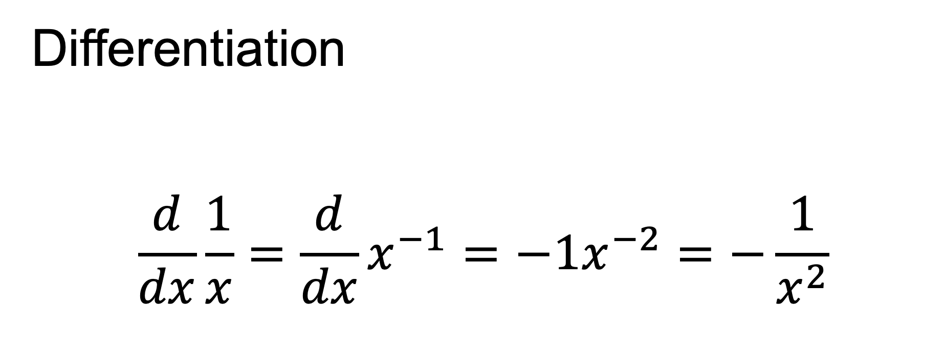
Differentiation
$$\frac{d}{dx}\frac{1}{x}=\frac{d}{dx}x^{−1}=−1x^{−2}=−\frac{1}{x^{2}}$$

Slide 13
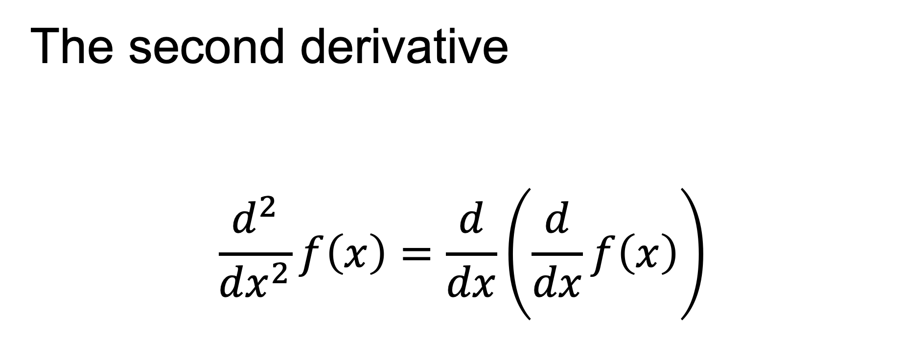
The second derivative
$$\frac{d^{2}}{{dx}^{2}}f\left(x\right)=\frac{d}{dx}\left(\frac{d}{dx}f\left(x\right)\right)$$

Slide 14
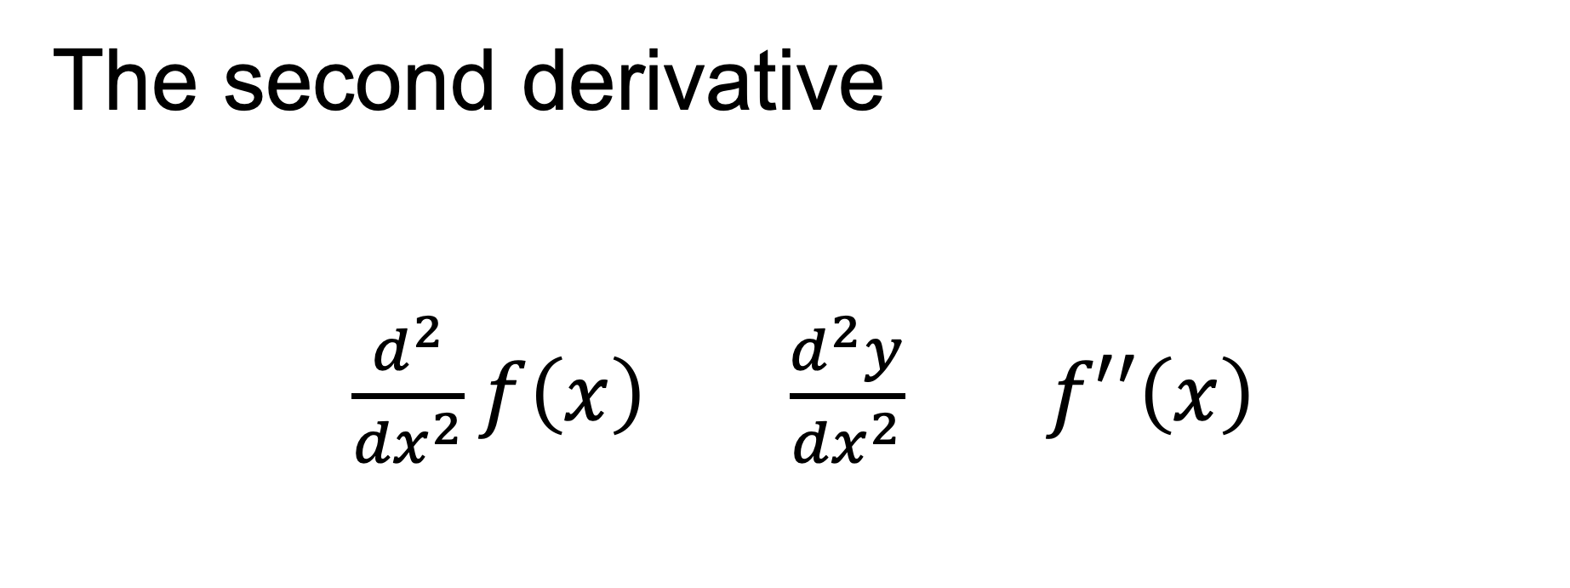
The second derivative
$\frac{d^{2}}{{dx}^{2}}f\left(x\right)$ $\frac{d^{2}y}{{dx}^{2}}$ $f′′\left(x\right)$

Slide 15
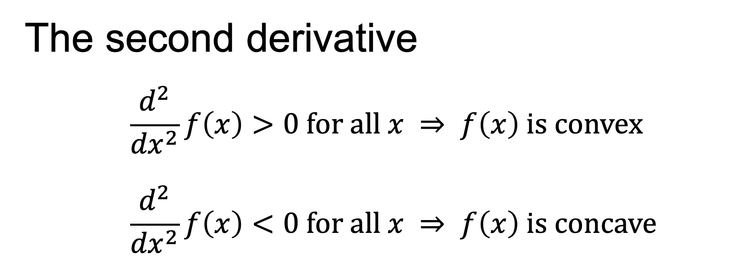
The second derivative
$$\frac{d^{2}}{{dx}^{2}}f\left(x\right)>0 for all x ⇒ f\left(x\right) is convex$$
$$\frac{d^{2}}{{dx}^{2}}f\left(x\right)<0 for all x ⇒ f\left(x\right) is concave$$

Slide 16
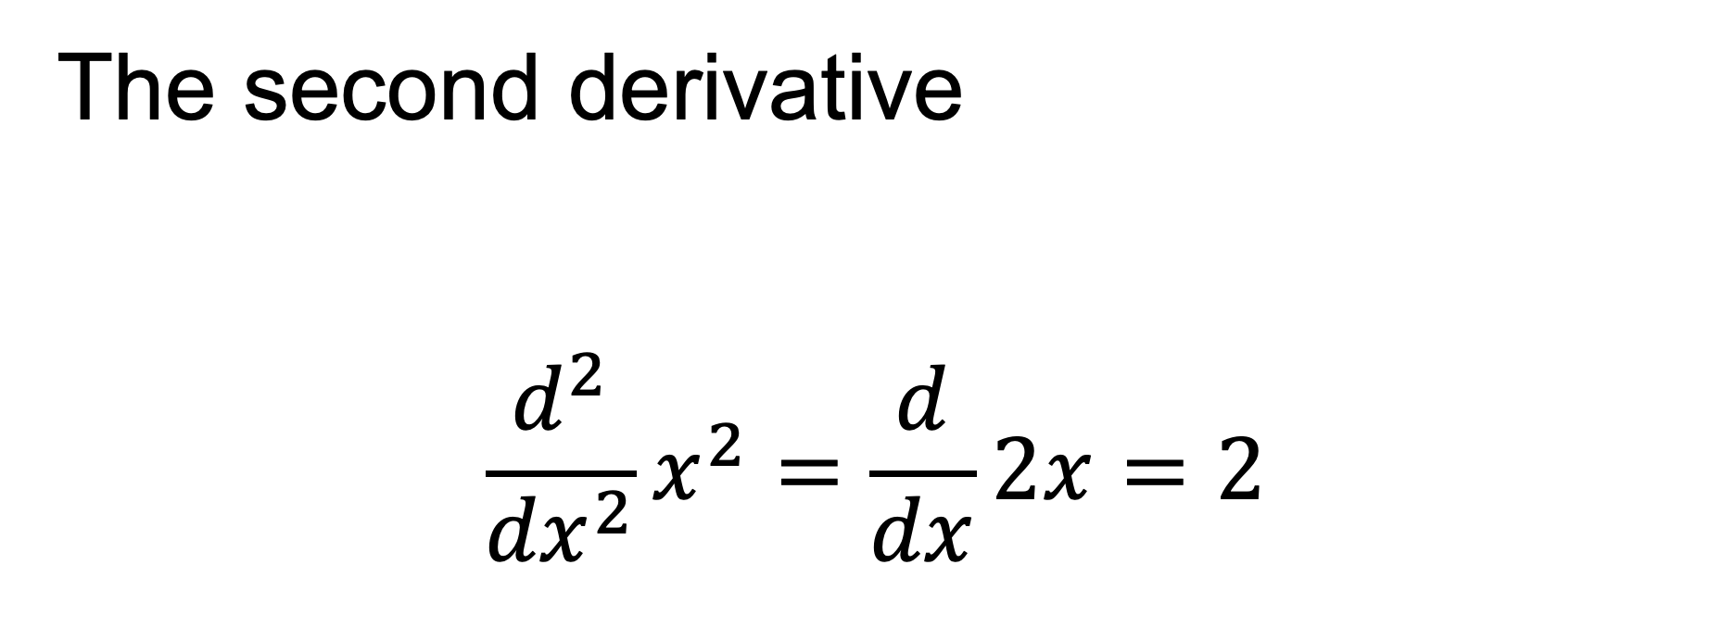
The second derivative
$$\frac{d^{2}}{{dx}^{2}}x^{2}=\frac{d}{dx}2x=2$$

Slide 17
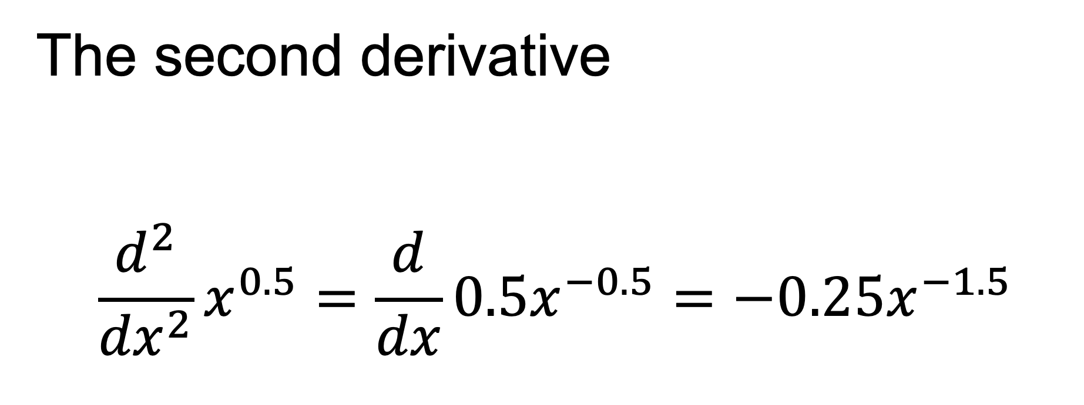
The second derivative
$$\frac{d^{2}}{{dx}^{2}}x^{0.5}=\frac{d}{dx}0.5x^{−0.5}=−0.25x^{−1.5}$$

Slide 19
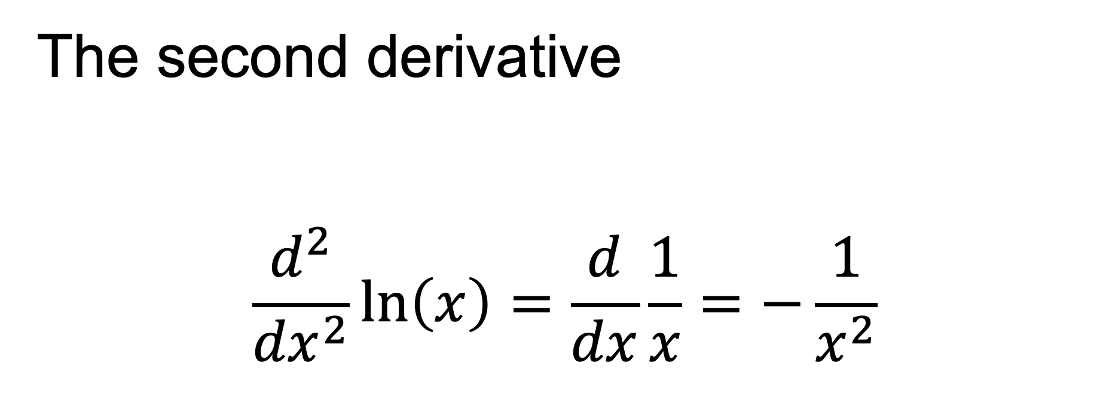
The second derivative
$$\frac{d^{2}}{{dx}^{2}}ln\left(x\right)=\frac{d}{dx}\frac{1}{x}=−\frac{1}{x^{2}}$$

