Slide 1

Mathematical background Functions
Notes on Behavioural Economics
Jason Collins

Slide 2

Exponentiation
$$f\left(x\right)=x^{a}$$

Slide 3

Exponentiation
$$2^{3}=2 × 2 × 2=8$$

Slide 4
Exponentiation
$$f\left(x\right)=x^{a}$$

Slide 5
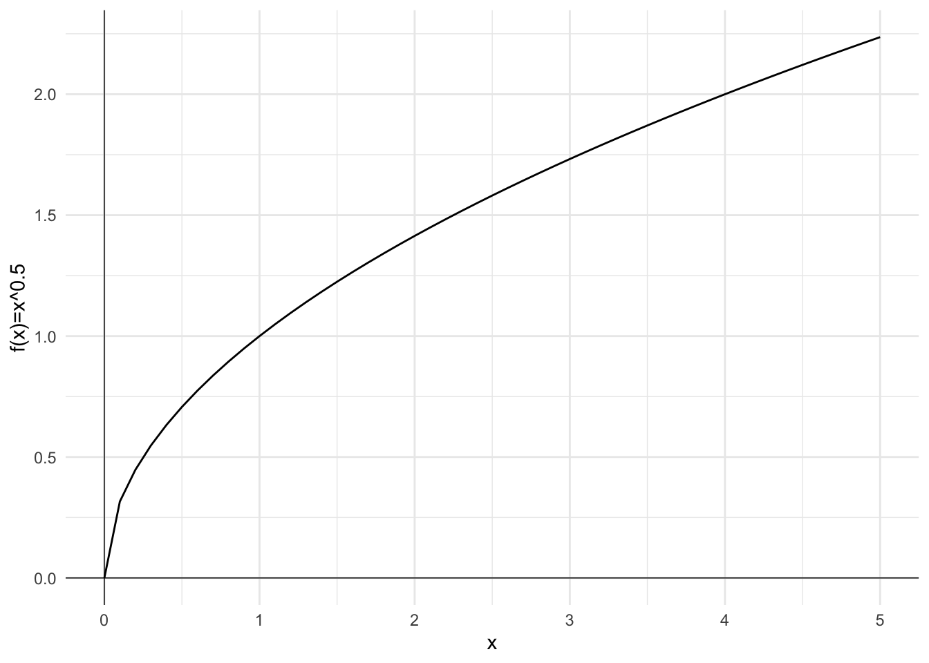

Slide 6

The exponential function
$$f\left(x\right)=e^{x}$$

Slide 7
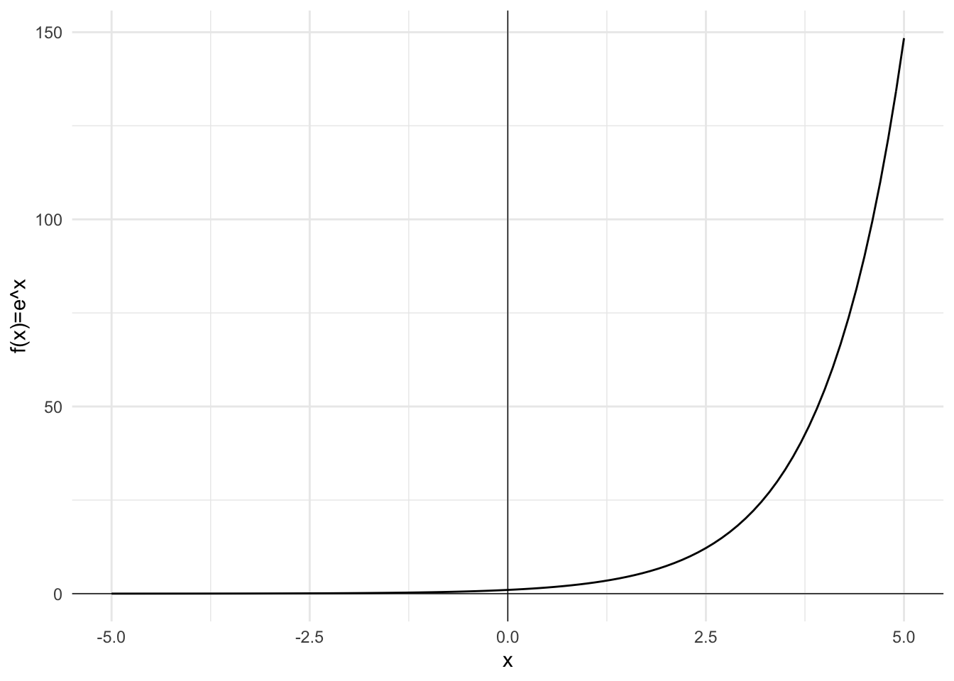

Slide 8
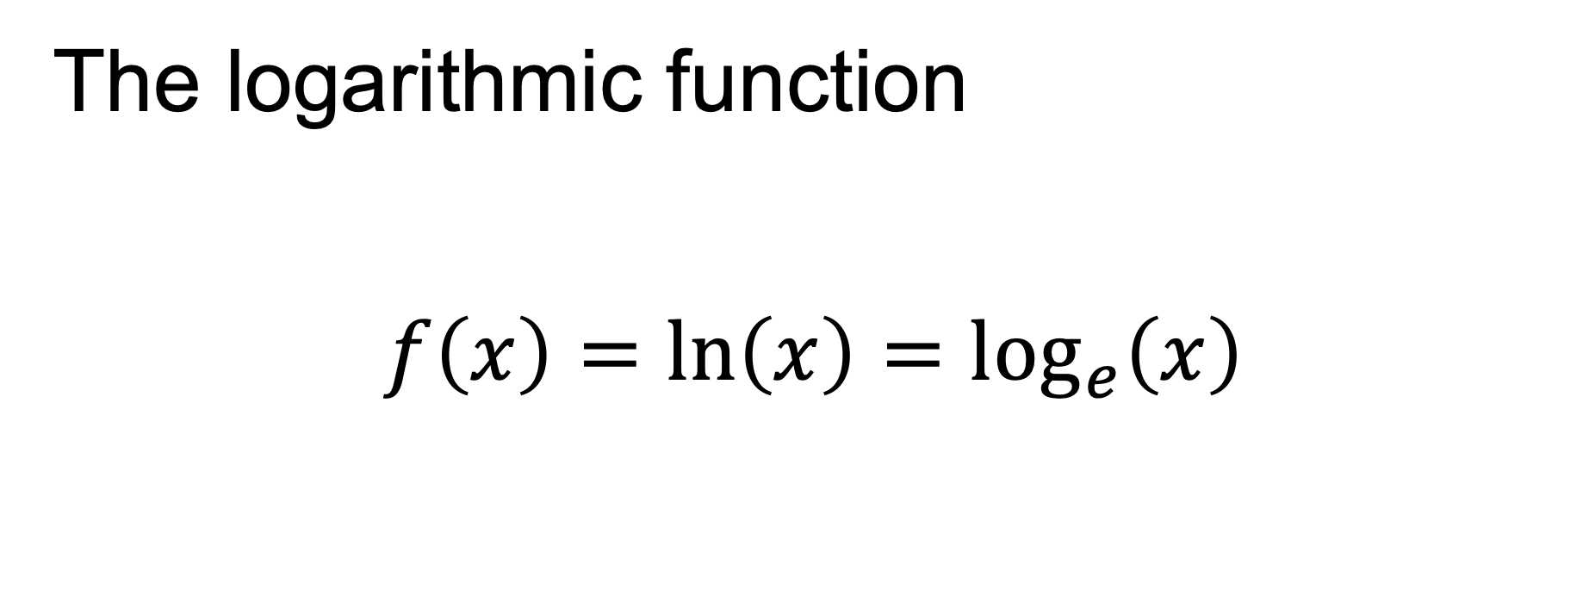
The logarithmic function
$$f\left(x\right)=ln\left(x\right)=\log_{e}\left(x\right)$$

Slide 9
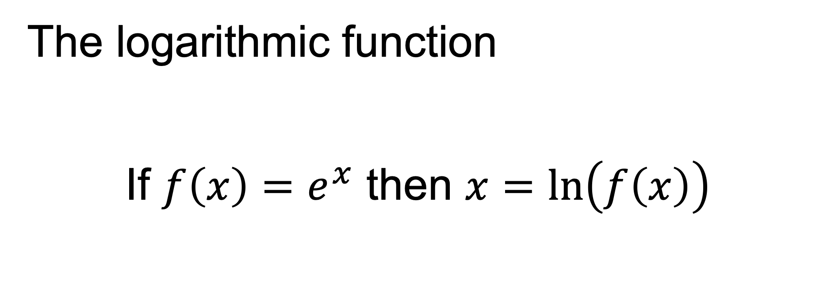
The logarithmic function
If $f\left(x\right)=e^{x}$ then $x=ln\left(f\left(x\right)\right)$

Slide 10
