Slide 1

Notation
Notes on Behavioural Economics
Jason Collins

Slide 2
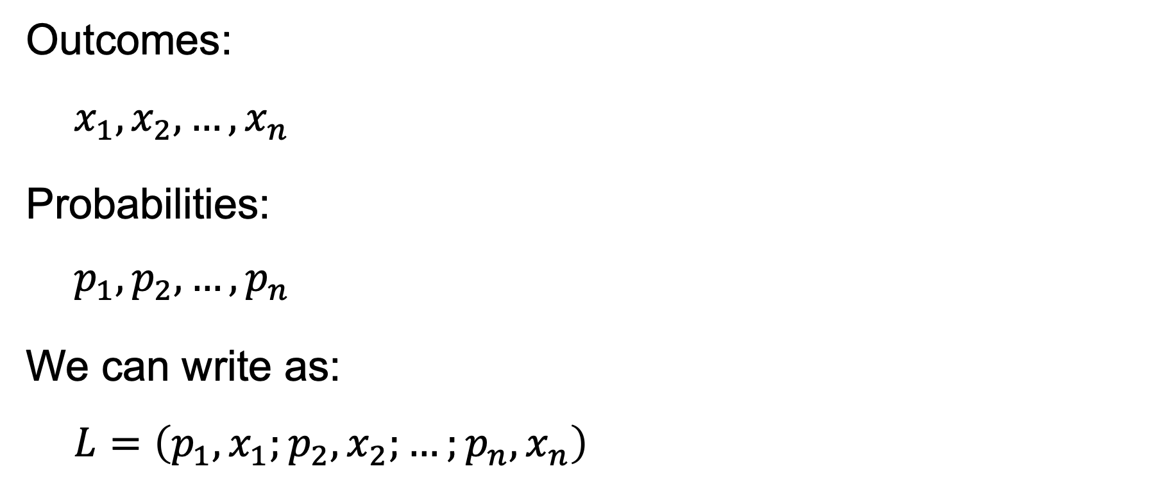
Outcomes:
$$x_{1},x_{2}, …,x_{n}$$
Probabilities:
$$p_{1},p_{2}, …,p_{n}$$
We can write as:
$$L=\left(p_{1}, x_{1};{p_{2}, x}_{2};…;p_{n},x_{n}\right)$$

Slide 3

$$L=\left(0.5,−100;0.5, 200\right)$$

Slide 4

$$L=\left(0.5,200;0.5, −100\right)$$

Slide 5

$$L=\left(x_{1}, p_{1};{x_{2}, p}_{2};…; x_{n},p_{n}\right)$$

Slide 6

$$L=\left(x_{1}, {x_{2},…,x_{n};p_{1},p}_{2},…, p_{n}\right)$$

