Slide 1

The St. Petersburg game
Notes on Behavioural Economics
Jason Collins

Slide 2


Slide 3
The St. Petersburg game
Tail on the 1st flip: $2
Tail on the 2nd flip: $4
Tail on the 3rd flip: $8
Tail on the 4th flip: $16
And so on.

Slide 4

The St. Petersburg game
The expected value of this game $X$ is equal to:
$$E\left[X\right]=\frac{1}{2}× 2+\left(\frac{1}{2}×\frac{1}{2}\right)× 4+\left(\frac{1}{2}×\frac{1}{2}×\frac{1}{2}\right)× 8+\left(\frac{1}{2}×\frac{1}{2}×\frac{1}{2}×\frac{1}{2}\right)× 16+…$$
Tail first Tail second Tail third Tail fourth

Slide 5
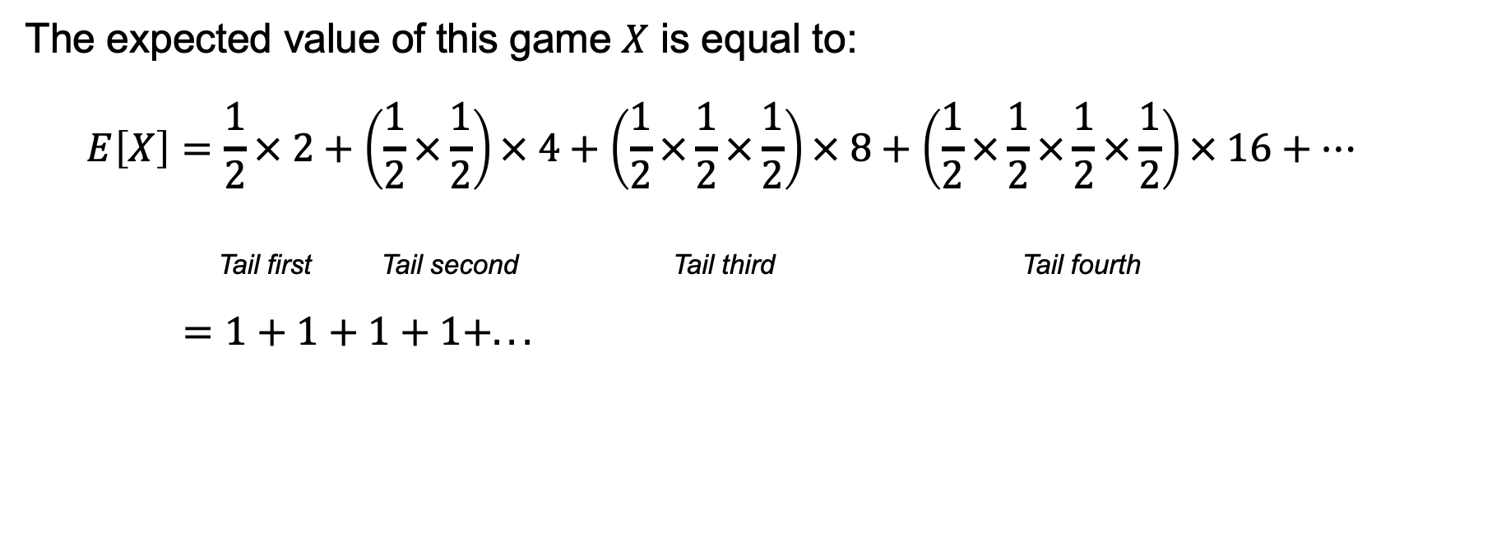
The St. Petersburg game
The expected value of this game $X$ is equal to:
$$E\left[X\right]=\frac{1}{2}× 2+\left(\frac{1}{2}×\frac{1}{2}\right)× 4+\left(\frac{1}{2}×\frac{1}{2}×\frac{1}{2}\right)× 8+\left(\frac{1}{2}×\frac{1}{2}×\frac{1}{2}×\frac{1}{2}\right)× 16+…$$
Tail first Tail second Tail third Tail fourth
$=1+1+1+1+...$

Slide 6
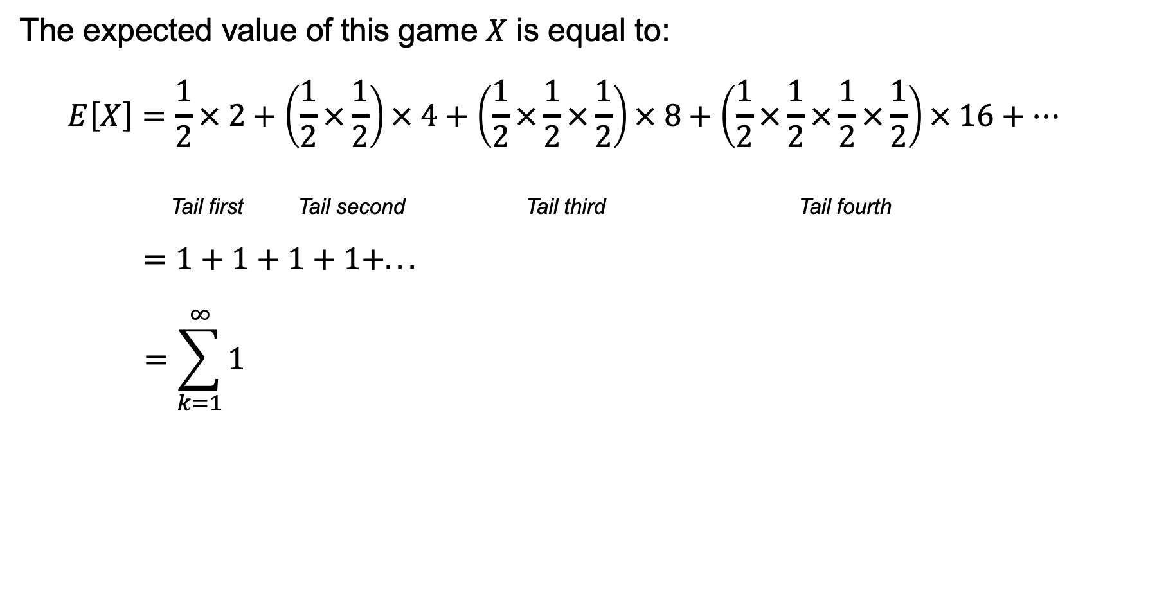
The St. Petersburg game
The expected value of this game $X$ is equal to:
$$E\left[X\right]=\frac{1}{2}× 2+\left(\frac{1}{2}×\frac{1}{2}\right)× 4+\left(\frac{1}{2}×\frac{1}{2}×\frac{1}{2}\right)× 8+\left(\frac{1}{2}×\frac{1}{2}×\frac{1}{2}×\frac{1}{2}\right)× 16+…$$
Tail first Tail second Tail third Tail fourth
$=1+1+1+1+...$
$$=\sum_{k=1}^{∞}{1}$$

Slide 7
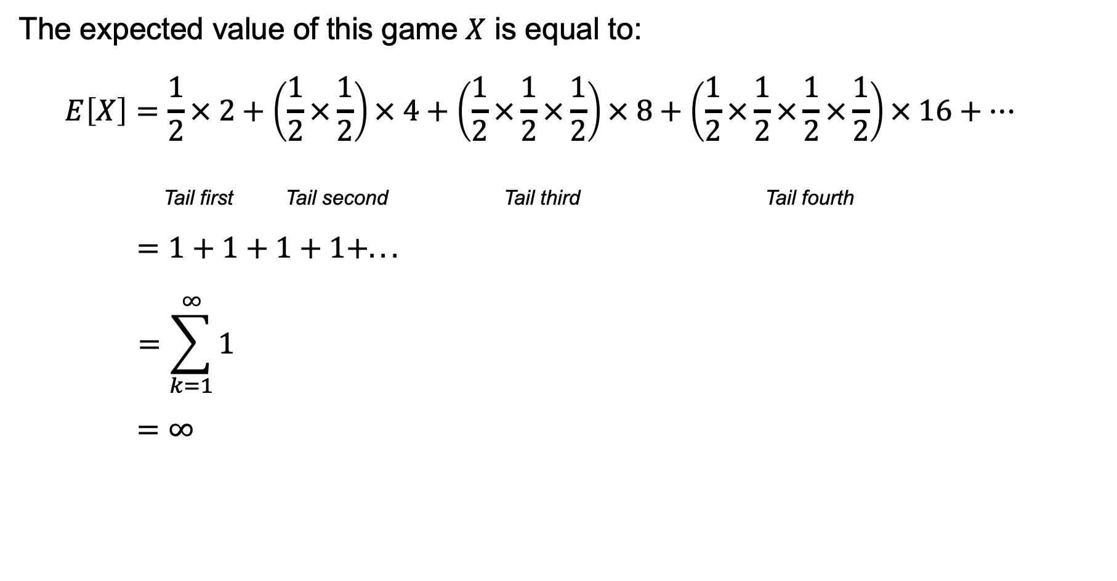
The St. Petersburg game
The expected value of this game $X$ is equal to:
$$E\left[X\right]=\frac{1}{2}× 2+\left(\frac{1}{2}×\frac{1}{2}\right)× 4+\left(\frac{1}{2}×\frac{1}{2}×\frac{1}{2}\right)× 8+\left(\frac{1}{2}×\frac{1}{2}×\frac{1}{2}×\frac{1}{2}\right)× 16+…$$
Tail first Tail second Tail third Tail fourth
$=1+1+1+1+...$
$$=\sum_{k=1}^{∞}{1}$$
$=∞$

Slide 8
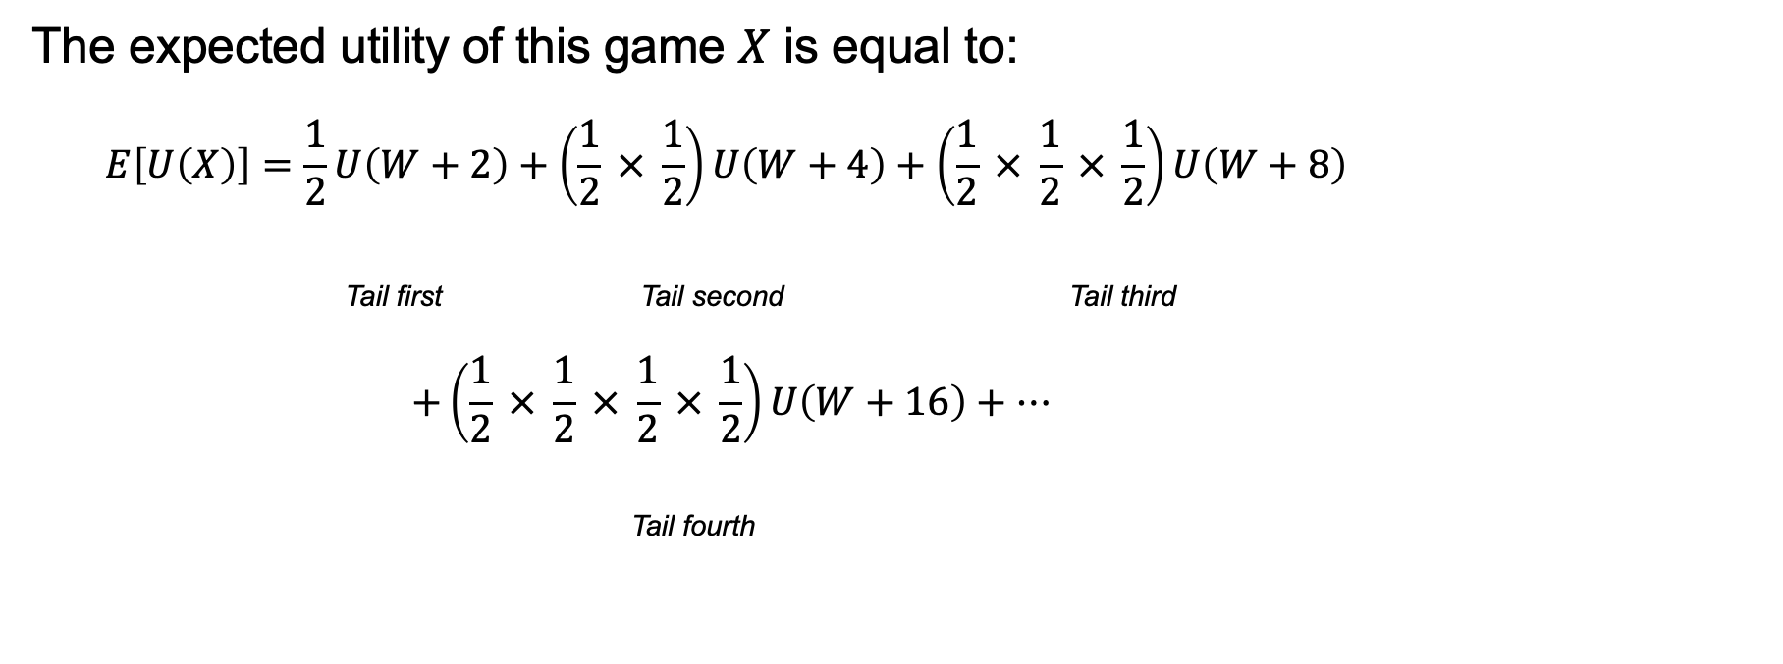
The St. Petersburg game
The expected utility of this game $X$ is equal to:
$$E\left[U\left(X\right)\right]=\frac{1}{2}U\left(W+2\right)+\left(\frac{1}{2} × \frac{1}{2}\right)U\left(W+4\right)+\left(\frac{1}{2} × \frac{1}{2} × \frac{1}{2}\right)U\left(W+8\right)$$
Tail first Tail second Tail third
$$+\left(\frac{1}{2} × \frac{1}{2} × \frac{1}{2} × \frac{1}{2}\right)U\left(W+16\right)+…$$
Tail fourth

Slide 9
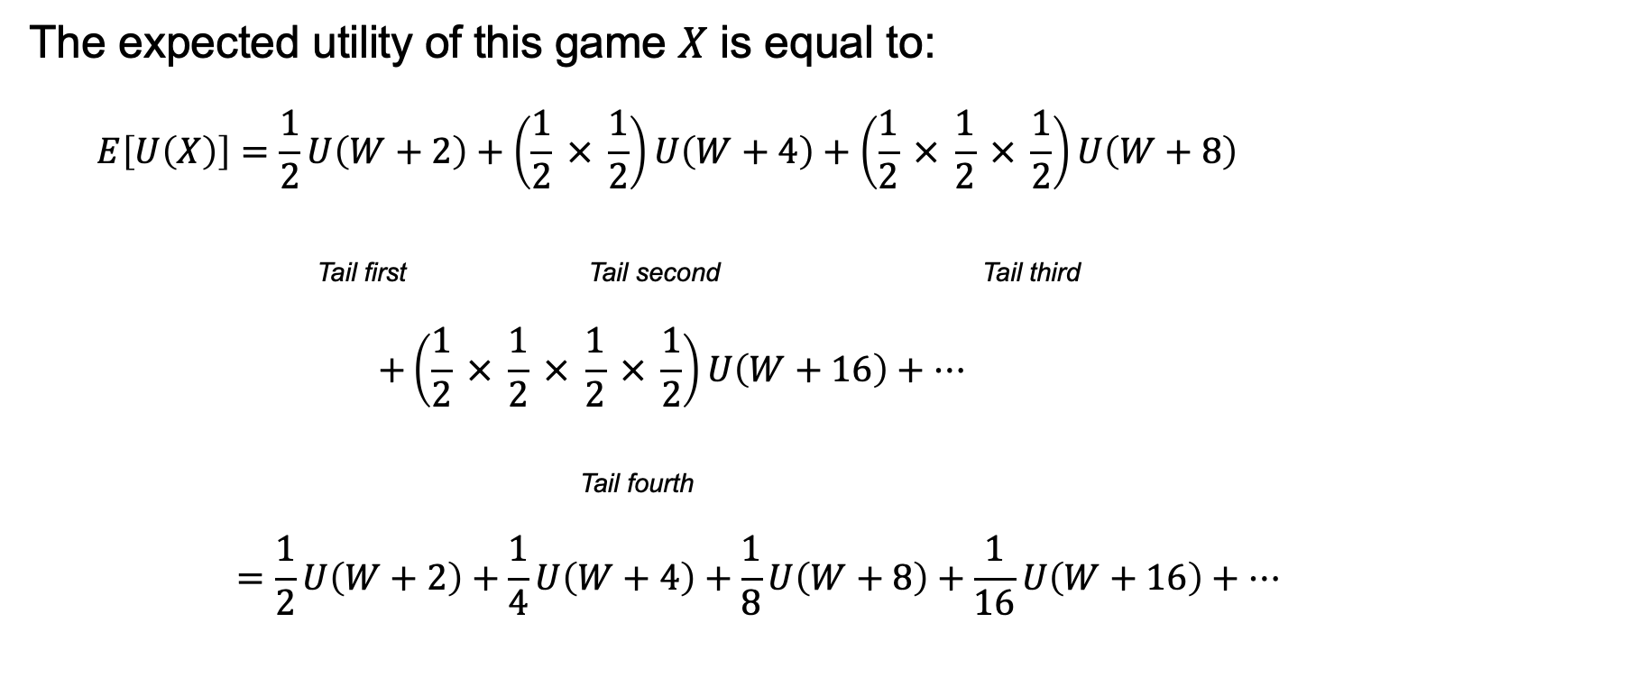
The St. Petersburg game
The expected utility of this game $X$ is equal to:
$$E\left[U\left(X\right)\right]=\frac{1}{2}U\left(W+2\right)+\left(\frac{1}{2} × \frac{1}{2}\right)U\left(W+4\right)+\left(\frac{1}{2} × \frac{1}{2} × \frac{1}{2}\right)U\left(W+8\right)$$
Tail first Tail second Tail third
$$+\left(\frac{1}{2} × \frac{1}{2} × \frac{1}{2} × \frac{1}{2}\right)U\left(W+16\right)+…$$
Tail fourth
$$=\frac{1}{2}U\left(W+2\right)+\frac{1}{4}U\left(W+4\right)+\frac{1}{8}U\left(W+8\right)+\frac{1}{16}U\left(W+16\right)+…$$

Slide 10
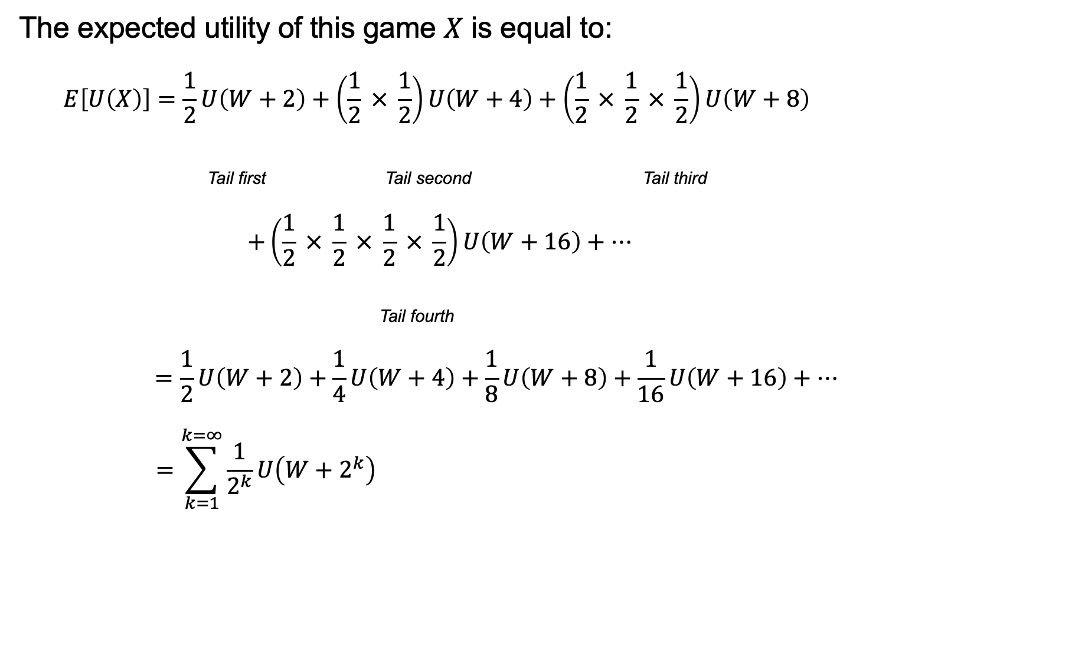
The St. Petersburg game
The expected utility of this game $X$ is equal to:
$$E\left[U\left(X\right)\right]=\frac{1}{2}U\left(W+2\right)+\left(\frac{1}{2} × \frac{1}{2}\right)U\left(W+4\right)+\left(\frac{1}{2} × \frac{1}{2} × \frac{1}{2}\right)U\left(W+8\right)$$
Tail first Tail second Tail third
$$+\left(\frac{1}{2} × \frac{1}{2} × \frac{1}{2} × \frac{1}{2}\right)U\left(W+16\right)+…$$
Tail fourth
$$=\frac{1}{2}U\left(W+2\right)+\frac{1}{4}U\left(W+4\right)+\frac{1}{8}U\left(W+8\right)+\frac{1}{16}U\left(W+16\right)+…$$
$$=\sum_{k=1}^{k=∞}{\frac{1}{2^{k}}U\left(W+2^{k}\right)}$$

Slide 11

The St. Petersburg game
What is the maximum $$c$ a risk neutral player with $U \left(x\right)=x$ would be willing to pay to play the game?
They will be indifferent when:
$$U\left(W\right)=E\left[U\left(X−c\right)\right]$$

Slide 12
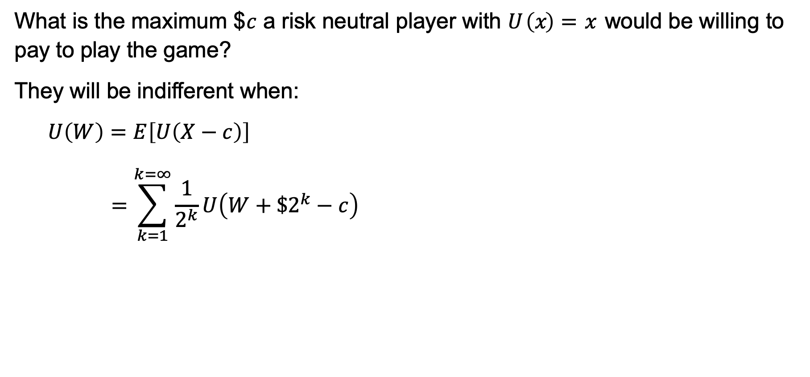
The St. Petersburg game
What is the maximum $$c$ a risk neutral player with $U \left(x\right)=x$ would be willing to pay to play the game?
They will be indifferent when:
$$U\left(W\right)=E\left[U\left(X−c\right)\right]$$
$$=\sum_{k=1}^{k=∞}{\frac{1}{2^{k}}U\left(W+\$2^{k}−c\right)}$$

Slide 13
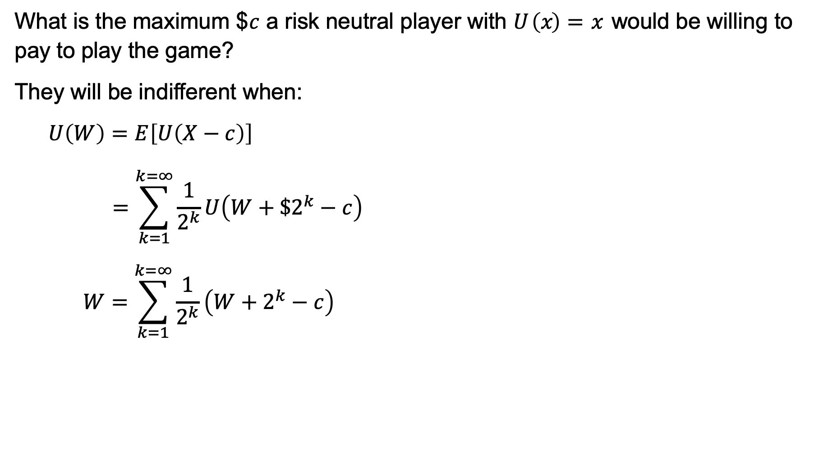
The St. Petersburg game
What is the maximum $$c$ a risk neutral player with $U \left(x\right)=x$ would be willing to pay to play the game?
They will be indifferent when:
$$U\left(W\right)=E\left[U\left(X−c\right)\right]$$
$$=\sum_{k=1}^{k=∞}{\frac{1}{2^{k}}U\left(W+\$2^{k}−c\right)}$$
$$W=\sum_{k=1}^{k=∞}{\frac{1}{2^{k}}\left(W+2^{k}−c\right)}$$

Slide 14
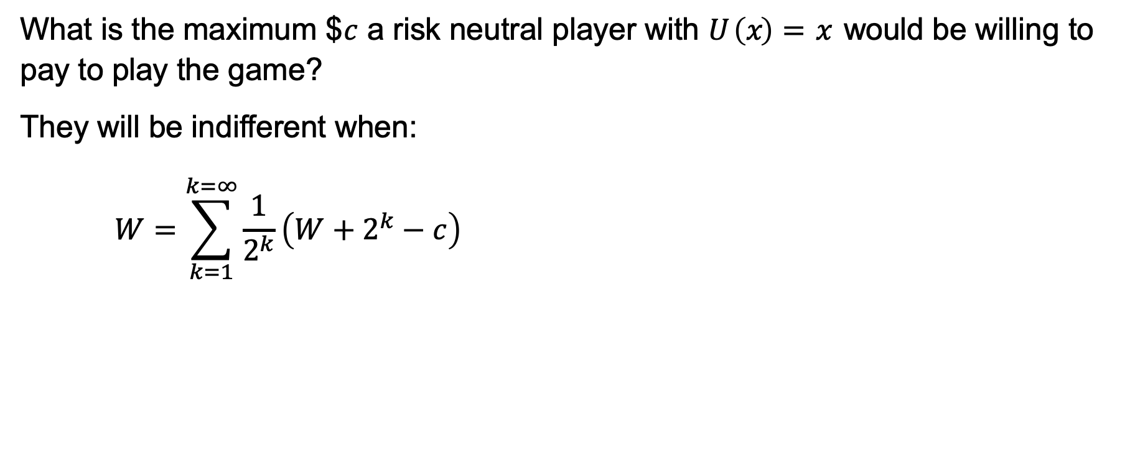
The St. Petersburg game
What is the maximum $$c$ a risk neutral player with $U \left(x\right)=x$ would be willing to pay to play the game?
They will be indifferent when:
$$W=\sum_{k=1}^{k=∞}{\frac{1}{2^{k}}\left(W+2^{k}−c\right)}$$

Slide 15
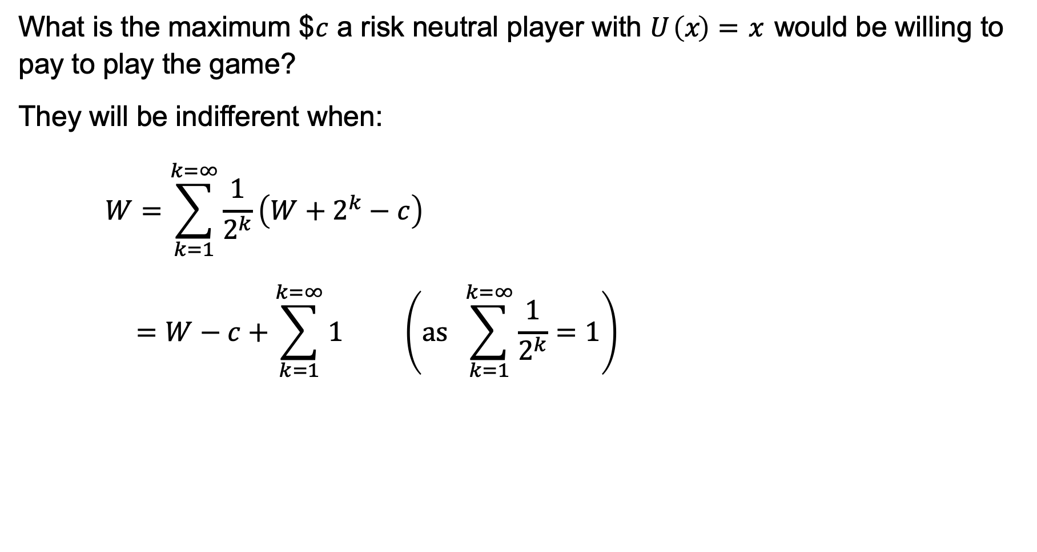
The St. Petersburg game
What is the maximum $$c$ a risk neutral player with $U \left(x\right)=x$ would be willing to pay to play the game?
They will be indifferent when:
$$W=\sum_{k=1}^{k=∞}{\frac{1}{2^{k}}\left(W+2^{k}−c\right)}$$
$$=W−c+\sum_{k=1}^{k=∞}{1} \left(as \sum_{k=1}^{k=∞}{\frac{1}{2^{k}}}=1\right)$$

Slide 16
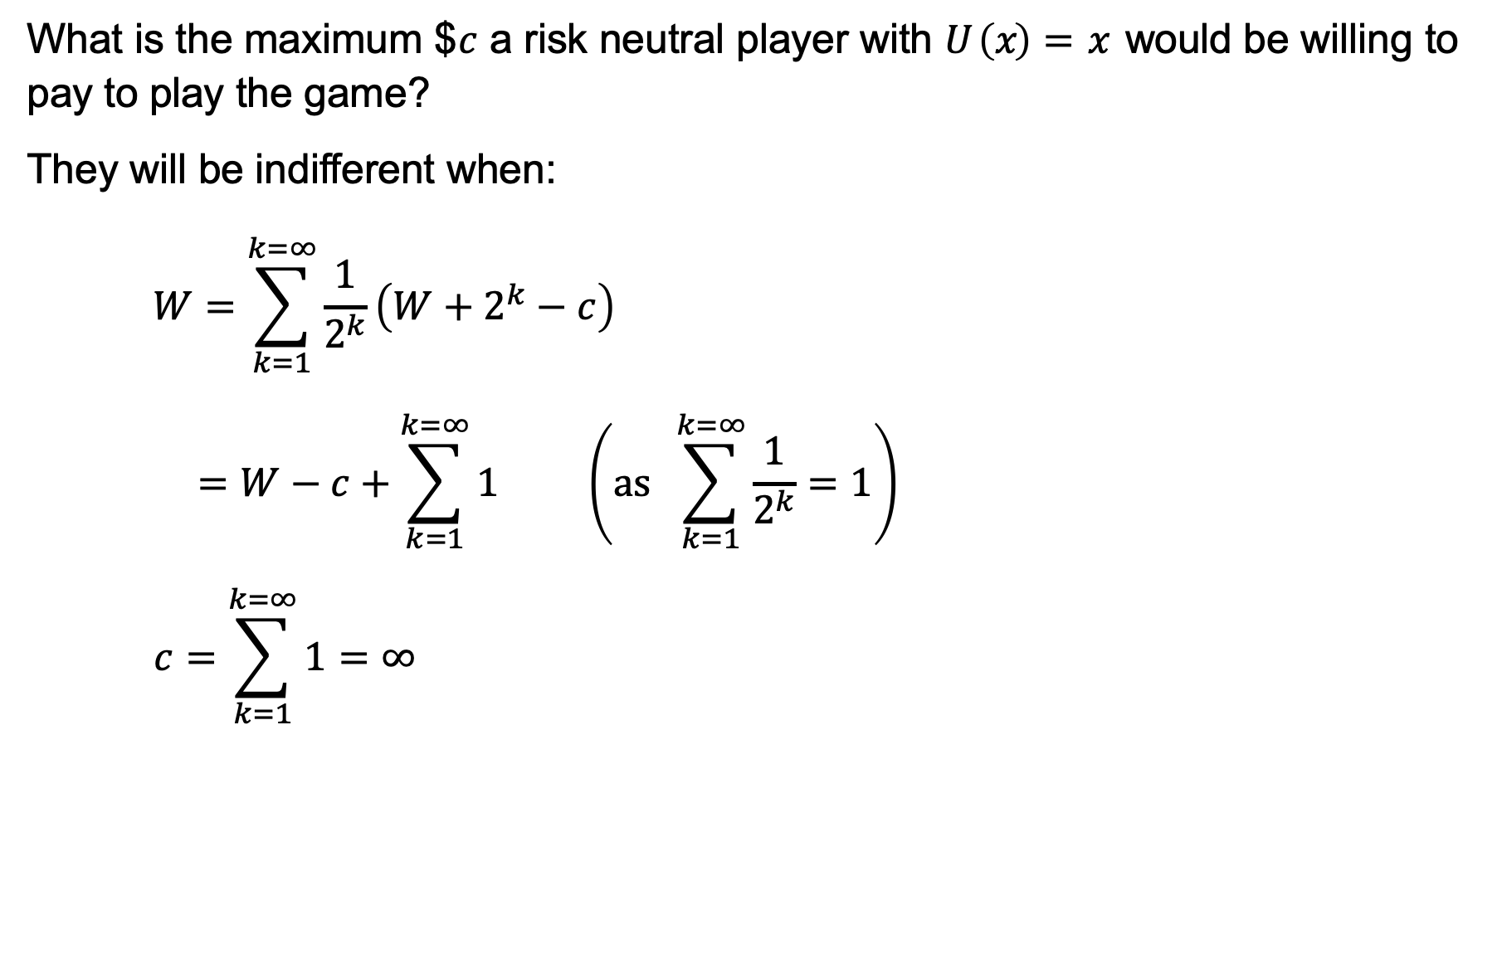
The St. Petersburg game
What is the maximum $$c$ a risk neutral player with $U \left(x\right)=x$ would be willing to pay to play the game?
They will be indifferent when:
$$W=\sum_{k=1}^{k=∞}{\frac{1}{2^{k}}\left(W+2^{k}−c\right)}$$
$$=W−c+\sum_{k=1}^{k=∞}{1} \left(as \sum_{k=1}^{k=∞}{\frac{1}{2^{k}}}=1\right)$$
$$c=\sum_{k=1}^{k=∞}{1}=∞$$

Slide 17

The St. Petersburg game
What is the maximum $$c$ a risk-averse player with $U \left(x\right)=ln\left(x\right)$ would be willing to pay to play the game? How does their wealth affect their willingness to pay?
They will be indifferent when:
$$U \left(W\right)=E\left[U\left(X−c\right)\right]$$

Slide 18
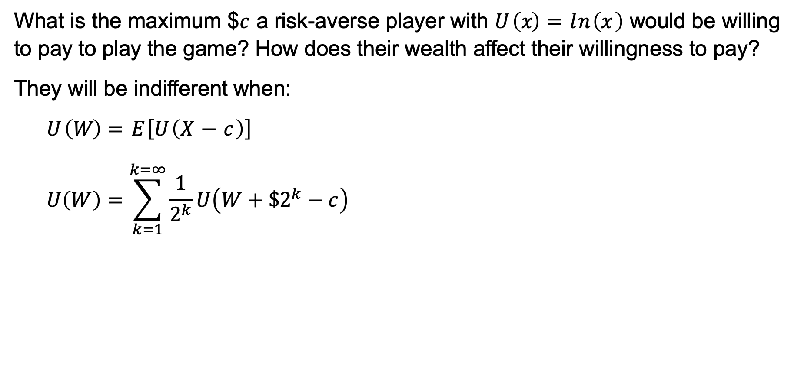
The St. Petersburg game
What is the maximum $$c$ a risk-averse player with $U \left(x\right)=ln\left(x\right)$ would be willing to pay to play the game? How does their wealth affect their willingness to pay?
They will be indifferent when:
$$U \left(W\right)=E\left[U\left(X−c\right)\right]$$
$$U\left(W\right)=\sum_{k=1}^{k=∞}{\frac{1}{2^{k}}U\left(W+\$2^{k}−c\right)}$$

Slide 19
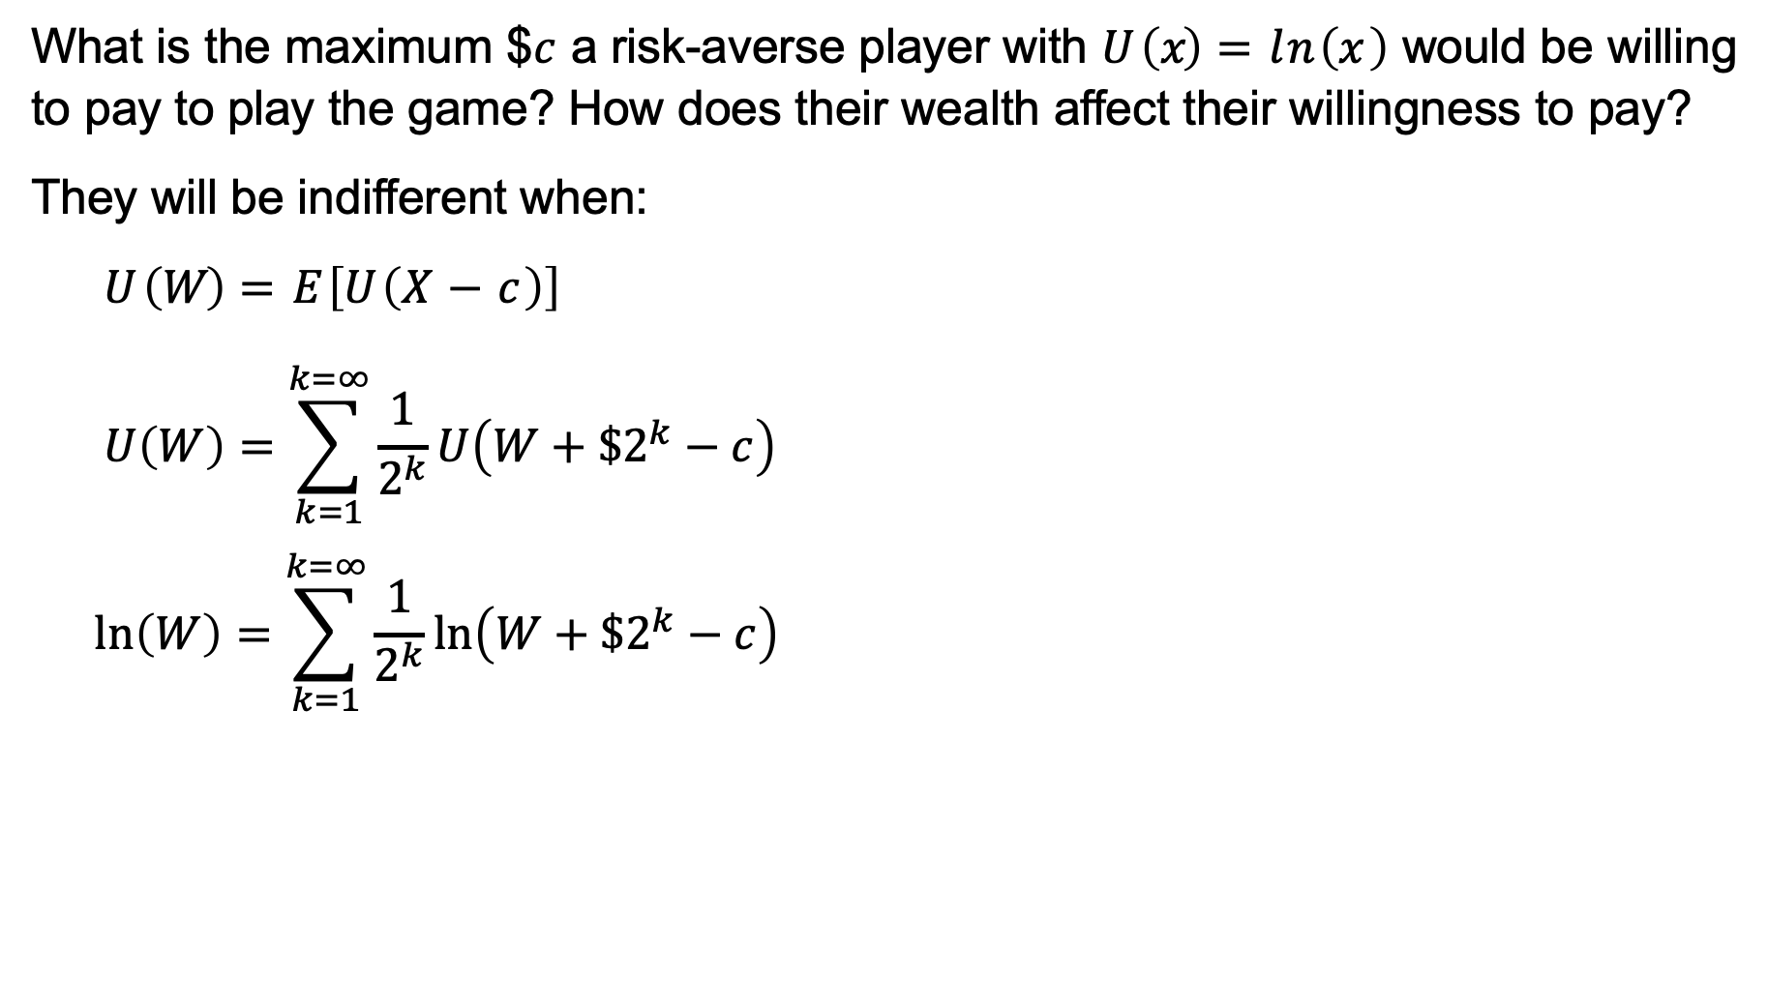
The St. Petersburg game
What is the maximum $$c$ a risk-averse player with $U \left(x\right)=ln\left(x\right)$ would be willing to pay to play the game? How does their wealth affect their willingness to pay?
They will be indifferent when:
$$U \left(W\right)=E\left[U\left(X−c\right)\right]$$
$$U\left(W\right)=\sum_{k=1}^{k=∞}{\frac{1}{2^{k}}U\left(W+\$2^{k}−c\right)}$$
$$ln\left(W\right)=\sum_{k=1}^{k=∞}{\frac{1}{2^{k}}ln\left(W+\$2^{k}−c\right)}$$

Slide 20

The St. Petersburg game
What is the maximum $$c$ a risk-averse player with $U \left(x\right)=ln\left(x\right)$ would be willing to pay to play the game? How does their wealth affect their willingness to pay?
Wealth | Willing to pay
$0.01 | $2.01
$1000 | $10.95
$1 million | $20.87

Slide 21
The St. Petersburg game
What is the the utility of a risk-averse player whose only asset is the opportunity to play this game?

Slide 22
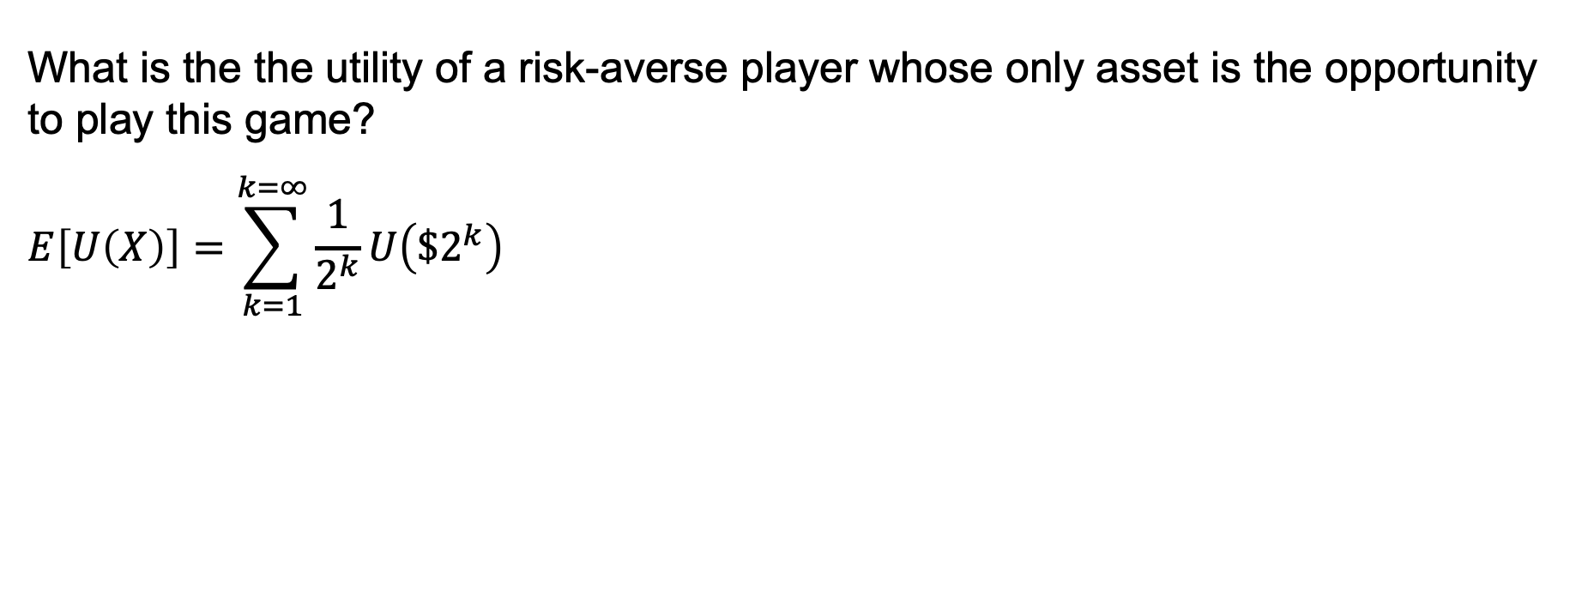
The St. Petersburg game
What is the the utility of a risk-averse player whose only asset is the opportunity to play this game?
$$E\left[U\left(X\right)\right]=\sum_{k=1}^{k=∞}{\frac{1}{2^{k}}U\left({\$2}^{k}\right)}$$

Slide 23
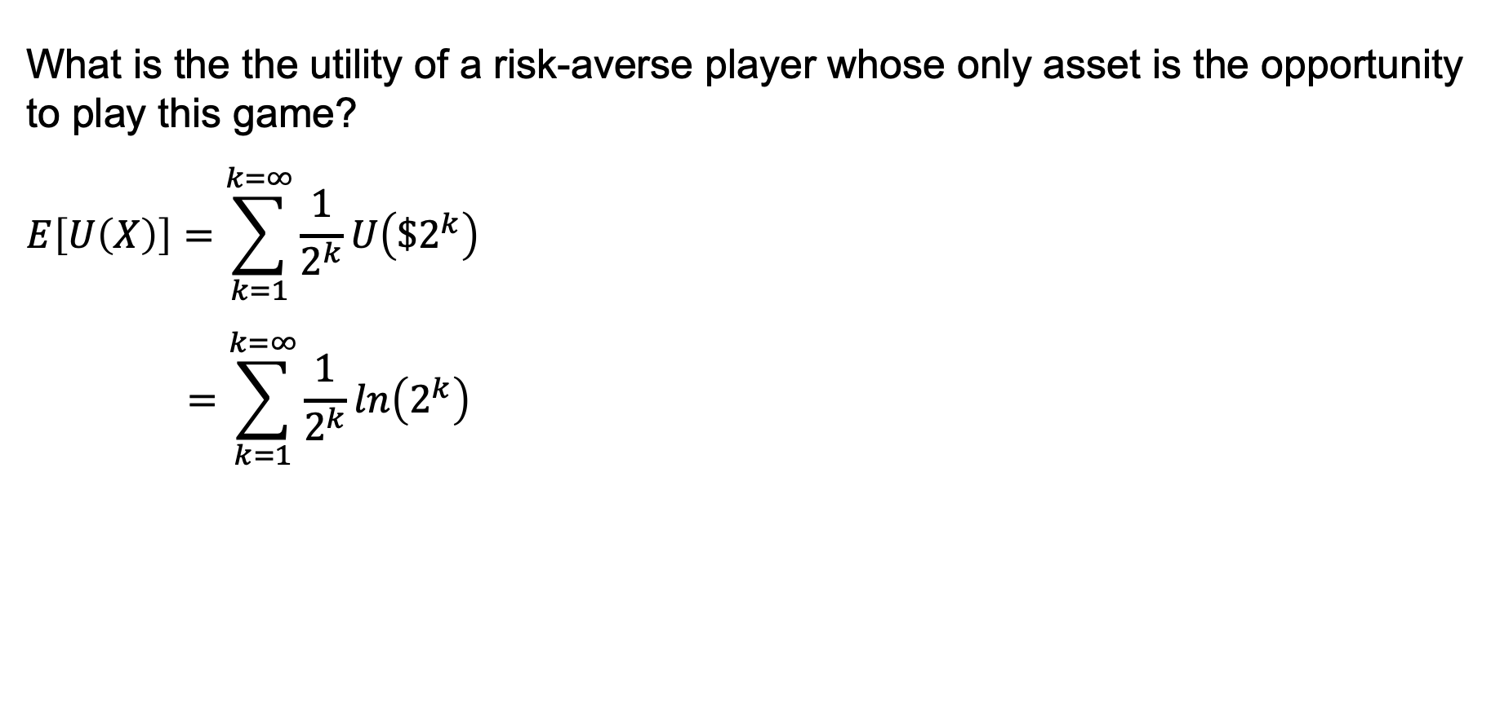
The St. Petersburg game
What is the the utility of a risk-averse player whose only asset is the opportunity to play this game?
$$E\left[U\left(X\right)\right]=\sum_{k=1}^{k=∞}{\frac{1}{2^{k}}U\left({\$2}^{k}\right)}$$
$$=\sum_{k=1}^{k=∞}{\frac{1}{2^{k}}ln\left(2^{k}\right)}$$

Slide 24
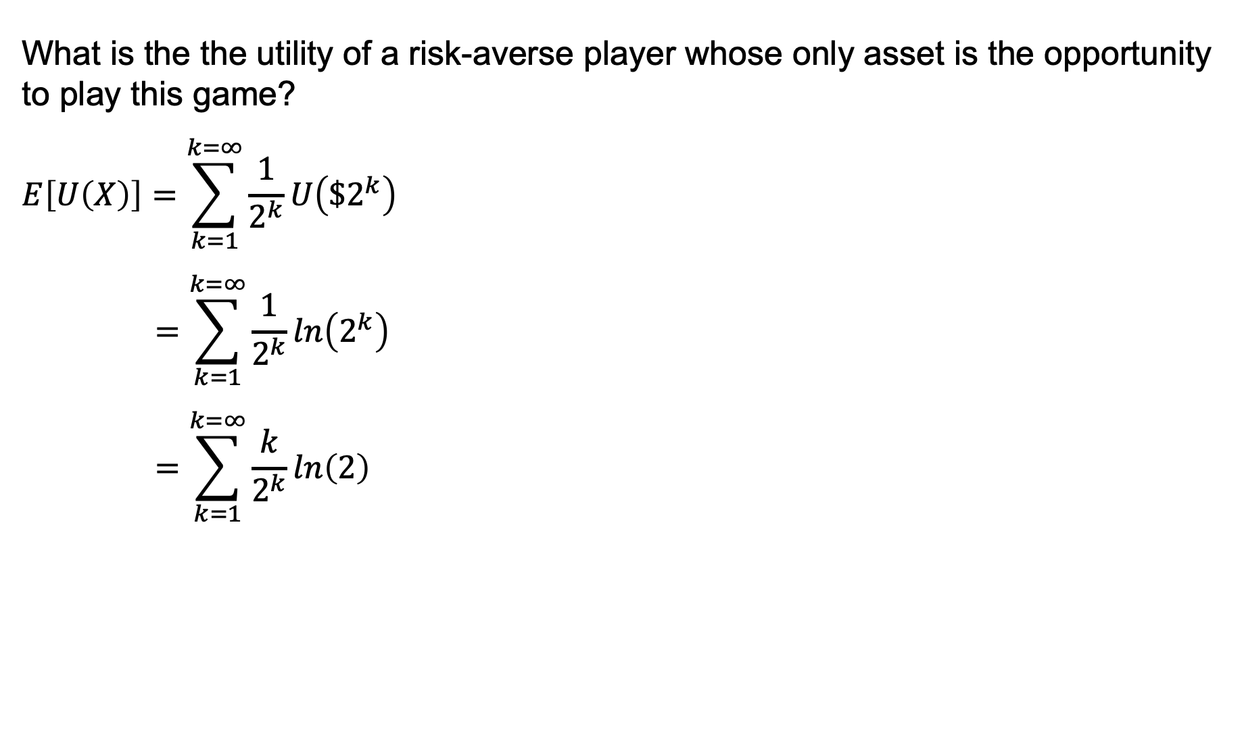
The St. Petersburg game
What is the the utility of a risk-averse player whose only asset is the opportunity to play this game?
$$E\left[U\left(X\right)\right]=\sum_{k=1}^{k=∞}{\frac{1}{2^{k}}U\left({\$2}^{k}\right)}$$
$$=\sum_{k=1}^{k=∞}{\frac{1}{2^{k}}ln\left(2^{k}\right)}$$
$$=\sum_{k=1}^{k=∞}{\frac{k}{2^{k}}ln\left(2\right)}$$

Slide 25
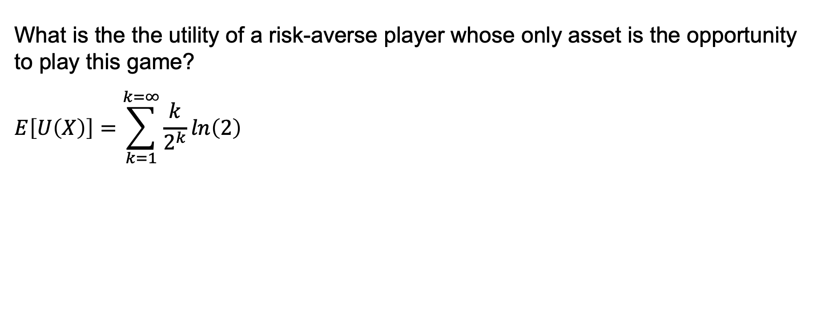
The St. Petersburg game
What is the the utility of a risk-averse player whose only asset is the opportunity to play this game?
$$E\left[U\left(X\right)\right]=\sum_{k=1}^{k=∞}{\frac{k}{2^{k}}ln\left(2\right)}$$

Slide 26
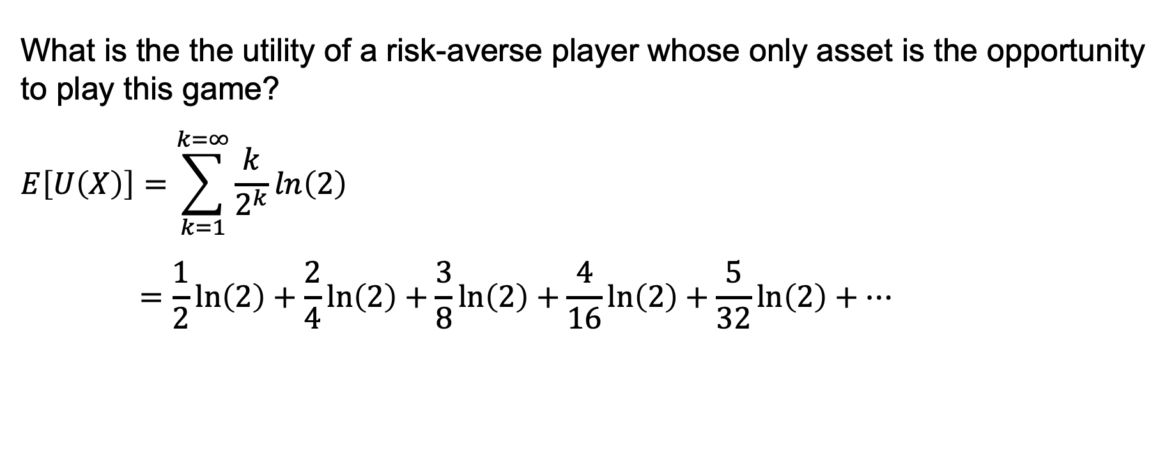
The St. Petersburg game
What is the the utility of a risk-averse player whose only asset is the opportunity to play this game?
$$E\left[U\left(X\right)\right]=\sum_{k=1}^{k=∞}{\frac{k}{2^{k}}ln\left(2\right)}$$
$$=\frac{1}{2}ln\left(2\right)+\frac{2}{4}ln\left(2\right)+\frac{3}{8}ln\left(2\right)+\frac{4}{16}ln\left(2\right)+\frac{5}{32}ln\left(2\right)+…$$

Slide 27
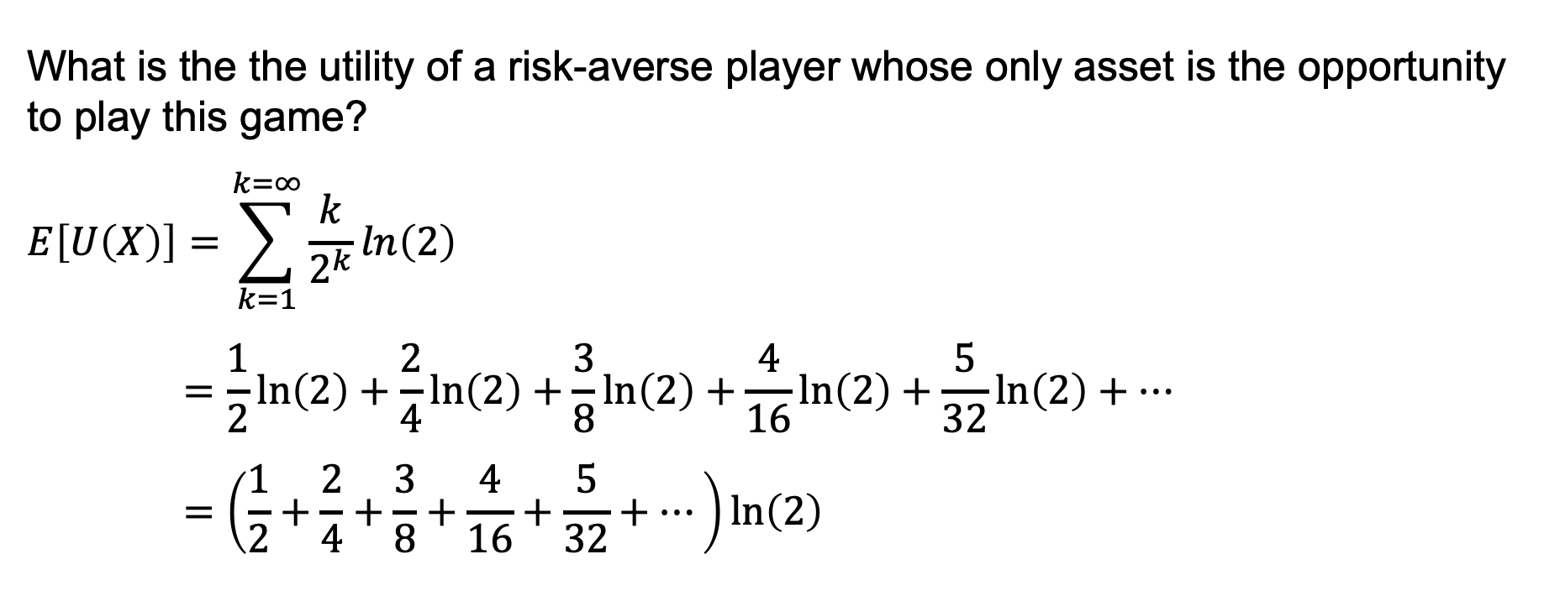
The St. Petersburg game
What is the the utility of a risk-averse player whose only asset is the opportunity to play this game?
$$E\left[U\left(X\right)\right]=\sum_{k=1}^{k=∞}{\frac{k}{2^{k}}ln\left(2\right)}$$
$$=\frac{1}{2}ln\left(2\right)+\frac{2}{4}ln\left(2\right)+\frac{3}{8}ln\left(2\right)+\frac{4}{16}ln\left(2\right)+\frac{5}{32}ln\left(2\right)+…$$
$$=\left(\frac{1}{2}+\frac{2}{4}+\frac{3}{8}+\frac{4}{16}+\frac{5}{32}+…\right)ln\left(2\right)$$

Slide 28
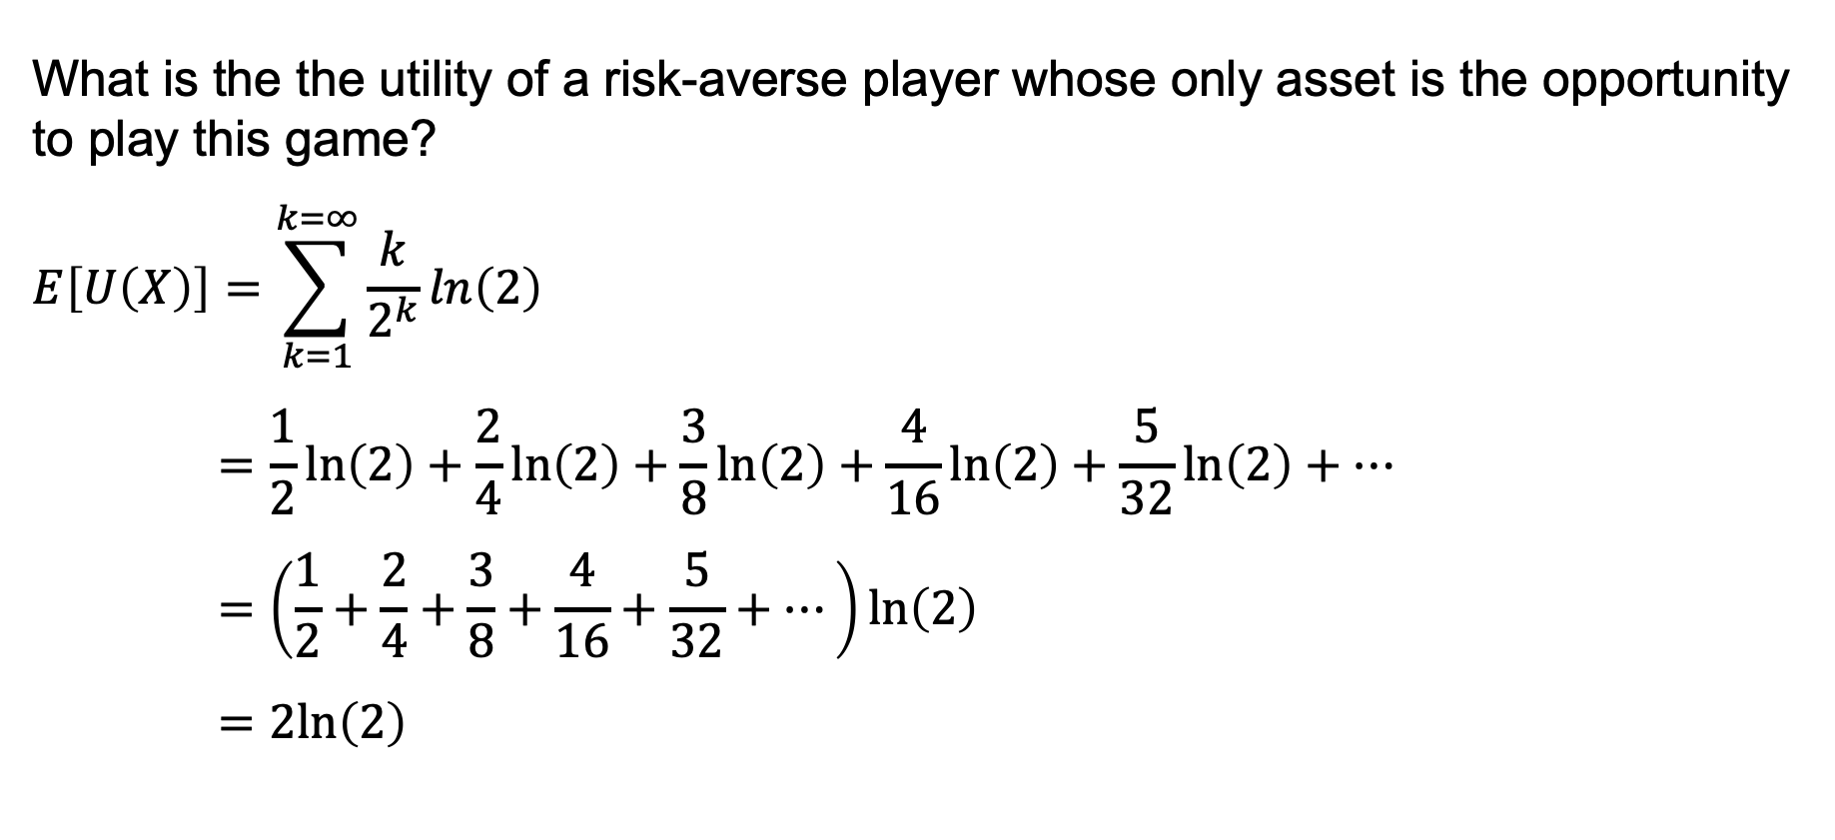
The St. Petersburg game
What is the the utility of a risk-averse player whose only asset is the opportunity to play this game?
$$E\left[U\left(X\right)\right]=\sum_{k=1}^{k=∞}{\frac{k}{2^{k}}ln\left(2\right)}$$
$$=\frac{1}{2}ln\left(2\right)+\frac{2}{4}ln\left(2\right)+\frac{3}{8}ln\left(2\right)+\frac{4}{16}ln\left(2\right)+\frac{5}{32}ln\left(2\right)+…$$
$$=\left(\frac{1}{2}+\frac{2}{4}+\frac{3}{8}+\frac{4}{16}+\frac{5}{32}+…\right)ln\left(2\right)$$
$$=2ln\left(2\right)$$

Slide 29

The St. Petersburg game
We can calculate what wealth is equivalent to this expected utility.
$$U\left(W\right)=ln\left(W\right)=2ln\left(2\right)$$

Slide 30

The St. Petersburg game
We can calculate what wealth is equivalent to this expected utility.
$$U\left(W\right)=ln\left(W\right)=2ln\left(2\right)$$
$$W=e^{2ln\left(2\right)}=4$$

