Slide 1
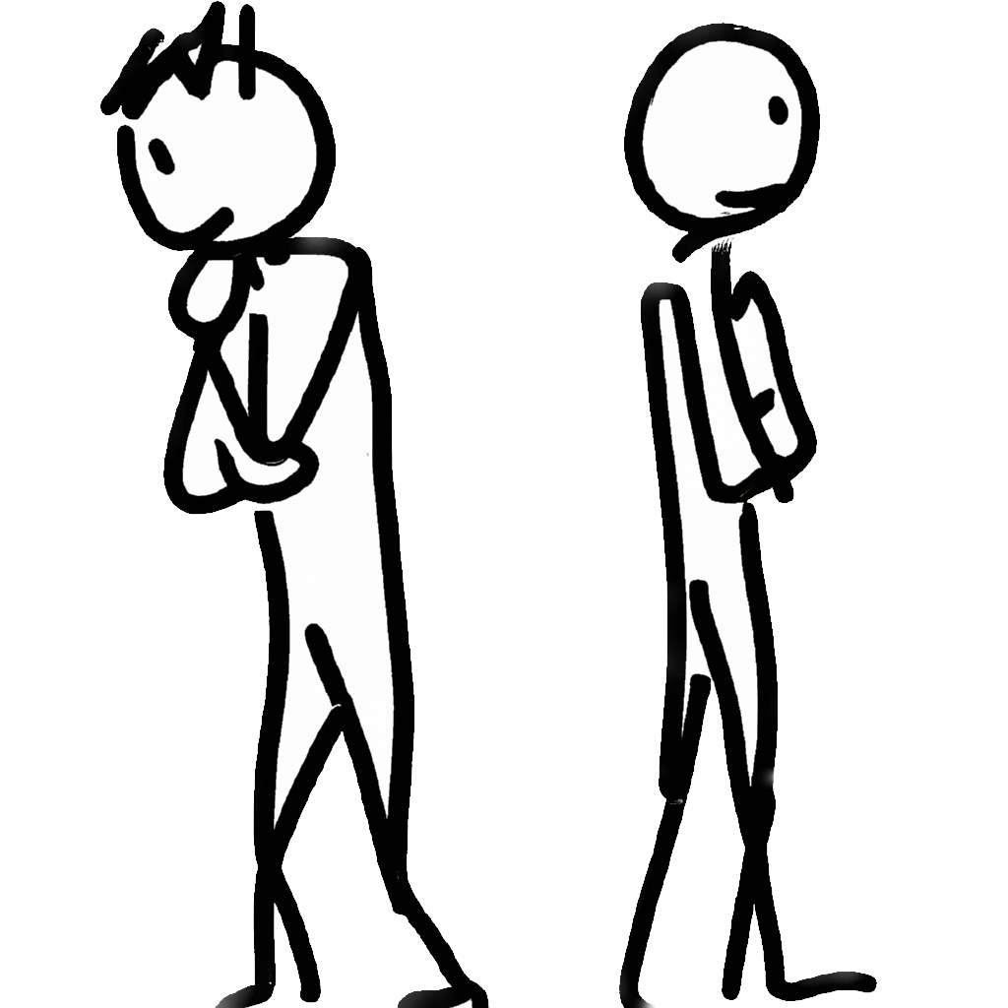
Loss aversion
Notes on Behavioural Economics
Jason Collins

Slide 2
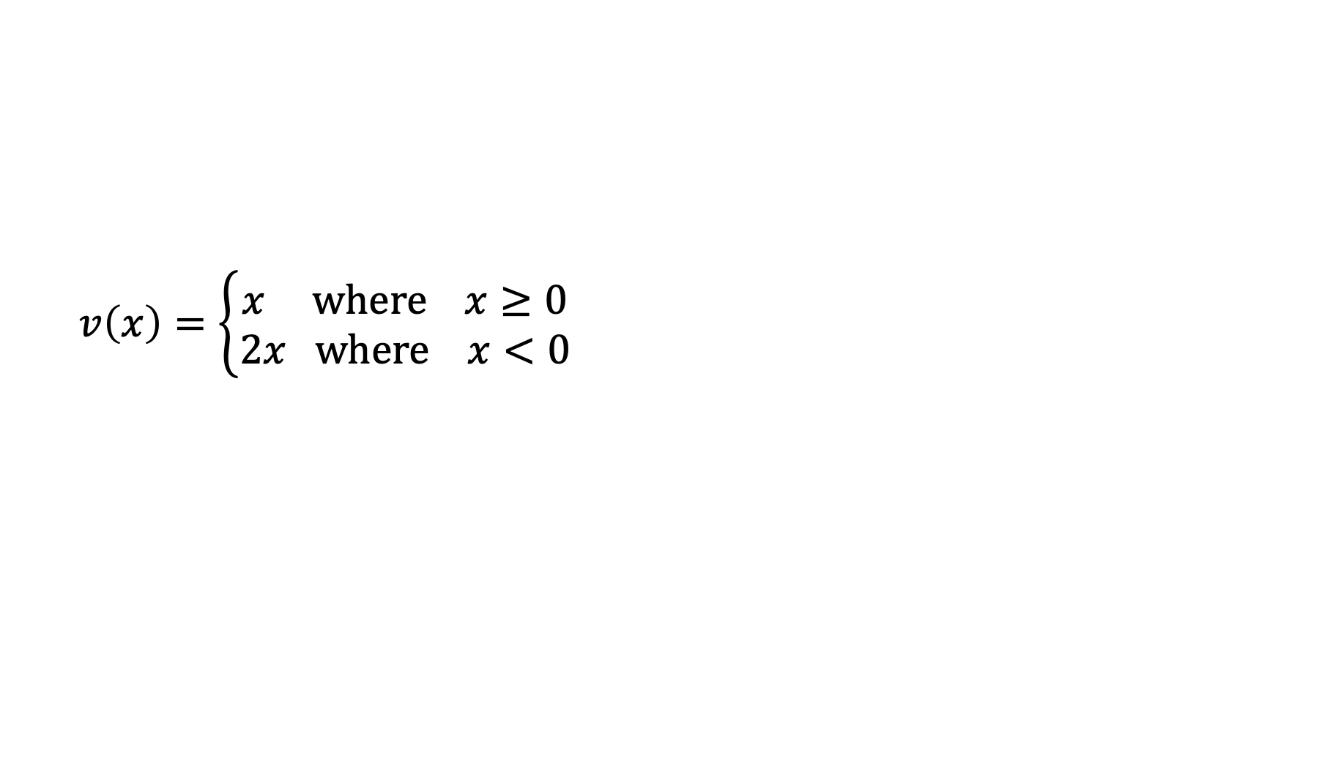
Loss aversion
$$v\left(x\right)=\left\{\begin{aligned}x where x≥0 \\ 2x where x<0\end{aligned}\right.$$

Slide 3
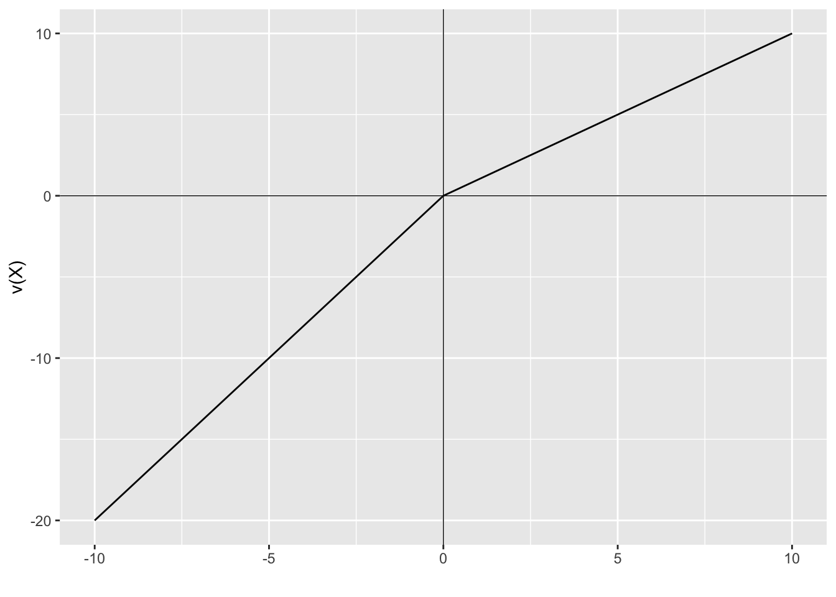

Slide 4
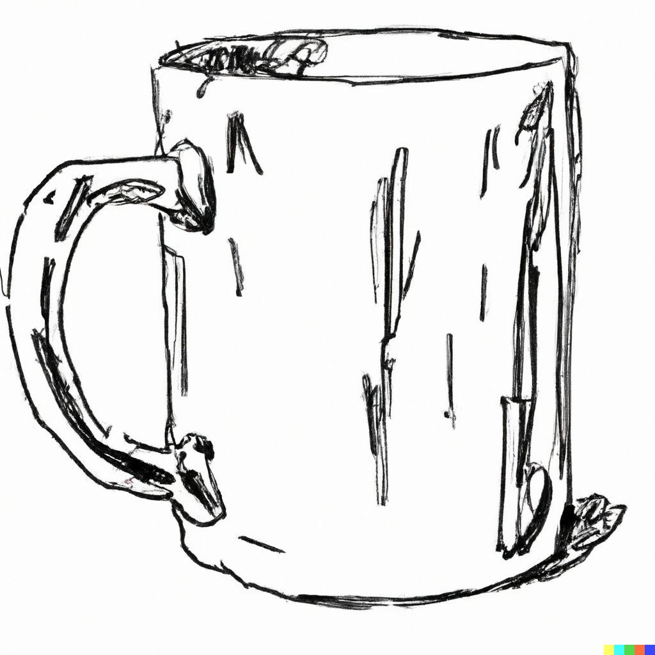
Willingness to accept: $5.75
Willingness to pay: $2.25

Slide 5
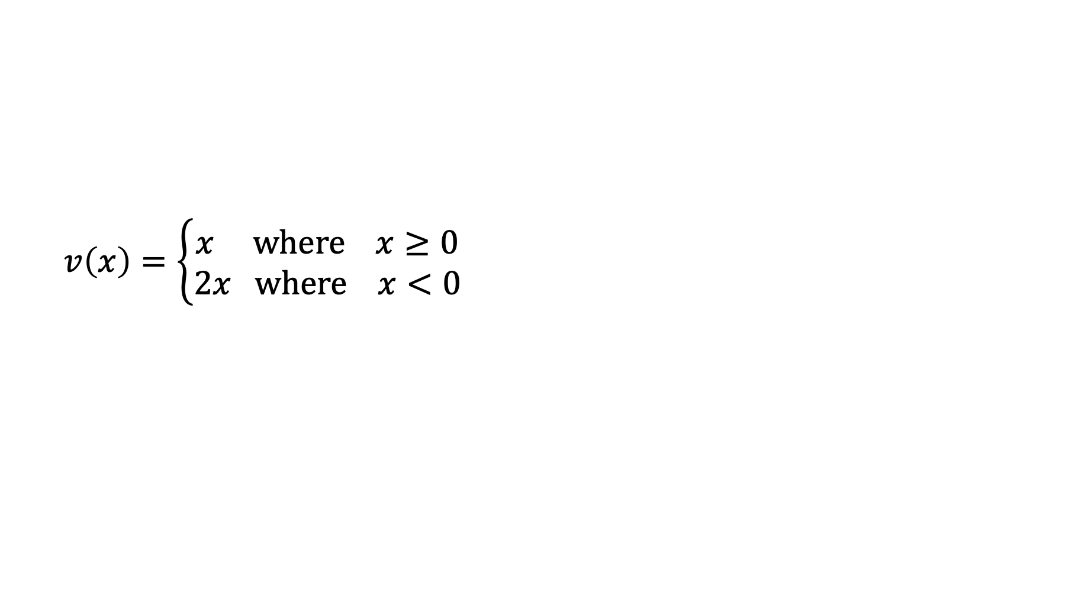
$$v\left(x\right)=\left\{\begin{aligned}x where x≥0 \\ 2x where x<0\end{aligned}\right.$$

Slide 6
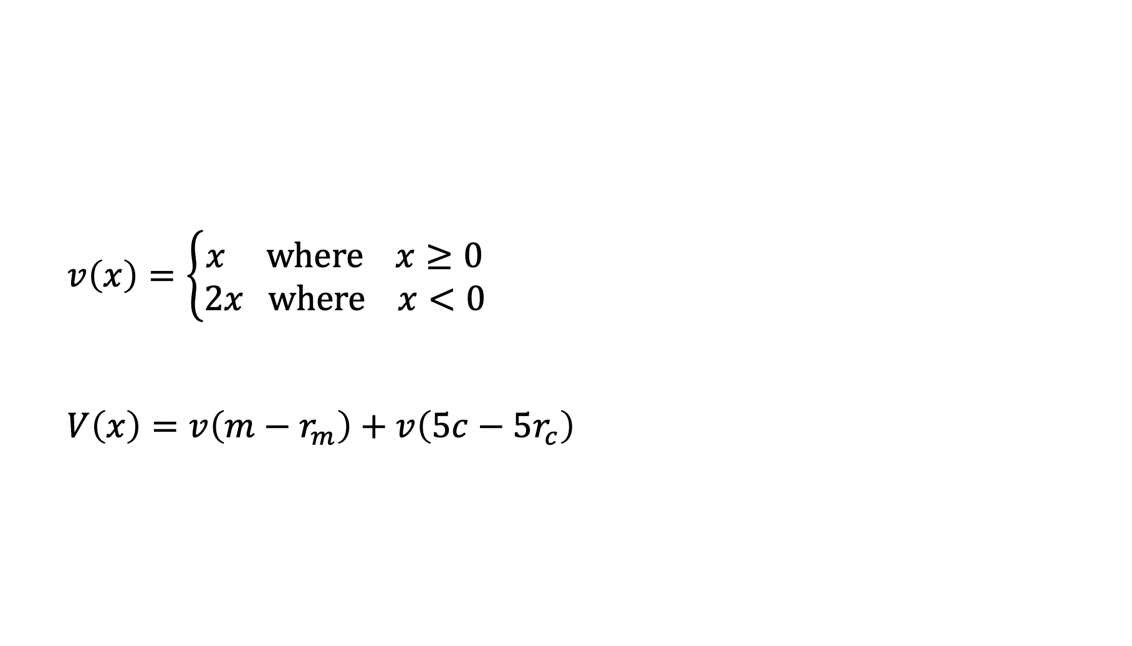
$$v\left(x\right)=\left\{\begin{aligned}x where x≥0 \\ 2x where x<0\end{aligned}\right.$$
$$V\left(x\right)=v\left(m−r_{m}\right)+v\left(5c−5r_{c}\right)$$

Slide 7

$$V\left(x\right)=v\left(5c−5r_{c}\right)$$
$$=v\left(5 × 1−5 × 2\right)$$
$$=v\left(−5\right)$$
$$=−10$$

Slide 8
Bruce is given a mug. Bruce’s reference point adapts such that he considers the mug his. How much would Bruce need to be paid to give up the mug?

Slide 9

$$V\left(x\right)=0$$

Slide 10
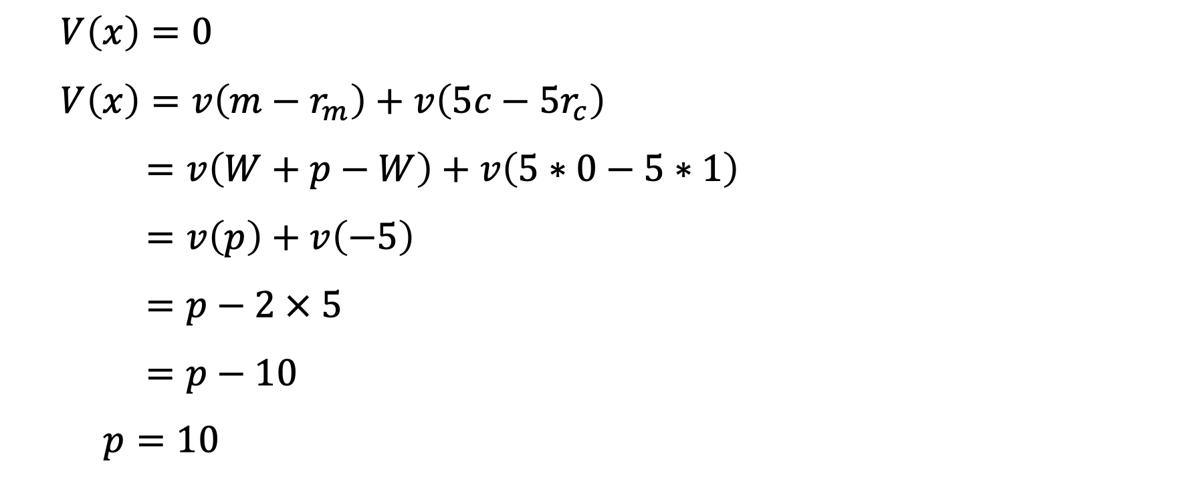
$$V\left(x\right)=0$$
$$V\left(x\right)=v\left(m−r_{m}\right)+v\left(5c−5r_{c}\right)$$
$$=v\left(W+p−W\right)+v\left(5∗0−5∗1\right)$$
$$=v\left(p\right)+v\left(−5\right)$$
$$=p−2 × 5$$
$$=p−10$$
$$p=10$$

Slide 11
Bruce is not given a mug, but rather an opportunity to purchase a mug. How much would Bruce be willing to pay for the mug?

Slide 12
$$V\left(x\right)=0$$

Slide 13

$$V\left(x\right)=0$$
$$V\left(x\right)=v\left(m−r_{m}\right)+v\left(5c−5r_{c}\right)$$
$$=v\left(W−p−W\right)+v\left(5∗1−5∗0\right)$$
$$=v\left(−p\right)+v\left(5\right)$$
$$=−2p+5$$
$$p=2.5$$

