Slide 1

Probability weighting
Notes on Behavioural Economics
Jason Collins

Slide 2
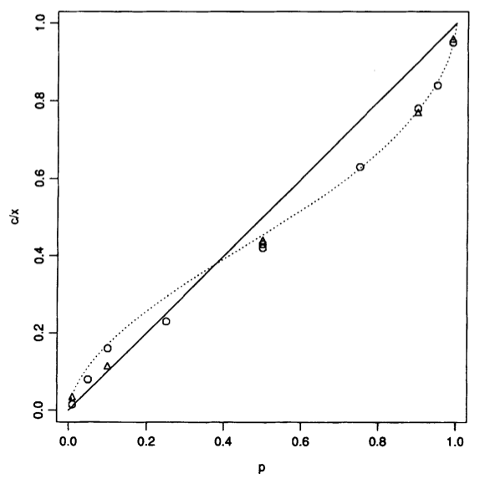

Slide 3
Choice 1: Choose one of the following bets:
Bet A: Bet B:
$2500 with probability: 33% $2400 with probability: 100%
$2400 with probability: 66%
$0 with probability: 1%

Slide 4
Choice 2: Choose one of the following bets:
Bet C: Bet D:
$2500 with probability: 33% $2400 with probability: 34%
$0 with probability: 67% $0 with probability: 66%

Slide 5
Choice 1: Choose one of the following bets:
Bet A: Bet B:
$2500 with probability: 33% $2400 with probability: 100%
$2400 with probability: 66%
$0 with probability: 1%
Certain outcome

Slide 6
Choice 2: Choose one of the following bets:
Bet C: Bet D:
$2500 with probability: 33% $2400 with probability: 34%
$0 with probability: 67% $0 with probability: 66%

Slide 7
Choice 2: Choose one of the following bets:
Bet C: Bet D:
$2500 with probability: 33% $2400 with probability: 34%
$0 with probability: 67% $0 with probability: 66%

Slide 8
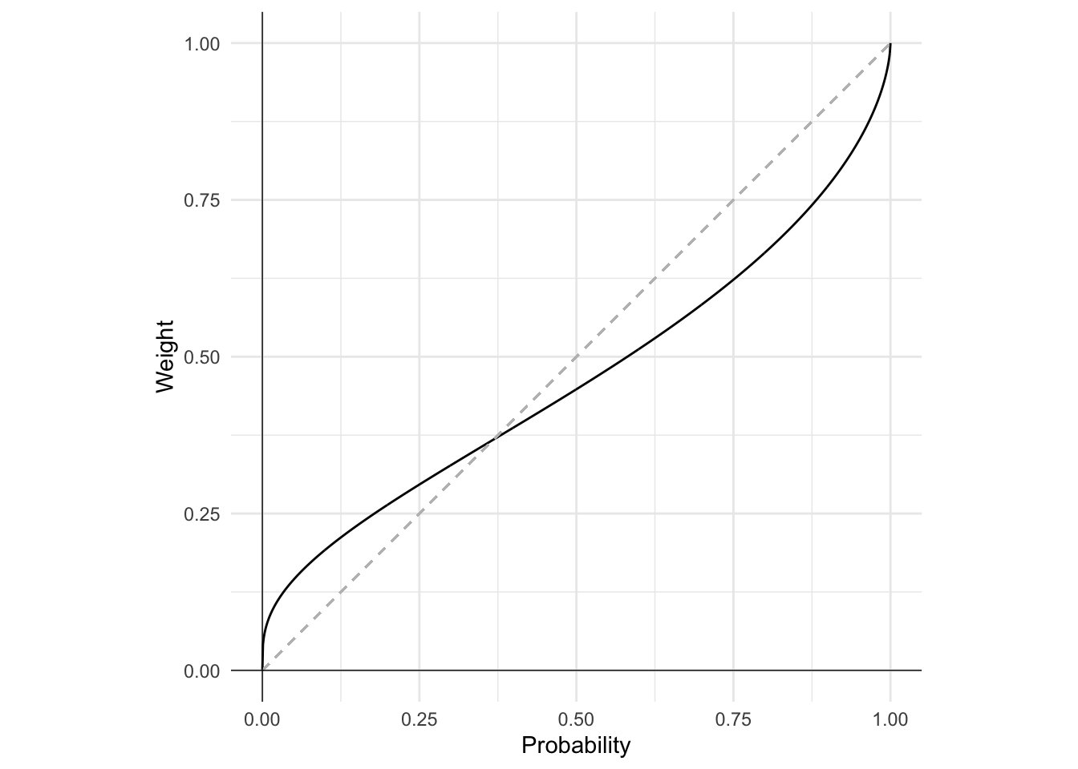

$$π\left(p\right)=e^{−{\left(−ln\left(p\right)\right)}^{α}}$$
$$0<α<1$$

