Slide 1

The reflection effect
Notes on Behavioural Economics
Jason Collins

Slide 2

The reflection effect

Slide 3
The Asian Disease Problem
Imagine that the U.S. is preparing for the outbreak of an unusual Asian disease, which is expected to kill 600 people. Two alternative programs to combat the disease have been proposed. Assume that the exact scientific estimates of the consequences of the programs are as follows:
If Program A is adopted, 200 people will be saved.
If Program B is adopted, there is a one-third probability that 600 people will be saved and a two-thirds probability that no people will be saved.
Which of the two programs would you favour?

Slide 4
The Asian Disease Problem
Imagine that the U.S. is preparing for the outbreak of an unusual Asian disease, which is expected to kill 600 people. Two alternative programs to combat the disease have been proposed. Assume that the exact scientific estimates of the consequences of the programs are as follows:
If Program C is adopted, 400 people will die.
If Program D is adopted, there is a one-third probability that nobody will die and a two-thirds probability that 600 people will die.
Which of the two programs would you favour?

Slide 5
The Asian Disease Problem
If Program A is adopted, 200 people will be saved.
If Program B is adopted, there is a one-third probability that 600 people will be saved and a two-thirds probability that no people will be saved.
If Program C is adopted, 400 people will die.
If Program D is adopted, there is a one-third probability that nobody will die and a two-thirds probability that 600 people will die.

Slide 6
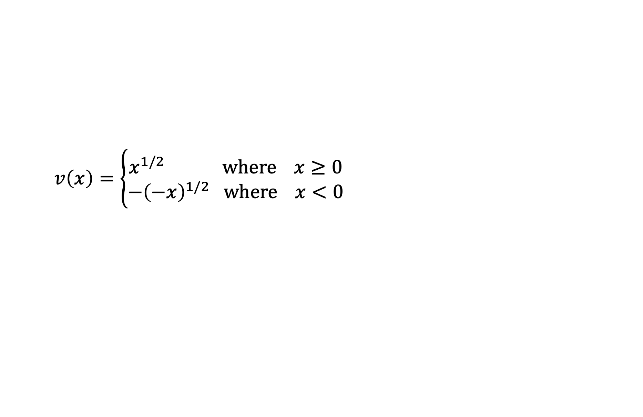
The reflection effect: a value function
$$v\left(x\right)=\left\{\begin{aligned}x^{1/2} where x≥0 \\ −{\left(−x\right)}^{1/2} where x<0\end{aligned}\right.$$

Slide 7
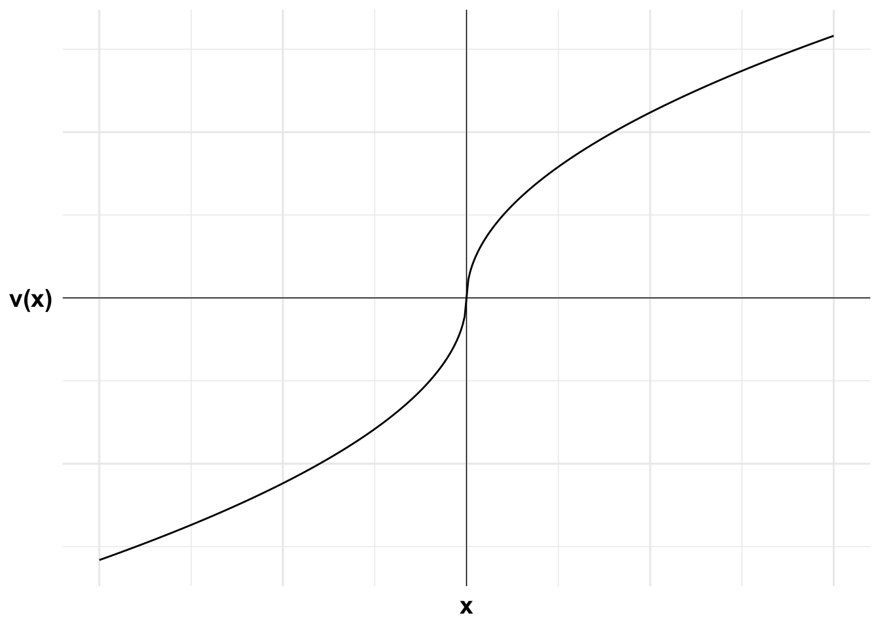
The reflection effect: plotting the value function

Slide 8
The reflection effect: a numerical example
$$v\left(x\right)=\left\{\begin{aligned}x^{1/2} where x≥0 \\ −{\left(−x\right)}^{1/2} where x<0\end{aligned}\right.$$

Slide 9
The reflection effect: a numerical example
The agent is offered a choice between $10 for certain and a 50:50 bet to win $20 or end up with nothing.

Slide 10
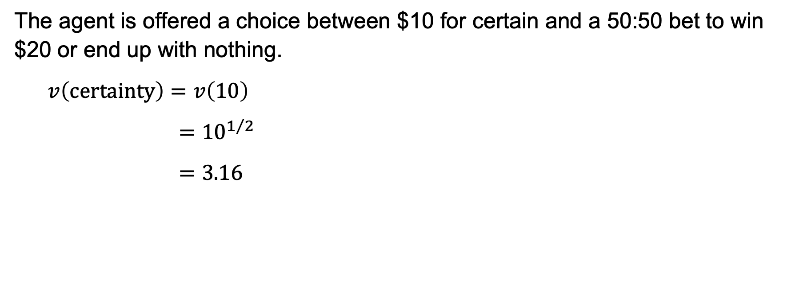
The reflection effect: a numerical example
The agent is offered a choice between $10 for certain and a 50:50 bet to win $20 or end up with nothing.
$$v\left(certainty\right)=v\left(10\right)$$
$$={10}^{1/2}$$
$$=3.16$$

Slide 11
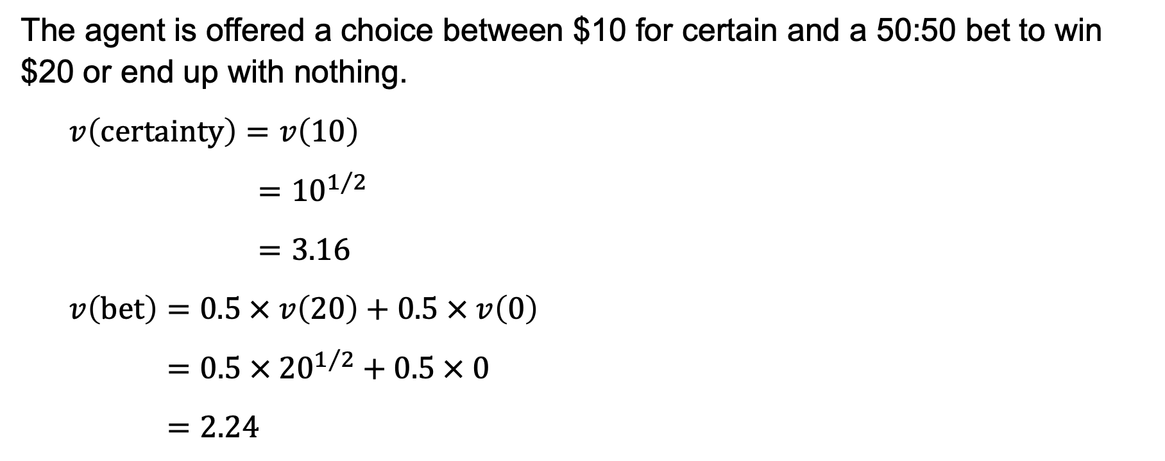
The reflection effect: a numerical example
The agent is offered a choice between $10 for certain and a 50:50 bet to win $20 or end up with nothing.
$$v\left(certainty\right)=v\left(10\right)$$
$$={10}^{1/2}$$
$$=3.16$$
$$v\left(bet\right)=0.5 × v\left(20\right)+0.5 × v\left(0\right)$$
$$=0.5 ×{ 20}^{1/2} + 0.5 × 0$$
$$=2.24$$

Slide 12
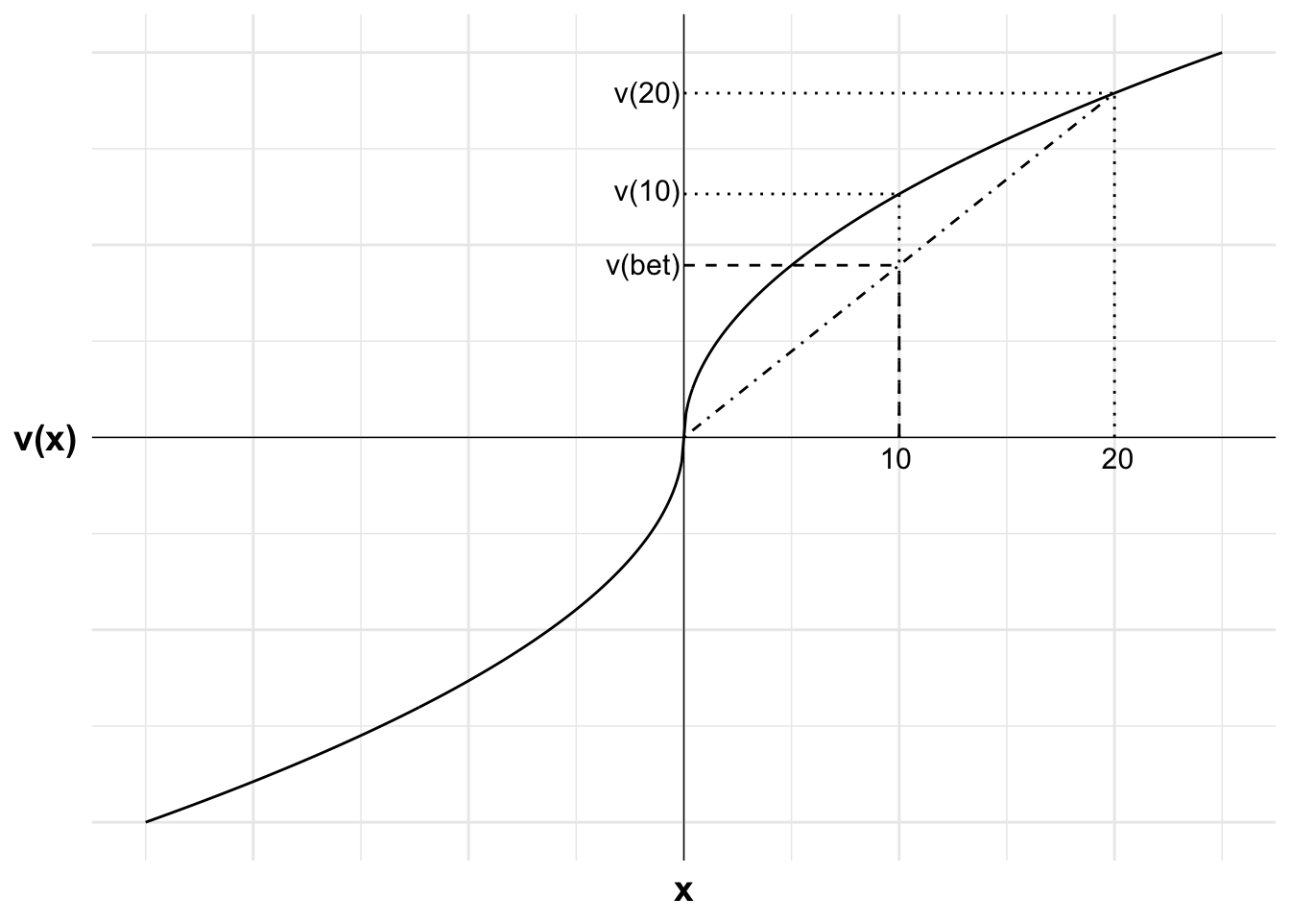
The reflection effect: a numerical example

Slide 13
The reflection effect: a numerical example
The agent is offered a choice between a certain loss of $10 or a 50:50 bet to lose $20 or to lose nothing.

Slide 14
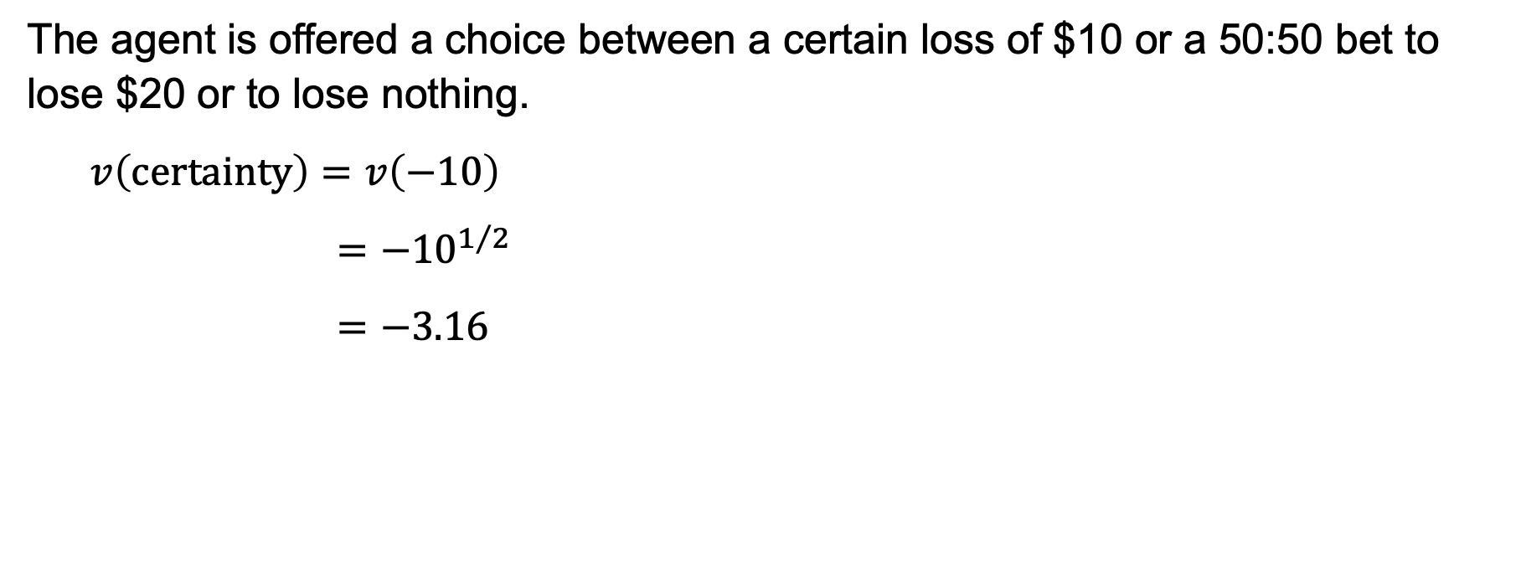
The reflection effect: a numerical example
The agent is offered a choice between a certain loss of $10 or a 50:50 bet to lose $20 or to lose nothing.
$$v\left(certainty\right)=v\left(−10\right)$$
$$={−10}^{1/2}$$
$$=−3.16$$

Slide 15
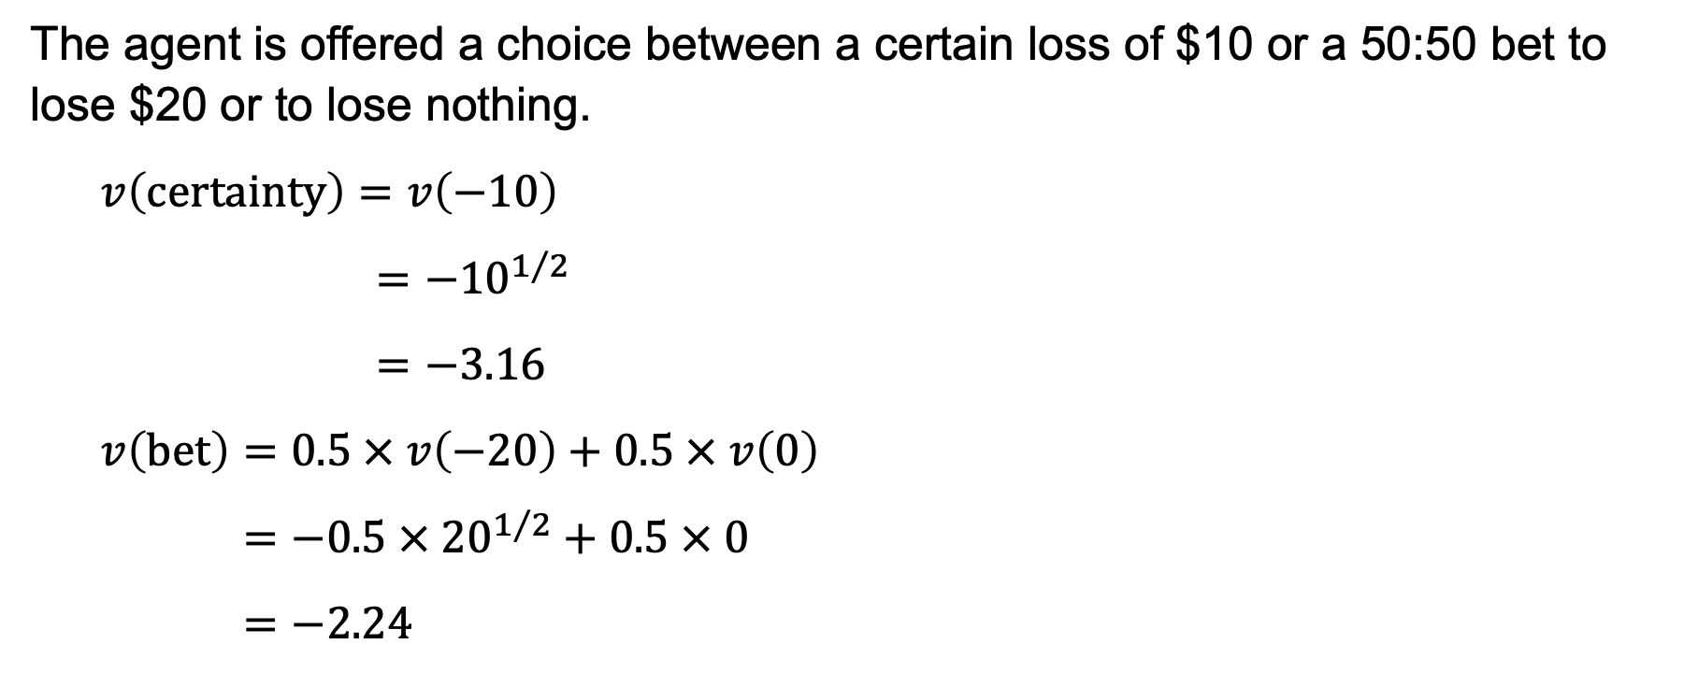
The reflection effect: a numerical example
The agent is offered a choice between a certain loss of $10 or a 50:50 bet to lose $20 or to lose nothing.
$$v\left(certainty\right)=v\left(−10\right)$$
$$={−10}^{1/2}$$
$$=−3.16$$
$$v\left(bet\right)=0.5 × v\left(−20\right)+0.5 × v\left(0\right)$$
$$=−0.5 × {20}^{1/2}+0.5 × 0$$
$$=−2.24$$

Slide 16
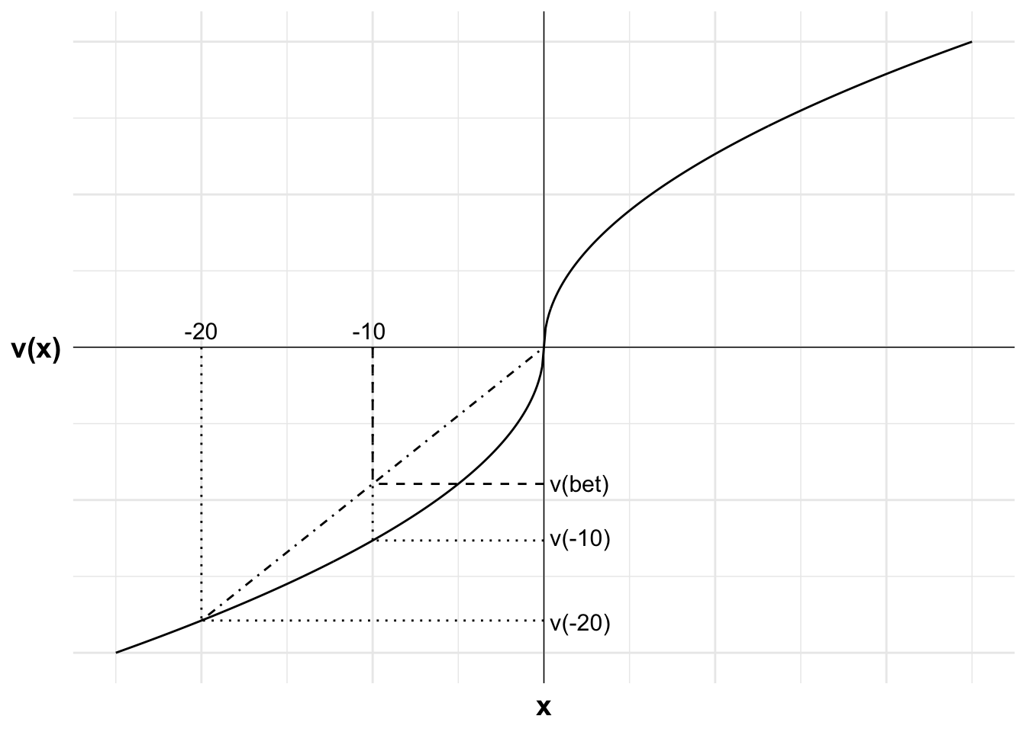
The reflection effect: a numerical example

