Slide 1

The value function
Notes on Behavioural Economics
Jason Collins

Slide 2
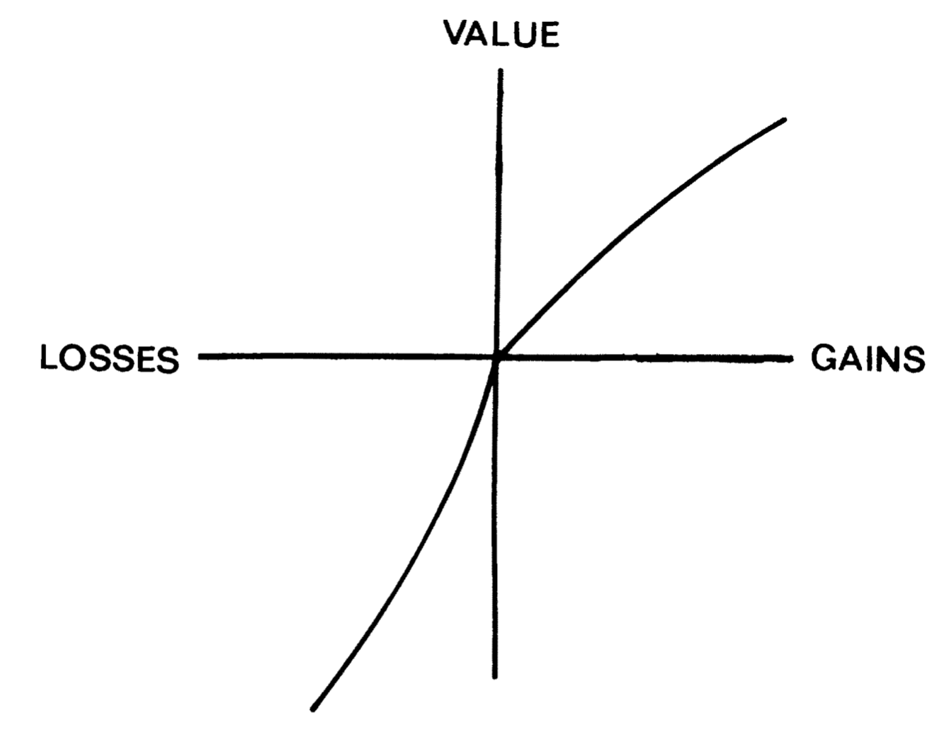

Slide 3
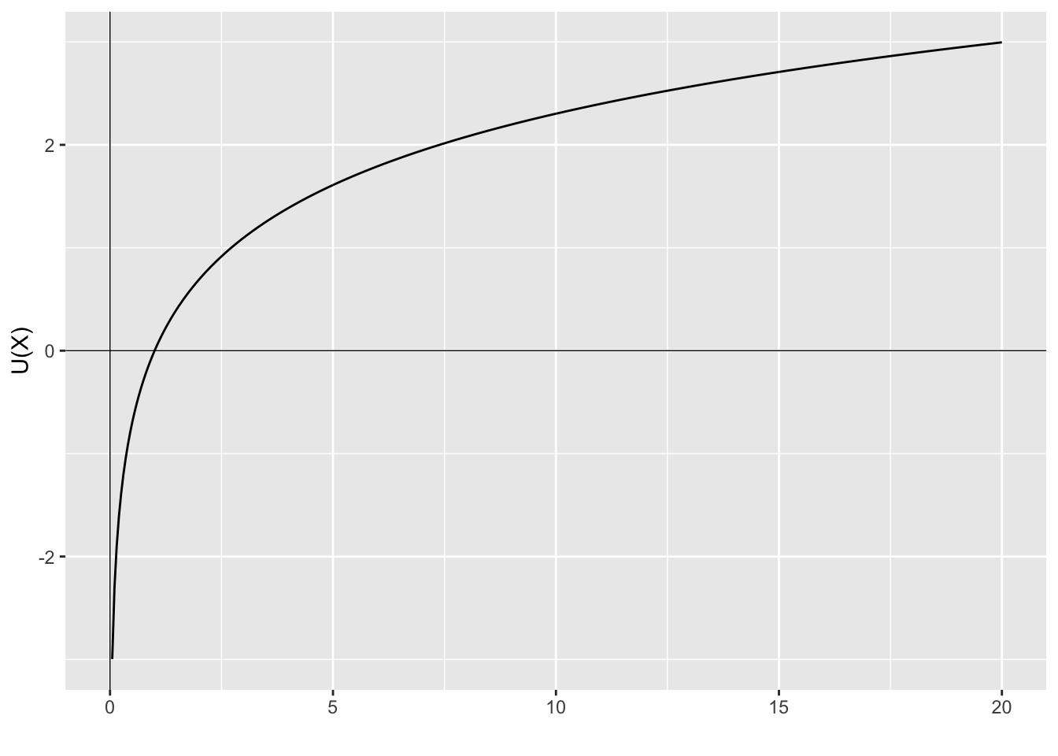

Slide 4
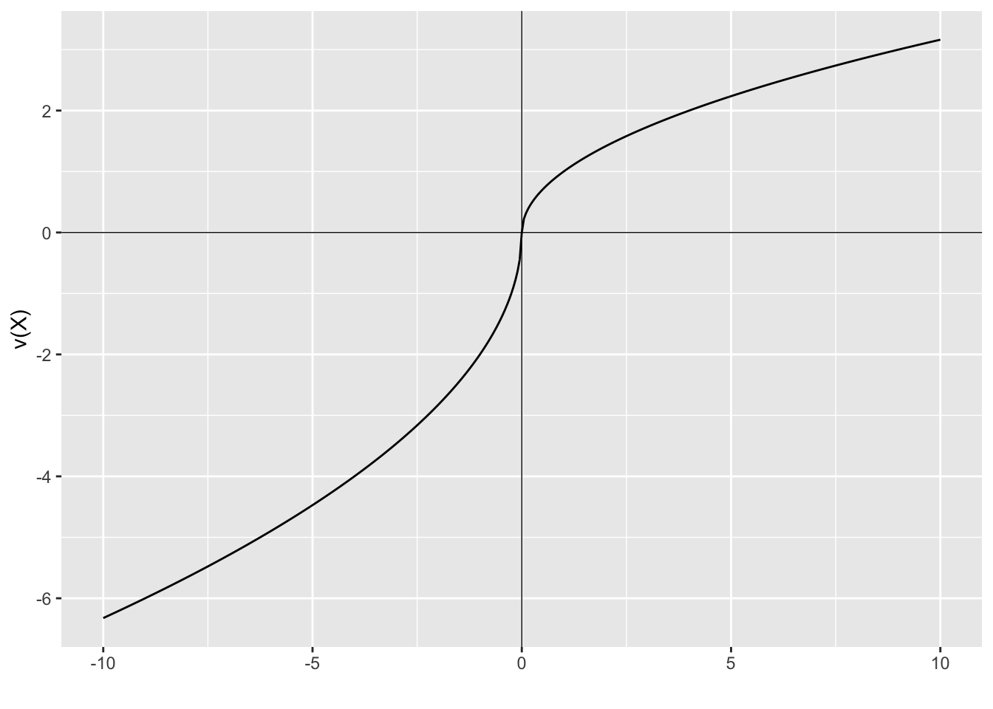

Slide 5
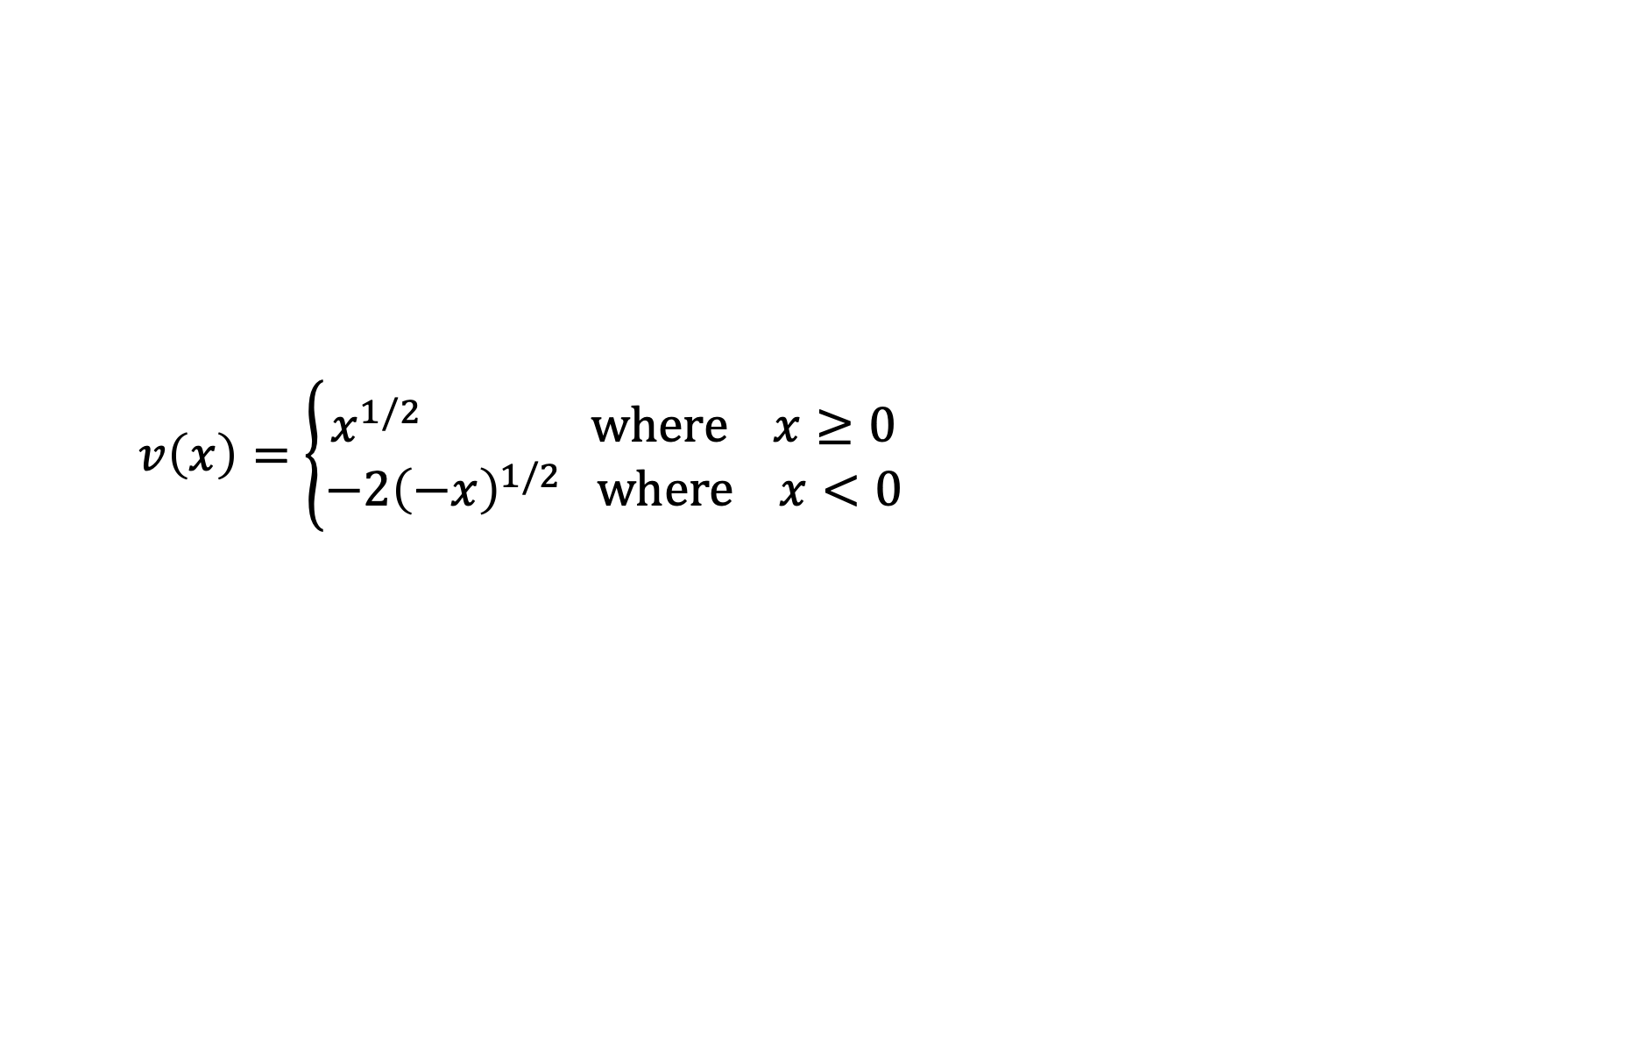
The value function
$$v\left(x\right)=\left\{\begin{aligned}x^{1/2} where x≥0 \\ −2{\left(−x\right)}^{1/2} where x<0\end{aligned}\right.$$

