Slide 1

Prospect theory implementation
Notes on Behavioural Economics
Jason Collins

Slide 2
Editing
Coding
Combination
Segregation
Cancellation

Slide 3

Combination
$$(0.25, 200;0.25, 200; 0.50, 0)⟹(0.50, 200;0.50,0)$$

Slide 4
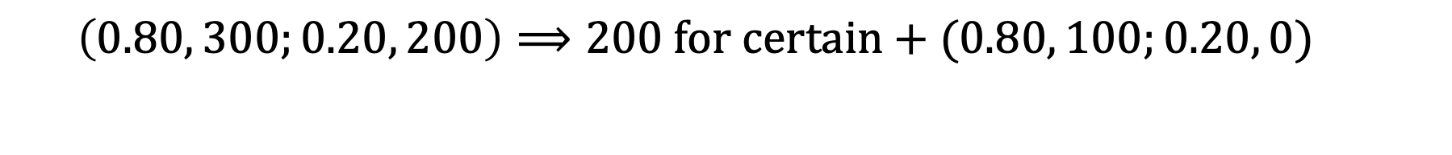
Segregation
$$\left(0.80, 300;0.20, 200\right)⟹200 for certain+(0.80, 100;0.20, 0)$$

Slide 5
Editing
Coding
Combination
Segregation
Cancellation

Slide 6
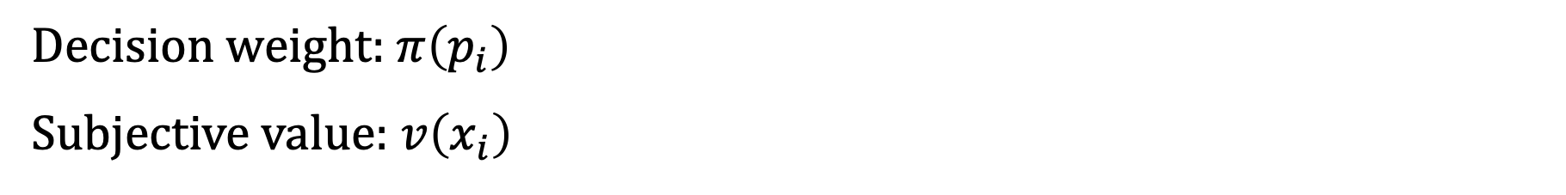
Evaluation
Decision weight: $π\left(p_{i}\right)$
Subjective value: $v\left(x_{i}\right)$

Slide 7
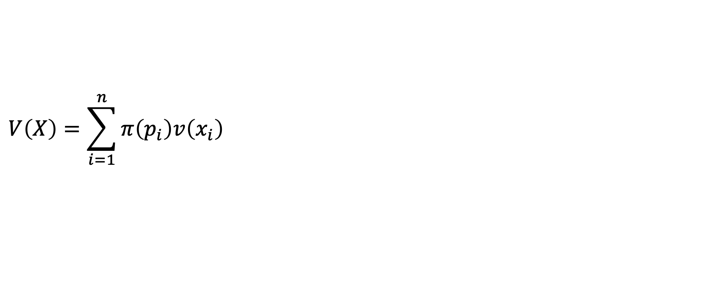
Evaluation
$$V\left(X\right)=\sum_{i=1}^{n}{π\left(p_{i}\right)v\left(x_{i}\right)}$$

Slide 8
Fourfold pattern
 | Gains | Losses
High probability | Risk aversion | Risk seeking
Low probability | Risk seeking | Risk aversion

