Slide 1

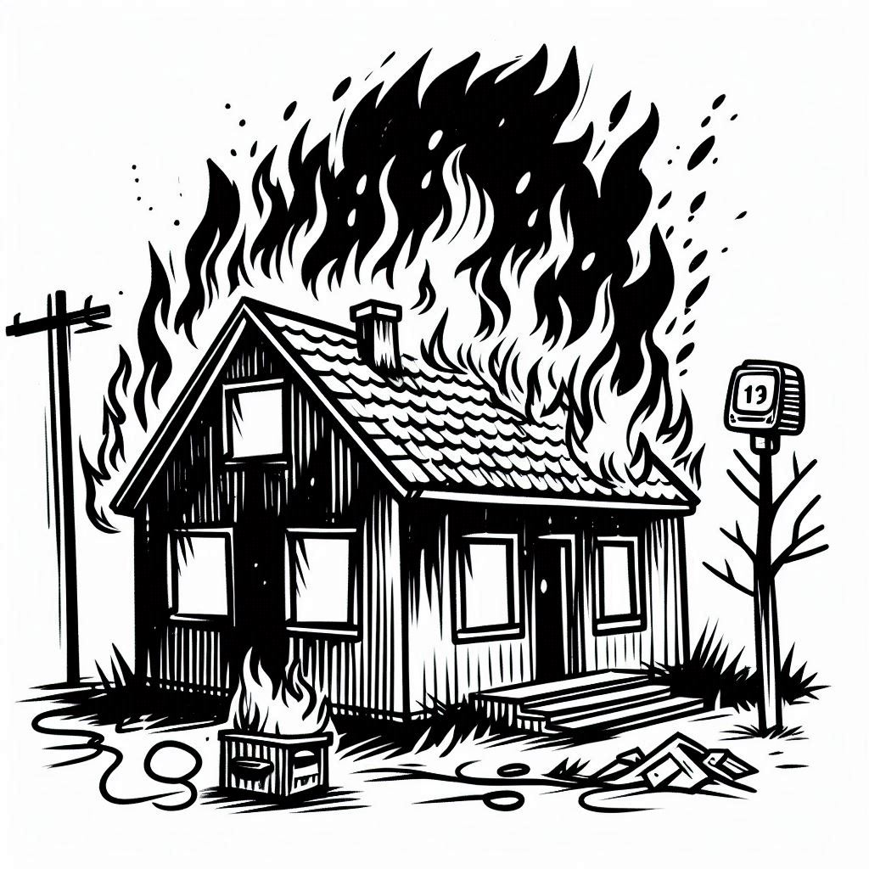
Prospect theory: Insurance
Notes on Behavioural Economics
Jason Collins

Slide 2
Why buy insurance?

Slide 3

Why buy insurance?
Expected utility theory
Risk aversion $⟹$ insurance

Slide 4
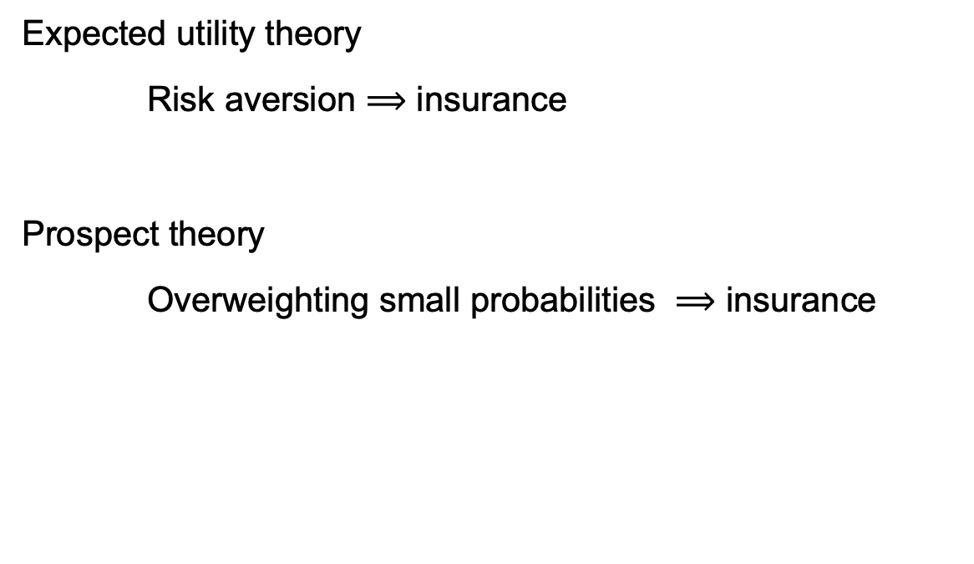
Why buy insurance?
Expected utility theory
Risk aversion $⟹$ insurance
Prospect theory
Overweighting small probabilities $⟹$ insurance

Slide 5
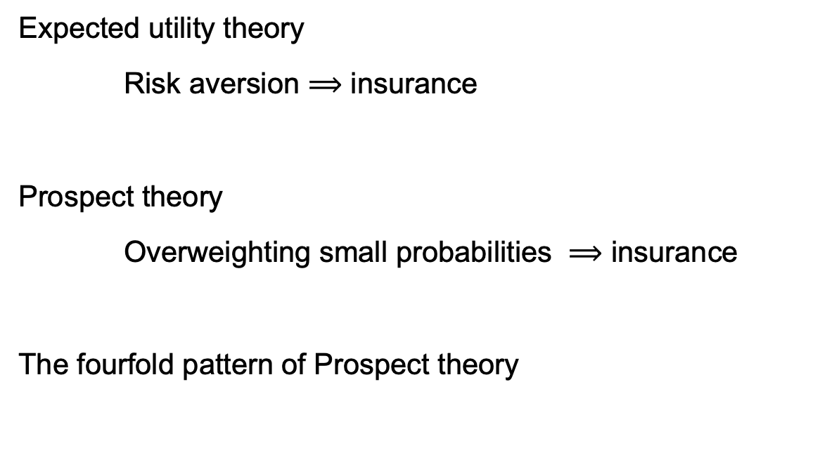
Why buy insurance?
Expected utility theory
Risk aversion $⟹$ insurance
Prospect theory
Overweighting small probabilities $⟹$ insurance
The fourfold pattern of Prospect theory
 | Gains | Losses
High probability | Risk aversion | Risk seeking
Low probability | Risk seeking | Risk aversion

Slide 6

Scenario
Value of the house $H=\$1 000 000$
Probability of fire $p=0.001$
Insurance premium $R=\$1100$

Slide 7
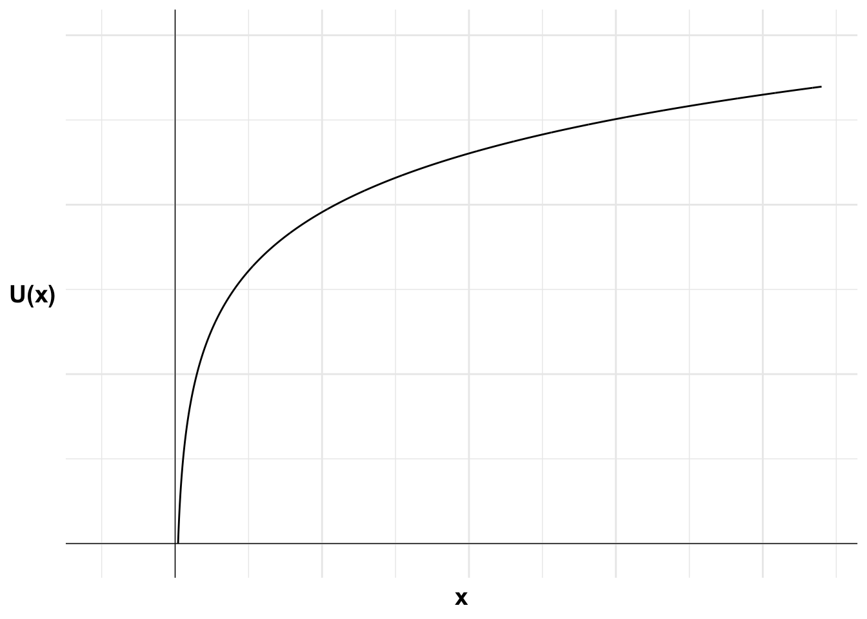

Insurance with risk neutral expected utility maximiser
$$u\left(x\right)=x$$

Slide 8

Insurance with risk neutral expected utility maximiser
$$u\left(x\right)=x$$
$$𝔼\left[I\right]=−R$$
$$=−\$1100$$

Slide 9

Insurance with risk neutral expected utility maximiser
$$u\left(x\right)=x$$
$$𝔼\left[¬I\right]=p × \left(−H\right)$$

Slide 10

Insurance with risk neutral expected utility maximiser
$$u\left(x\right)=x$$
$$𝔼\left[¬I\right]=p × \left(−H\right)$$
$$=−0.001 × 1 000 000$$
$$=−\$1000$$

Slide 11

Insurance with risk neutral expected utility maximiser
$$u\left(x\right)=x$$
$$𝔼\left[¬I\right]=−\$1000>−\$1100=𝔼\left[I\right]$$

Slide 12

Insurance with risk averse expected utility maximiser
$$u\left(x\right)=ln\left(x\right) W=H+\$10 000$$

Slide 13

Insurance with risk averse expected utility maximiser
$$u\left(x\right)=ln\left(x\right) W=H+\$10 000$$
$$𝔼\left[U\left(I\right)\right]=u\left(W−R\right)$$

Slide 14

Insurance with risk averse expected utility maximiser
$$u\left(x\right)=ln\left(x\right) W=H+\$10 000$$
$$𝔼\left[U\left(I\right)\right]=u\left(W−R\right)$$
$$=ln\left(1 010 000−1100\right)$$
$$=13.8244$$

Slide 15

Insurance with risk averse expected utility maximiser
$$u\left(x\right)=ln\left(x\right) W=H+\$10,000$$
$$𝔼\left[U\left(¬I\right)\right]=p × u\left(W−H\right)+\left(1−p\right) × u\left(W\right)$$

Slide 16

Insurance with risk averse expected utility maximiser
$$u\left(x\right)=ln\left(x\right) W=H+\$10 000$$
$$𝔼\left[U\left(¬I\right)\right]=p × u\left(W−H\right)+\left(1−p\right) × u\left(W\right)$$
$$=0.001 × ln\left(1 010 000−1 000 000\right)+0.999 × ln\left(1 010 000\right)$$
$$=13.8208$$

Slide 17

Insurance with risk averse expected utility maximiser
$$u\left(x\right)=ln\left(x\right) W=H+\$10 000$$
$$𝔼\left[U\left(I\right)\right]=13.8244>13.8208=𝔼\left[U\left(¬I\right)\right]$$

Slide 18
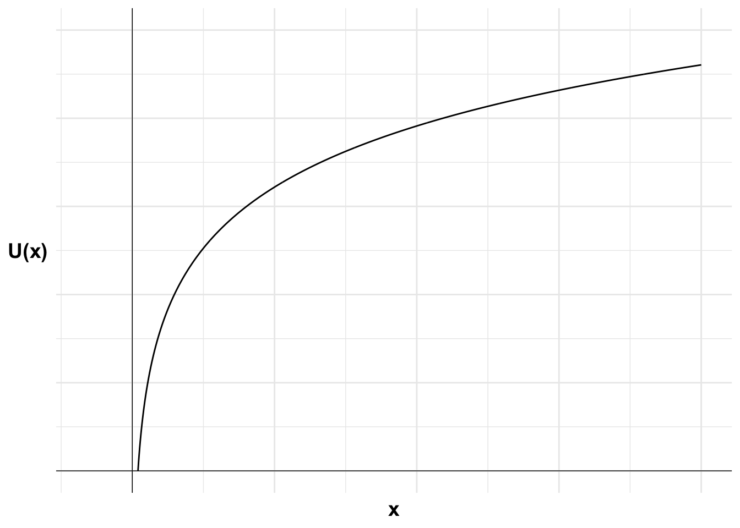
Insurance with risk averse expected utility maximiser

Slide 19
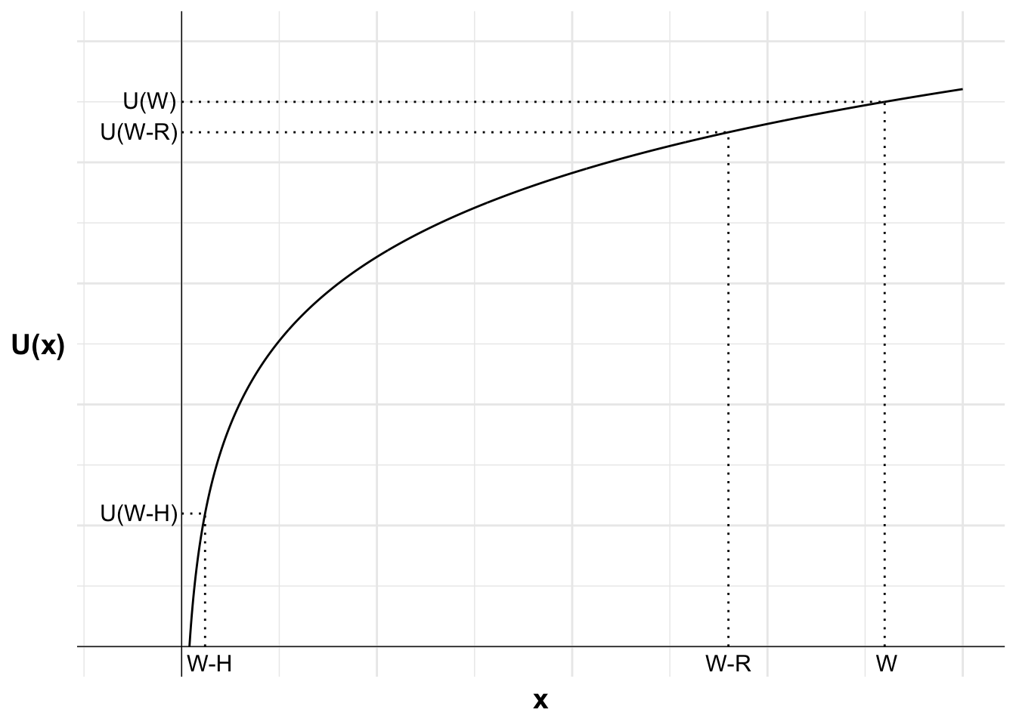
Insurance with risk averse expected utility maximiser

Slide 20
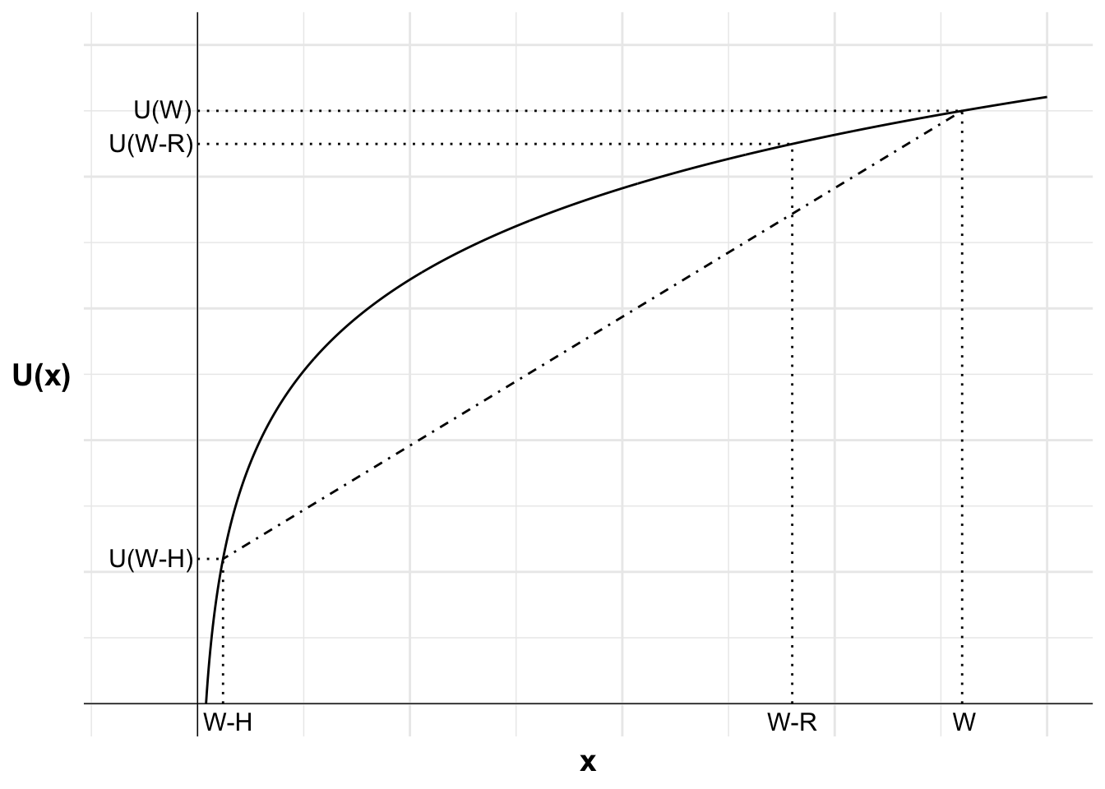
Insurance with risk averse expected utility maximiser

Slide 21
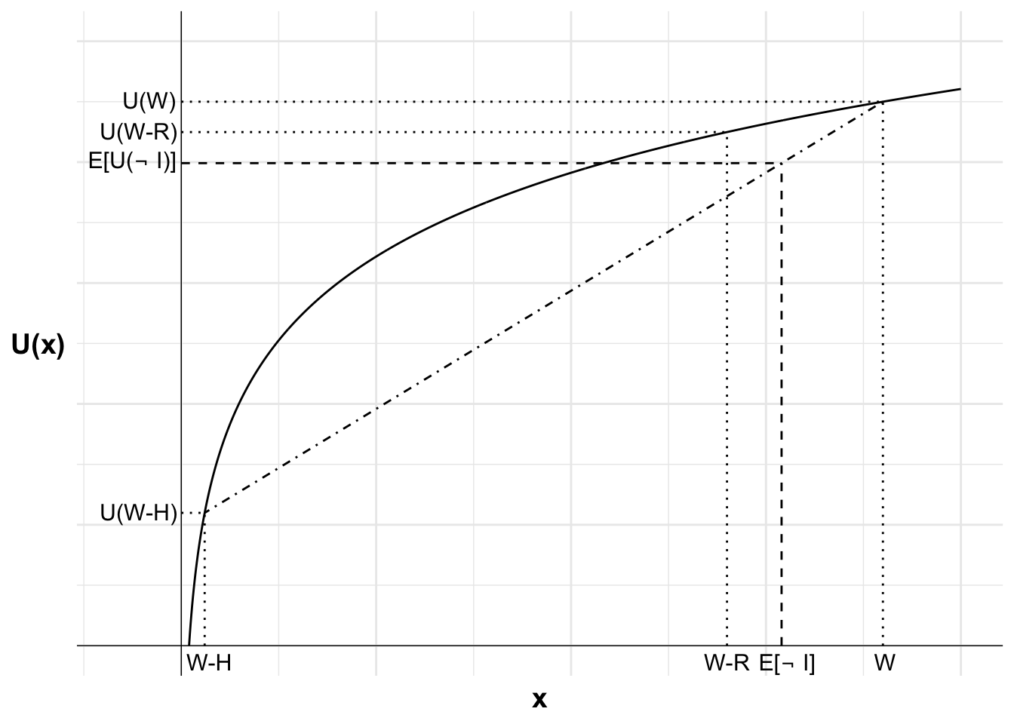
Insurance with risk averse expected utility maximiser

Slide 22
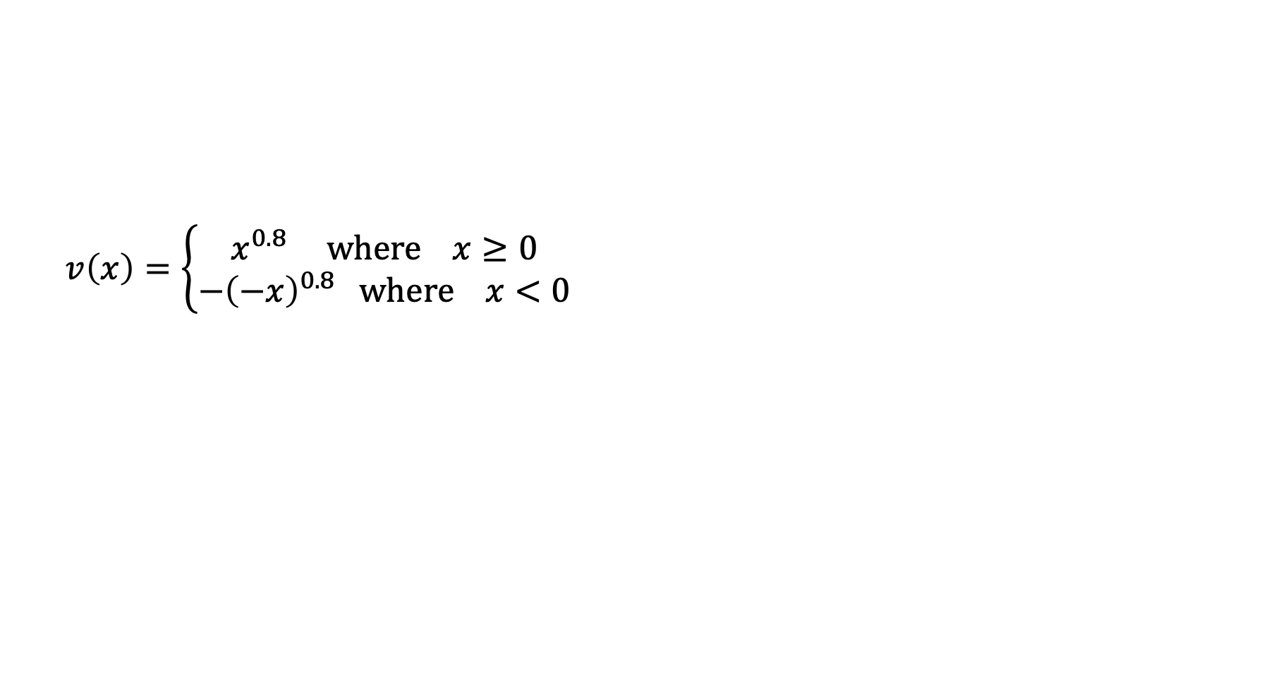
Insurance with the reflection effect
$$v\left(x\right)=\left\{\begin{aligned}x^{0.8} where x≥0 \\ −{\left(−x\right)}^{0.8} where x<0\end{aligned}\right.$$

Slide 23
Insurance with the reflection effect
Buy insurance
-H
-R
0
House fire
Reference point

Slide 24
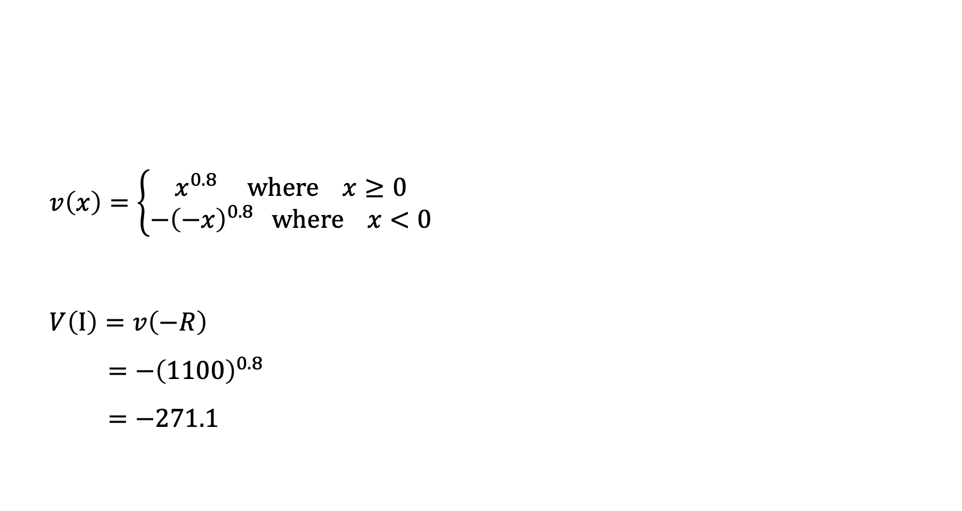
Insurance with the reflection effect
$$v\left(x\right)=\left\{\begin{aligned}x^{0.8} where x≥0 \\ −{\left(−x\right)}^{0.8} where x<0\end{aligned}\right.$$
$$V\left(I\right)=v\left(−R\right)$$
$$=−{\left(1100\right)}^{0.8}$$
$$=−271.1$$

Slide 25
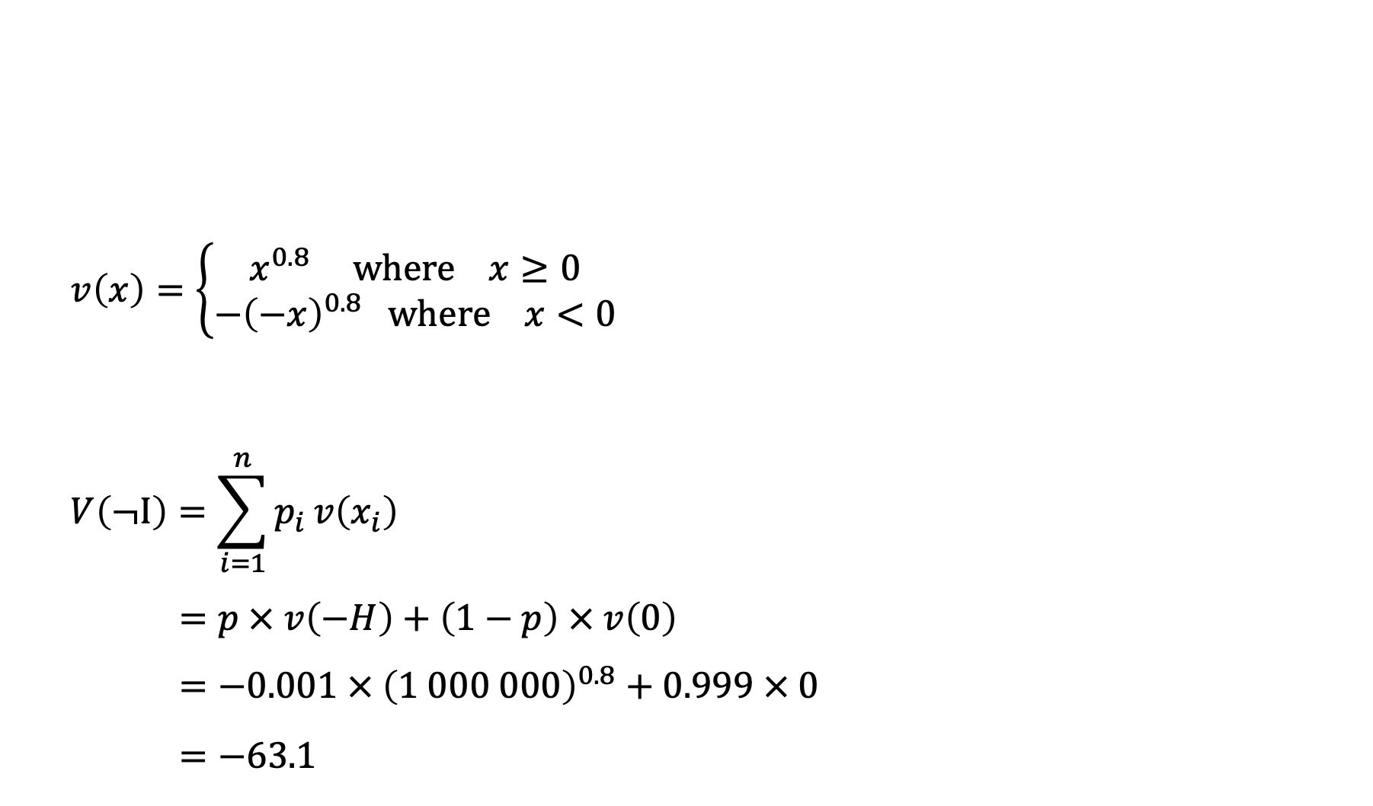
Insurance with the reflection effect
$$v\left(x\right)=\left\{\begin{aligned}x^{0.8} where x≥0 \\ −{\left(−x\right)}^{0.8} where x<0\end{aligned}\right.$$
$$V\left(¬I\right)=\sum_{i=1}^{n}{p_{i}}v\left(x_{i}\right)$$
$$=p × v\left(−H\right)+\left(1−p\right) × v\left(0\right)$$
$$=−0.001 × {\left(1 000 000\right)}^{0.8}+0.999 × 0$$
$$=−63.1$$

Slide 26
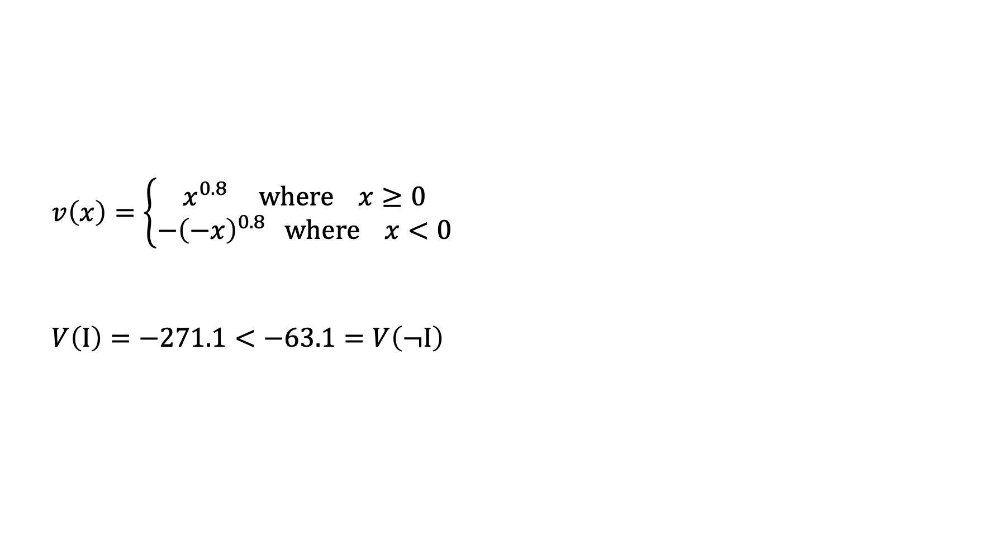
Insurance with the reflection effect
$$v\left(x\right)=\left\{\begin{aligned}x^{0.8} where x≥0 \\ −{\left(−x\right)}^{0.8} where x<0\end{aligned}\right.$$
$$V\left(I\right)=−271.1<−63.1=V\left(¬I\right)$$

Slide 27
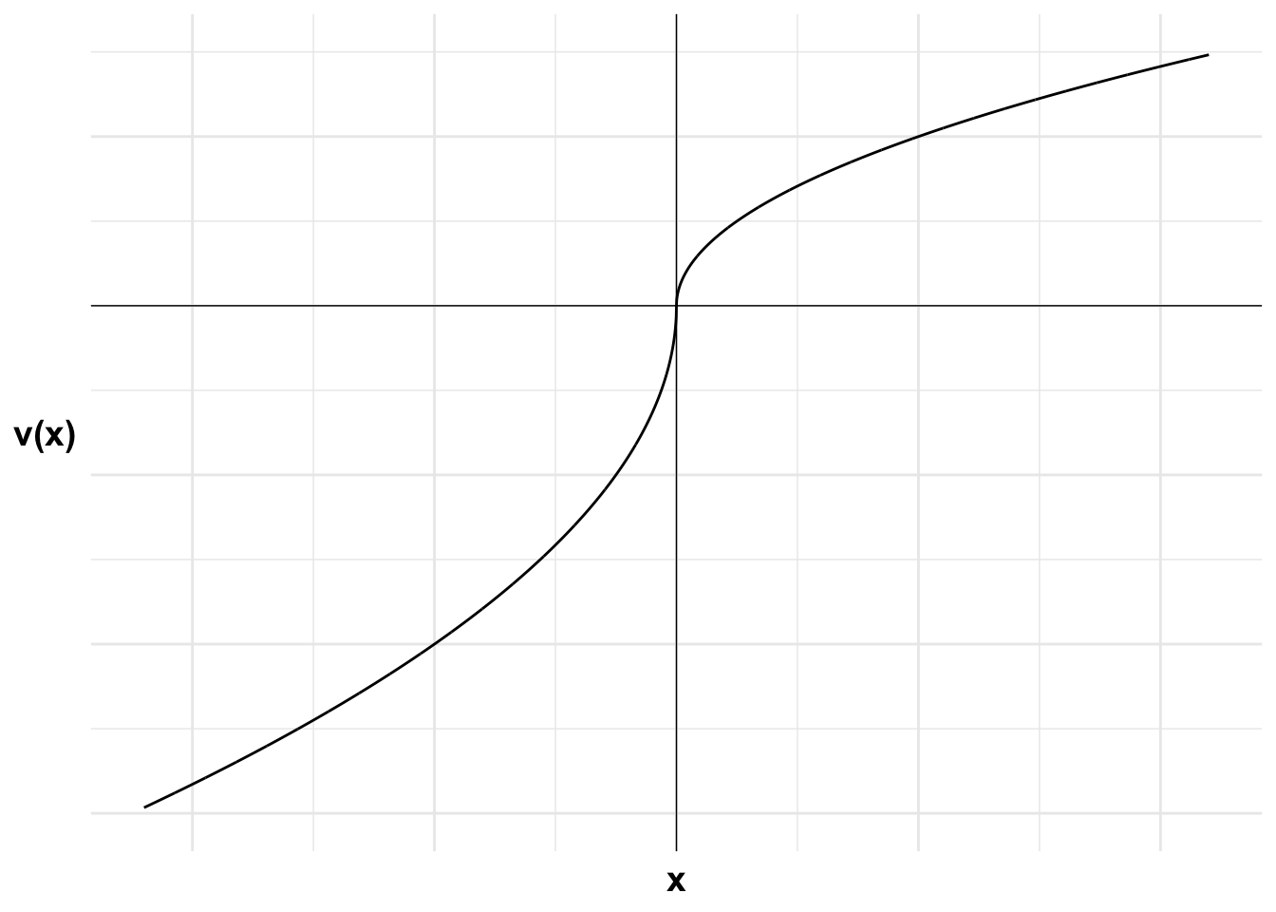
Insurance with the reflection effect

Slide 28
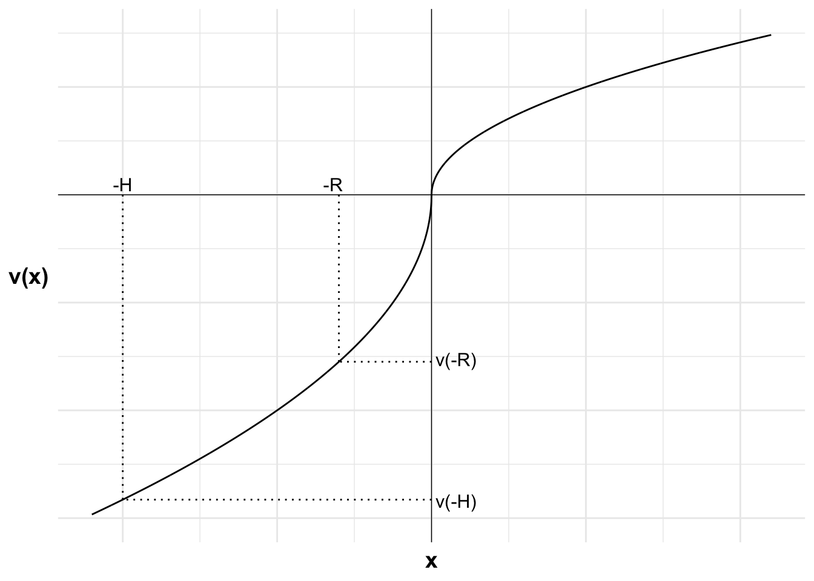
Insurance with the reflection effect

Slide 29
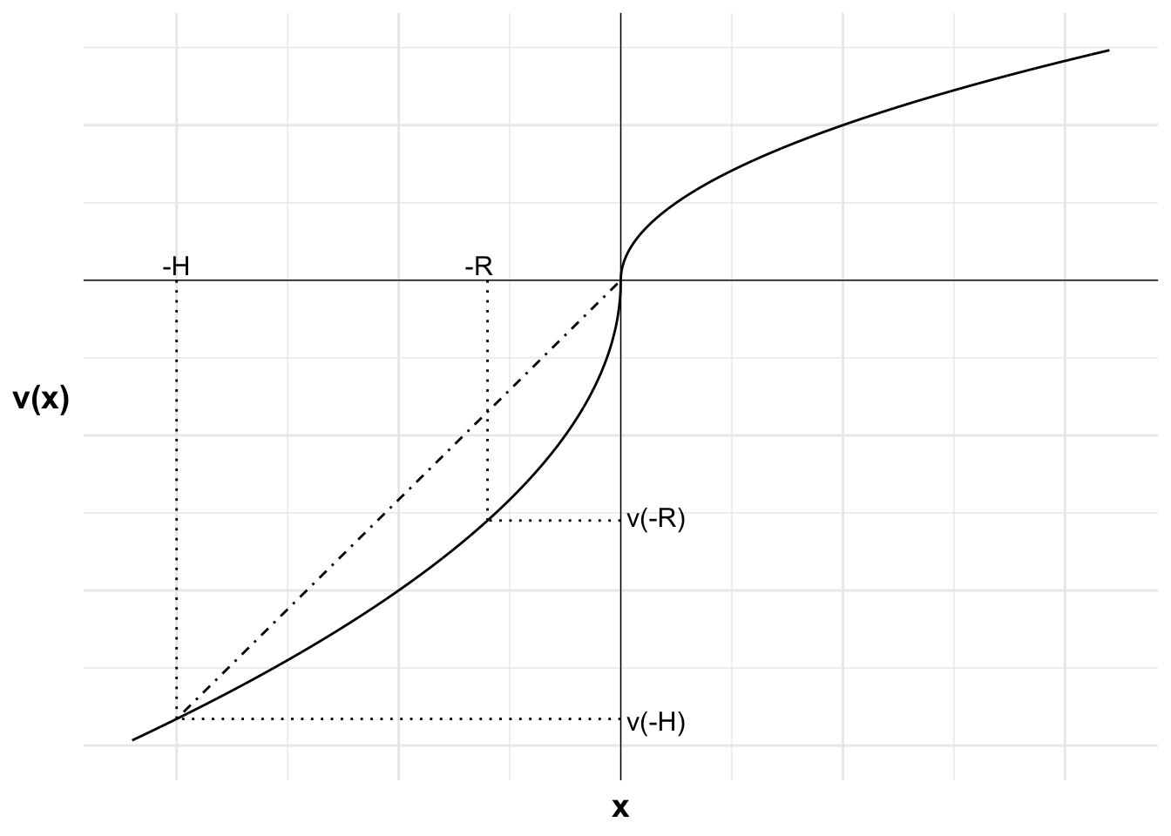
Insurance with the reflection effect

Slide 30
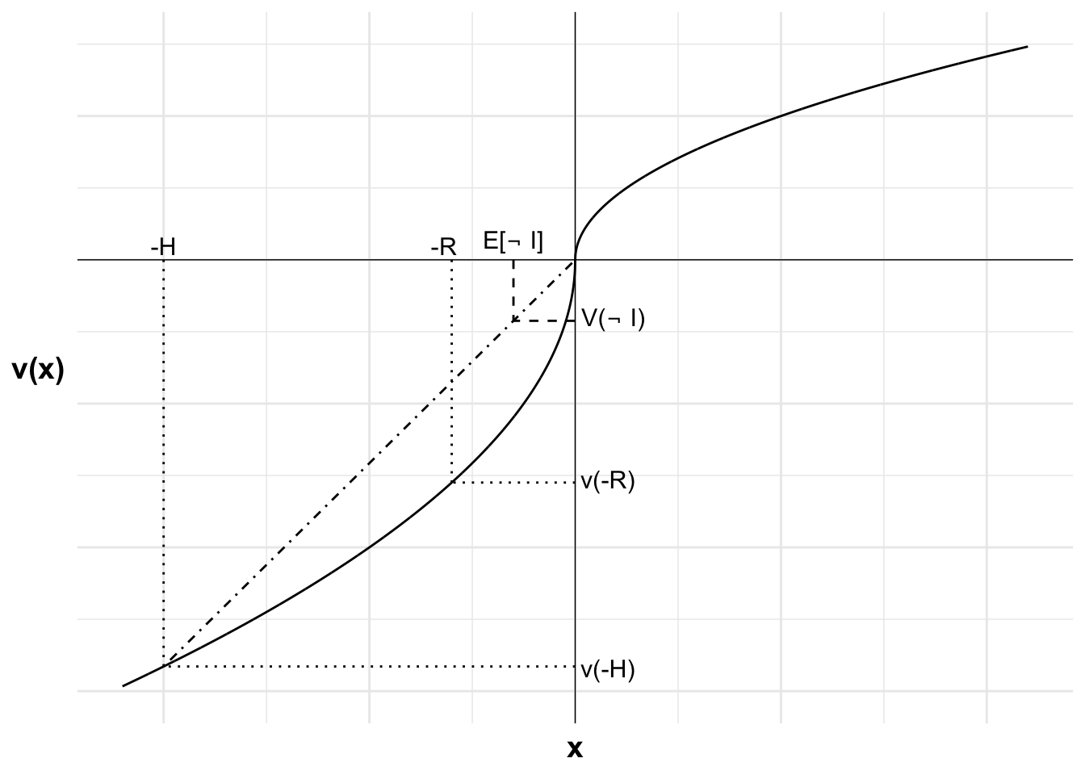
Insurance with the reflection effect

Slide 31
Insurance with probability weighting
Decision weights:
Probability $\left(p\right)$ | 0.001 | 0.01 | 0.1 | 0.25 | 0.5 | 0.75 | 0.90 | 0.99 | 0.999
Weight $π\left(p\right)$ | 0.01 | 0.05 | 0.15 | 0.3 | 0.5 | 0.7 | 0.85 | 0.95 | 0.99

Slide 32
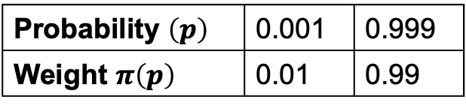
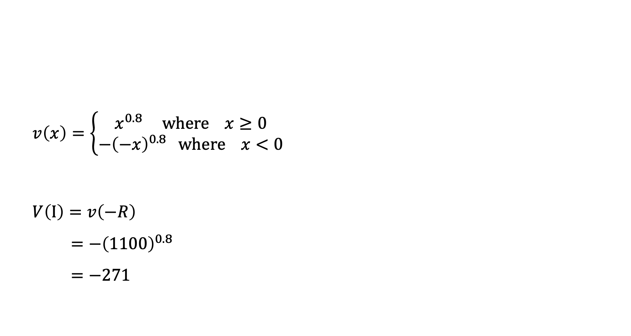
Insurance with probability weighting
$$v\left(x\right)=\left\{\begin{aligned}x^{0.8} where x≥0 \\ −{\left(−x\right)}^{0.8} where x<0\end{aligned}\right.$$
$$V\left(I\right)=v\left(−R\right)$$
$$=−{\left(1100\right)}^{0.8}$$
$$=−271$$
Probability $\left(p\right)$ | 0.001 | 0.999
Weight $π\left(p\right)$ | 0.01 | 0.99

Slide 33
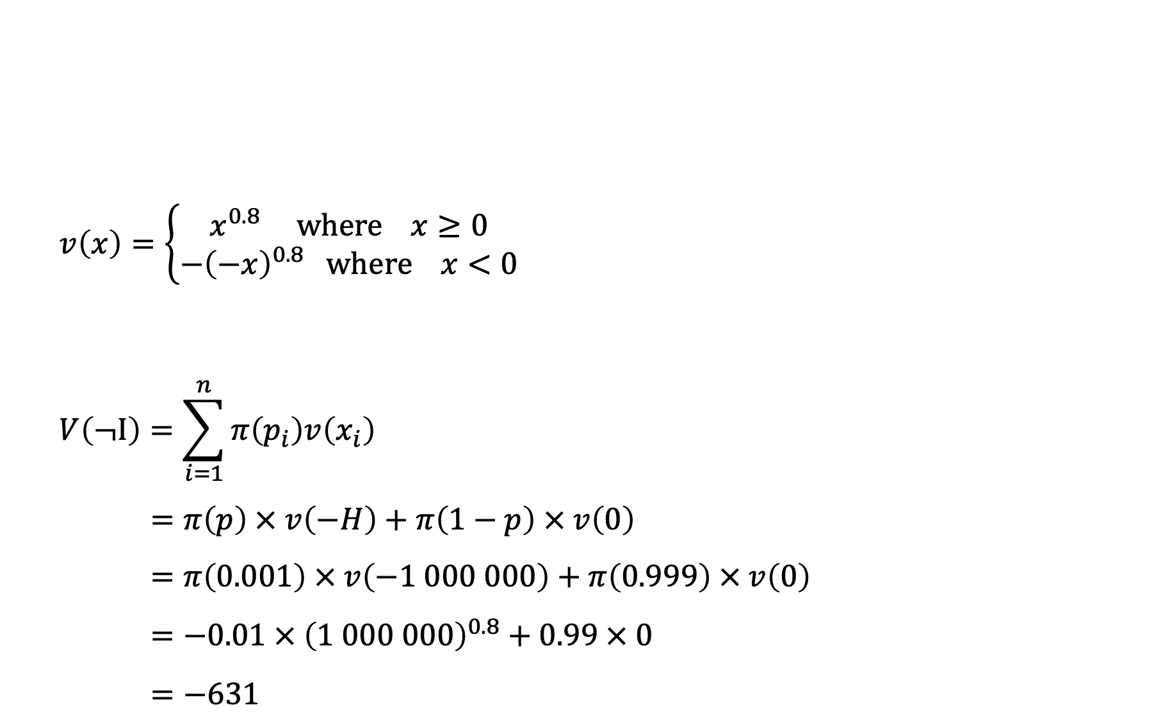
Insurance with probability weighting
$$v\left(x\right)=\left\{\begin{aligned}x^{0.8} where x≥0 \\ −{\left(−x\right)}^{0.8} where x<0\end{aligned}\right.$$
$$V\left(¬I\right)=\sum_{i=1}^{n}{π\left(p_{i}\right)v\left(x_{i}\right)}$$
$$=π\left(p\right) × v\left(−H\right)+π\left(1−p\right) × v\left(0\right)$$
$$=π\left(0.001\right) × v\left(−1 000 000\right)+π\left(0.999\right) × v\left(0\right)$$
$$=−0.01 × {\left(1 000 000\right)}^{0.8}+0.99 × 0$$
$$=−631$$
Probability $\left(p\right)$ | 0.001 | 0.999
Weight $π\left(p\right)$ | 0.01 | 0.99

Slide 34
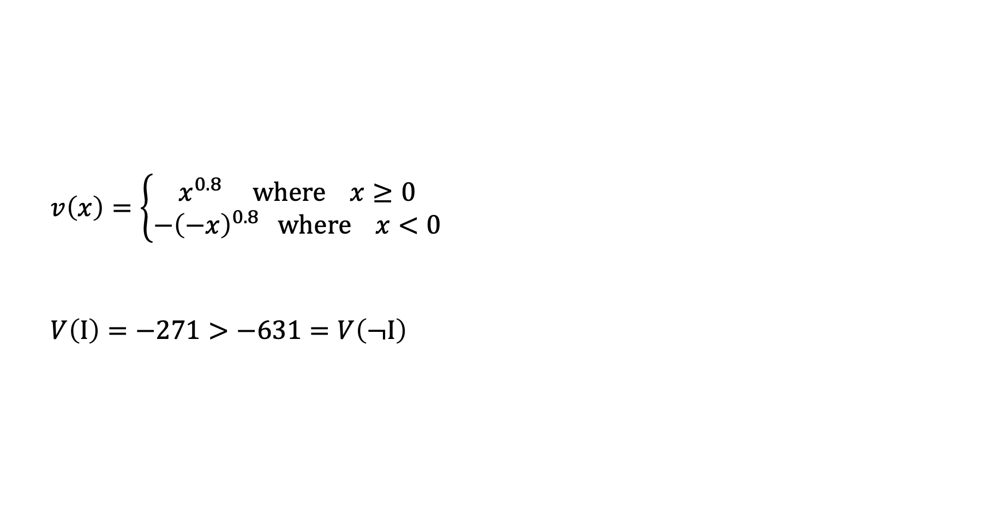
Insurance with probability weighting
$$v\left(x\right)=\left\{\begin{aligned}x^{0.8} where x≥0 \\ −{\left(−x\right)}^{0.8} where x<0\end{aligned}\right.$$
$$V\left(I\right)=−271>−631=V\left(¬I\right)$$
Probability $\left(p\right)$ | 0.001 | 0.999
Weight $π\left(p\right)$ | 0.01 | 0.99

