Slide 1

Exponential discounting examples
Notes on Behavioural Economics
Jason Collins

Slide 2

$100 today or $110 next week
$$δ=0.95$$
$$u\left(x_{n}\right)=x_{n}$$

Slide 3

$100 today or $110 next week
$$δ=0.95$$
$$u\left(x_{n}\right)=x_{n}$$
Choice 1: $100 today or $110 next week

Slide 4

$100 today or $110 next week
$$U_{0}\left(0, \$100\right)=u\left(\$100\right)$$
$$=100$$

Slide 5

$100 today or $110 next week
$$U_{0}\left(0, \$100\right)=u\left(\$100\right)$$
$$=100$$
$$U_{0}\left(1,\$110\right)=δu\left(\$110\right)$$
$$=0.95 × 110$$
$$=104.50$$

Slide 6

$100 today or $110 next week
$$U_{0}\left(0, \$100\right)=100<104.50=U_{0}\left(1,\$110\right)$$

Slide 7
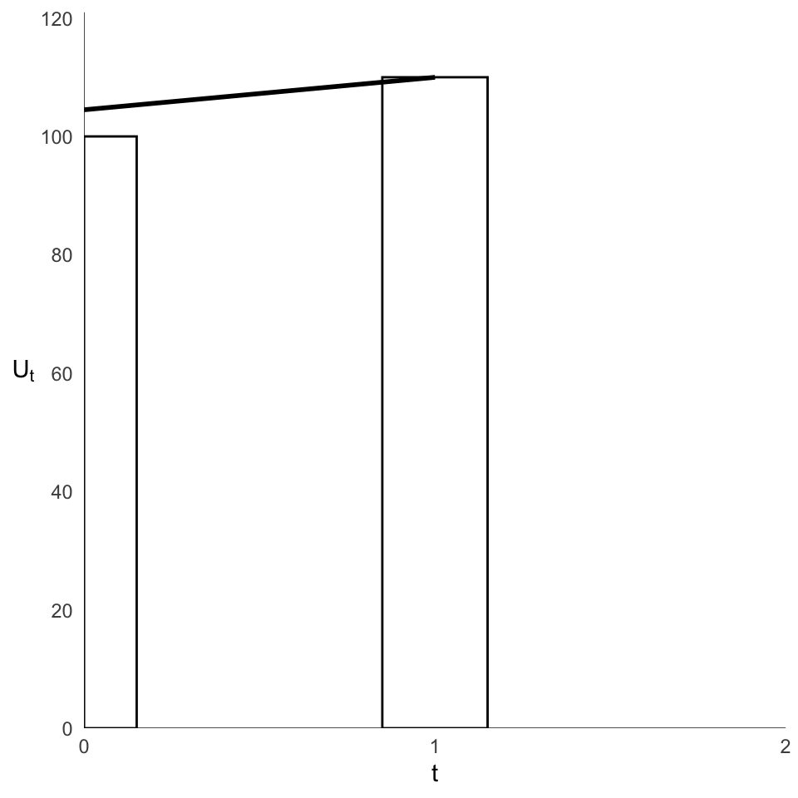
$100 today or $110 next week

Slide 8

$100 next week or $110 in two weeks
$$δ=0.95$$
$$u\left(x_{n}\right)=x_{n}$$
Choice 2: $100 next week or $110 in two weeks

Slide 9

$100 next week or $110 in two weeks
$$U_{0}\left(1,\$100\right)=δu\left(\$100\right)$$
$$=0.95 × 100$$
$$=95$$

Slide 10
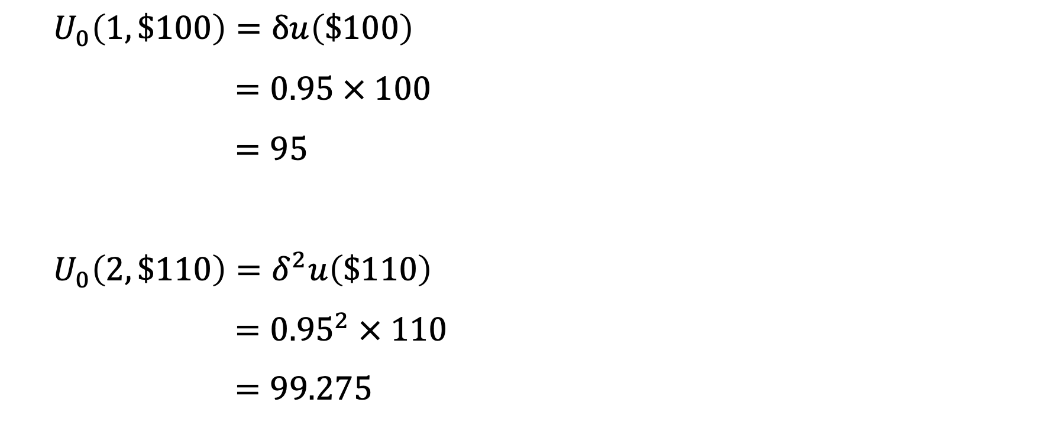
$100 next week or $110 in two weeks
$$U_{0}\left(1,\$100\right)=δu\left(\$100\right)$$
$$=0.95 × 100$$
$$=95$$
$$U_{0}\left(2,\$110\right)=δ^{2}u\left(\$110\right)$$
$$={0.95}^{2} × 110$$
$$=99.275$$

Slide 11

$100 next week or $110 in two weeks
$$U_{0}\left(1, \$100\right)=95<99.275=U_{0}\left(2,\$110\right)$$

Slide 12
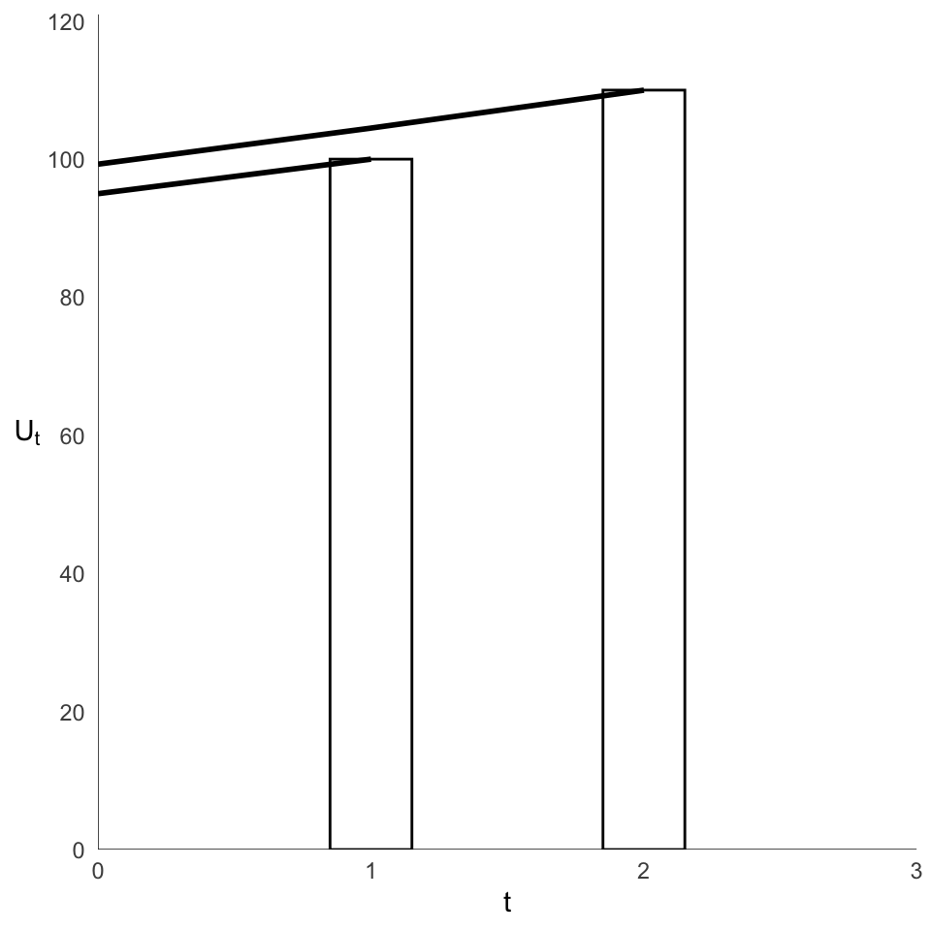
$100 next week or $110 in two weeks

Slide 13
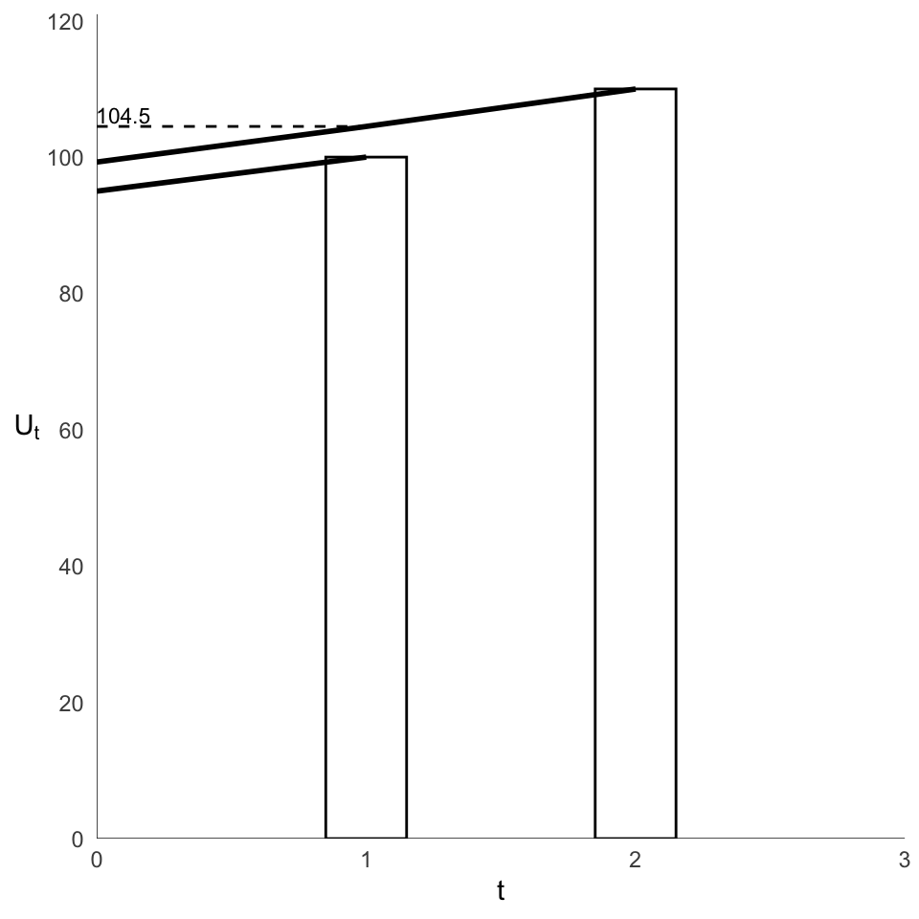
$100 next week or $110 in two weeks

Slide 14

$100 next week or $110 in two weeks

Slide 15
How much for a one-year delay?
$$δ=0.95$$
$$u\left(x_{n}\right)=x_{n}$$

Slide 16
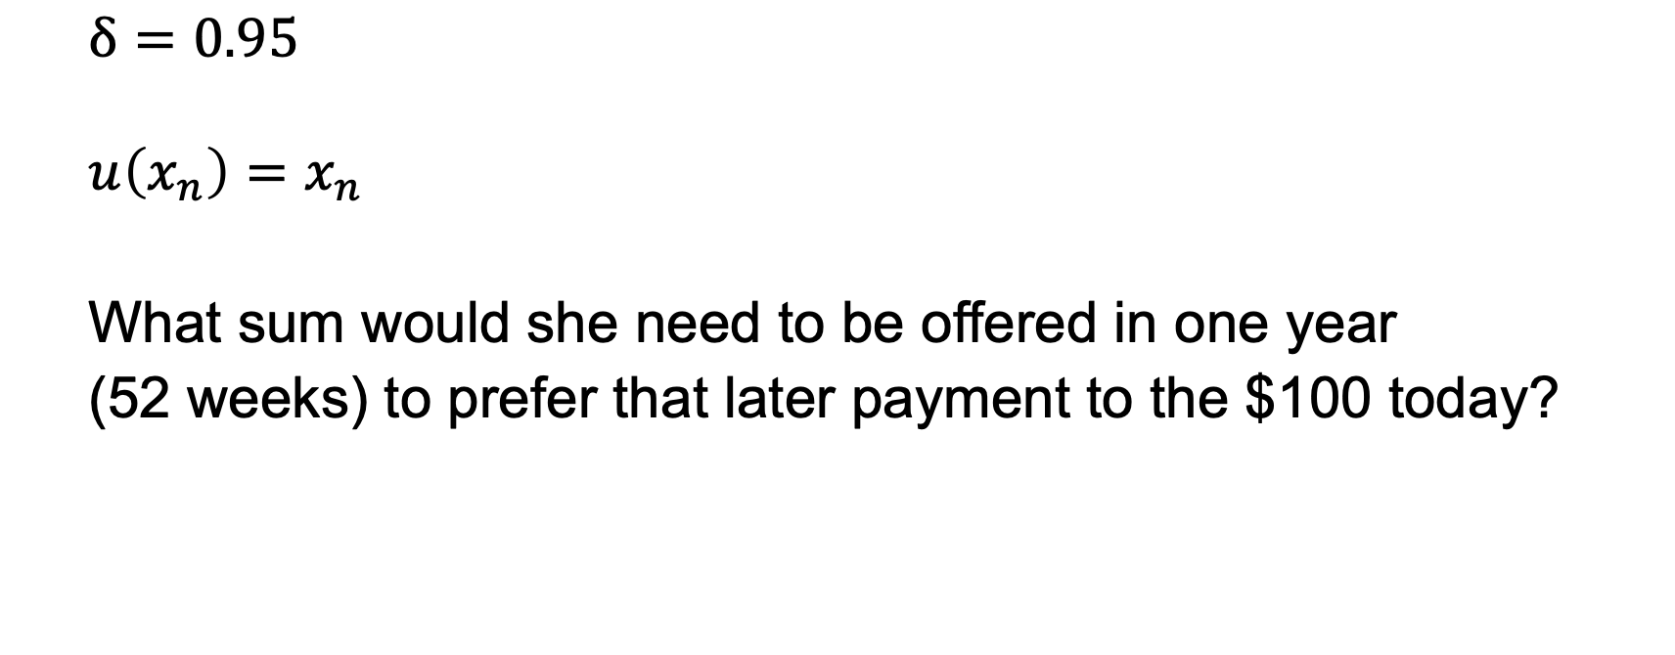
How much for a one-year delay?
$$δ=0.95$$
$$u\left(x_{n}\right)=x_{n}$$
What sum would she need to be offered in one year (52 weeks) to prefer that later payment to the $100 today?

Slide 17
How much for a one-year delay?
$$U_{0}\left(0,\$100\right)=u\left(\$100\right)$$
$$=100$$

Slide 18

How much for a one-year delay?
$$U_{0}\left(0,\$100\right)=u\left(\$100\right)$$
$$=100$$
$$U_{0}\left(52,\$y\right)=δ^{52}u\left(\$y\right)$$
$$={0.95}^{52} × y$$

Slide 19

How much for a one-year delay?
$$U_{0}\left(52,\$y\right)>100$$

Slide 20

How much for a one-year delay?
$$U_{0}\left(52,\$y\right)>100$$
$${0.95}^{52} × y>100$$

Slide 21

How much for a one-year delay?
$$U_{0}\left(52,\$y\right)>100$$
$${0.95}^{52} × y>100$$
$$y>\frac{100}{{0.95}^{52}}$$

Slide 22

How much for a one-year delay?
$$U_{0}\left(52,\$y\right)>100$$
$${0.95}^{52} × y>100$$
$$y>\frac{100}{{0.95}^{52}}$$
$$y>\$1440.03$$

Slide 23
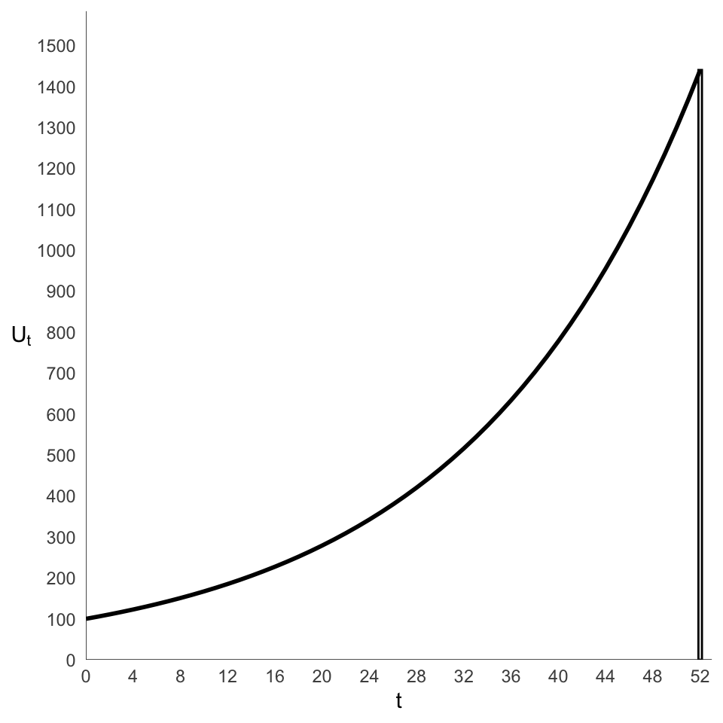
How much for a one-year delay?

Slide 24

$10 in five days or $20 in 10 days?
$$δ=0.75$$
$$u\left(x_{n}\right)=x_{n}$$

Slide 25

$10 in five days or $20 in 10 days?
$$δ=0.75$$
$$u\left(x_{n}\right)=x_{n}$$
$10 in five days (t = 5) or $20 in 10 days (t = 10)?

Slide 26

$10 in five days or $20 in 10 days?
$$U_{0}\left(5, \$10\right)=δ^{5}u\left(\$10\right)$$
$$={0.75}^{5} × 10$$
$$=2.37$$

Slide 27
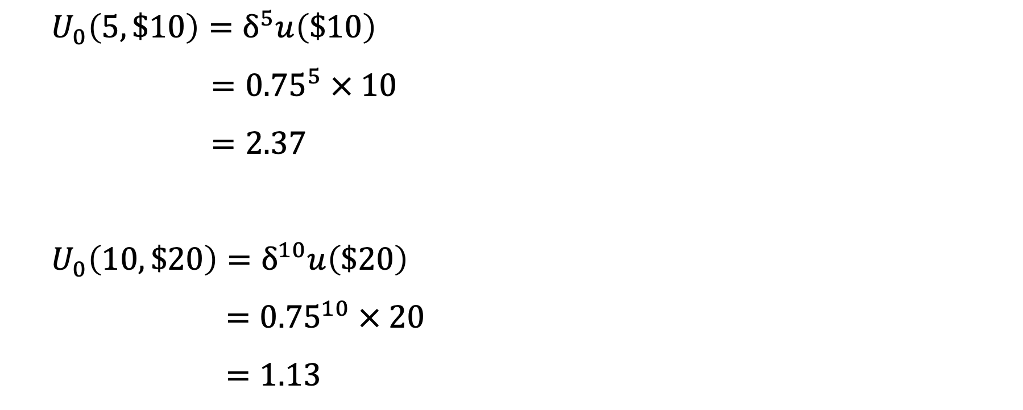
$10 in five days or $20 in 10 days?
$$U_{0}\left(5, \$10\right)=δ^{5}u\left(\$10\right)$$
$$={0.75}^{5} × 10$$
$$=2.37$$
$$U_{0}\left(10, \$20\right)=δ^{10}u\left(\$20\right)$$
$$={0.75}^{10} × 20$$
$$=1.13$$

Slide 28

$10 in five days or $20 in 10 days?
$$U_{0}\left(5, \$10\right)=2.37>1.13=U_{0}\left(10,\$20\right)$$

Slide 29

$10 in five days or $20 in 10 days?
$$δ=0.95$$
$$u\left(x_{n}\right)=x_{n}$$
$10 in five days (t = 5) or $20 in 10 days (t = 10)?

Slide 30

$10 in five days or $20 in 10 days?
$$U_{0}\left(5, \$10\right)=δ^{5}u\left(\$10\right)$$
$$={0.95}^{5}×10$$
$$=7.74$$

Slide 31
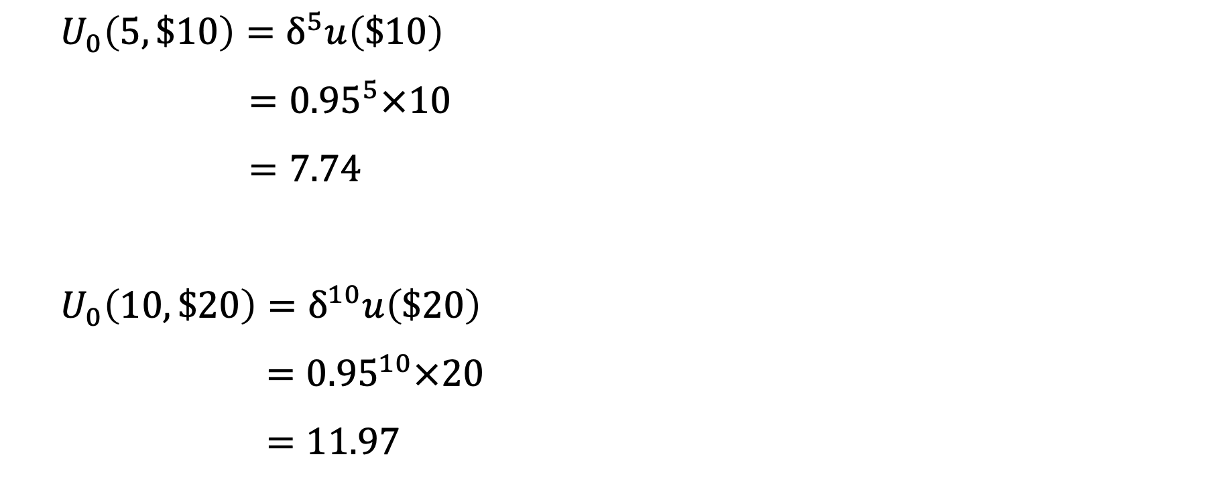
$10 in five days or $20 in 10 days?
$$U_{0}\left(5, \$10\right)=δ^{5}u\left(\$10\right)$$
$$={0.95}^{5}×10$$
$$=7.74$$
$$U_{0}\left(10, \$20\right)=δ^{10}u\left(\$20\right)$$
$$={0.95}^{10}×20$$
$$=11.97$$

Slide 32

$10 in five days or $20 in 10 days?
$$U_{0}\left(5, \$10\right)=7.74<11.97=U_{0}\left(10,\$20\right)$$

Slide 33
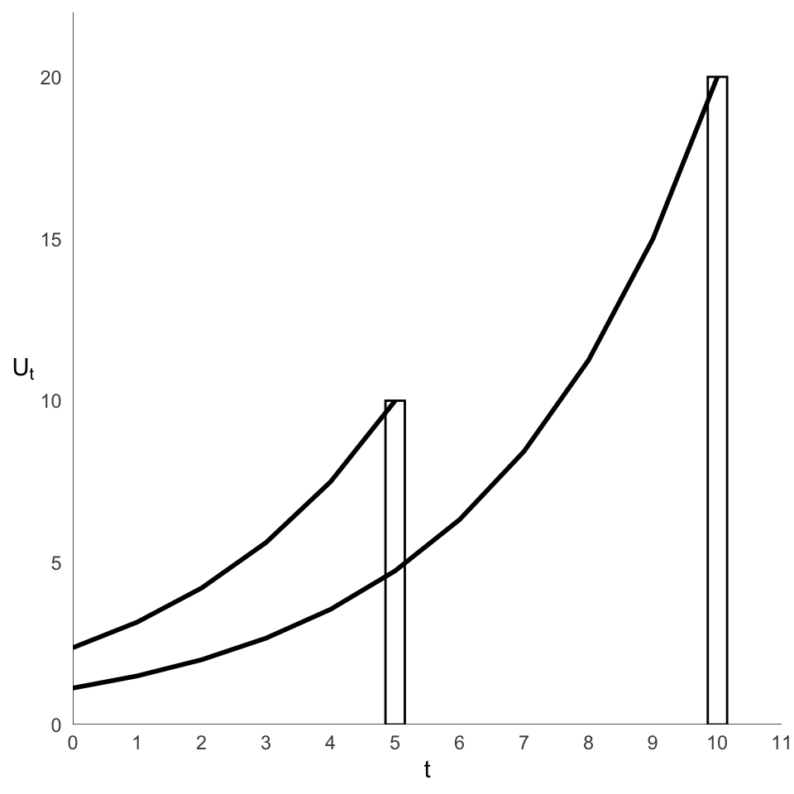
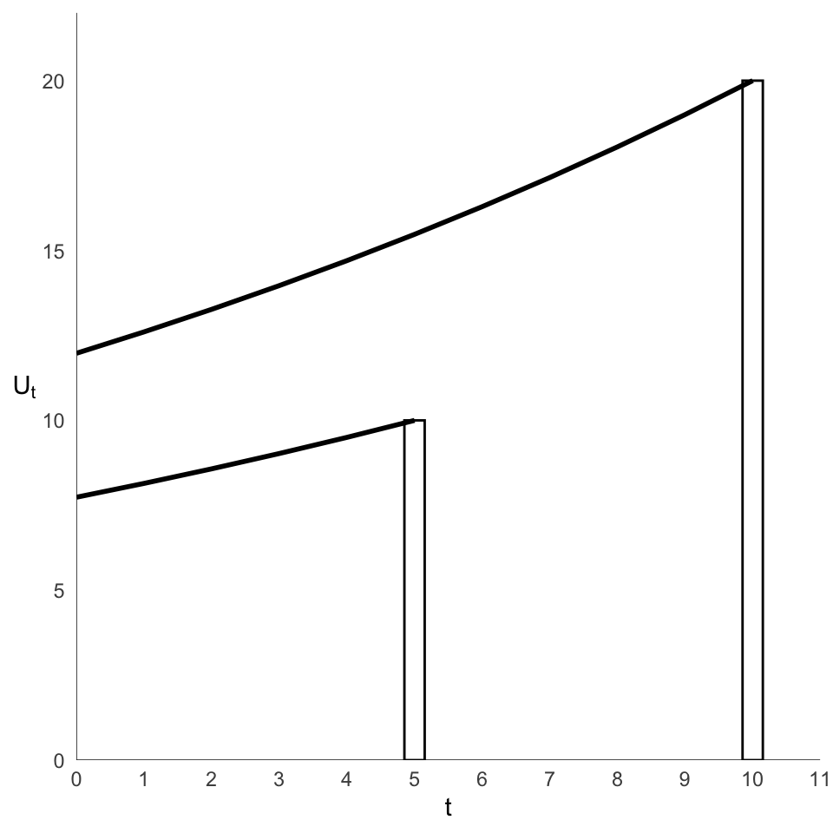


$10 in five days or $20 in 10 days?
$$δ=0.75$$
$$δ=0.95$$

