Slide 1

Exponential discounting
Notes on Behavioural Economics
Jason Collins

Slide 2

Discount factor:
$$δ$$

Slide 3

Discount factor:
$$δ$$
$$0≤δ≤1$$

Slide 4

Discount rate:
$$r$$

Slide 5

Discount rate:
$$r$$
$$δ=\frac{1}{1+r}$$

Slide 6
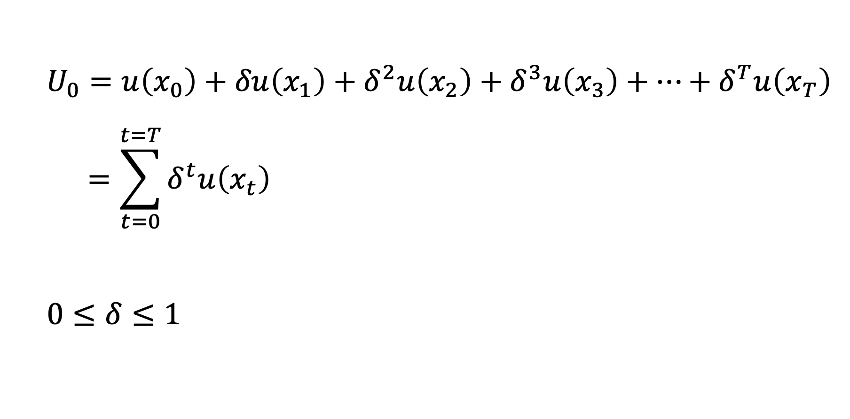
$$U_{0}=u\left(x_{0}\right)+δu\left(x_{1}\right)+δ^{2}u\left(x_{2}\right)+δ^{3}u\left(x_{3}\right)+…+δ^{T}u\left(x_{T}\right)$$
$$=\sum_{t=0}^{t=T}{δ^{t}u\left(x_{t}\right)}$$
$$0≤δ≤1$$

Slide 7

Discount progression:
1, $δ$, $δ^{2}$, $δ^{3}$, $δ^{4}$

Slide 8
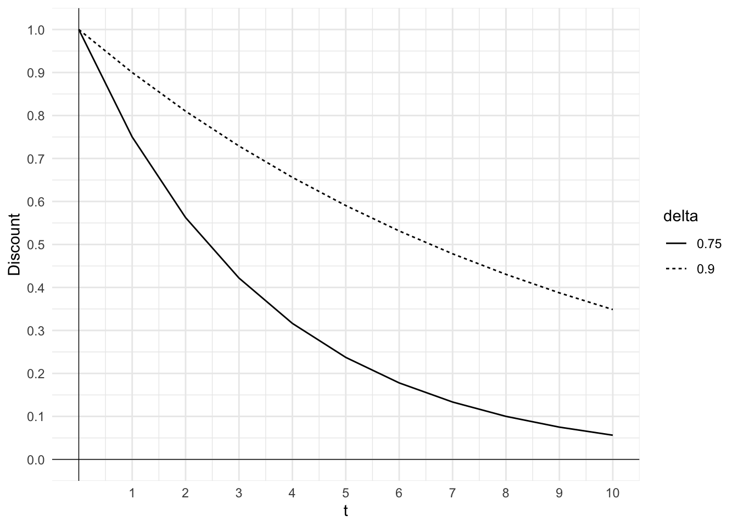

Slide 9
Assumptions
Time−consistency
Consumption independence
Stationary preferences
Utility Independence

Slide 10
Time-consistency
Would you like $100 today or $110 next week?
Would you like $100 next week or $110 in two weeks?

Slide 11

Consumption independence
$$x=x_{1}+x_{2}​+x_{3}​+…+x_{n}$$

Slide 12

Stationary preferences
$$U_{t}=U_{t+k}​$$

Slide 13
Assumptions
Time−consistency
Consumption independence
Stationary preferences
Utility Independence

