Slide 1

Intertemporal choice
Notes on Behavioural Economics
Jason Collins

Slide 2
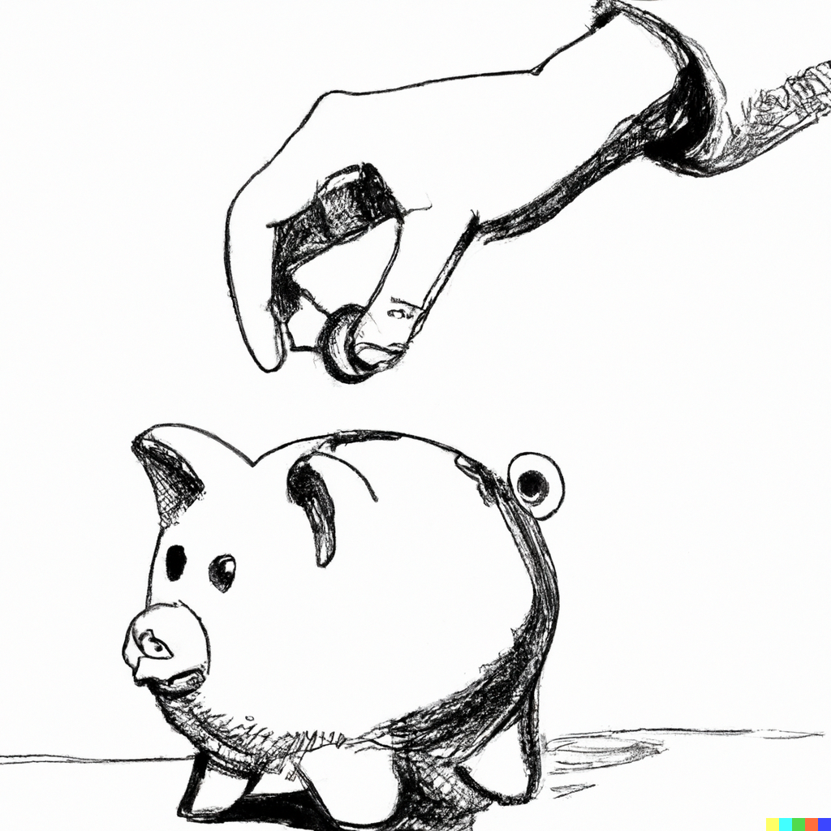

Slide 3

Stream:
$$S=\left(t_{1}, x_{1};{t_{2}, x}_{2};…;t_{n},x_{n}\right)$$

Slide 4

$$S_{1}=\left(0, \$100;1, 0\right)$$
$$S_{2}=(0, 0; 1, \$107)$$

