Slide 1

Present bias examples
Notes on Behavioural Economics
Jason Collins

Slide 2
$100 today or $110 next week?
$100 next week or $110 in two weeks?

Slide 3

Exponential discounter
$$δ=0.95$$
$$u\left(x_{n}\right)=x_{n}$$

Slide 4
$100 today or $110 next week?

Slide 5

$100 today or $110 next week?
$$U_{0}\left(0, \$100\right)=100<104.5<U_{0}\left(1,\$110\right)$$

Slide 6
$100 next week or $110 in two weeks?

Slide 7
$100 next week or $110 in two weeks?

Slide 8

$100 next week or $110 in two weeks?
$$U_{0}\left(1,\$100\right)=95<99.275=U_{0}\left(2,\$110\right)$$

Slide 9

Present biased agent
$$β=0.95$$
$$δ=0.95$$
$$u\left(x_{n}\right)=x_{n}$$

Slide 10
$100 today or $110 next week?

Slide 11

$100 today or $110 next week?
$$U_{0}\left(0,\$100\right)=u\left(\$100\right)$$
$$=100$$

Slide 12

$100 today or $110 next week?
$$U_{0}\left(1,\$110\right)=u\left(x_{0}\right)+βδu\left(x_{1}\right)$$
$$=βδu\left(\$110\right)$$
$$=0.95 × 0.95 × 110$$
$$=99.275$$

Slide 13

$100 today or $110 next week?
$$U_{0}\left(0,\$100\right)=100>99.275=U_{0}\left(1,\$110\right)$$

Slide 14
$100 next week or $110 in two weeks?

Slide 15
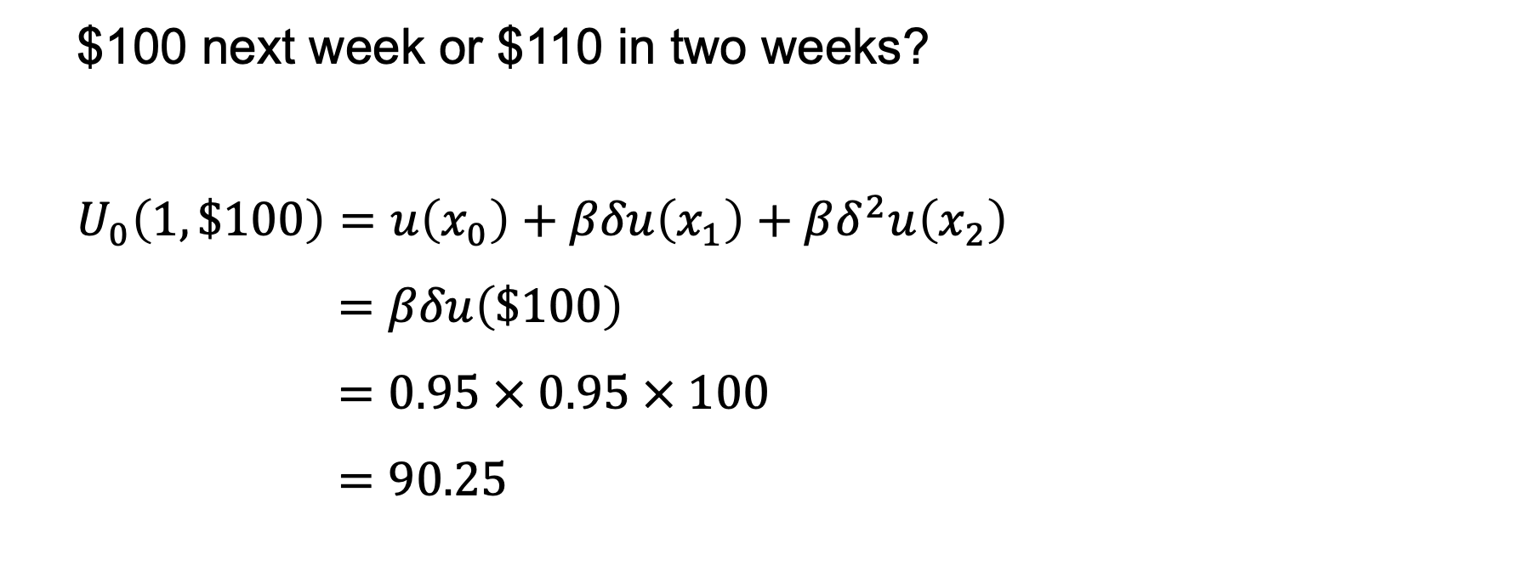
$100 next week or $110 in two weeks?
$$U_{0}\left(1,\$100\right)=u\left(x_{0}\right)+βδu\left(x_{1}\right)+βδ^{2}u\left(x_{2}\right)$$
$$=βδu\left(\$100\right)$$
$$=0.95 × 0.95 × 100$$
$$=90.25$$

Slide 16
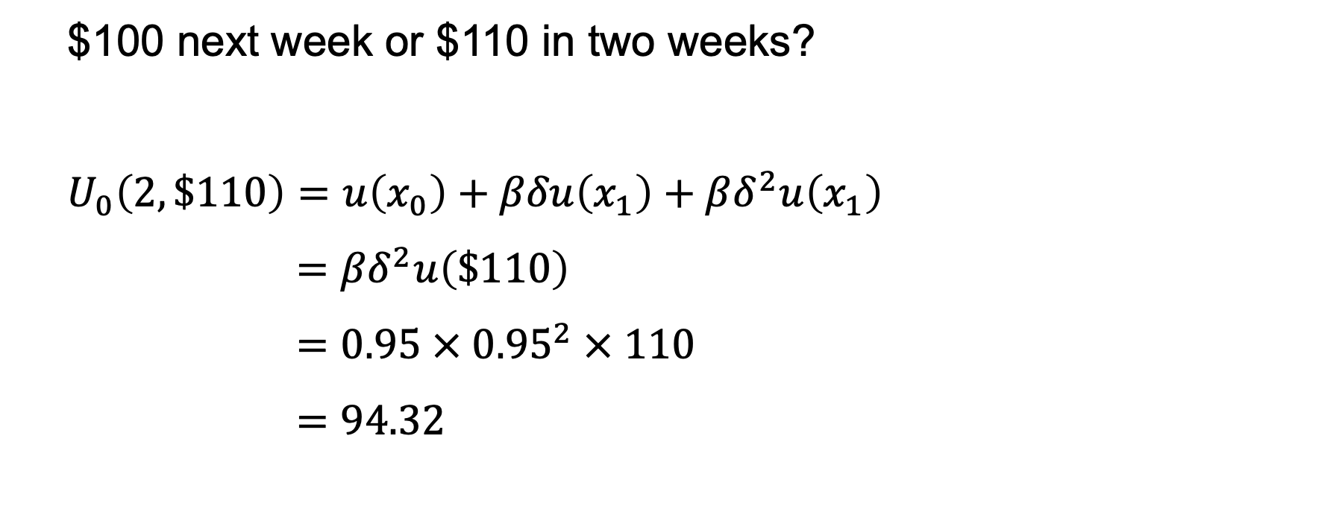
$100 next week or $110 in two weeks?
$$U_{0}\left(2,\$110\right)=u\left(x_{0}\right)+βδu\left(x_{1}\right)+βδ^{2}u\left(x_{1}\right)$$
$$={βδ}^{2}u\left(\$110\right)$$
$$=0.95 × {0.95}^{2} × 110$$
$$=94.32$$

Slide 17

$100 next week or $110 in two weeks?
$$U_{0}\left(1,\$100\right)=90.25<94.32=U_{0}\left(2,\$110\right)$$

Slide 18

$$U_{0}\left(0,\$100\right)=100>99.275=U_{0}\left(1,\$110\right)$$
$$U_{0}\left(1,\$100\right)=90.25<94.32=U_{0}\left(2,\$110\right)$$

Slide 19


$$U_{t}$$
$$t$$

Slide 20

Present biased agent
$$β=0.75$$
$$δ=0.9$$
$$u\left(x_{n}\right)=x_{n}$$

Slide 21
$10 in five days (t = 5) or $20 in 10 days (t = 10)?

Slide 22

$10 in five days (t = 5) or $20 in 10 days (t = 10)?
$$U_{0}\left(5, \$10\right)=βδ^{5}u\left(\$10\right)$$
$$=0.75×{0.9}^{5}×10$$
$$=4.43$$

Slide 23

$10 in five days (t = 5) or $20 in 10 days (t = 10)?
$$U_{0}\left(10, \$20\right)={βδ}^{10}u\left(\$20\right)$$
$$=0.75×{0.9}^{10}×20$$
$$=5.23$$

Slide 24

$10 in five days (t = 5) or $20 in 10 days (t = 10)?
$$U_{0}\left(5, \$10\right)=4.43<5.23=U_{0}\left(10, \$20\right)$$

Slide 25
Five days pass and the agent is now asked if they would like to change their mind.

Slide 26
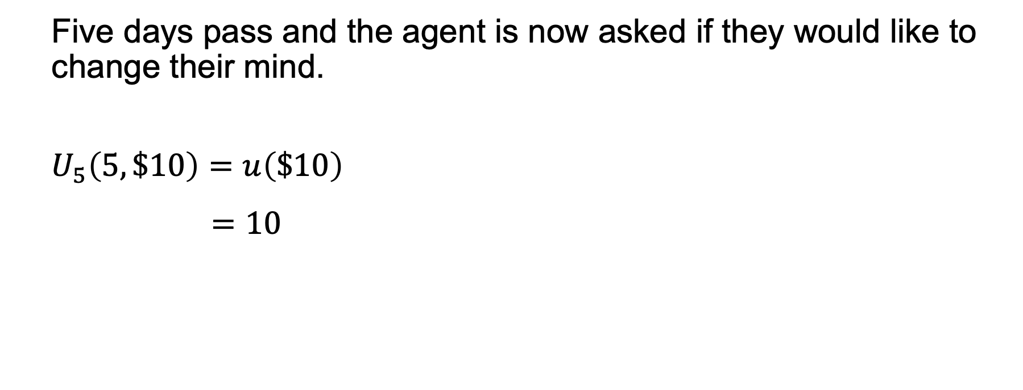
Five days pass and the agent is now asked if they would like to change their mind.
$$U_{5}\left(5, \$10\right)=u\left(\$10\right)$$
$$=10$$

Slide 27
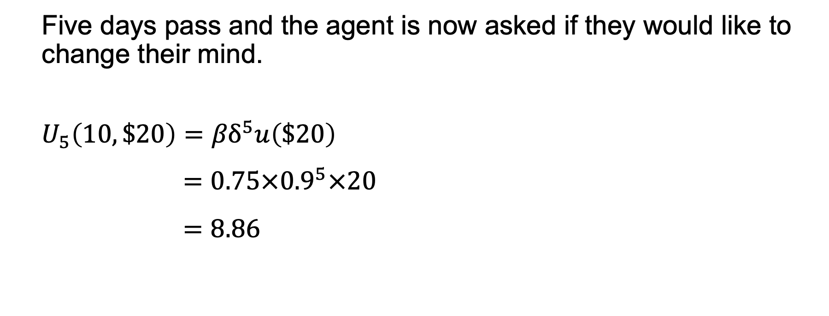
Five days pass and the agent is now asked if they would like to change their mind.
$$U_{5}\left(10, \$20\right)={βδ}^{5}u\left(\$20\right)$$
$$=0.75×{0.9}^{5}×20$$
$$=8.86$$

Slide 28

Five days pass and the agent is now asked if they would like to change their mind.
$$U_{5}\left(5, \$10\right)=10>8.86=U_{10}\left(10, \$20\right)$$

Slide 29

$$U_{0}\left(5, \$10\right)=4.43<5.23=U_{0}\left(10, \$20\right)$$
$$U_{5}\left(5, \$10\right)=10>8.86=U_{10}\left(10, \$20\right)$$

Slide 30
$$U_{t}$$
$$t$$

