Slide 1
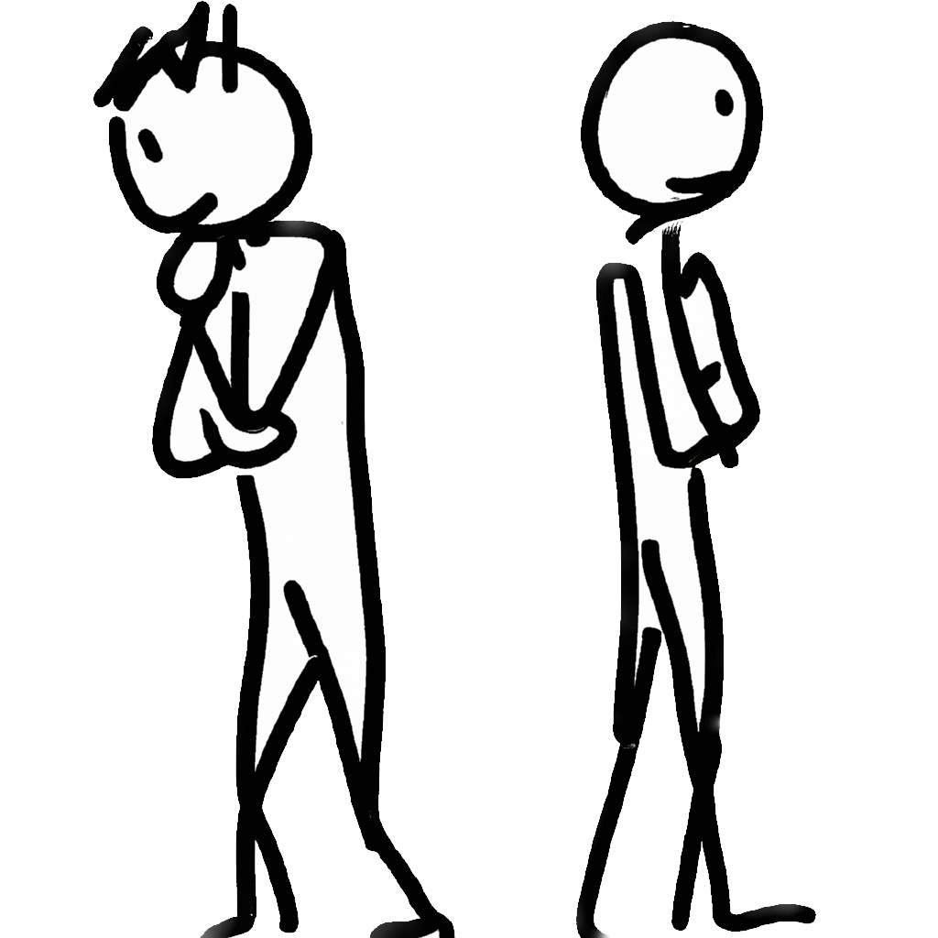
Sophisticated present bias
Notes on Behavioural Economics
Jason Collins

Slide 2

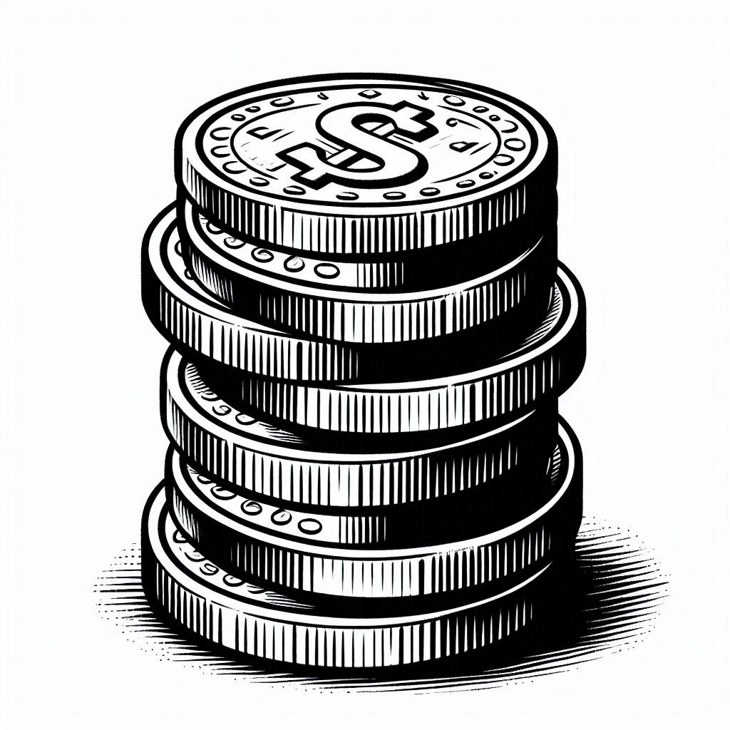

Slide 5
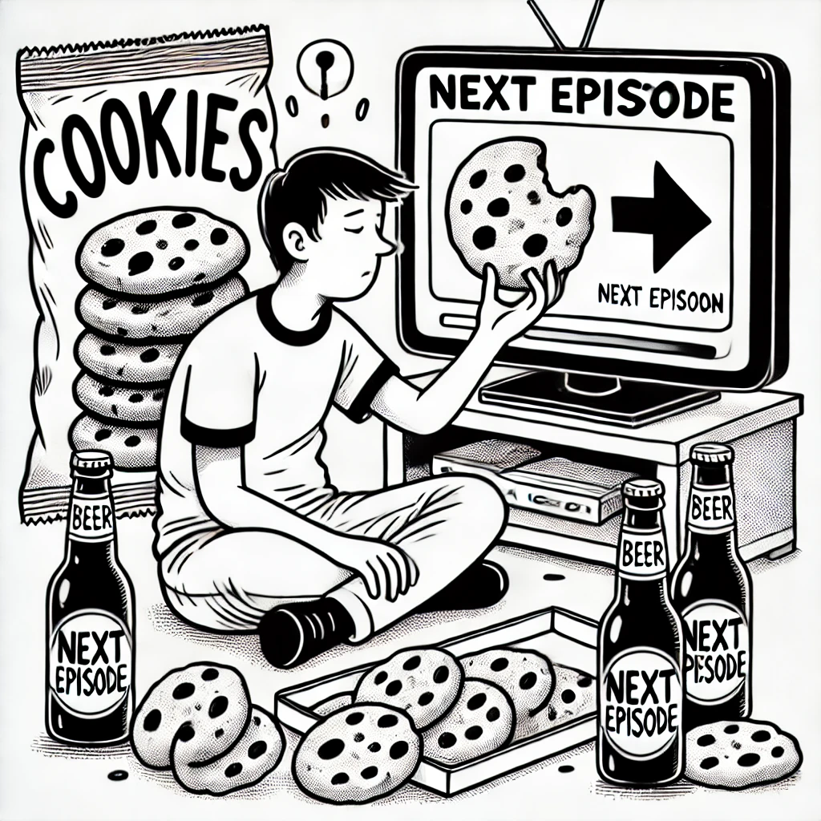

Slide 6


Naïve
Sophisticated

Slide 7




$$βδ$$
$$δ$$
$$δ$$
$$δ$$
$$δ$$
0
1
2
3
4
5

Slide 8
$$βδ$$
$$δ$$
$$δ$$
$$δ$$
$$δ$$
0
1
2
3
4
5

Slide 9
$$δ$$
$$δ$$
$$δ$$
0
1
2
3
4
5

Slide 10

$$βδ$$
$$δ$$
$$δ$$
$$δ$$
0
1
2
3
4
5

Slide 11
$$βδ$$
$$δ$$
$$δ$$
$$δ$$
$$δ$$
0
1
2
3
4
5

Slide 12

$$βδ$$
$$δ$$
$$δ$$
0
1
2
3
4
5

Slide 13
Naïve
Sophisticated

Slide 14




Naïve present-biased agent
$$βδ$$
$$δ$$
$$δ$$
$$δ$$
$$δ$$
0
1
2
3
4
5

Slide 15

Naïve present-biased agent
$$βδ$$
$$δ$$
$$δ$$
$$δ$$
0
1
2
3
4
5

Slide 16

Naïve present-biased agent
$$βδ$$
$$δ$$
$$δ$$
0
1
2
3
4
5

Slide 17
Sophisticated present-biased agent
0
1
2
3
4
5

Slide 18

Sophisticated present-biased agent
$$βδ$$
0
1
2
3
4
5

Slide 19

Sophisticated present-biased agent
$$βδ$$
$$δ$$
0
1
2
3
4
5

Slide 20

Sophisticated present-biased agent
$$βδ$$
$$δ$$
$$δ$$
0
1
2
3
4
5

Slide 21
Sophisticated present-biased agent
$$βδ$$
$$δ$$
$$δ$$
$$δ$$
$$δ$$
0
1
2
3
4
5

Slide 22
Naïve
Sophisticated

