Slide 1

Subjective expected utility theory
Notes on Behavioural Economics
Jason Collins

Slide 2

Subjective expected utility theory

Slide 3

Subjective expected utility theory
Subjective expected utility: $𝔼\left[U\left(X\right)\right]$
Subjective probability: $π\left(x_{i}\right)$

Slide 4
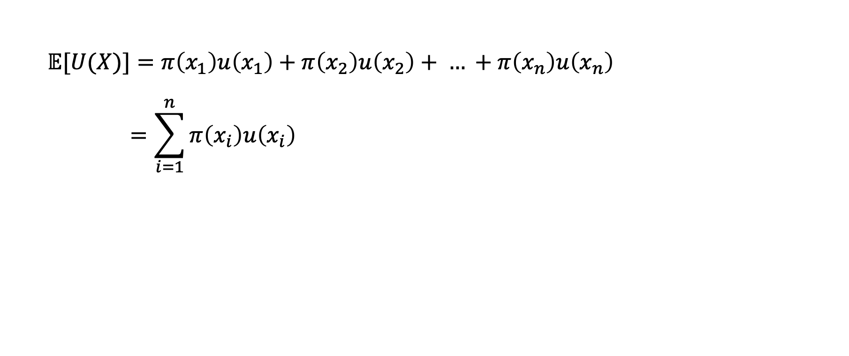
Subjective expected utility theory
$$𝔼[U(X)]=π\left(x_{1}\right)u\left(x_{1}\right)+π\left(x_{2}\right)u\left(x_{2}\right)+ … +π\left(x_{n}\right)u\left(x_{n}\right)$$
$$=\sum_{i=1}^{n}{π\left(x_{i}\right)u\left(x_{i}\right)}$$

Slide 5
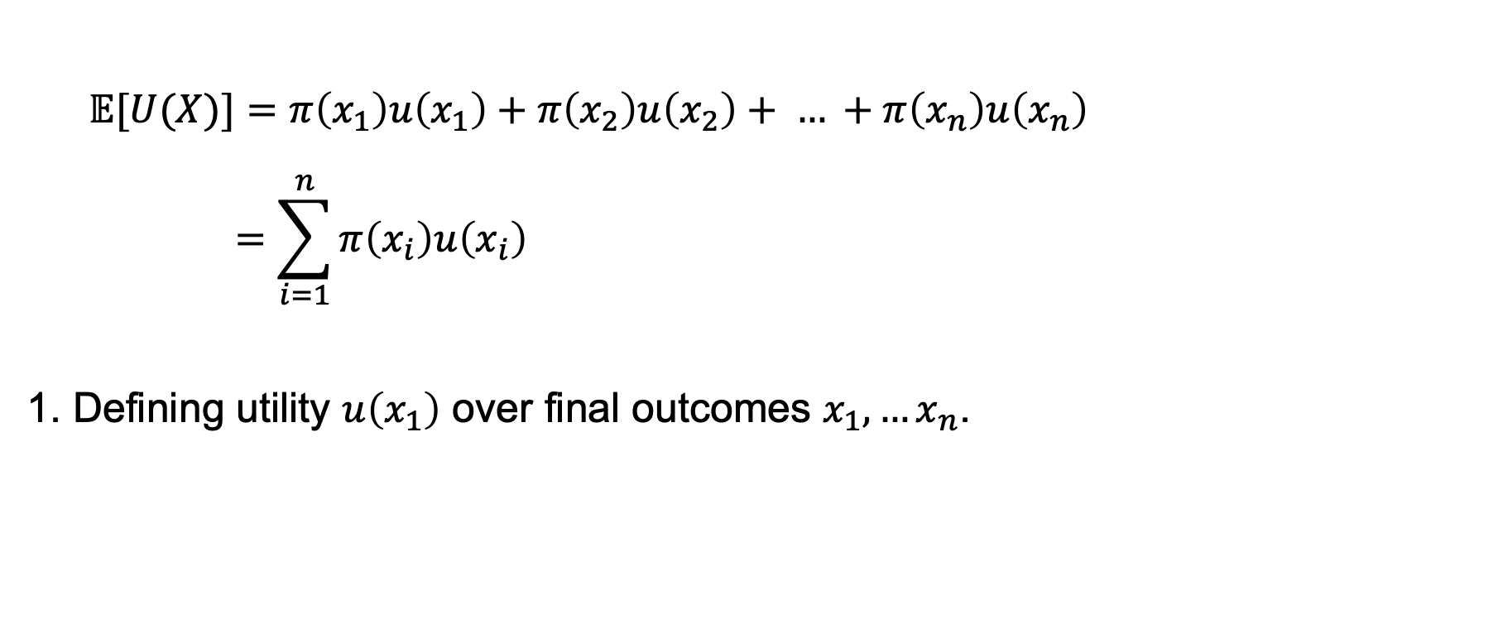
Subjective expected utility theory
$$𝔼[U(X)]=π\left(x_{1}\right)u\left(x_{1}\right)+π\left(x_{2}\right)u\left(x_{2}\right)+ … +π\left(x_{n}\right)u\left(x_{n}\right)$$
$$=\sum_{i=1}^{n}{π\left(x_{i}\right)u\left(x_{i}\right)}$$
1. Defining utility $u\left(x_{1}\right)$ over final outcomes $x_{1}, …x_{n}$.

Slide 6
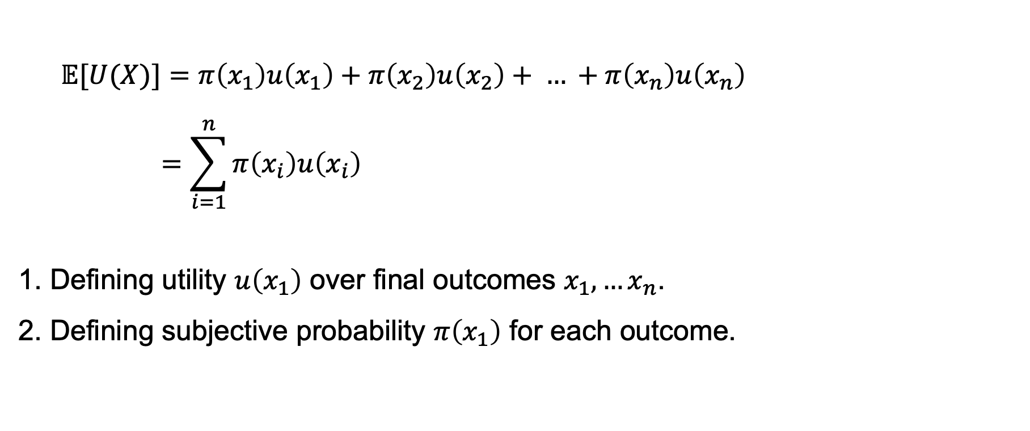
Subjective expected utility theory
$$𝔼[U(X)]=π\left(x_{1}\right)u\left(x_{1}\right)+π\left(x_{2}\right)u\left(x_{2}\right)+ … +π\left(x_{n}\right)u\left(x_{n}\right)$$
$$=\sum_{i=1}^{n}{π\left(x_{i}\right)u\left(x_{i}\right)}$$
1. Defining utility $u\left(x_{1}\right)$ over final outcomes $x_{1}, …x_{n}$.
2. Defining subjective probability $π\left(x_{1}\right)$ for each outcome.

Slide 7
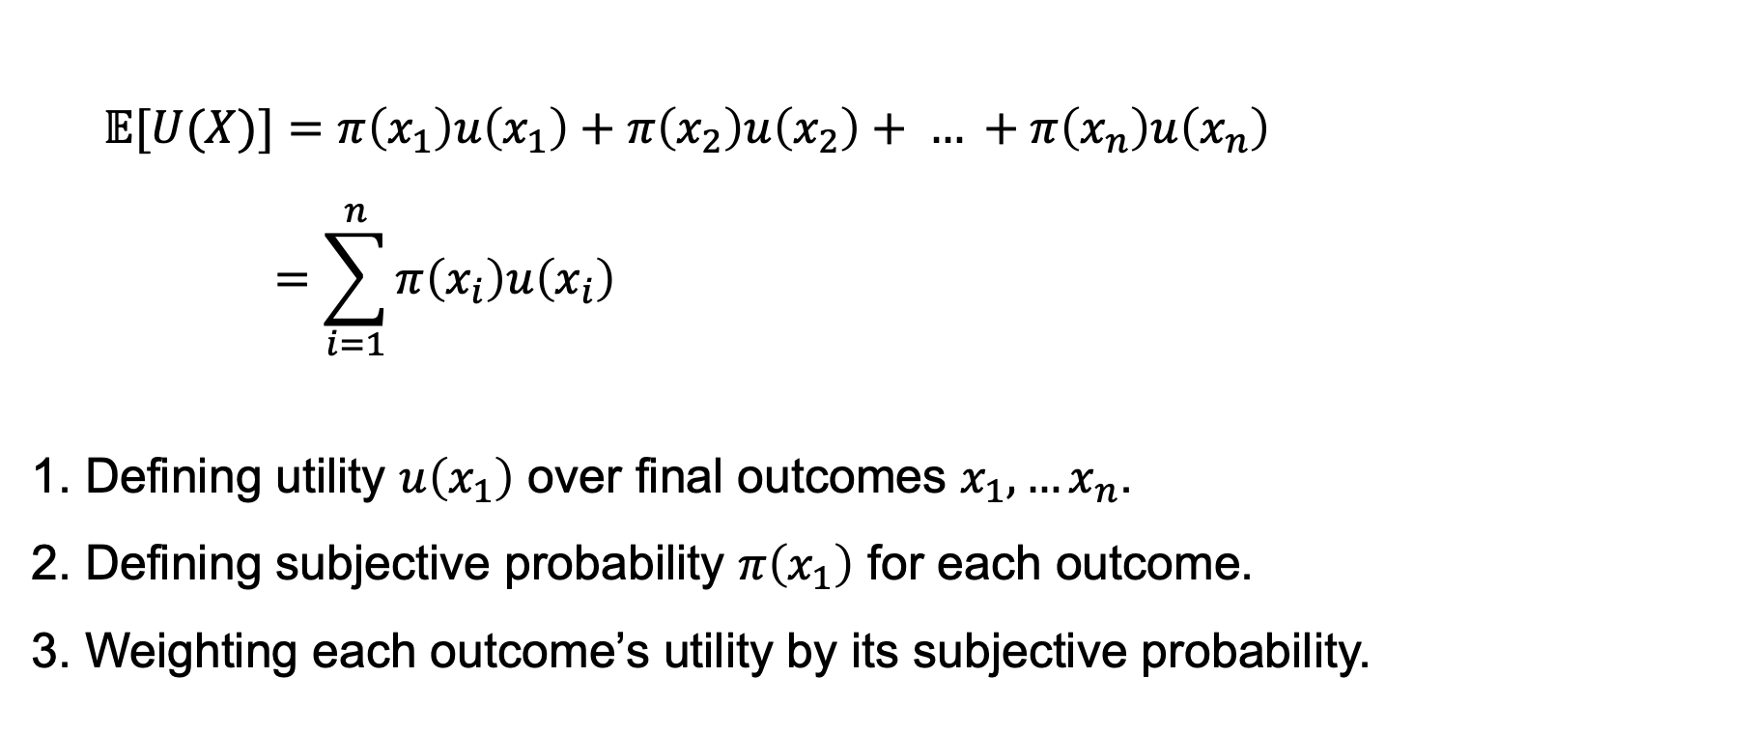
Subjective expected utility theory
$$𝔼[U(X)]=π\left(x_{1}\right)u\left(x_{1}\right)+π\left(x_{2}\right)u\left(x_{2}\right)+ … +π\left(x_{n}\right)u\left(x_{n}\right)$$
$$=\sum_{i=1}^{n}{π\left(x_{i}\right)u\left(x_{i}\right)}$$
1. Defining utility $u\left(x_{1}\right)$ over final outcomes $x_{1}, …x_{n}$.
2. Defining subjective probability $π\left(x_{1}\right)$ for each outcome.
3. Weighting each outcome’s utility by its subjective probability.

Slide 8
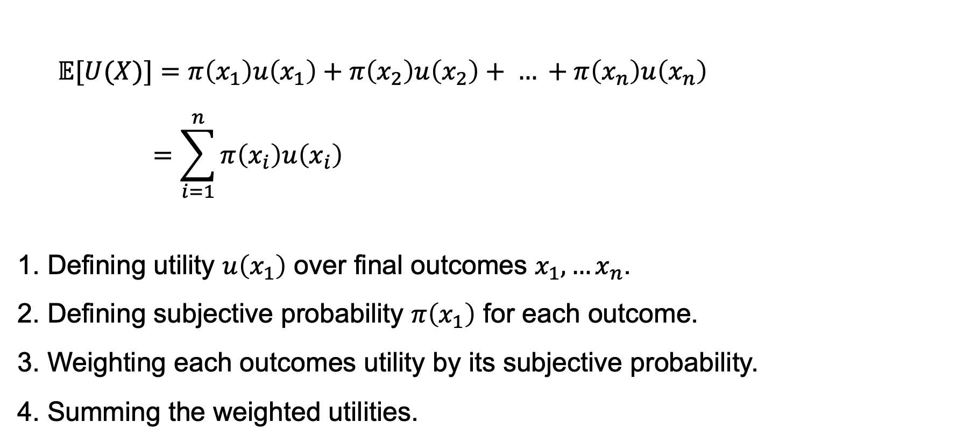
Subjective expected utility theory
$$𝔼[U(X)]=π\left(x_{1}\right)u\left(x_{1}\right)+π\left(x_{2}\right)u\left(x_{2}\right)+ … +π\left(x_{n}\right)u\left(x_{n}\right)$$
$$=\sum_{i=1}^{n}{π\left(x_{i}\right)u\left(x_{i}\right)}$$
1. Defining utility $u\left(x_{1}\right)$ over final outcomes $x_{1}, …x_{n}$.
2. Defining subjective probability $π\left(x_{1}\right)$ for each outcome.
3. Weighting each outcomes utility by its subjective probability.
4. Summing the weighted utilities.

Slide 9
Axioms for subjective expected utility theory

Slide 10
Axioms for subjective expected utility theory
Sure-thing principle
Suppose there are two possible states of the world. If you prefer one option (A) over another (B) in one possible state, and you also prefer A over B under the alternative state, then you should prefer A over B even if you do not know which state will occur.

Slide 11
Coherent probabilities

Slide 12

Coherent probabilities
Non-negativity
$$0≤π\left(A\right)≤1$$

Slide 13

Coherent probabilities
Non-negativity
$$0≤π\left(A\right)≤1$$
Additivity
$$π \left(A∪B\right)=π\left(A\right)+π\left(B\right)$$

Slide 14

Coherent probabilities
Non-negativity
$$0≤π\left(A\right)≤1$$
Additivity
$$π \left(A∪B\right)=π\left(A\right)+π\left(B\right)$$
Normalisation
$$π \left(∙\right)=1$$

Slide 15
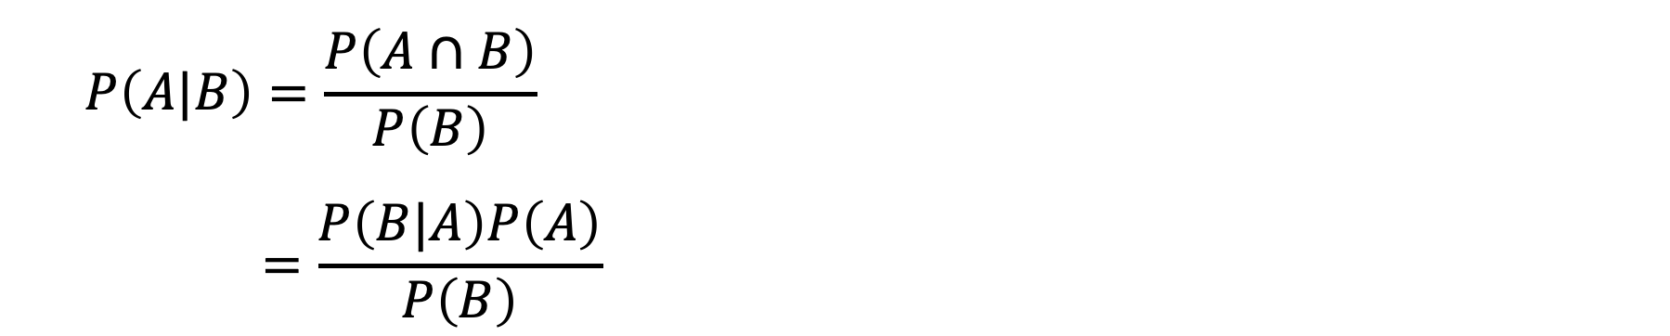
Baye’s rule
$$P\left(A|B\right)=\frac{P\left(A∩B\right)}{P\left(B\right)}$$
$$=\frac{P\left(B|A\right)P\left(A\right)}{P\left(B\right)}$$

Slide 16
Why coherence matters

Slide 17
Why coherence matters
Dutch book

Slide 18

Why coherence matters
Dutch book
Probability of rain tomorrow: 60%
Probability of no rain tomorrow: 50%

Slide 19
Why coherence matters
Dutch book
Probability of rain tomorrow: 60%
Probability of no rain tomorrow: 50%
Sell a $60 bet paying $100 if it rains
Sell a $50 bet paying $100 if it doesn't rain

Slide 20

The Ellsberg paradox

Slide 21
The Ellsberg paradox
A: risky
B: ambiguous

Slide 22

The Ellsberg paradox
Gamble A
$$𝔼[U(A)]=0.5u\left(\$100\right)$$

Slide 23

The Ellsberg paradox
Gamble A
$$𝔼[U(A)]=0.5u\left(\$100\right)$$
Gamble B
$$Red: π\left(r\right)$$
$$Black:π\left(b\right)=1−π\left(r\right)$$

Slide 24
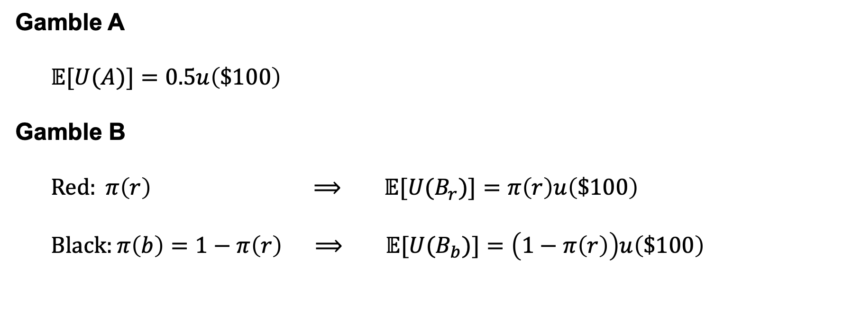
The Ellsberg paradox
Gamble A
$$𝔼[U(A)]=0.5u\left(\$100\right)$$
Gamble B
$$Red: π\left(r\right) ⟹ 𝔼[U(B_{r})]=π\left(r\right)u\left(\$100\right)$$
$$Black:π\left(b\right)=1−π\left(r\right) ⟹ 𝔼[U(B_{b})]=\left(1−π\left(r\right)\right)u\left(\$100\right)$$

Slide 25
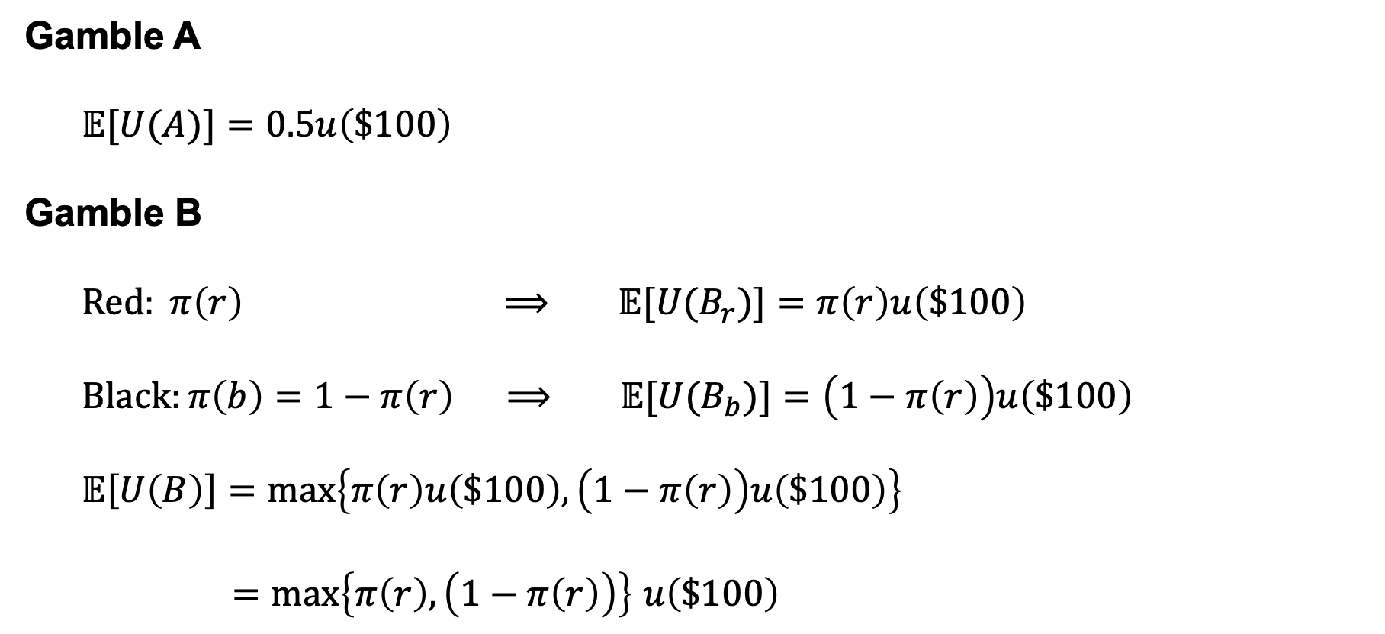
The Ellsberg paradox
Gamble A
$$𝔼[U(A)]=0.5u\left(\$100\right)$$
Gamble B
$$Red: π\left(r\right) ⟹ 𝔼[U(B_{r})]=π\left(r\right)u\left(\$100\right)$$
$$Black:π\left(b\right)=1−π\left(r\right) ⟹ 𝔼[U(B_{b})]=\left(1−π\left(r\right)\right)u\left(\$100\right)$$
$$𝔼\left[U\left(B\right)\right]=max\left\{π\left(r\right)u\left(\$100\right),\left(1−π\left(r\right)\right)u\left(\$100\right)\right\}$$
$=max\left\{π\left(r\right),\left(1−π\left(r\right)\right)\right\}$ $u\left(\$100\right)$

Slide 26
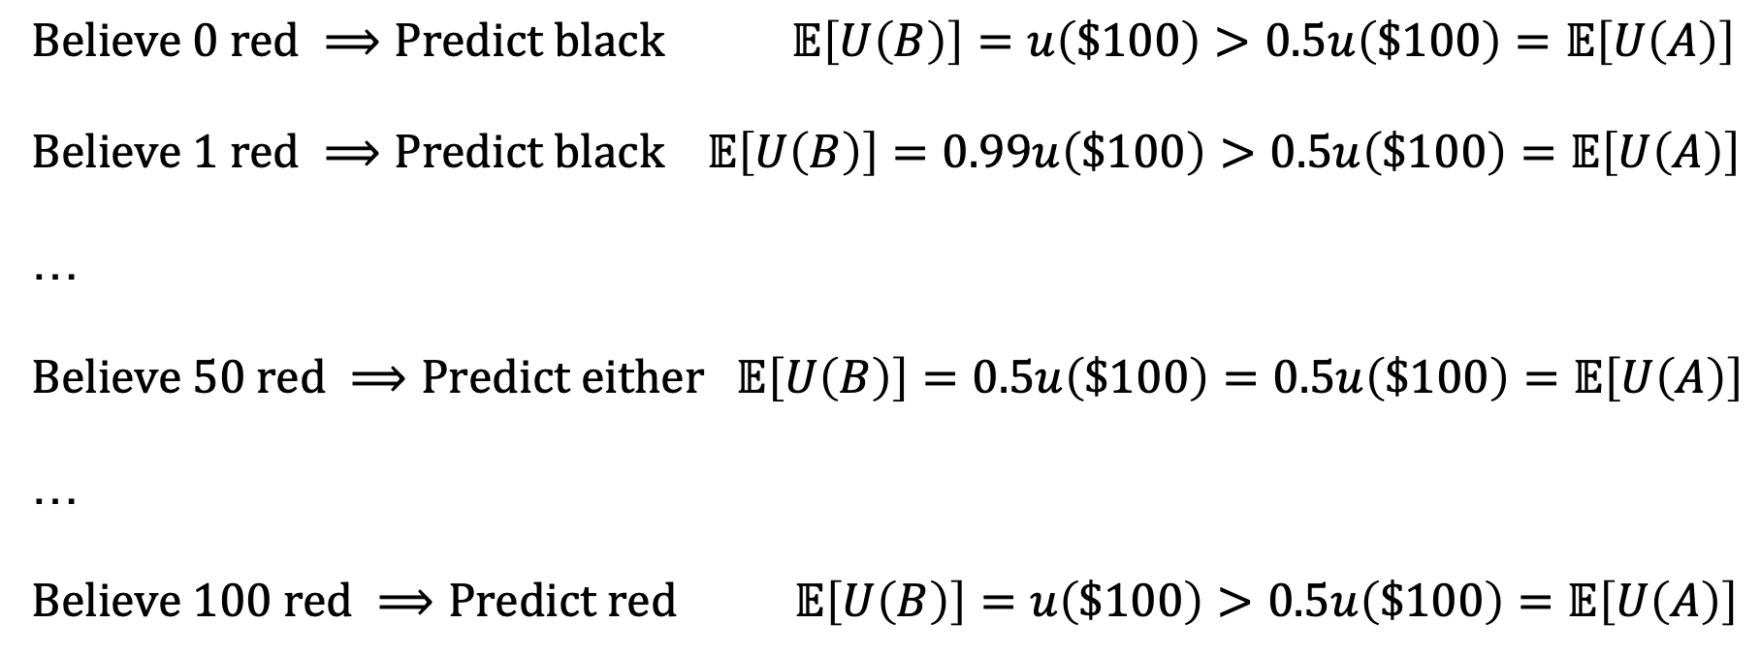
The Ellsberg paradox
$$Believe 0 red ⟹Predict black 𝔼\left[U\left(B\right)\right]=u\left(\$100\right)>0.5u\left(\$100\right)=𝔼\left[U\left(A\right)\right]$$
$$Believe 1 red ⟹Predict black 𝔼\left[U\left(B\right)\right]=0.99u\left(\$100\right)>0.5u\left(\$100\right)=𝔼\left[U\left(A\right)\right]$$
…
$$Believe 50 red ⟹Predict either 𝔼\left[U\left(B\right)\right]=0.5u\left(\$100\right)=0.5u\left(\$100\right)=𝔼\left[U\left(A\right)\right]$$
…
$$Believe 100 red ⟹Predict red 𝔼\left[U\left(B\right)\right]=u\left(\$100\right)>0.5u\left(\$100\right)=𝔼\left[U\left(A\right)\right]$$

