Slide 1
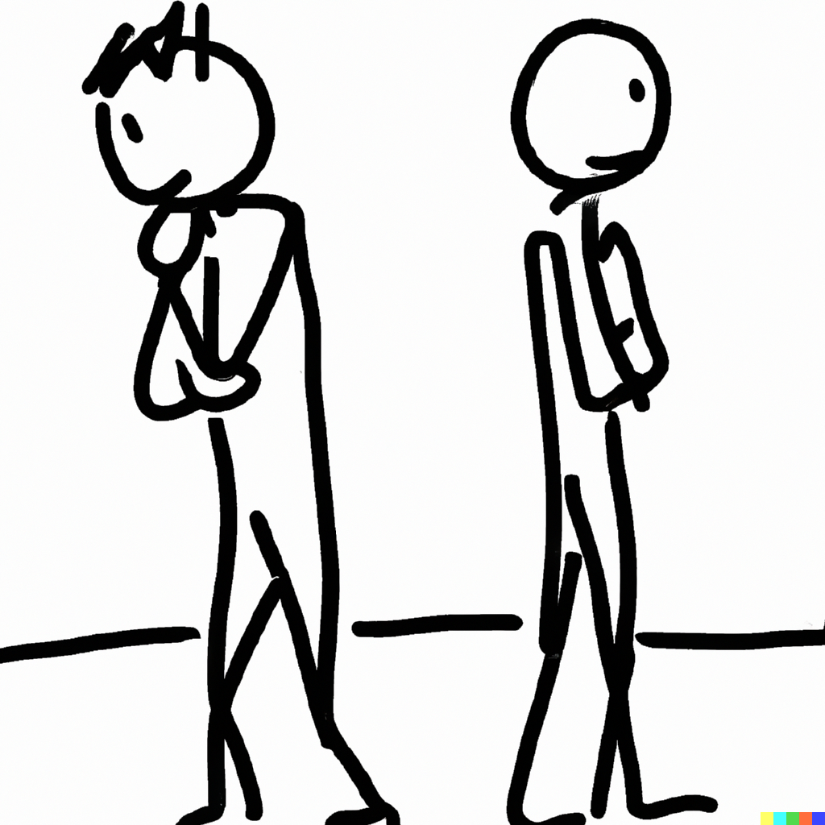
The conjunction fallacy
Notes on Behavioural Economics
Jason Collins

Slide 2
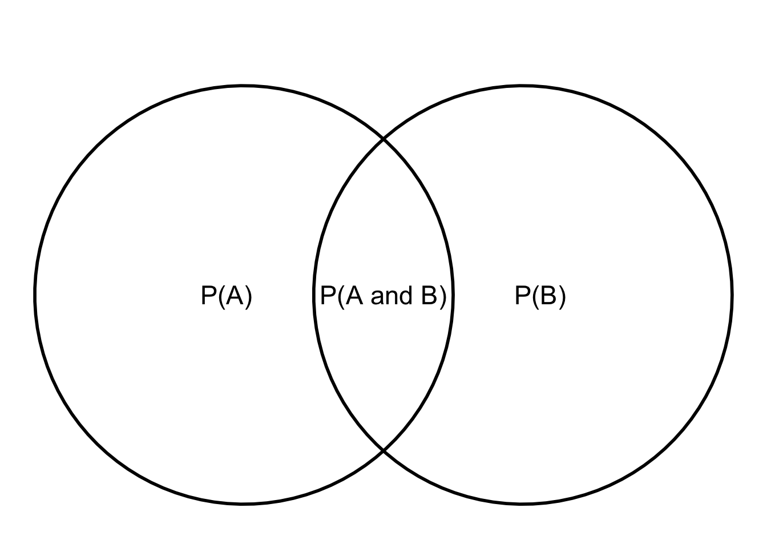

Slide 3
The Linda problem
“Linda is 31 years old, single, outspoken, and very bright. She majored in philosophy. As a student, she was deeply concerned with issues of discrimination and social justice, and also participated in anti-nuclear demonstrations.”

Slide 4
The Linda problem
Rank the following statements from most (1) to least (8) probable:
Linda is a teacher in elementary school.
Linda works in a bookstore and takes Yoga classes.
Linda is active in the feminist movement.
Linda is a psychiatric social worker.
Linda is a member of the League of Women Voters.
Linda is a bank teller.
Linda is an insurance salesperson.
Linda is a bank teller and is active in the feminist movement.

Slide 5
The Linda problem
Rank the following statements from most (1) to least (8) probable:
Linda is a teacher in elementary school.
Linda works in a bookstore and takes Yoga classes.
Linda is active in the feminist movement.
Linda is a psychiatric social worker.
Linda is a member of the League of Women Voters.
Linda is a bank teller.
Linda is an insurance salesperson.
Linda is a bank teller and is active in the feminist movement.

Slide 6
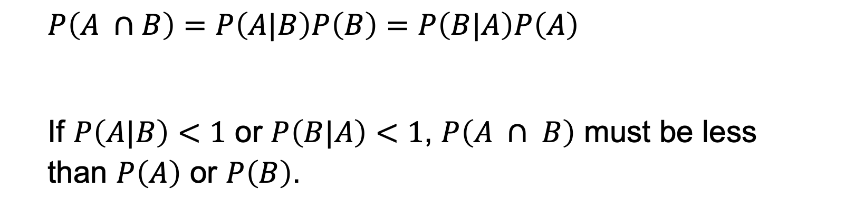
The conjunction fallacy
$$P\left(A ∩B\right)=P\left(A|B\right)P\left(B\right)=P\left(B|A\right)P\left(A\right)$$
If $P\left(A|B\right)<1$ or $P\left(B|A\right)<1$, $P\left(A ∩ B\right)$ must be less than $P\left(A\right)$ or $P\left(B\right)$.

Slide 7
Betting on the result
Consider a regular six-sided die with four green faces and two red faces. The die will be rolled 20 times and the sequence of greens (G) and reds (R) will be recorded. You are asked to select one sequence, from a set of three, and you will win $25 if the sequence you chose appears on successive rolls of the die. Please check the sequence of greens and reds on which you prefer to bet.
1. RGRRR
2. GRGRRR
3. GRRRRR

