Slide 1

Heuristics and biases
Notes on Behavioural Economics
Jason Collins

Slide 2
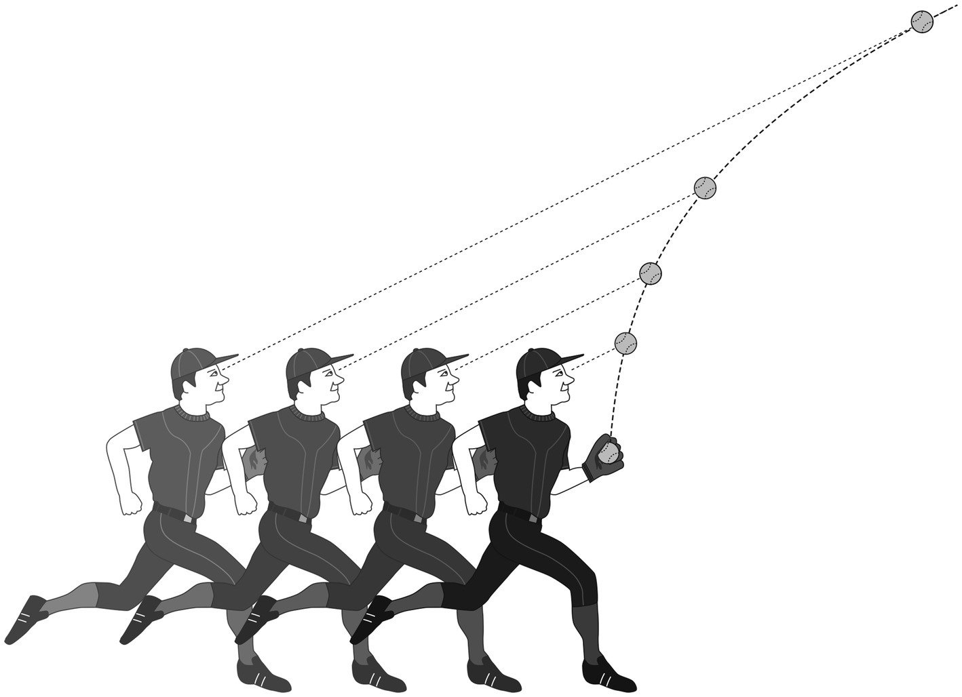

Slide 3
Heuristics
The representative heuristic
The availability heuristic
Anchoring and adjustment

Slide 4
Biases
The conjunction fallacy
Base-rate neglect
The hot-hand fallacy
The gambler's fallacy

Slide 5
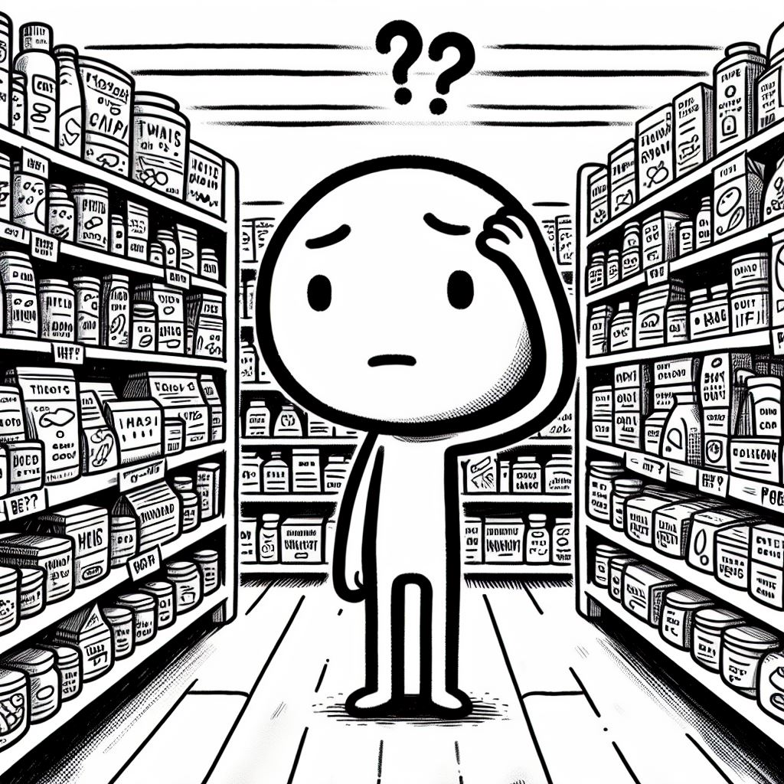
Heuristics and the bias-variance trade-off

Slide 6
Overconfidence
Overprecision
Overestimation
Overplacement

