Slide 1

Probability matching
Notes on Behavioural Economics
Jason Collins

Slide 2


Slide 3

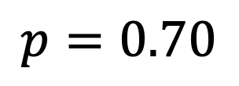
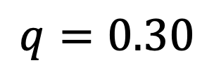
$$p=0.70$$
$$q=0.30$$

Slide 4
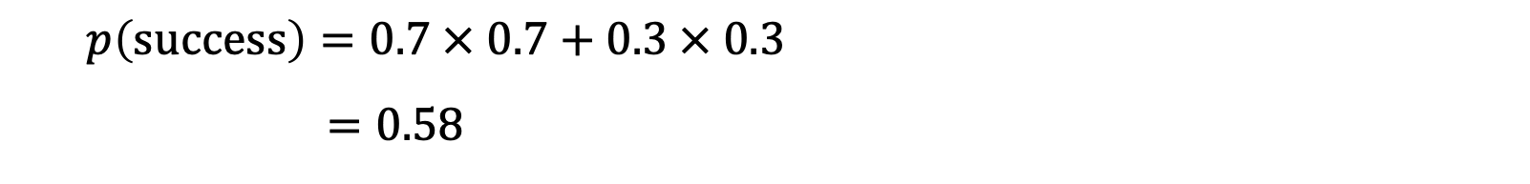
Probability matching
$$p\left(success\right)=0.7 × 0.7+0.3 × 0.3$$
$$=0.58$$

