Slide 1

Game theory
Notes on Behavioural Economics
Jason Collins

Slide 2
Components of a game
Players
Actions
Strategies
Information
Payoffs

Slide 3
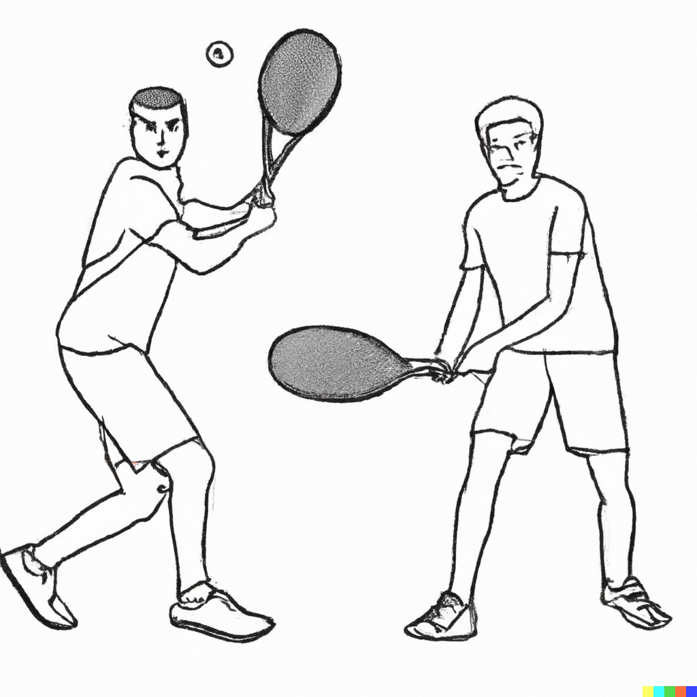

Slide 4
Types of games
Cooperative
Non-cooperative

Slide 5
Types of games
Simultaneous
Sequential

