Slide 1

Sequential game examples
Notes on Behavioural Economics
Jason Collins

Slide 2
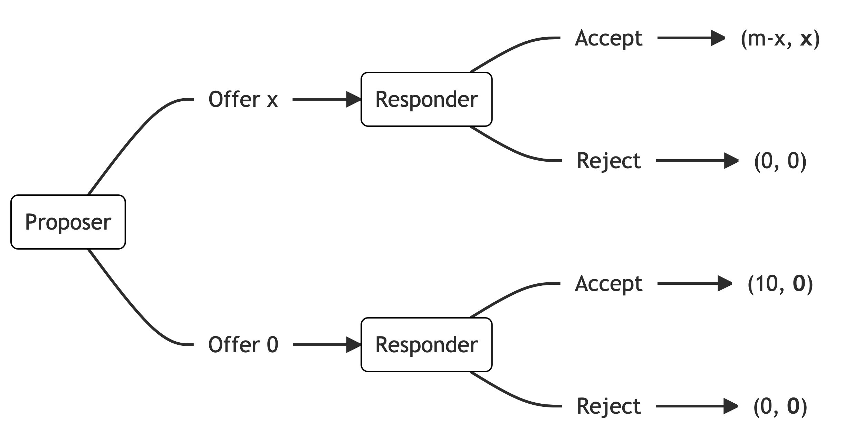
The ultimatum game

Slide 3














Proposer
$0
$1
$2
$3
$...
$8
$9
$10
Responder
Responder
Responder
Responder
Responder
Responder
Responder
Responder
A
R
A
R
A
R
A
R
...
A
R
A
R
A
R
$$(10, 0)$$
$$(0, 0)$$
$$(9, 1)$$
$$(0, 0)$$
$$(8, 2)$$
$$(0, 0)$$
$$(7, 3)$$
$$(0, 0)$$
$$(2, 8)$$
$$(0, 0)$$
$$(1, 9)$$
$$(0, 0)$$
$$(0, 10)$$
$$(0, 0)$$

Slide 4


Proposer
$0
$1
$2
$3
$...
$8
$9
$10
Responder
Responder
Responder
Responder
Responder
Responder
Responder
Responder
A
R
A
R
A
R
A
R
...
A
R
A
R
A
R
$$(10, 0)$$
$$(0, 0)$$
$$(9, 1)$$
$$(0, 0)$$
$$(8, 2)$$
$$(0, 0)$$
$$(7, 3)$$
$$(0, 0)$$
$$(2, 8)$$
$$(0, 0)$$
$$(1, 9)$$
$$(0, 0)$$
$$(0, 10)$$
$$(0, 0)$$

Slide 5
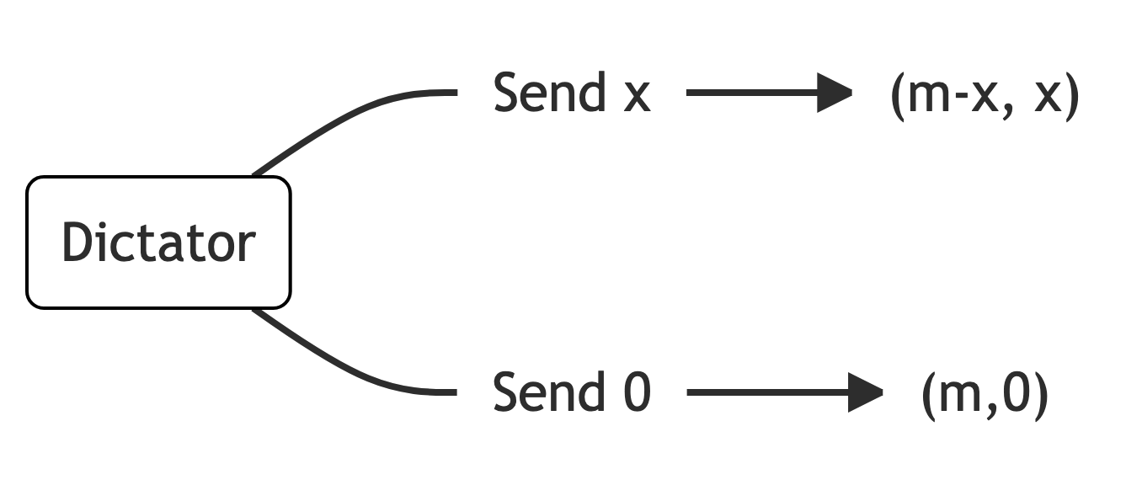
The dictator game

Slide 6
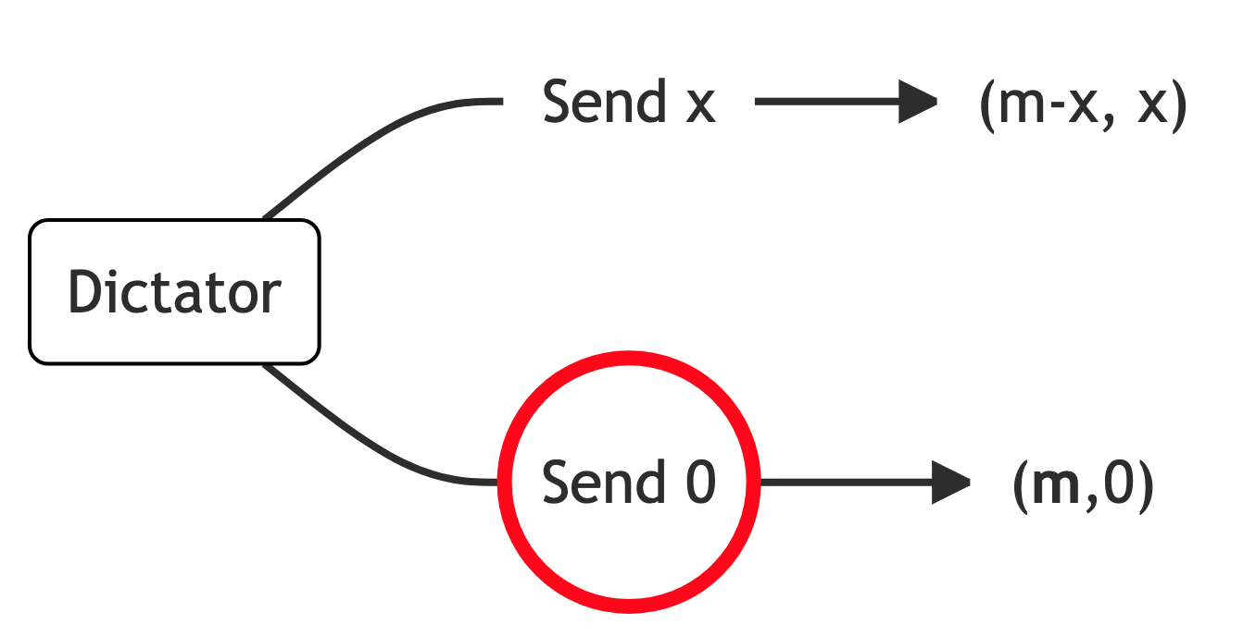
The dictator game

Slide 7
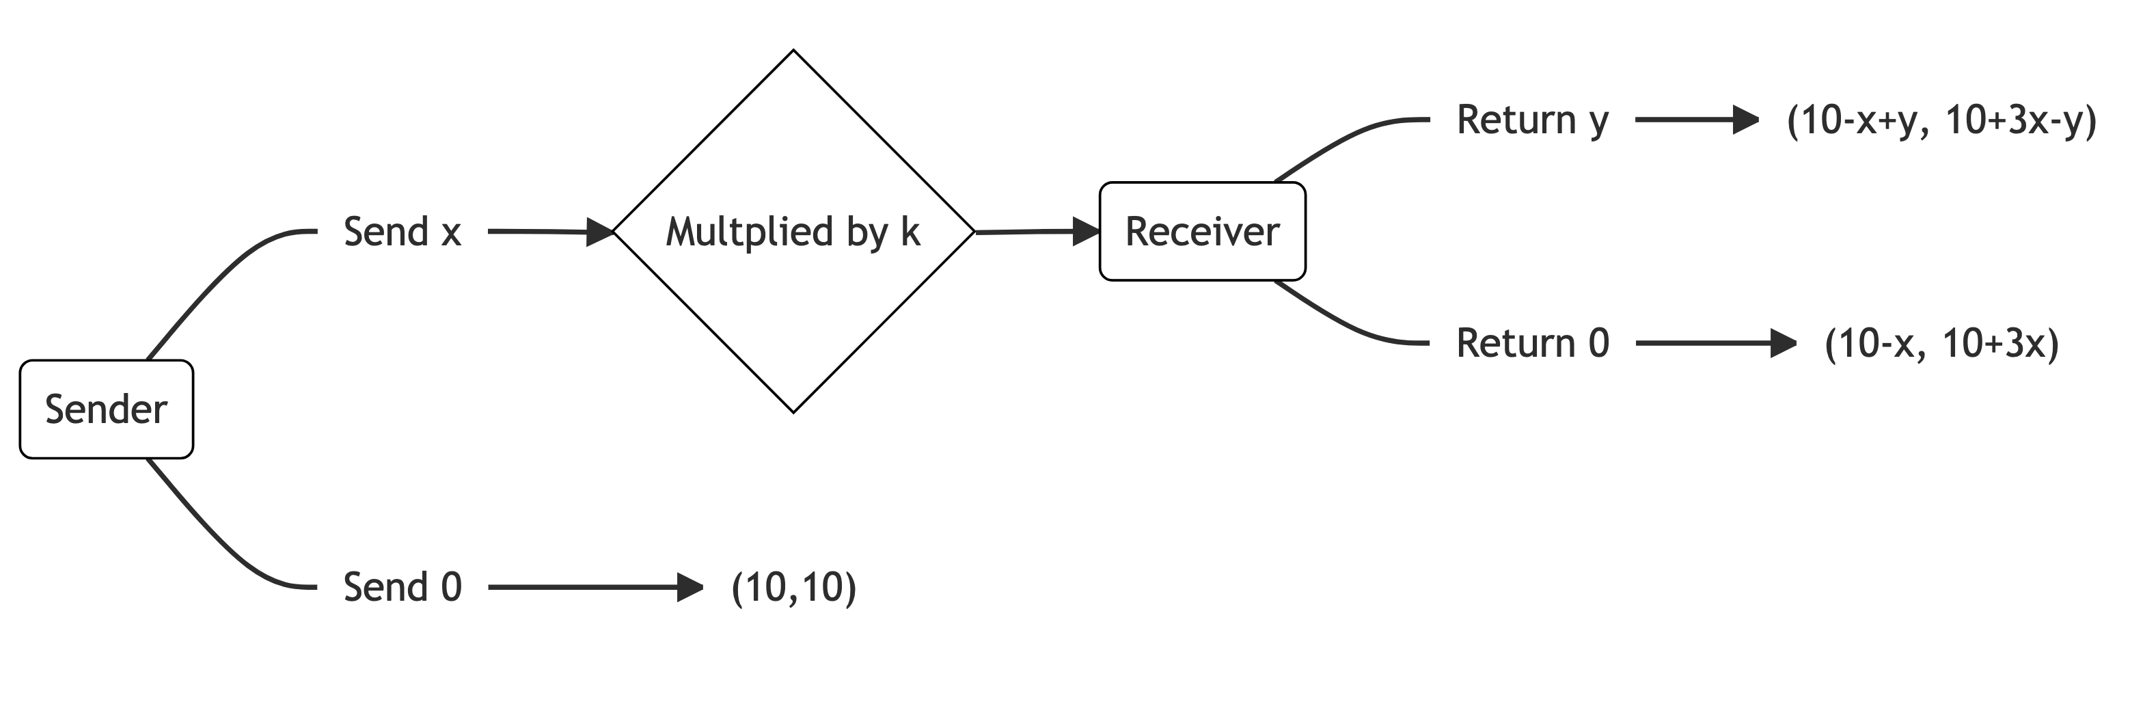
The trust game

Slide 8
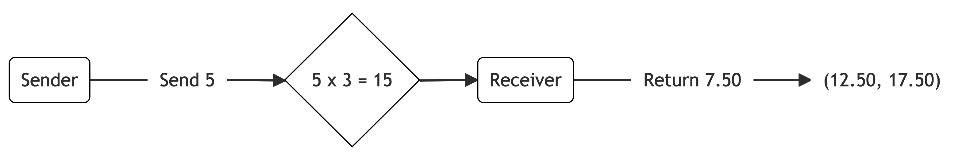
The trust game

Slide 9
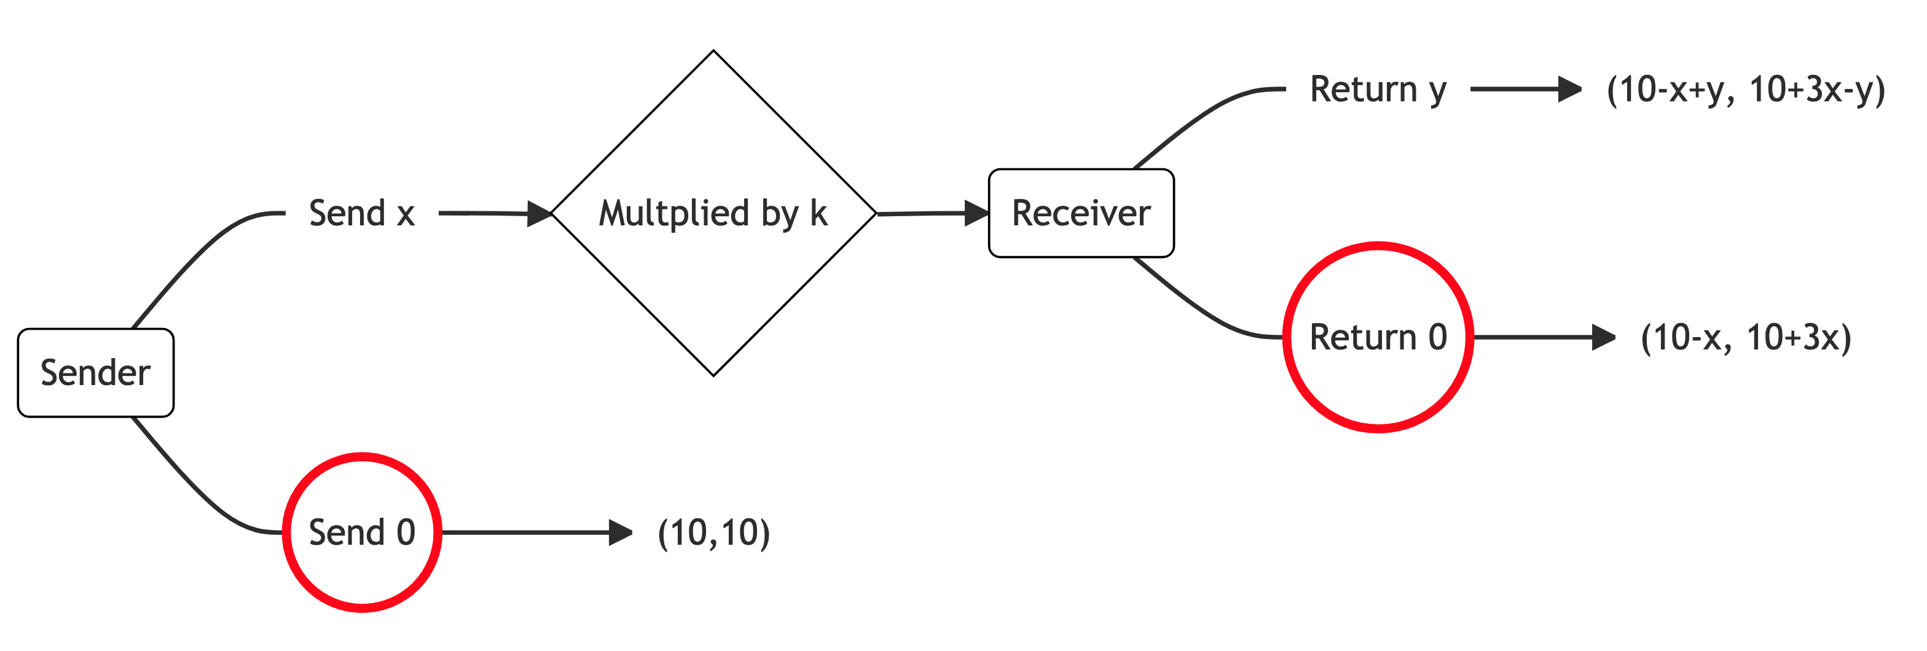
The trust game

