Slide 1
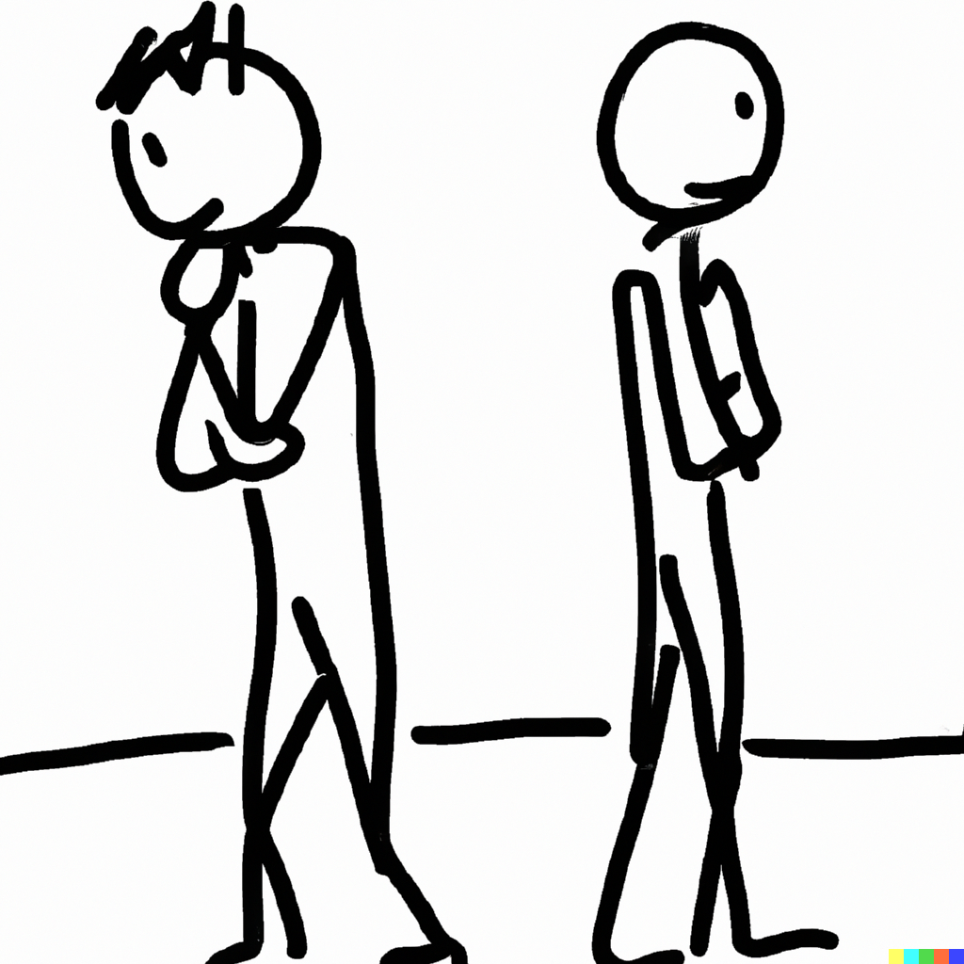
Simultaneous-move one-shot game examples
Notes on Behavioural Economics
Jason Collins

Slide 2
 |  | Driver 2
 |  | Left | Right
Driver 1 | Left | 10, 10 | -10, -10
 | Right | -10, -10 | 10, 10

Slide 3
 |  | Driver 2
 |  | Left | Right
Driver 1 | Left | 10, 10 | -10, -10
 | Right | -10, -10 | 10, 10

Slide 4
 |  | Driver 2
 |  | Left | Right
Driver 1 | Left | 10, 10 | -10, -10
 | Right | -10, -10 | 10, 10

Slide 5
 |  | Driver 2
 |  | Left | Right
Driver 1 | Left | 10, 10 | -10, -10
 | Right | -10, -10 | 10, 10

Slide 6
 |  | Driver 2
 |  | Left | Right
Driver 1 | Left | 10, 10 | -10, -10
 | Right | -10, -10 | 10, 10

Slide 7
 |  | Odd
 |  | Heads | Tails
Even | Heads | 1, -1 | -1, 1
 | Tails | -1, 1 | 1, -1

Slide 8
 |  | Odd
 |  | Heads | Tails
Even | Heads | 1, -1 | -1, 1
 | Tails | -1, 1 | 1, -1

Slide 9
 |  | Odd
 |  | Heads | Tails
Even | Heads | 1, -1 | -1, 1
 | Tails | -1, 1 | 1, -1

Slide 10
 |  | Odd
 |  | Heads | Tails
Even | Heads | 1, -1 | -1, 1
 | Tails | -1, 1 | 1, -1

Slide 11
 |  | Odd
 |  | Heads | Tails
Even | Heads | 1, -1 | -1, 1
 | Tails | -1, 1 | 1, -1

Slide 12
 |  | Hunter 2
 |  | Stag | Hare
Hunter 1 | Stag | 3, 3 | 0, 1
 | Hare | 1, 0 | 1, 1

Slide 13
 |  | Hunter 2
 |  | Stag | Hare
Hunter 1 | Stag | 3, 3 | 0, 1
 | Hare | 1, 0 | 1, 1

Slide 14
 |  | Hunter 2
 |  | Stag | Hare
Hunter 1 | Stag | 3, 3 | 0, 1
 | Hare | 1, 0 | 1, 1

Slide 15
 |  | Hunter 2
 |  | Stag | Hare
Hunter 1 | Stag | 3, 3 | 0, 1
 | Hare | 1, 0 | 1, 1

Slide 16
 |  | Hunter 2
 |  | Stag | Hare
Hunter 1 | Stag | 3, 3 | 0, 1
 | Hare | 1, 0 | 1, 1

Slide 17
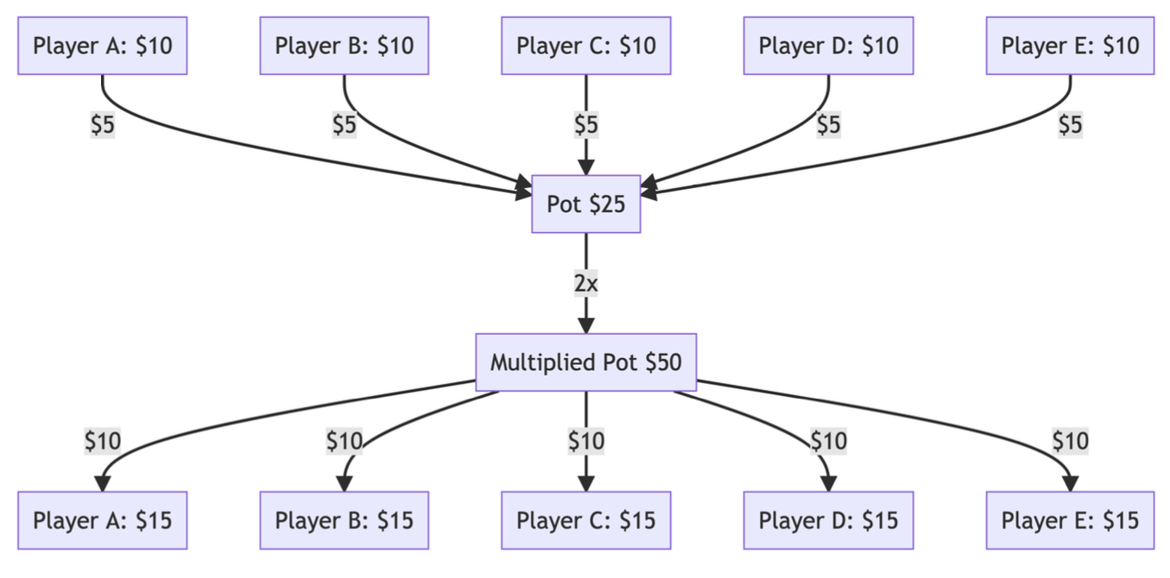

Slide 18
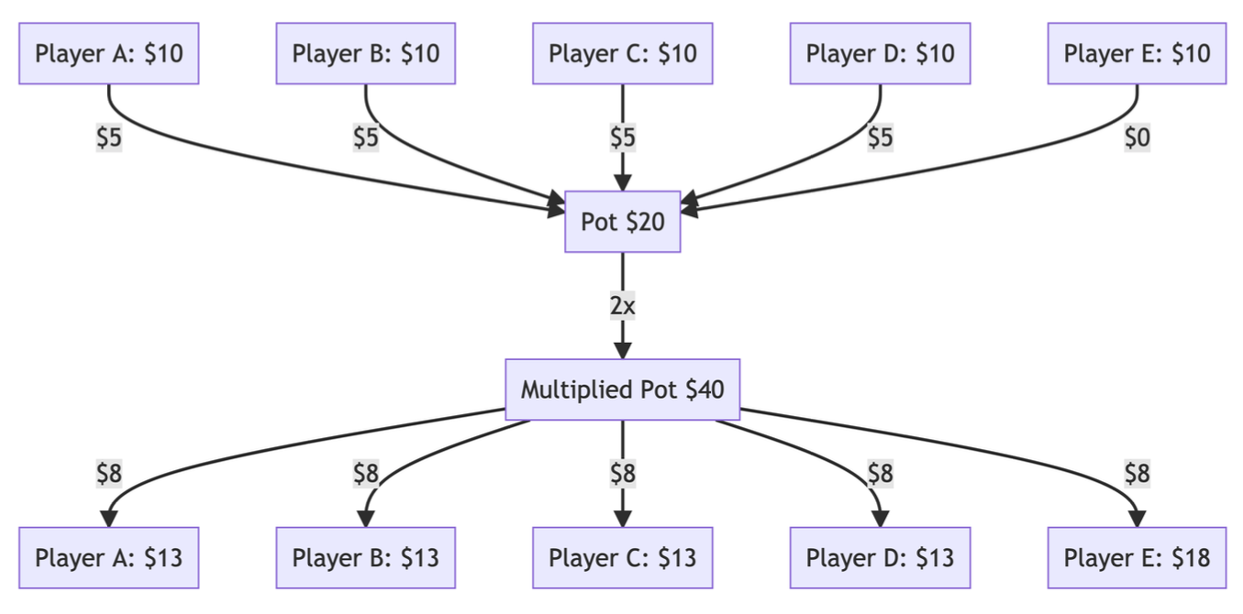

Slide 19
