Slide 1
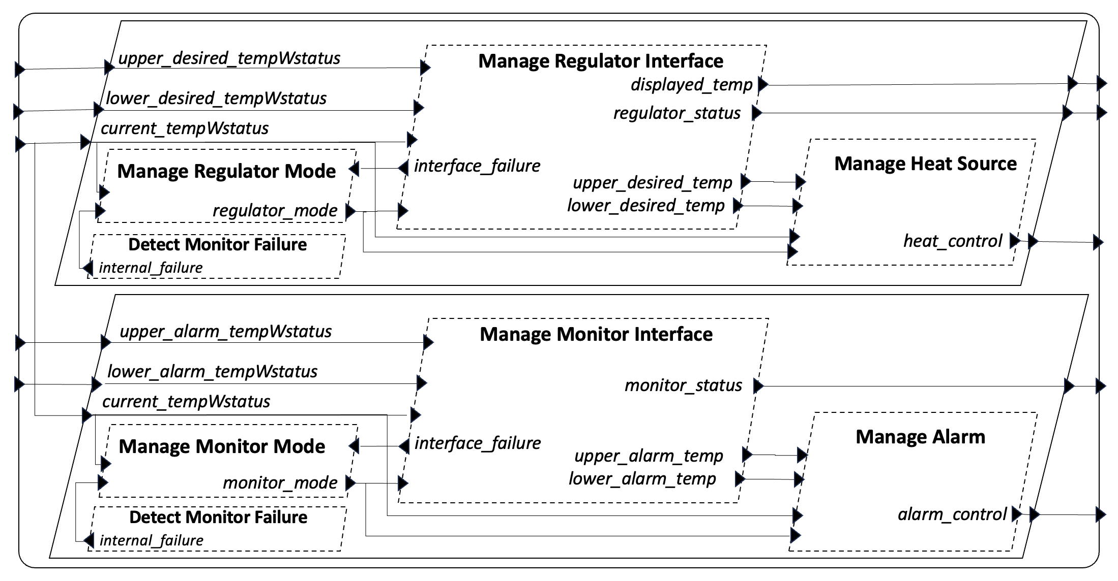
Architecture Characteristics – Component Structure
Collection of components
Each component has inputs/outputs (and possibly local state)
Data dependences between components are explicitly stated as connections
Notions of control (ordering of execution) are implicit (and we start by assuming that control is specified (made explicit) by a static schedule for each phase)

Slide 2
Architecture Characteristics – Subsystem Boundary
Architecture may be organized into subsystems; maybe nested to provide architecture hierarchy and abstraction
Scope of subsystem is determined by designer to aggregate logically related components and to support decomposition for reasoning (e.g., grouping components that perform functions/services that have been identified (abstractly) in informal system design and requirements documents.
Subsystem boundary contains input ports and output ports. Following AADL principles, these boundary ports are notional/virtual – they are not associated with specific state but instead act as aliases for one or more connected concrete ports (as determined specifically by AADL instance model)
Possible architectural constraints
Subsystems may not span processors/cores
Subsystems may not span multiple scheduled component sets; every component must appear in a schedule

Slide 3
Architecture Characteristics – Boundary Ports Are Challenging
Concerning subsystem inputs…
Boundary ports provide are the natural notions of value to be referenced in subsystem property specification (e.g., because we typically state properties of abstract functions computed from subsystem inputs to subsystem outputs – with possible references to internal state)
But boundary ports are notional/virtual – a single boundary input port may reference multiple concrete thread input port states
Concrete port states associated with a boundary input port will be given their values by communication actions likely scheduled independently of the subsystem component schedule
We will likely need some sort of coherence axioms about the consistency of the values of partner/sibling thread port states (i.e., those referenced by a single input port state)
Simplification/Approach: We could imagine changing the AADL semantics to introduce a notion of ”gateway port”, with its own storage, or we could for simplicity require a gateway component (perhaps hidden from the view of the developer) that processes a single boundary input and distributes it to internal components.

Slide 4
Architecture Characteristics – Boundary Ports Are Challenging
Concerning subsystem outputs…
Output ports are also virtual
In contrast to input boundary ports, it doesn’t even ”make sense” to have a boundary output port associated with a multiple thread output ports – there would need to be some notion of merging of values
Therefore, architecture specification should only allow a single thread output to be associated with a subsystem output (not sure if AADL/HAMR currently enforces this)
Approach: only allow a single thread output to be associated with a subsystem output

Slide 5
Structure vs Control (Execution)
Notions of subsystem structure (decomposition/aggregation, data flow) are distinct from notions of control/execution – though graphical views often mislead developers into identifying them or making unwarranted semantic assumptions about their relationships
Architecture structure does not imply ordering – even data flow dependences do not imply ordering (though they might be used to suggest good orderings)
Approach: We will need a distinct reasoning framework
to reason about ordering of tasks within a subsystem
To reason about the ordering of subsystem tasks with respect to interactions with the environment

Slide 6
Control
Control (scheduling of tasks, ordering of task dispatches) in AADL can be driven by timing properties (e.g., periodic threads) or event delivery (e.g., sporadic threads)
The more simple form of all of these is time-driven control determined by a static schedule of threads
Approach: first, design reasoning framework assuming a static schedule of periodic components
We have various well-formedness assumptions on such schedules which we do not enumerate here because they have been sufficiently discussed previously

Slide 7
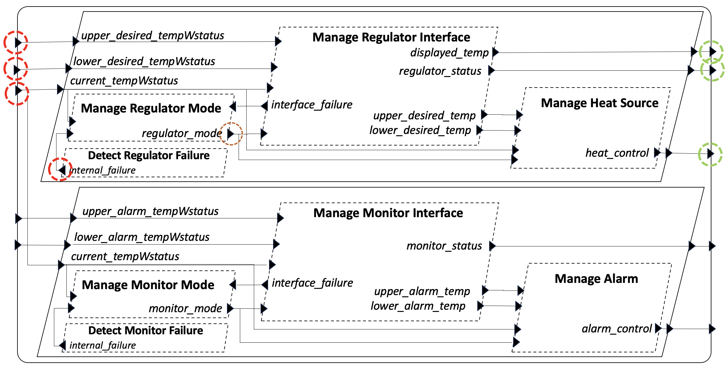
Static Schedule (Intuition)
Intuitive representation of static cyclic schedule (from HAMR System Testing paper)
Subsytem Inputs
0
Operator Interface
Manage Interface
Manage Heat Source
3
10
Manage Mode
4
5
Heat
Controller
Internal Failure Detection
2
8
1
9
7
Temp
Sensor
6
Each thread within a subsystem appears one or more times in a static schedule (open question: what is the relationship between subsystem task set and schedule task set? These notions are not spelled out in AADL)
There is some notion of relating the schedule of a subsystem with the schedule of its context (e.g., steps 0, 1, 10 above) and I don’t know what this should be yet.
To support reasoning, the subsystem will need to understand the points in time (in the static schedule) in which: input values are acquired from the context, output values are delivered to the context

Slide 8
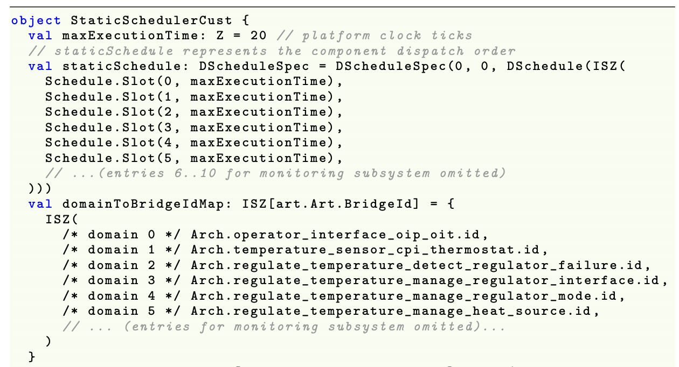
Static Schedule Declaration
Using a scheduling approach that aligns with seL4 domain scheduler and Collins Aerospace strategies – static cyclic scheduling
0
..
3
4
5
..
Scheduling slots that include a thread identifier and the absolute execution time associated with that thread…
Excerpts
Manage Heat Source allocated to slot # 5

Slide 9
Schedule Abstractions (Intuition)
Well-established notions of action independence (commutativity of task actions), e.g., when there is no notion of data dependence between tasks will be important for us (connected to the notions of partial order reductions in model-checking)
0
Operator Interface
Regulate
3
10
4
5
Heat
Controller
2
7
1
9
8
Temp
Sensor
6
Monitor
For example, from the structure and data dependence determined by connections above, we can see that the Regulate components are independent of the Monitor (safety) components.
Theoretically, this indicates that Regulate components can be commuted with Monitor components without changing the semantics of the abstract functions computed by the subsystem
Takeaway: This indicates that we may want to work with an abstraction of a static schedule (e.g., a partial ordering) that only indicates dependences between task execution. Intuitively, we will key on determining which predecessor task post-conditions are relevant for determining pre-conditions for a task. Such predecessor tasks may not be the immediate predecessors of the successor task in the static schedule.

Slide 10
Example System Property
Imprecise!!
Typical embedded system properties require not only identifying state constraints but placing these in time
Observe subsystem boundary input ports
If
[When ..subsystem has received all inputs]
Observe subsystem internal state at internal ports or thread state
There are no failure conditions on inputs
Acquire observations of system state at specific points in schedule
The Regulate Subsystem is in NORMAL mode
The current temp is greater than high set point
Bound by latency constraints
[When ..subsystem completes its scheduling]
Then
The heat control command shall be set to OFF
Challenges
…observations are for different parts of the system state (different ports (boundary and internal); thread local state??)
…observations occur at different points in time (different points in schedule)

Slide 11
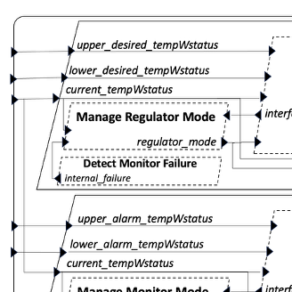
Boundary Input Port Observations
Each box below represents different atomic observations of boundary input port states
[When ..subsystem has received all inputs]
References “status” fields of the three inputs below.
If
There are no failure conditions on inputs
The Regulate Subsystem is in NORMAL mode
The current temp is greater than high set point
The above requires observations of three boundary input ports
Upper_desired_tempWstatus
Lower_desired_tempWstatus
Current_tempWstatus
We must figure out the exact notion of state being observed (complicated by “virtual port”)
We must figure out the point in time (e.g., point in static schedule) at which each observation is made

Slide 12
Internal State Observations
The box below represents an atomic observations of internal state encoding current mode (could be thread local state (should this be observable??) or internal port state)
[When ..subsystem has received all inputs]
References “status” fields of the three inputs below.
If
There are no failure conditions on inputs
The Regulate Subsystem is in NORMAL mode
The current temp is greater than high set point
The above requires an observation of encoding of current mode. This appears multiple places (output port of mode calculating component; internal state of mode calculating component; input ports of components receiving calculated mode)
???
Framework must be designed to support such operations
When multiple opportunities for observation exist, verification engineer must determine which choice of observation is most approrpriate

Slide 13
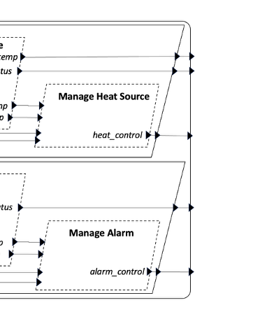
Boundary Output Port Observations
Each box below represents different atomic observations of boundary output port states
[When ..subsystem completes its scheduling]
Then
The heat control command shall be set to OFF
The above requires observations of the heat_control boundary output port
We must figure out the exact notion of state being observed (complicated by “virtual port”, but simplified because there should only be one thread output port associated with the boundary output port)
We must figure out the point in time (e.g., point in static schedule) at which the observation is made

Slide 14
More Complications Infrastructure Ports vs Application Ports
HAMR interprets AADL semantics for thread component ports in terms of infrastructure ports and application ports.
Application ports only obtain their values when a thread is dispatched.
Thread component contracts are interpreted in terms of application port values.
When stating properties about a subsystem, at the beginning of a schedule cycle (before components are dispatched), the values referenced by a system property are sitting in infrastructure ports (if we assume that all communication to input infrastructure ports from the context before the cycle begins has been completed)
Observe that we are being led to desire a notion of freezing of boundary ports for subsystems in analogy to the freezing of component input ports
Thus, when we draw an intuitive diagram like the one above, the circled ports really reference the input and output infrastructure ports of the internal thread components

Slide 15
More Complications Infrastructure Ports vs Application Ports
General thoughts…
We can see that all the preceeding concepts regarding boundary inputs/outputs and timing are quite complicated – developers will struggle to understand them and they make the reasoning quite complicated
It is likely that we will want to design some notion of “subsystem boundary abstraction” that simplifies the scheduling and port state issues. Boundary abstractions would define the units of subsystem compositional reasoning within the system. HAMR code generation would like generate additional infrastructure to realize this abstraction (for the developer programming model, and for testing and run-time monitoring).
The boundary abstraction would clarify the notions of input/output port observations – what state is being observed, and at what time (relative to the component schedule) the observation is being made
My intuition tells me that this is related to previous work on GALS (Globally asynchronous, locally synchronous work with Lustre) and the notion of Logical Execution Time (LET) – descending from work by Henzinger et al.

Slide 16
Temporal Observation Points
Property( , ... , )
<v₁,v₂, ..., v_{n}>
<v₁,v₂, ..., v_{n}>
<w₁,w₂, ..., w_{k}>
Integrated contract
checking
observe
observe
observe
...
scriptable execution progression
Initialization
Phase
Compute
Phase
Finalization
Phase
I believe that our system reasoning framework in its most general instantiation will include “temporal observations”
Properties will be stated in terms of the temporal observations
Deductions will be organized around the temporal reasoning points
A logic of invariants, pre-conditions, post-conditions are built around temporal observations in same way that..
Pre- and Post-conditions apply to statement executions (in a conventional programming logic)
Invariants apply to repeated control points (e.g., top of a loop) in a conventional programming logic
In contrast to a conventional programming logic (CPL), the notion of observation points in HAMR system is less static
In a CLP, the developer can “see” the positioning of the observation point in the program (start/end of a method, start of a loop, end of a statement) and have an easy intuitive understanding of the relative ordering of the points and the needed deductions (to prove the post-condition from the pre-condition, one needs to assume the pre-condition and move facts through each statement in the method to get to the post-condition)
In HAMR systems, observation points will be appear more “dynamic” and will likely be more “temporally triggered” that “structurally triggered”. For example, observation points will be indicated by certain points in a static schedule, or more generally, at certain interesting “schematic points” in an execution trace (e.g., “before this component is scheduled/dispatched”
This whole issue of the boundary (discussed previously) is the general problem of aligning the visibly apparent architecture structure points of interest with temporal observation points in the execution that are necessary for stating properties and forming deductions

Slide 17
Temporal Observations – Simplification: Starting from Static Schedule
Intuitive representation of static cyclic schedule (from HAMR System Testing paper)
Subsytem Inputs
0
Operator Interface
Manage Interface
Manage Heat Source
3
10
Manage Mode
4
5
Heat
Controller
Internal Failure Detection
2
7
1
9
8
Temp
Sensor
6
Temporal observation points derived from intuitive architecture structure and scheduling concept
Scheduling steps in execution trace:
…
…
10
0
1
2
3
4
5
6
7
8
9
10
0
1
2
3

Slide 18
Temporal Observations – Simplification: Starting from Static Schedule
Intuitive representation of static cyclic schedule (from HAMR System Testing paper)
Temporal observation points derived from intuitive architecture structure and scheduling concept
Scheduling steps in execution trace:
…
…
10
0
1
2
3
4
5
6
7
8
9
10
0
1
2
3
If
[When ..subsystem has received all inputs]
There are no failure conditions on inputs
The Regulate Subsystem is in NORMAL mode
The current temp is greater than high set point
Then
The heat control command shall be set to OFF

Slide 19
What are the rules for composing schedules?
Does the execution semantics get instrumented in someway to reflect the addition of hierarchy and compositional reasoning? I think yes, because there must be some notion of soundness for the compositional reasoning interpreted against the executions.
Consider a reasoning framework in terms of observation nodes and functions between observation nodes
We do eventually have to make a relationship to ports, or at least those ports that represent inputs and outputs of the system. Perhaps those can be linked in a systematic way to the observed variables.
Is a framework that focuses totally on observations about variable nodes mismatched with GUMBO contracts that reason about ports? It seems like we need someway to unify observation values with ”saved values of ports”, e.g., the last value to cross a port boundary.

Slide 20
Control Points (States?)
A set of control points and control constraints together form a control graph (structure?) that abstractly indicates designed ordering on atomic and aggregate components that is relied on to achieve functional behavior
A HAMR schedule must conform to the control graph; the control graph serves as an abstraction of a schedule.
Example: control graphs control constraints are a partial order and a static schedule is a total order that conforms to the partial order
Compositional verification is carried out wrt the control graph. This enables verification wrt an ordering abstraction, allowing the verification to be sound for all schedules that conform to the control graph
The absence of constaints (including transitive constraints) between components in the control graph indicates independence – the ability of executions of the components to be reordered without impacting the property-observed functionality of the system
Note: some aspects of this were prototyped in the “may follow” and “may proceed” relations and associated verification framework in HAMR Micro 2 models

Slide 21
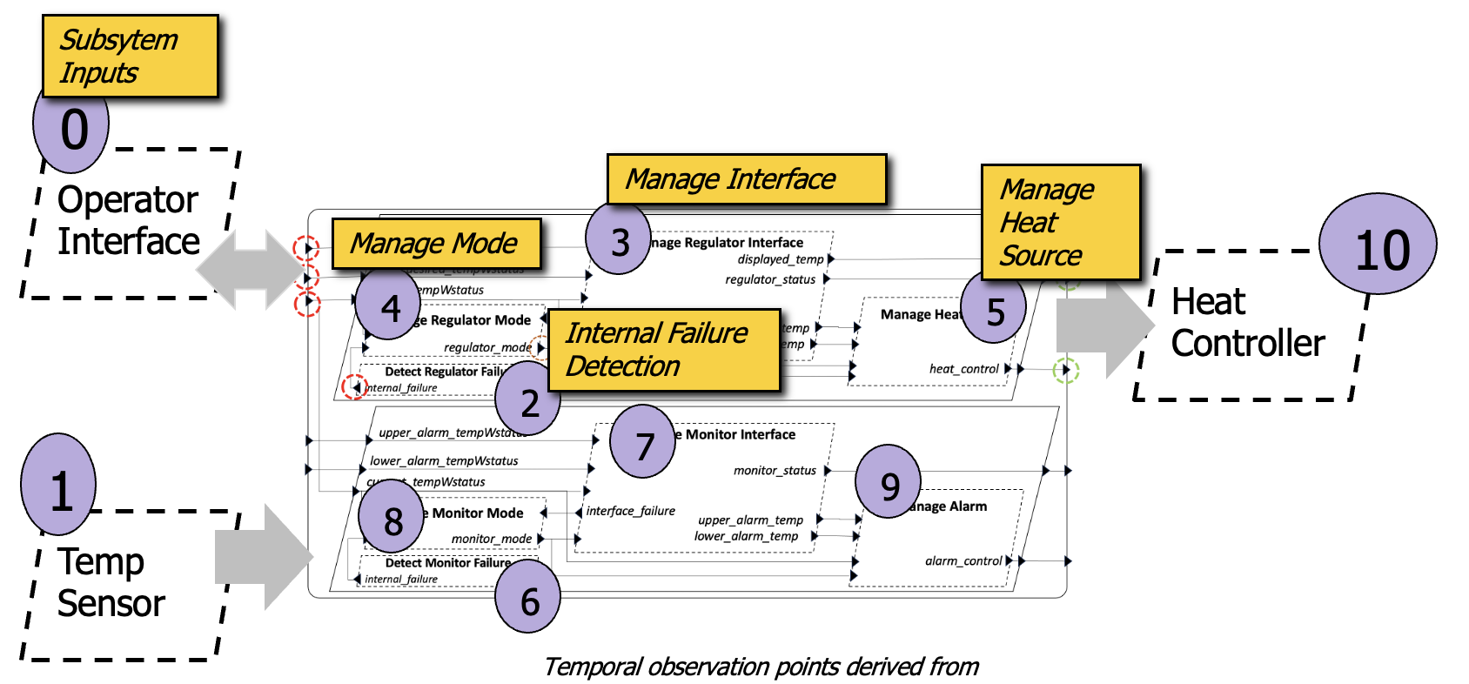
Control Graph - Intuition
A control graph is always predicated on the notion of major frame – there is always a notion of cyclicness, and stating constraints across cycle boundaries requires extra notation.
Components can be organized into (possibly nested) schedule groups to support modular specification of constraints. Each component is assumed to execute exactly once in the schedule group. If there are “inner cycles” (repetition of one or more components), these must be declared in a separate subgroup (analogous to a nested loop). This notion can be potentially supported via the AADL notion of thread group.
Regulate Subsystem Group
Monitor Subsystem
DRF < MRM
MRI < MRM
MRM < MHS
DMF < MMM
MMI < MMM
MMM < MA
Absence of constraints between components in these subgroups (and/or the fact that the components are in different subgroups) indicates “independence” between the components in the respective groups, i.e., a concrete schedule may the subgroups in any order or may interleave components from the subgroup in any order.
DRF must precede MRM,
MRI must precede MRM, MRM must precede MHS

Slide 22
Abstract Control Points
Reg_begin
Reg_end
Thermostat_begin
Thermostat_end
Mon_begin
Mon_end
To support composition of control groups and to manage verification of composition, control graphs may include abstract control points that are not thread ids, but are symbols introduced by the designer to represent symbolic points in time that may used in the constraint specification.
Some abstract control points are automatically generated from the architecture structure and control group declarations. For example, every architecture composite component C (process, system, thread group) introduces C_begin and C_end abstract control points.
Thermostat_begin < Reg_begin
Thermostat_begin < Mon_begin
Reg_end < Thermostat_end
Mon_end < Thermostat_end
Note: if we wanted to state that the Regulate subsystem must come before the monitor subsystem, we could specify that by saying Reg_end < Mon_begin
Implicit constraints are introduced, e.g., C_begin must precede every component within C ???

Slide 23
Two Phases (at least)
Initialization Phase
Compute Phase
Stopped here…

Slide 24
Properties for Abstract Functions
Display Temp function
Often, a subsystem will realize multiple functions that can be reasoned about independently (even though the components that compute the functions are not independent). For example, the Regulate subsystem computes three independent functions, as indicated on the right.
Regulator Status function
Heat Control function
AADL flows can be used to indicate which inputs are used to compute outputs associated with each functions (this can be extended to also include which local state is used to support which outputs)
When the system is refined to actual threads, we can map the abstract functions onto the interfaces and state of the threads (using AADL end-to-end flows)
The above would provide the ability to decompose and organize the functionality of a subsystem in terms of functions, which probably corresponds to how requirements would be stated in any case.
Can we organize the lower-level system assertions (used for reasoning about component composition) and component contracts themselves in terms of these functions?
Can we develop rules that allow the verification results of abstract functions to be composed?

Slide 25
Example: Abstract Component Spec
Abstract Sub-system Component Spec (consisting of all features mentioned in requirements allocated to this component)
Regulate
upper_desired_tempWstatus
lower_desired_tempWstatus
display_temp
regulator_mode
previous_heat_control
regulator_status
internal_failure
current_tempWstatus
heat_control

Slide 26
Example: Abstract Functional Specification
Overlaying the Display Temp function using notation similar to AADL Flows
Regulate
upper_desired_tempWstatus
lower_desired_tempWstatus
display_temp
regulator_mode
previous_heat_control
regulator_status
internal_failure
current_tempWstatus
heat_control
Like a thread interface and contract, each functional spec indicates
boundary port inputs
boundary port outputs
Local state read (as necessary for requirements)
Local state updated (as necessary for requirements)
Note: potential source of ambiguity – does regulator_mode in the example above refer to the previous mode (mode from the previous cycle) or newly computed mode
In the actual implementation, it depends on the previous mode computed in the previous cycle

Slide 27
Example: (Regulate) Display Temp Function
Abstract Sub-system behavior element specification
Regulate
regulator_mode
display_temp
current_tempWstatus
Associated requirements (note: these are not in original REMH, they are proposed by John H, reverse-engineered from lower-level requirements)
Req-REG-DisplayTemp-1: If the mode is normal in the subsystem pre-state, then the display temp = current temp value in the subsystem post-state (in full system, display temp is current temp rounded to the closest integer).
Req-REG-DisplayTemp-2: If the mode is not normal in the subsystem pre-state, then the display temp is unspecified (unconstrained) in the subsystem post-state.
Note: to specify a function that is computed over time, we need to indicate the temporal points for the input and output. In the above requirements, by writing “pre-state” and “post-state” we are indicating that there are temporal points in the system trace in which input values are acquired and in which outputs are produced. This needs to be formally represented in some way (which can be refined later to specific points in system scheduling). In this case, we have the simplistic situation in which there is only one input and one output (so there is no issue of inputs/outputs at different times). Moreover, we also talk about the internal state (regulator) mode as being available in the pre-state.

Slide 28
Example: Abstract Functional Specification
Overlaying the Heat Control function using notation similar to AADL Flows
Regulate
upper_desired_tempWstatus
lower_desired_tempWstatus
display_temp
regulator_mode
previous_heat_control
regulator_status
internal_failure
current_tempWstatus
heat_control

Slide 29
Example: (Regulate) Display Temp Function
Abstract Sub-system behavior element specification
Regulate
regulator_mode
display_temp
current_tempWstatus
Associated requirements (note: these are not in original REMH, they are proposed by John H, reverse-engineered from lower-level requirements)
Req-REG-DisplayTemp-1: If the mode is normal in the subsystem pre-state, then the display temp = current temp value in the subsystem post-state (in full system, display temp is current temp rounded to the closest integer).
Req-REG-DisplayTemp-2: If the mode is not normal in the subsystem pre-state, then the display temp is unspecified (unconstrained) in the subsystem post-state.
Note: to specify a function that is computed over time, we need to indicate the temporal points for the input and output. In the above requirements, by writing “pre-state” and “post-state” we are indicating that there are temporal points in the system trace in which input values are acquired and in which outputs are produced. This needs to be formally represented in some way (which can be refined later to specific points in system scheduling). In this case, we have the simplistic situation in which there is only one input and one output (so there is no issue of inputs/outputs at different times). Moreover, we also talk about the internal state (regulator) mode as being available in the pre-state.

Slide 30
Types of Properties (Phase I)
Component Contract
Pre-condition
Constraint on component input ports (application port view) and local variables
always holds when the component is executed
Post-condition
Constraint on component input ports (application port view), pre-state local variables, output ports (application port view), post-state local variables
System Assertion
Constraint on system state including communication substrate, component input and output infrastructure ports, component local variables
Invariant can also be conditioned on control points. The simplest form of this is to condition it on the schedule state (e.g., different positions in the static schedule), but it could also be conditioned on more abstract notions (e.g., component X just finished executing).
Pre
SysAssert1
SysAssert2
Post

Slide 31
VC Structure (Phase 1)
Pre
SysAssert1
SysAssert2
Post
SysAssert1 implies Pre
SysAssert1 & Post implies SysAssert2

Slide 32
Types of Properties (Phase X?)
C1@end
…
Cn@end
Pre
SysAssert
SysAssert1
SysAssert2
Sched@begin
Post
Sched@end
Infra
For practicality, it is like that the invariant will be broken down into “useful pieces” that are intuitive to engineers
This means that the full invariant would not have to be treated by the user at each component, but only the parts that are established (proven in the meta-theory) to be relevant for that component

Slide 33
Example: (Regulate) Display Temp Function
Display Temp is a particularly simple subsystem function that is actually componented by a single refining component, and that component occurs first in the subsystem schedule
Regulate
regulator_mode
display_temp
The choice for refinement of the mode is not as simple as there are multiple state elements in the refinement where mode is stored. Moreover, a change in mode is computed during the execution of the subsystem. We choose the input to MRI as that is what is used directly to compute display_temp. Note that this value was computed on the previous cycle. It should be equal to the pre-state value of the MRM local state variable. Reasoning about this would be part of the reasoning associated with composing cycles or composing abstract functions for computing the mode and for computing the display temp.
current_tempWstatus
?
Refinement…
This is essentially defining the refinement for the abstract boundary ports
MRI
display_temp
display_temp
MRM
mode
MHS
mode
current_tempWstatus
DRF
mode
Recall that boundary ports are essentially aliases for internal ports. Their observable state is the observable state of the internal port. Things work out more easily if there is only one internal port per one boundary port.
DRF < MRM
MRI < MRM
MRM < MHS

Slide 34
Example: (Regulate) Display Temp Function
Display Temp is a particularly simple subsystem function that is actually componented by a single refining component, and that component occurs first in the subsystem schedule
Regulate
regulator_mode
display_temp
current_tempWstatus
Refinement… (with proof concepts)
MRI
display_temp
display_temp
MRM
mode
MHS
mode
current_tempWstatus
DRF
mode
Verification note: rely directly on the contract for MRI
DRF < MRM
MRI < MRM
MRM < MHS
Verification note: rely on frame conditions for display_temp for MRM and MHS components

Slide 35
Example: (Regulate) Display Temp Function
DRF < MRM
MRI < MRM
MRM < MHS
MRI
@Reg_end
display_temp
@Reg_begin
display_temp
MRM
mode
MHS
mode
Note: Refinement also requires a temporal refinement – an association of the refined state to a refined temporal point associated with temporal points in the refinement subsystem
current_tempWstatus
DRF
@Reg_begin
mode
Temporal view
Warning: This is only intuition, I can’t figure out the exact semantics for the temporal precedence relation
There are no frame preconditions relevant for the DISPLAY TEMP function .. BUT MRI and MHS have pre-conditions on lower/upper desired that must be established
Frame: Display Temp not modified; mode is modified (but our requirement references logged mode at beginning of cycle.
DisplayTemp
DRF
MRM
MHS
DisplayTemp_post
Reg_begin
DisplayTemp_pre
?
Log post-state values displayTemp
Reg_end
Log pre-state values current_tempWstatus and last_regulator_mode
MRI
MRM_end_SA
MHS_end_SA
..& Display_Temp_Fun
..& Display_Temp_Fun
Reg_begin_SA
..& Display_Temp_Fun
MRI_Pre
MRI_Post
Reg_end_SA
Display_Temp_Fun property is established from MRI contract here…
Display_Temp_Fun property is preserved via component frame conditions here…
Display_Temp_Fun property holds at the end of the cycle

Slide 36
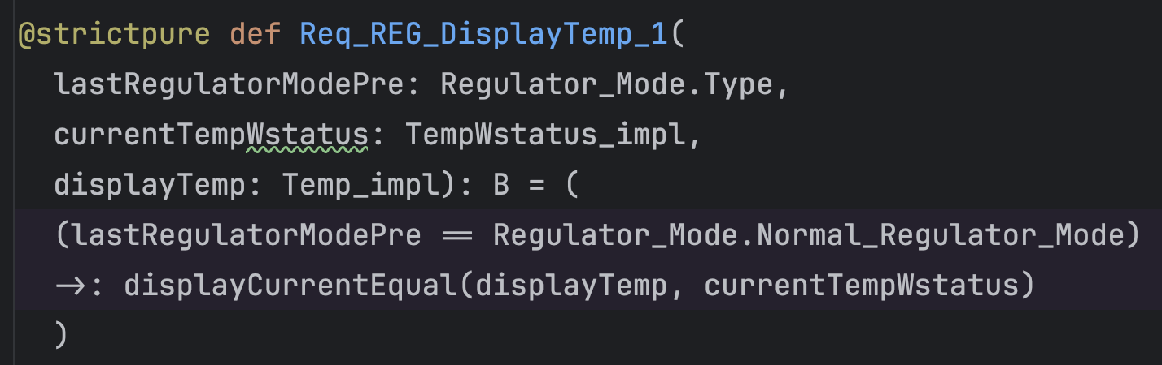
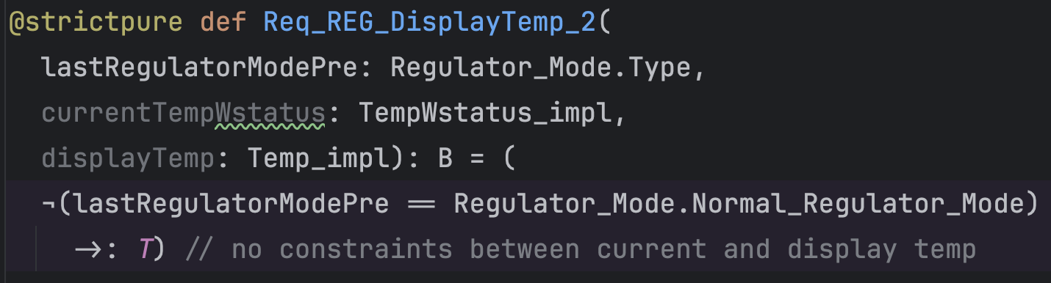
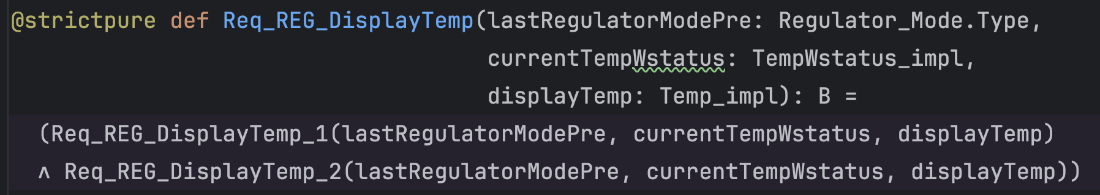
Example: (Regulate) Display Temp Function
Formalize predicates corresponding to abstract subsystem requirements
Req-REG-DisplayTemp-1: If the mode is normal in the subsystem pre-state, then the display temp = current temp value in the subsystem post-state
Req-REG-DisplayTemp-2: If the mode is not normal in the subsystem pre-state, then the display temp is unspecified (unconstrained) in the subsystem post-state.
Req-REG-DisplayTemp: (Conjunction of the two properties above). Intuitively, this is the predicate representing the logic of the contract for the abstract DisplayTemp function allocated to the REG subsystem.
…but we still need to map/refine the function contract logic above to particular temporal points

Slide 37
Example: (Regulate) Display Temp Function
Display Temp is a particularly simple subsystem function that is actually componented by a single refining component, and that component occurs first in the subsystem schedule
Regulate
regulator_mode
display_temp
current_tempWstatus
Req_REG_DisplayTemp(
current_tempWstatus@Reg_begin,
regulator_mode@Reg_begin
display_temp@Reg_end
)
These must be refineable to observable/loggable aspects of the system state. Documentation of the refinement (e.g., down to seL4) is key for supporting appropriate audits
Stefan: To provide the “logging” concept or the notion of a state element, they can be mark “dirty”.

Slide 38
To Do
Define notion of independence (commutivity) for HAMR components
What about component pre-conditions not related to the current abstract function that we are trying to reason about

Slide 39
Other properties to be consider
The last command saved and used by the MHS component, is really the command sent on the previous cycle
A similar property exists for the previous mode
Composition of the mode and heat control functions (e.g., if there is a bad value on an input), then the heat will be off
Regulator status is reported on operator interface (delayed one frame)
Compose temp sensor with thermostat

Slide 40
Need some type of constraint that gets specified by one component that indicates what needs to not happen in other components for it to be composable with those components and still meet its specification.

