Slide 1
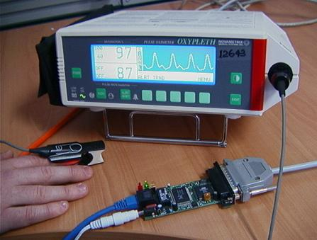
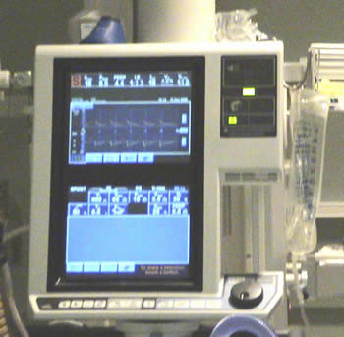
2
AADL System
package PCA_Shutoff
public
with PulseOx_Interface, RespiratoryMonitor_Interface, PCAPump_Interface, PCA_Shutoff_Logic, PCA_Shutoff_Properties, PCA_Shutoff_Display;
system PCA_Shutoff_System
end PCA_Shutoff_System;
system implementation PCA_Shutoff_System.imp
subcomponents
pulseOx : device PulseOx_Interface::ICEpoInterface.imp;
respiratoryMonitor : device RespiratoryMonitor_Interface::ICErrInterface.imp;
appLogic : process PCA_Shutoff_Logic::ICEpcaShutoffProcess.imp;
appDisplay : process PCA_Shutoff_Display::ICEpcaDisplayProcess.imp;
pcaPump : device PCAPump_Interface::ICEpcaInterface.imp;
connections
-- From components to logic
spo2_logic : port pulseOx.SpO2 -> appLogic.SpO2;
pulserate_logic : port pulseOx.PulseRate -> appLogic.PulseRate;
respiratoryrate_logic : port respiratoryMonitor.RespiratoryRate -> appLogic.RespiratoryRate;
3
AADL Types
Output rate: 1 sec .. 5 sec
AADL Process: Logic
AADL Process: Display
Device2
Thread1
Thread1
1
A
3
Thread4
4
Thread2
Default Properties
Device1
Thread2
1
Thread3
Channel Delay: 50ms
Translates to…
Period: 50ms
WCET: 5ms
<mdcf.core.app.AppSpec>
<appName>PCA_Shutoff_System</appName>
<components>
<mdcf.core.app.VirtualComponent>
<name>appDisplay</name>
<type>ICEpcaDisplayProcess</type>
<role>AppPanel</role>
</mdcf.core.app.VirtualComponent>
<mdcf.core.app.VirtualComponent>
<name>appLogic</name>
<type>ICEpcaShutoffProcess</type>
<role>Logic</role>
</mdcf.core.app.VirtualComponent>
</components>
<channels>
<mdcf.core.app.Channel>
< <subName>SpO2</subName>
<pubComp>
<name>$PLACEHOLDER$</name>
<type>$PLACEHOLDER$</type>
<role>Device</role>
</pubComp>
<subComp>
<name>appLogic</name>
<type>ICEpcaShutoffProcess</type>
<role>Logic</role>
</subComp>
<channelDelay>100</channelDelay>
</mdcf.core.app.Channel>
<mdcf.core.app.Channel>
<chanName>$PLACEHOLDER$</chanName>
<subName>PulseRate</subName>
System.cfg.xml
Logic.java
Display.java
Dev2.java
Task1
Task1
5
B
Task2
Task4
Task2
Dev1.java
Task3
LogicSuperType.java
DisplaySuperType.java
Logic.compsig.xml
Display.compsig.xml
Instantiates as…
Display
Task1
Task2
ICE Manager
App
C
ICE Data Logger
Task1
Task4
Task2
Task3
PseudoDev1
PseudoDev2

