Slide 1
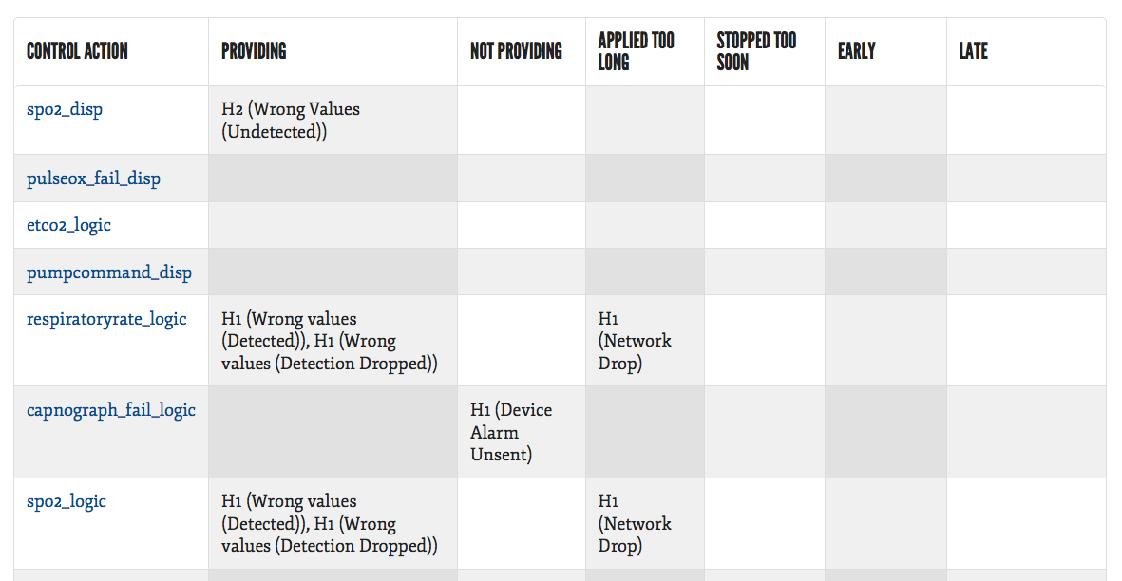
Hazard Analysis Process
Interaction between Report and Model
1. Report indicates analysis incomplete
Notes:
10.50 – 11.35 [45s]
Intro: “This means that we now have an iterative, architecturally-integrated hazard analysis process”
Outro: “But it turns out, this is only one of the impacts of our work.”

Slide 2
Hazard Analysis Process
Interaction between Report and Model
1. Report indicates analysis incomplete
Top Down
2. Developer creates occurrence property and supporting EMV2 annotations
Notes:
10.50 – 11.35 [45s]
Intro: “This means that we now have an iterative, architecturally-integrated hazard analysis process”
Outro: “But it turns out, this is only one of the impacts of our work.”

Slide 3
Hazard Analysis Process
Interaction between Report and Model
1. Report indicates analysis incomplete
Top Down
3. Tool highlights unconsidered propagation paths
2. Developer creates occurrence property and supporting EMV2 annotations
Notes:
10.50 – 11.35 [45s]
Intro: “This means that we now have an iterative, architecturally-integrated hazard analysis process”
Outro: “But it turns out, this is only one of the impacts of our work.”

Slide 4
Hazard Analysis Process
Interaction between Report and Model
4. Developer creates supporting occurrence property, considers alternative impacts of hazard
1. Report indicates analysis incomplete
Bottom Up
Top Down
3. Tool highlights unconsidered propagation paths
2. Developer creates occurrence property and supporting EMV2 annotations
Notes:
10.50 – 11.35 [45s]
Intro: “This means that we now have an iterative, architecturally-integrated hazard analysis process”
Outro: “But it turns out, this is only one of the impacts of our work.”

