Slide 1
Program Reasoning Using Logika: Conditional Statements
STRESS 2024 – October 24, 2024
Kansas State University
Aarhus University
Robby
John Hatcliff
Jason Belt
Stefan Hallerstede
This material is based on research sponsored in part by DARPA
DISCLAIMER: The views and conclusions contained in this presentation are those of the author and should not be interpreted as representing the official policies, either express or implied, of any agency or department of the U.S. Government, Kansas State University or Aarhus University
Notes:
I'm John Hatcliff, a professor from Kansas State University. This is a second talk on semantics for a modeling language, and here we aim to make deeper connections with the underlying application and infrastructure code via contracts. This talk pulls together several different lines of work that were carried out in collaboration with different teams, including teams from SEI and Galois primarily, but always folks from Collins Aerospace and people working on seL4.

Slide 2
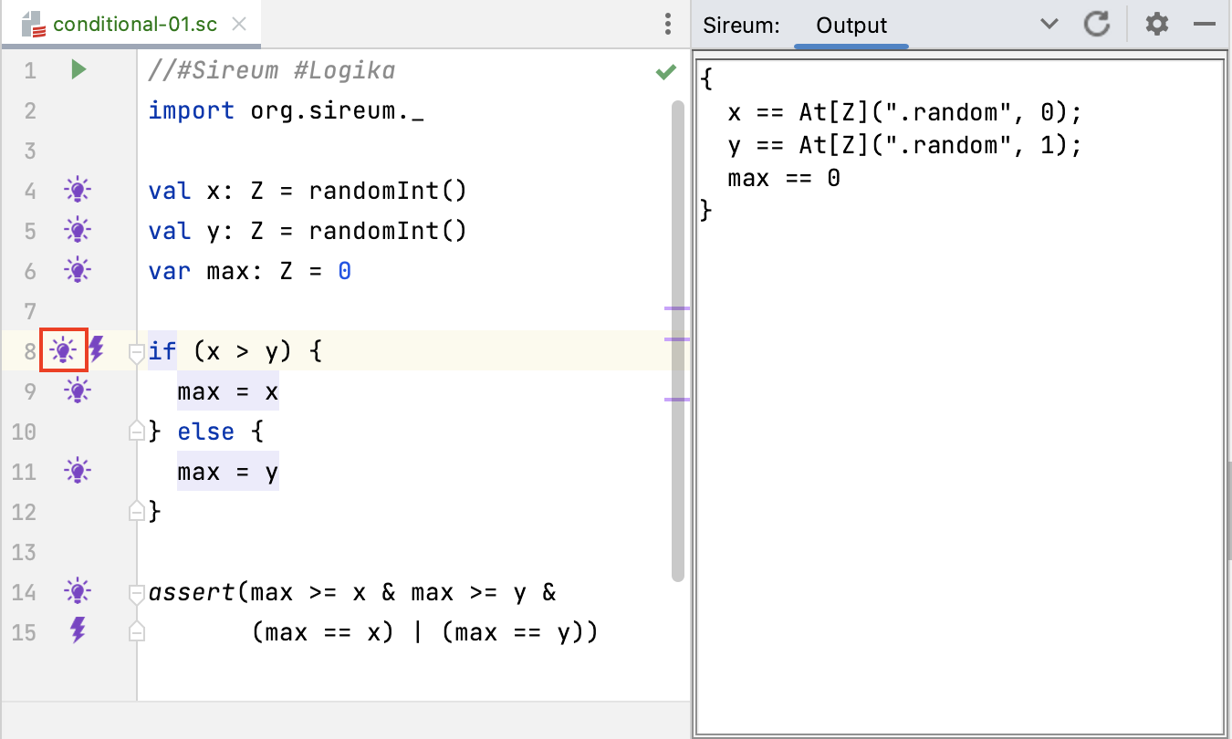
Conditionals: Example

Slide 3
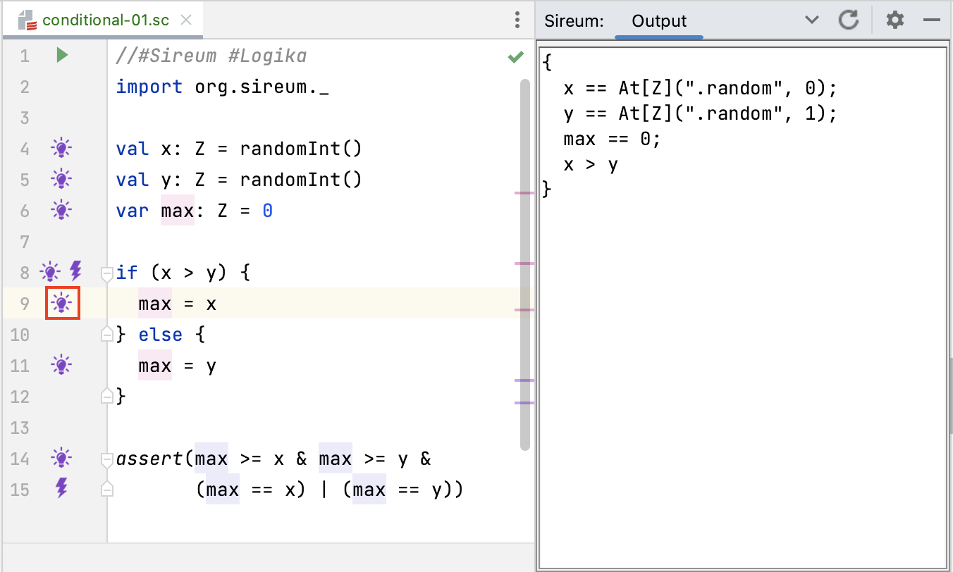
Conditionals: Example

Slide 4
Conditionals: Example
Check if branches are feasible

Slide 5
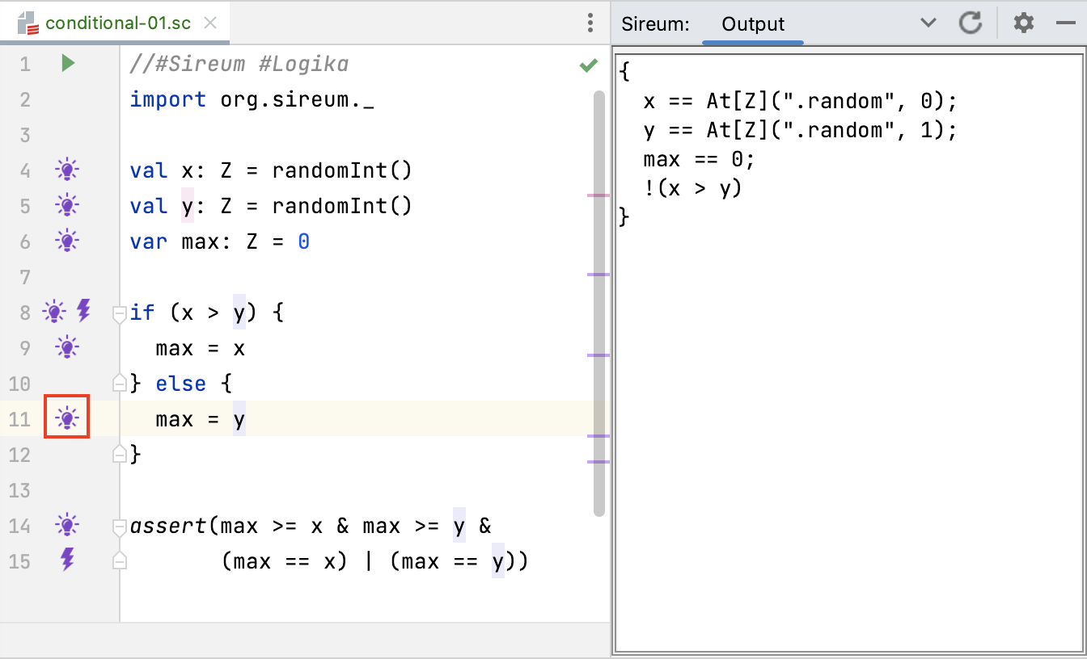
Conditionals: Example

Slide 6
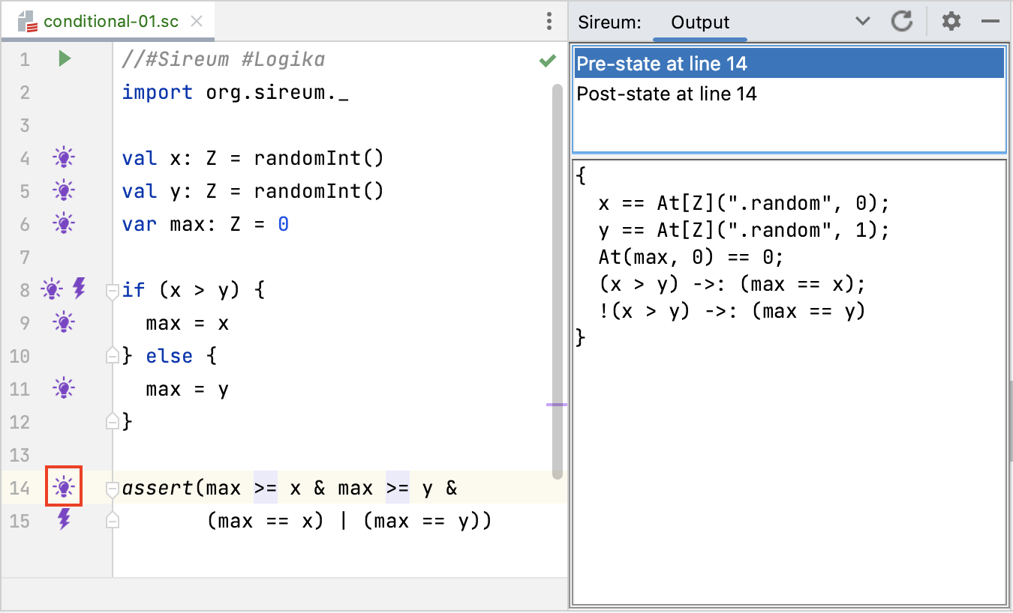
Conditionals: Example

Slide 7
Conditionals: Reasoning Principles
At test expression..
Is true branch feasible based on accumulated facts? (if so, check the code in true branch)
Is false branch feasible based on the accumulated facts? (if so, check the code in the false branch)
In true branch..
Carry accumulated facts from before test into local fact set
Gain knowledge locally: Add test expression B to the local fact set for the branch
In false branch..
Carry accumulated facts from before test into local fact set
Gain knowledge locally: Add negation of test expression !B to the local fact set for the branch
At the end of the conditional..
Merge facts – when both branches were checked
Add B =>

Slide 8
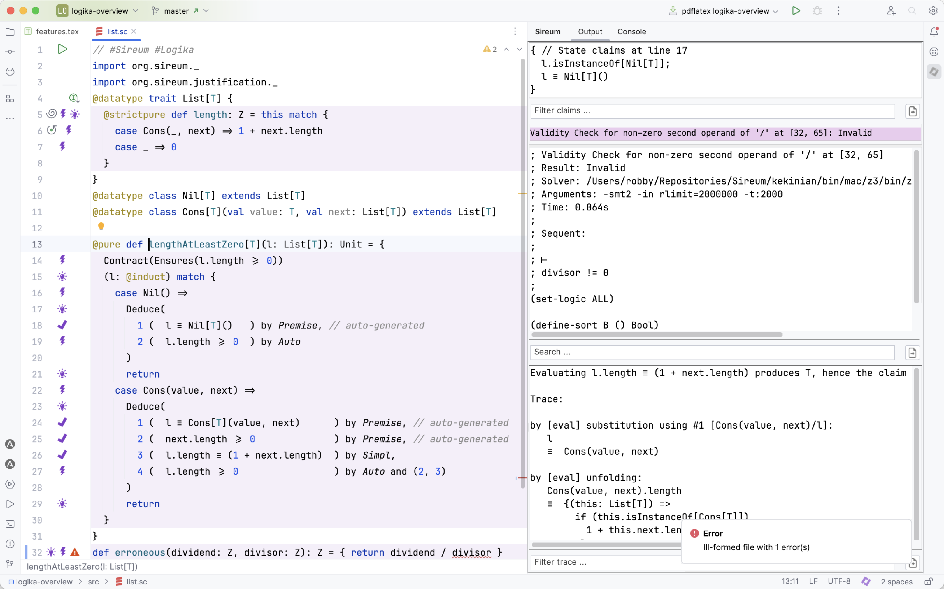
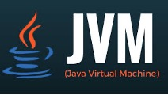
Slang-based Development
Integrates with JVM-based languages and libraries
A safety-critical subset of Scala with tailored (simplified) semantics
Retains Scala blending of imperative, functional, and OO paradigms
Compiles to JVM bytecode, Javascript, and native
Rich IDE support
Interoperable with huge collection of libraries in Java/Scala ecosystem

Slide 9


Slang-based Development
Slang Embedded profile – supports industrial embedded system development
Translation to C99
No garbage collection at runtime (only global & stack allocations)
Can be compiled using gcc, clang, and the CompCert Verified C compiler
Translation to Rust
under development with Collins Aerospace and Aarhus University (Stefan Hallerstede)
Contract verification with CMU Verus Rust verification tool
(in progress)

Slide 10
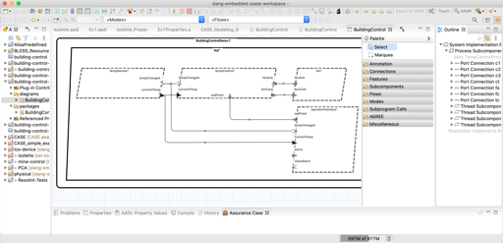
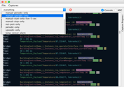
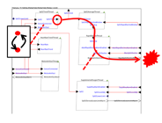



HAMR – Model-driven Developemnt
One of the industry-relevant applications of applications of Slang & Logika
Leveraging analyses from AADL community
Modeling, analysis, and verification in the AADL modeling language
(+ SysMLv2 Prototype)
Component development and verification in multiple languages
C
Slang (developed at Kansas State)
high integrity subset of Scala
contract verification framework
translates to C
translates to Rust (upcoming)
Rust (upcoming on DARPA PROVERS)
Deployments aligned with AADL run-time on multiple platforms
JVM Deployment
Linux Deployment
seL4 Deployment
verified micro-kernel
Notes:
The framework that we will be using for this work is HAMR -- a model-driven development tool chain for high assurance embedded systems that emphasizes three layers of development:
Modeling, analysis and verification in the AADL modeling language, leveraging many tools in the AADL ecosystem
Development of component application logic in multiple languages include C and Slang (a safety-critical system of Scala with a contract verification framework, which can be translated to C)
Deployments on multiple platforms including seL4 verified microkernel.

Slide 11
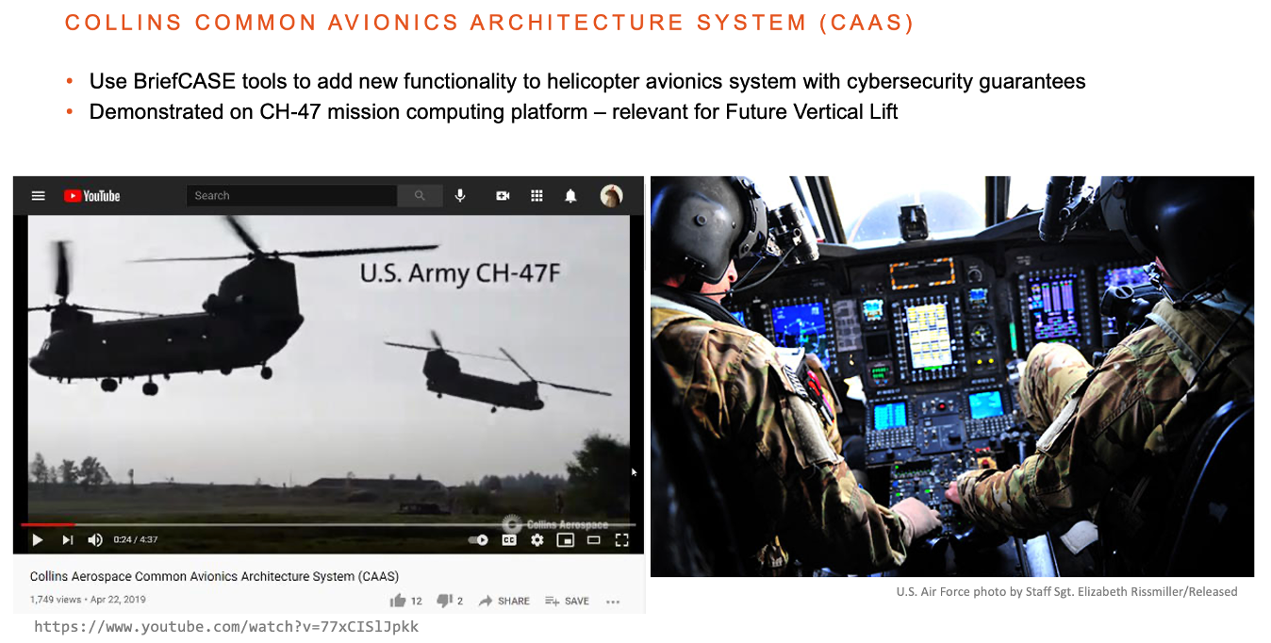
HAMR – Collins Aerospace
Collins technology stack (including HAMR) used to add new cyber-resilient functionality to CH-47 military helicopter mission computing…
Detailed journal paper on HAMR with seL4 backend
Jason Belt, John Hatcliff, Robby, John Shackleton, Jim Carciofini, Todd Carpenter, Eric Mercer, Isaac Amundson, Junaid Babar, Darren Cofer, David Hardin, Karl Hoech, Konrad Slind, Ihor Kuz, Kent Mcleod. “Model-Driven Development for the seL4 Microkernel Using the HAMR Framework”. Journal of Systems Architecture. Volume 134, January 2023
Notes:
The framework that we will be using for this work is HAMR -- a model-driven development tool chain for high assurance embedded systems that emphasizes three layers of development:
Modeling, analysis and verification in the AADL modeling language, leveraging many tools in the AADL ecosystem
Development of component application logic in multiple languages include C and Slang (a safety-critical system of Scala with a contract verification framework, which can be translated to C)
Deployments on multiple platforms including seL4 verified microkernel.

Slide 12

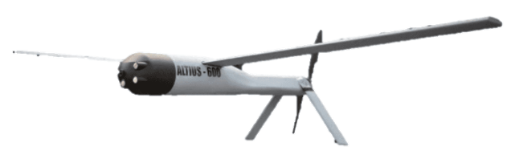
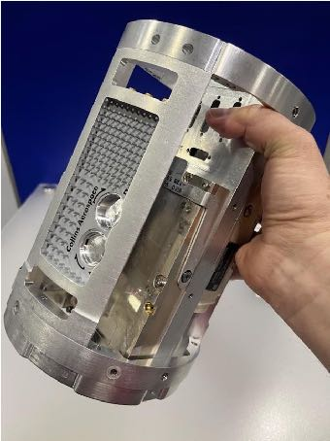
HAMR – Collins Aerospace
XXXX
Current - Mission computer for UAVs launched from a tube (Air Launched Effects)
Notes:
The framework that we will be using for this work is HAMR -- a model-driven development tool chain for high assurance embedded systems that emphasizes three layers of development:
Modeling, analysis and verification in the AADL modeling language, leveraging many tools in the AADL ecosystem
Development of component application logic in multiple languages include C and Slang (a safety-critical system of Scala with a contract verification framework, which can be translated to C)
Deployments on multiple platforms including seL4 verified microkernel.

