Slide 1
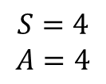
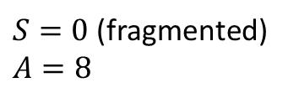
$S=0$ (fragmented)
$$A=8$$
$$S=4$$
$$A=4$$

