Slide 1
CSS430 File-System Implementation
Textbook Ch11
These slides were compiled from the OSC textbook slides (Silberschatz, Galvin, and Gagne) and the instructor’s class materials.
css430 file-system implementation

Slide 2
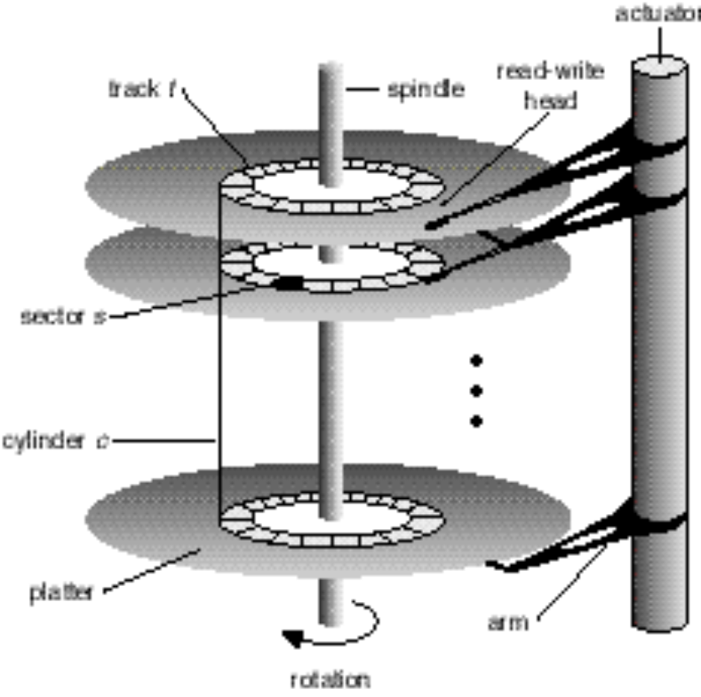
File System Structure
File system interface provides applications with various system calls and commands such as open, write, read, seek, etc..
File system maintains disk space in blocks and allocates available blocks to each stream-oriented file.
Basic file system (BIOS) maintains data in physical blocks
Disk driver reads from and writes to disk in a unit of block which consists of one (or more) sector(s).
Disk maintains data locations with drive#, cylinder#, track# and sector#
track
sector
cylinder
css430 file-system implementation

Slide 3

File System Implementation
Boot control block contains info needed by system to boot OS from that volume
Volume control block contains volume details (= super block in Unix)
Directory structure organizes the files file (= a file in Unix)
Per-file File Control Block (FCB) contains many details about the file (= inode in Unix)
css430 file-system implementation

Slide 4

In-Memory File System Structures
css430 file-system implementation

Slide 5
Allocation Methods
How should file system allocate disk blocks to each stream-oriented file?
  Contiguous Allocation
  Linked Allocation
    File allocation table
  Indexed Allocation
    Linked scheme
    Multilevel index
    Combined scheme (Unix)
css430 file-system implementation

Slide 6
Contiguous Allocation
directory
Merits
  Good performance (minimal seek time)
Example
  IBM VM/CMS
Problems
  External fragmentation
  Determining the file space upon its creation
  (Can we predict the size before a file is written?)
File | Start | Length
count | 0 | 2
tr | 14 | 3
mail | 19 | 6
list | 28 | 2
f | 6 | 2
0
1
2
3
4
5
6
7
8
9
10
11
12
13
14
15
16
17
18
19
20
21
22
23
24
25
26
27
28
29
css430 file-system implementation

Slide 7

Linked Allocation
Merits
  Need only starting block
  No external fragmentation
Problems
  Sequential access
  Link information occupying a portion of block
  File not recovered if its link is broken
css430 file-system implementation

Slide 8
File Allocation Table (FAT)
directory entry
FAT has an entry for each disk block.
FAT entries rather than blocks themselves are linked.
Example:
  MS-DOS and OS/2
Merit:
  Save disk block space
  Faster random accesses
Demerit:
  A significant number of disk head seeks
name
start block
test
217
0
217
618
339
EOF
217
339
618
339
618
#blocks -1
FAT
css430 file-system implementation

Slide 9
File Allocation Table (FAT)
FAT12
  FAT entry size: 12bits
  #FAT entries: 4K
  Disk block (cluster) size: 32K (depends on each system)
  Total disk size: 128M
FAT16
  FAT entry size: 16bits
  #FAT entries: 64K
  Disk block size: 32K
  Total disk size: 2G
FAT32
  FAT entry size: 32bits, of which 28bits are used to hold blocks
  #FAT entries: 256M
  Disk block size: 32K
  Total disk size: 8T, (but limited to 2T due to the use of sector counts with the 32bit entry.)
css430 file-system implementation

Slide 10
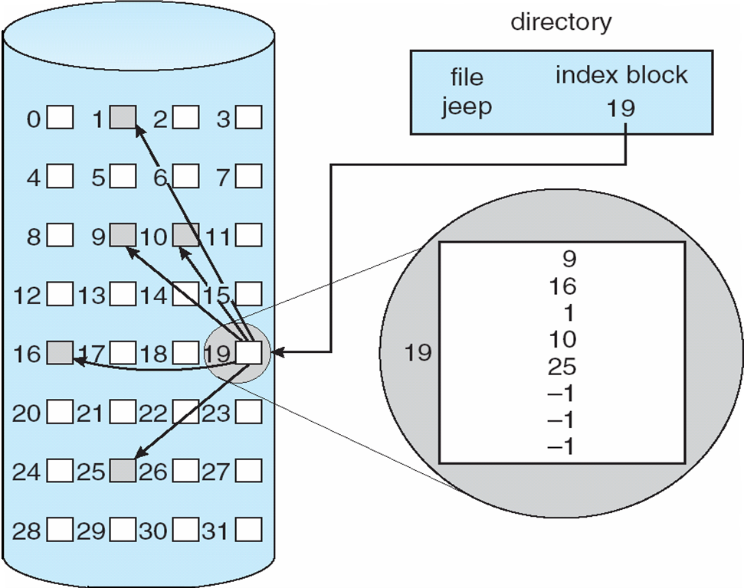
Indexed Allocation
Similar to the paging scheme
Merit:
  Directory access
Demerits:
  Internal fragmentation
  Uncertainty in the index block size
    Too small: cannot hold a large file
    Too large: waste disk space
css430 file-system implementation

Slide 11
NTFS
MFT (Master File Table):
  An array of records, each holding the attributes for a different file
File reference
MFT
63
47
0
Sequence
File Number
File record: name, security, and data
For consistency
check
MFT entry - 1
Run(extent)
Run(extent)
Disk
Cluster numbers
Cluster numbers
86 87 88 89
505 506 507 508
css430 file-system implementation

Slide 12
NTFS Continued
Directory:
  Includes all the file references belonging to the directory in its runs
MFT
Directory “\”
File record: name, security, and data
Run(extent)
Run(extent)
Cluster numbers
Cluster numbers
file1 file2 file3 file4
file5 file6 file7 file8
css430 file-system implementation

Slide 13

Linked Scheme in Index Allocation
Advantage:
Adjustable to any size of files
Disadvantages:
Slower random accesses for larger files
4
5
6
.
.
.
.
28
27
29
30
css430 file-system implementation

Slide 14
Multilevel Index in Indexed Allocation

outer-index
Advantage:
Adjustable to any size of files
Disadvantages:
Multiple table accesses
index table
file
css430 file-system implementation

Slide 15

Combined Scheme: UNIX (4K bytes per block)
Inode
  File information
  The first 12 pointers point directly to data blocks
  The 13th pointer points to an index block
  The 14th pointer points to a block containing the addresses of index blocks
  The 15th pointer points to a triple index block.
css430 file-system implementation

Slide 16
Unix File System Structure
Process
int fd = open(“fileA”, flags);
read(fd, …);
PCB
0
1
2
3
stdin
stdout
Inode:
length
count 1
direct[12]
indirect[3]
stderr
struct file:
count 1
inode
Disk
User file
Descriptor table
File Structure Table
Inode table
css430 file-system implementation

Slide 17
Discussions 1
In which table should we implement the file seek pointer, a user file descriptor table, a file structure table, or an inode table?
  Why? Consider the reason as focusing on the situation where a parent and a child process shares the same file at the same time when another independent process also reads the same file.
What is the similarity and difference in file allocation between Unix and Windows NTFS
css430 file-system implementation

Slide 18
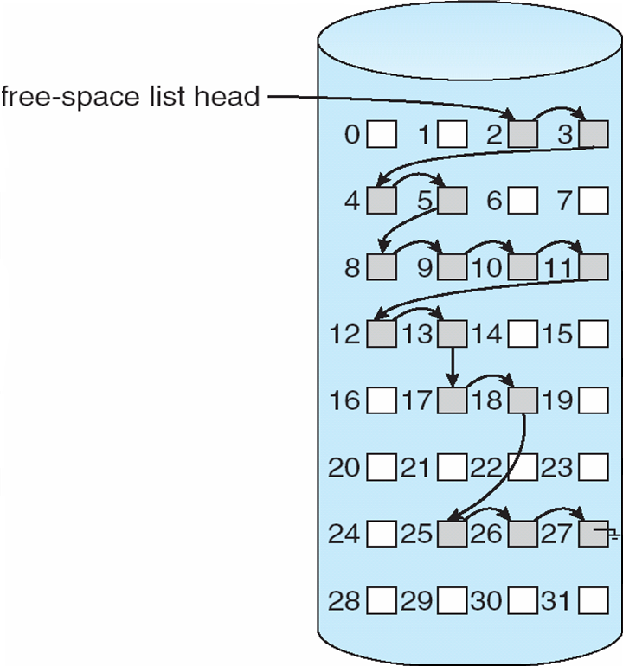
Free Space Management
Bit vector (n blocks)
Linked free space list
Easy to find contiguous space | Pros | No waste of space
Waste of memory space | Cons | Difficult to find contiguous space
0
1
2
n-1
…
0 ⇒ block[i] free
1 ⇒ block[i] occupied
bit[i] =

css430 file-system implementation

Slide 19
Directory Implementation
Linear list of file names with pointer to the data blocks
  simple to program
  time-consuming to execute
  Unix/Linux
Hash Table – linear list with hash data structure
  decreases directory search time
  collisions – situations where two file names hash to the same location
  fixed size
inode | name
358 | a.out
285 | Boot.java
571 | prog.cpp
css430 file-system implementation

Slide 20
CSS430 ThreadOS File System
Superblock and Inodes
Superblock
int totalBlocks;
int totalInodes;
int freeList;
Block #0
Free
Block #x
Free
Block #y
Free
Block #z
Inode #0 32bytes
Inode #1
Block #1
Inode #15
/ root
directory
Block #2
Inode #inodeBlocks -1
Block #totalBlocks - 1
css430 file-system implementation

Slide 21
CSS430 ThreadOS File System
“/” Root Directory
Directory()
  Initialize “/” directory
bytes2directory( byte data[])
  Initialize directory with byte[] which have been retrieved from disk
directory2bytes()
  Converts directory information into byte[]
ialloc(String filename)
  Allocate an iNumber
ifree(short iNumber)
  Deallocate the iNumber
namei(String filename)
  Return this file’s iNumber
Entry[] fname size fileName
(iNumber)
0
1
2
3
4
5
6
7
8
9
10
inodeBlock-1
1
4
4
4
4
5
5
6
6
9
6
6
5
/
init
fsck
clri
motd
mount
mknod
passwd
umount
checklist
fsdblb
config
getty
css430 file-system implementation

Slide 22
CSS430 ThreadOS File System
Thread
int fd = SysLib.open(“fileA”, mode);
SysLib.read(fd, …);
A simplified structure of Unix file system
TCB
0
1
2
3
31
stdin
stdout
Inode:
length
count 1
direct[11]
indirect
stderr
struct file:
count 1
inode
Disk
User file
Descriptor table
File (Structure) Table
Inode table
css430 file-system implementation

Slide 23
Exercises 1 ~ 3
Final Project:
  Check the syllabus for its due date.
Problems (No turn-in):
  Solve Exercise 11.1.
  Solve Exercise 11.11.
  Solve Exercise 11.14.
css430 file-system implementation

Slide 24
Exercise 4
Consider two different file systems, one based on a contiguous allocation strategy and the other based on our ThreadOS’ allocation strategy, (i.e., a combined index allocation.) The interface of those two file systems is the same as our ThreadOS, (i.e., based on Java). Assume that an 11-block file named “css430” has been already created in each of those file systems. Trace the operations performed by each file system when executing the following Java code. List all conceivable file system operations incurring a disk read, a disk write, and/or even no disk access chronologically. Calculate how many disk-read and write operations are required for executing this Java code. (20pts)
Java code:
int fd = open( “css430”, “a” );
byte[] buffer = new byte[300];
write( fd, buffer );
seek( fd, 1000, 0 );
read( fd, buffer );
Assumptions:
The disk block size is 512 bytes.
The file system has a single level directory named “/”.
The directory is maintained in the memory.
A seek pointer for each opened file is maintained in a certain data structure or an object instantiated in the memory.
In the contiguous allocation, there is room to grow in the end but in the beginning of the file.
Inode data members you need to care of include 11 direct pointers, an indirect pointer, and length. You may ignore all the other data members such as flag and count.
An index block includes 256 pointers to a disk block.
css430 file-system implementation

Slide 25
Exercise 4 (Cont’d)
Each of the following operations involves one disk read:
Reading a block that includes an inode you need to refer to
Referring to an index block
Receiving a new free block from the super block (except in contiguous allocation)
Reading a block of a user file’s
Each of the following operations involves one disk write:
Writing a block that includes an inode you need to update
Updating the content of an index block
Returning a new free block to the super block (except in contiguous allocation)
Writing a block of a user file’s
Each of the following operations involves no disk read/write:
Referring to the directory
Updating the directory contents
Referring to a seek pointer
Changing the position of a seek pointer
Allocating and de-allocating a new block in contiguous allocation
When filling out the following table, focus on only file system operations. Do not include general OS operations such as “a system call invoked”, “an interrupt happened”, “a requesting process suspended”, and “a new process scheduled”.
css430 file-system implementation

Slide 26
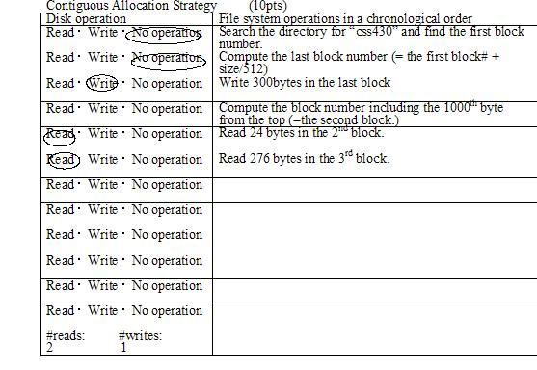
Exercise 4 (Cont’d)
css430 file-system implementation

Slide 27
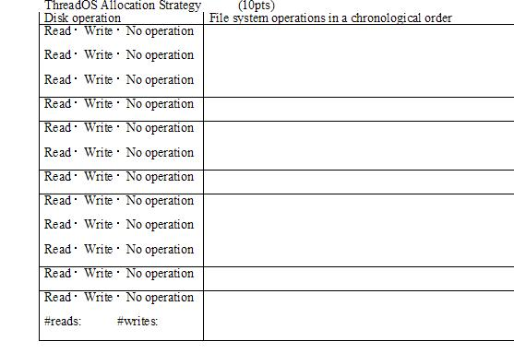
Exercise 4 (Cont’d)
css430 file-system implementation

