Slide 1
CSS430 Process Synchronization
Textbook Ch6
These slides were compiled from the OSC textbook slides (Silberschatz, Galvin, and Gagne) and the instructor’s class materials.
CSS430 Processes Synchronization
Notes:
Hello! Everyone,
My name is Shinya Kobayashi. Today, I am going to present our paper titled “Inter-Cluster Job Coordination Using Mobile Agents” on behalf of the first author, Munehiro Fukuda. Munehiro was hoping to show up and present the paper at AMS2001, however he got to wait in Japan until he will get an H1B visa. Since I received the presentation materials from him quite recently, please allow me to present this paper using this script.
I can respond to your questions as far as I know, however you can also ask Munehiro by email. His email address is on the title page of our paper.
(time 1:05)

Slide 2
Revisiting Bounded Buffer
Producer Process
for(int i = 0; ; i++ ) {
BoundedBuffer.enter(new Integer(i));
}
public void enter( Object item ) {
while ( count == BUFFER_SIZE )
; // buffer is full! Wait till buffer is consumed
++count;
buffer[in] = item; // add an item
in = ( in + 1 ) % BUFFER_SIZE;
}
public object remove( ) {
Object item;
while ( count == 0 )
; // buffer is empty! Wait till buffer is filled
-- count;
item = buffer[out]; // pick up an item
out = ( out + 1 ) % BUFFER_SIZE;
}
Dissect it !!
Dissect it !!
Buffer[0] [1] [2] [3] [4]
Consumer Process
for(int i = 0; ; i++ ) {
BoundedBuffer.remove();
}
out
in
CSS430 Processes Synchronization

Slide 3
Race Condition
++count:
reg1 = mem[count];
reg1 = reg1 + 1;
mem[count] = reg1;
- count:
    reg2 = mem[count];
    reg2 = reg2 – 1;
    mem[count] = reg2;
Producer: reg1 = mem[count]; {reg1=5}
Producer: reg1 = reg1 + 1; {reg1=6}
Consumer: reg2 = mem[count]; {reg2=5}
Consumer: reg2 = reg2 – 1; {reg2=4}
Producer: mem[count] = reg1; {count=6}
Consumer: mem[count] = reg2; {count=4}
The outcome of concurrent thread execution depends on the particular order in which the access takes place = race condition.
CSS430 Processes Synchronization

Slide 4
Critical Section
When coming and entering CS
Mutual Exclusion. If process Pi is executing in its critical section(CS), then no other processes can be executing in their critical sections.
Progress. If no process is executing in its CS and there exist some processes that wish to enter their CS, then the selection of the processes that will enter the CS next cannot be postponed indefinitely.
Bounded Waiting. A bound must exist on the number of times that other processes are allowed to enter their CS after a process has made a request to enter its CS and before that request is granted.
3. Delta time exists
2. Pick up a process to enter
Critical Section
1. only one process
When exiting from CS
CSS430 Processes Synchronization

Slide 5
Worker Thread
public class Worker extends Thread {
public Worker(String n, int i, MutualExclusion s) {
name = n; // my name
id = i; // my thread id
shared = s; // a share object including a critical section
}
public void run() {
while (true) {
shared.enteringCriticalSection(id);
// in critical section code
shared.leavingCriticalSection(id);
// out of critical section code
}
}
private String name;
private int id;
private MutualExclusion shared;
}
CSS430 Processes Synchronization

Slide 6
Mutual Exclusion Class
public abstract class MutualExclusion {
public static void criticalSection() {
// simulate the critical section
}
public static void nonCriticalSection() {
// simulate the non-critical section
}
public abstract void enteringCriticalSection(int t); // guarantee a mutual execution
public abstract void leavingCriticalSection(int t); // picks up another thread to enter
public static final int TURN_0 = 0; // turn_0 = 1 allows thread 0 to enter
public static final int TURN_1 = 1; // turn_1 = 1 allows thread 1 to enter
}
CSS430 Processes Synchronization

Slide 7
Test Algorithm (AlgorithmFactory)
public class AlgorithmFactory
{
public static void main(String args[]) {
MutualExclusion alg = new Algorithm_1();
// alg is the shared object including enter/leaveCriticalSection( )
// those CS control methods are actually introduced in the next three slides
Worker first = new Worker("Runner 0", 0, alg);
Worker second = new Worker("Runner 1", 1, alg);
first.start(); // first’s thread id is 0
second.start(); // second’s thread id is 1
}
}
CSS430 Processes Synchronization

Slide 8
Algorithm 1 (yielding by turn)
public class Algorithm_1 extends MutualExclusion {
public Algorithm_1() {
turn = TURN_0;
}
public void enteringCriticalSection(int t) {
while (turn != t) // If it is not my turn,
Thread.yield(); // I will relinquish CPU
}
public void leavingCriticalSection(int t) {
turn = 1 - t; // If I’m thread 0, turn will be 1, otherwise 0
}
private volatile int turn; // turn placed in a register
}
Violate CS rule #2, #3 – progress
  Both thread 0 and 1 cannot enter CS consecutively.
CSS430 Processes Synchronization

Slide 9
Algorithm 2 (saying I’m using)
public class Algorithm_2 extends MutualExclusion {
public Algorithm_2() {
flag[0] = false;
flag[1] = false;
}
public void enteringCriticalSection(int t) {
int other = 1 - t; // If I am thread 0, the other is 1
flag[t] = true; // I declared I’ll enter CS
while (flag[other] == true) // If the other is in CS
Thread.yield(); // I’ll relinquish CPU.
}
public void leavingCriticalSection(int t) {
flag[t] = false; // I declared I’m exiting from CS
}
private volatile boolean[] flag = new boolean[2];
}
Violate CS rule #2, #3 – progress
  Thread 0 sets flag[0].
  A context switch occurs.
  Thread 1 sets flag[1].
  Thread 1 finds out flag[0] is true, and wait for Thread 0.
  A context switch occurs.
  Thread 0 finds out flag[1] is true, and wait for Thread 1.
CSS430 Processes Synchronization

Slide 10
Algorithm 3 (Mixed of 1 and 2)
public class Algorithm_3 extends MutualExclusion {
public Algorithm_3( ) {
flag[0] = false;
flag[1] = false;
turn = TURN_0;
}
public void enteringCriticalSection( int t ) {
int other = 1 - t; // If I am thread 0, the other is 1
flag[t] = true; // I declared I’ll enter CS
turn = other; // Yield to another if both threads declared I’l enter CS
while ( ( flag[other] == true ) && ( turn == other ) )
Thread.yield(); // If the other declared and turn is in the other, wait!
}
public void leavingCriticalSection( int t ) { flag[t] = false; }
private volatile int turn;
private volatile boolean[] flag = new boolean[2];
}
Comply with CS rule #2,3 – progress
  Even in case both threads declared I’ll enter CS, turn eventually points to either thread A or B!
CSS430 Processes Synchronization

Slide 11
Synchronization Hardware
Software solutions:
  Algorithm 3:
    It works only for a pair of threads. How about a mutual execution among three or more threads? Check Lamport’s Algorithm (See Appendix).
  Interrupt Masking:
    It disables even time interrupts, thus not allowing preemption. Malicious user program may hog CPU forever.
Hardware solutions:
  Atomic (non-interruptible) set of instructions provided
    Test-and-set (or read-modify-write)
    Swap
  They are an atomic combination of memory read and write operations.
CSS430 Processes Synchronization

Slide 12
Test (Get) and Set
Atomic operation:
  Test the value of flag.
  If it is set, leave it ( and wait till it is reset by the other).
  Else set it (as saying I’ll enter CS.)
Example:
  While ( testAndSet( flag ) == true )
    ;
  // I’ll enter CS.
CSS430 Processes Synchronization

Slide 13
Thread Using Test-and-Set
1. Test and Set
2. Thread Code
public class HardwareData {
private boolean data;
public HardwareData(boolean data) {
this.data = data;
}
public boolean get( ) {
return data;
}
public void set(boolean data) {
this.data = data;
}
public boolean testAndSet(boolean data) {
boolean oldValue = this.get();
this.set(data);
return oldValue;
}
public void swap(HardwareData other) { /* next page */ }
}
HardwareData lock = new HardwareData(false);
while (true) {
while (lock.testAndSet(true))
Thread.yield(); // do not
// now in critical section code
lock.set(false);
// out of critical section
}
CSS430 Processes Synchronization

Slide 14
Swap
Swapping variables a and b contents atomically
public void swap(HardwareData other) {
boolean temp = this.get();
this.set(other.get()); // b’s content goes to a
other.set(temp); // a’s content goes to b
}
CSS430 Processes Synchronization

Slide 15
Thread Using Swap
1st Process
HardwareData lock = new HardwareData(false); // a shared lock
HardwareData key = new HardwareData(true); // my key
while (true) {
key.set(true); // my key is now true
do {
lock.swap(key);
// my key got lock’s content.
} while (key.get() == true); // this means lock was true locked!
criticalSection( ); // now in critical section code
lock.set(false);
nonCriticalSection( ); // out of critical section
}
2nd Process
key
key
true
false
true
I got it!
1st swap
2nd swap
Lock
false
true
CSS430 Processes Synchronization

Slide 16

Semaphore
Synchronization tool that does not require busy waiting at a user level
Semaphore S – integer variable
Two standard operations modify S: acquire() and release()
  Originally called P() and V()
Less complicated
Can only be accessed via two indivisible (atomic) operations
acquire( ) {
while value <= 0
; // no-op
value--;
}
release( ) {
value++;
wakeup( );
}
P
V
P
V
P
V
CSS430 Processes Synchronization

Slide 17
Thread Using Semaphore
public class Worker implements Runnable {
private Semaphore sem;
private String name;
public Worker(Semaphore sem, String name) {
this.sem = sem;
this.name = name;
}
public void run() {
while (true) {
sem.acquire();
MutualExclusionUtilities.criticalSection(name);
sem.release();
MutualExclusionUtilities.nonCriticalSection(name);
} } }
Bee
public class SemaphoreFactory {
public static void main(String args[]) {
Semaphore sem = new Semaphore(1);
Thread[] bees = new Thread[5];
for (int i = 0; i < 5; i++)
bees[i] = new Thread(
new Worker(sem,
"Worker " + (new Integer(i)).toString() ));
for (int i = 0; i < 5; i++)
bees[i].start();
} }
Bee
Bee
P
V
Bee
Bee
CSS430 Processes Synchronization

Slide 18
Semaphore Eliminating Busy-Waiting
Waiting List
Bee
acquire(S){
value--;
if (value < 0) {
add this process to list
block;
}
}
release(S){
value++;
if (value <= 0) {
remove a process P from list
wakeup(P);
}
}
Bee
Bee
P
V
Bee
Bee
Waiting List
Bee
Wake up one
Bee
Bee
P
V
Bee
Bee
CSS430 Processes Synchronization

Slide 19
Discussion 1
Non-interruptible execution of CPU instructions is not enough to implement TestAndSet and Swap. Why? What else should hardware support?
Can you implement P and V functions using the TestAndSet instruction? If so, how? Briefly design the algorithm you thought.
Fill out the following table.
 | Advantage | Disadvantage | Implementation (HW, OS, or Language)
Test and set Swap
Semaphore
Monitor
CSS430 Processes Synchronization

Slide 20
Deadlock and Starvation
Deadlock – two or more processes are waiting indefinitely for an event that can be caused by only one of the waiting processes.
Let S and Q be two semaphores initialized to 1
P₀ P₁
P(S); P(Q);
P(Q); P(S);
 
V(Q); V(S);
V(S); V(Q);
Starvation – indefinite blocking. A process may never be removed from the semaphore queue in which it is suspended.
  What if processes are waiting at P(S) in LIFO order
CSS430 Processes Synchronization

Slide 21
Classical problem 1:
Bounded-Buffer Problem
public class BoundedBuffer {
public BoundedBuffer( ) {
// buffer is initially empty
in = 0; out = 0;
buffer = new Object[BUFFER_SIZE]; // Shared buffer can store five objects.
mutex = new Semaphore( 1 ); // mutex allows only one thread to enter
empty = new Semaphore(BUFFER_SIZE); // empty blocks producer while empty=0
full = new Semaphore( 0 ); // full blocks consumer while full=0
}
public void insert( ) { /* see next slides */ }
public Object remove( ) { /* see next slides */ }
private static final int BUFFER_SIZE = 5;
private Semaphore mutex, empty, full;
private int in, out;
private Object[] buffer;
}
producer
consumer
empty.P( )
(empty--)
full.P( )
(full--)
mutex.P( )
signal
signal
mutex.V( )
full.V( )
(full++)
empty.V( )
(empty++)
CSS430 Processes Synchronization

Slide 22
Enter and Remove methods
public void insert(Object item) {
empty.acquire(); // blocked while empty = 0
mutex.acquire(); // blocked while someone is using mutex, (i.e., in CS)
// add an item to the buffer this is CS
buffer[in] = item;
in = (in + 1) % BUFFER_SIZE;
mutex.release(); // releasing mutex, (i.e., exited from CS)
full.release(); // increment full
}
public Object remove( ) {
full.acquire(); // blocked while full = 0
mutex.acquire(); // blocked while someone is using mutex, (I.e., in CS)
// remove an item from the buffer this is CS
Object item = buffer[out];
out = (out + 1) % BUFFER_SIZE;
mutex.release(); // releasing mutex, (i.e., exited from CS)
empty.release(); // increment empty
return item;
}
CSS430 Processes Synchronization

Slide 23
Producer and Consumer Threads
import java.util.Date;
public class Producer implements Runnable {
private Buffer buffer;
public Producer(Buffer buffer) {
this.buffer = buffer;
}
public void run() {
Date message;
while (true) {
// nap for awhile
SleepUtilities.nap();
// produce an item & enter it into the buffer
message = new Date();
buffer.insert(message);
} } }
public class Consumer implements Runnable {
private Buffer buffer;
public Consumer(Buffer buffer) {
this.buffer = buffer;
}
public void run() {
Date message;
while (true) {
// nap for awhile
SleepUtilities.nap();
// consume an item from the buffer
message = (Date)buffer.remove();
} } }
CSS430 Processes Synchronization

Slide 24
Bounded Buffer Problem: Factory
public class Factory
{
public static void main(String args[]) {
Buffer buffer = new BoundedBuffer();
// now create the producer and consumer threads
Thread producer = new Thread(new Producer(buffer));
Thread consumer = new Thread(new Consumer(buffer));
producer.start();
consumer.start();
}
}
CSS430 Processes Synchronization

Slide 25
Monitors
Entry
queue
p6
p7
p8
X:
Y:
p2
p4
p1
High-level language construct
Only one process allowed in a monitor, thus executing its method
A process in the monitor can wait on a condition variable, say x, thus relinquishing the monitor and allowing another process to enter
A process can signal another process waiting on a condition variable (on x).
A process signaling another process should exit from the monitor, because the signal process may have begun to work in the monitor.
p3
p5
MethodA
MethodB
MethodC
x.wait( );
x.signal( )
p1
CSS430 Processes Synchronization

Slide 26
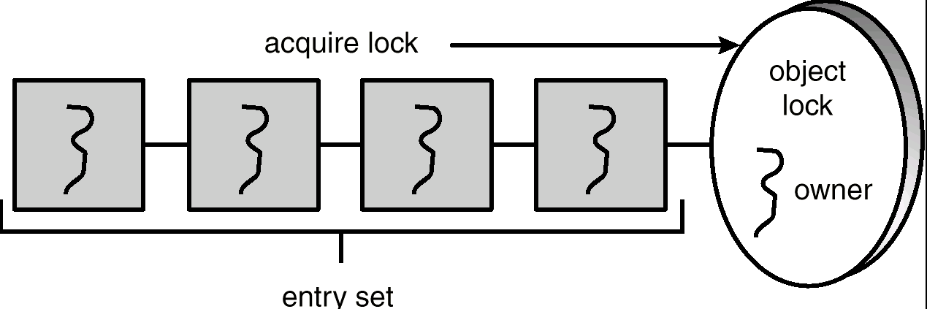
Java Synchronization
public class ClassA { // Every object has a lock associated with it.
public synchronized void method1( ) { // Calling a synchronized method requires “owning” the lock.
….;
// The lock is released when a thread exits the synchronized method.
}
public Synchronized void method2( ) { // If a calling thread does not own the lock it is placed in the entry set.
}
private data a, b, c;
}
CSS430 Processes Synchronization

Slide 27
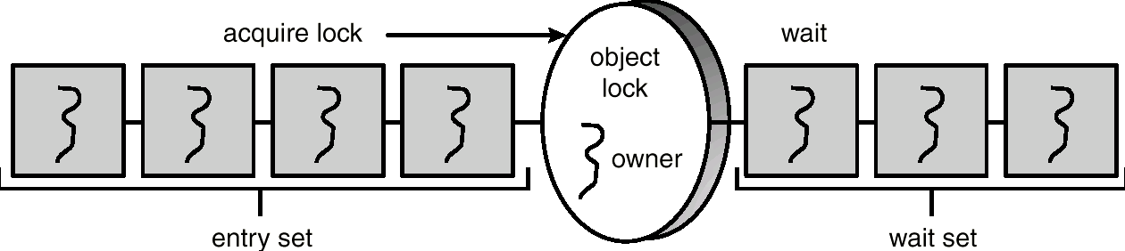
Java Monitor
public void synchronized method1( ) { // Calling a synchronized method requires “owning” the lock.
// If a calling thread does not own the lock it is placed in the entry set.
while ( condition == false )
try {
wait( ); // The thread releases a lock and places itself in the wait set.
} catch( InterruptedException e ) { }
}
….;
notify( ); // The calling thread resumes one of threads waiting in the wait set.
}
CSS430 Processes Synchronization

Slide 28
Enter and Remove with Java Synchronization
Producer
Consumer
Public synchronized void insert( Object item ) {
while ( count == BUFFER_SIZE )
try {
wait( );
} catch ( InterruptedException e ) { }
}
++count;
buffer[in] = item;
in = ( in + 1 ) % BUFFER_SIZE;
notify( );
}
Public synchronized Object remove( ) {
while ( count == 0 )
try {
wait( );
} catch ( InterruptedException e ) { }
}
--count;
item = buffer[out];
out = ( out + 1 ) % BUFFER_SIZE;
notify( );
return item;
}
CS
CSS430 Processes Synchronization

Slide 29
Classical Problem 2:
The Readers-Writers Problem
Multiple readers or a single writer can use DB.
X
writer
X
X
reader
writer
reader
reader
writer
reader
reader
reader
writer
reader
reader
CSS430 Processes Synchronization

Slide 30
Database
public class Database implements RWLock {
public Database( ) {
readerCount = 0; // # readers in database access
dbWriting = false; // a writer in database modification
}
public synchronized void acquireReadLock( ) {
/* A reader can start reading if dbWritng == false */ }
public synchronized void releaseReadLock( ) {
/* A reader exits from database, as waking up a thread */ }
public synchronized void acquireWriteLock( ) {
/* A writer can start writing if dbReading and dbWriting == false */ }
public synchronized void releaseWriteLock( ) {
/* A writer can exit from database, as waking up a thread */ }
private int readerCount;
private boolean dbWriting;
}
CSS430 Processes Synchronization

Slide 31
Readers
Condition reader, writer; // introduce condition variables
public synchronized void acquireReadLock( ) {
while (dbWriting == true) { // while a writer is in DB, I have to wait.
try {
wait( );
} catch (InterruptedException e) { }
}
++readerCount;
}
public synchronized void releaseReadLock( ) {
--readerCount
if (readerCount == 0) // if I’m the last reader, tell all others that DB has no more readers.
notify(); // wake up someone
}
|| !writer.isEmpty( ) ) {
reader.wait( )
writer.signal( )
CSS430 Processes Synchronization

Slide 32
Writers
Public synchronized void ackquireWriteLock( ) {
while (readerCount > 0 || dbWriting == true) // while reader(s) or another write is in DB
try {
wait( ); // I have to wait.
} catch ( InterruptedException e ) { }
}
dbWriting = true; // Tell all others that DB is in write.
}
public syncrhonized void releaseWriteLock( ) {
dbWriting = false; // Tell all others that DB is no more in write
notifyAll( ); // Wake up all others
}
writer.wait( )
If ( !reader.isEmpty( ) ) reader.notify( ); else wirter.notify( );
Why do we have to use notifyAll rather than notify?
Is this algorithm perfect?
CSS430 Processes Synchronization

Slide 33
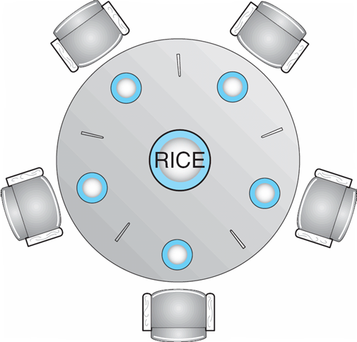
Classical Problem 3:
Dining Philosophers Problem
THINKING
HUNGRY
EATING
Shared data
Semaphore chopStick[] = new Semaphore[5];
CSS430 Processes Synchronization

Slide 34

The Structure of Philosopher i
Philosopher i
while ( true ) {
// get left chopstick
chopStick[i].P();
// get right chopstick
chopStick[(i + 1) % 5].P();
// eat for awhile
//return left chopstick
chopStick[i].V( );
// return right chopstick
chopStick[(i + 1) % 5].V( );
// think for awhile
}
Waiting
Picked up
A deadlock occurs!
CSS430 Processes Synchronization

Slide 35
Dining-Philosophers Problem Using a Monitor
monitor DiningPhilosophers {
int[ ] state = new int[5];
static final int THINKING = 0;
static final int HUNGRY = 1;
static final int EATING = 2;
condition[ ] self = new condition[5];
public DiningPhilosophers {
for ( int i = 0; i < 5; i++ )
state[i] = THINKING;
}
public entry pickUp( int i ) {
state[i] = HUNGRY; // I got hungry
test( i ); // can I have my left and right chopsticks?
if (state[i] != EATING) // no, I can’t, then I should wait
self[i].wait;
}
public entry putDown( int i ) {
state[i] = THINKING; // I’m stuffed and now thinking.
// test lef and right neighbors
test( ( i+4 ) % 5 ); // if possible, wake up my left.
test( ( i+1 ) % 5 ); // if possible, wake up my right.
}
private test( int i ) {
// if phi-i’s left is not eating, phi-i is hugry, and
// phi-i’s right is not eating, then phi-i can eat!
// Wake up phi-i.
if ( ( state[( i+4 ) % 5 ] != EATING ) &&
( state[i] == HUNGRY ) &&
( state[( i+1 ) % 5] != EATING ) ) {
state[i] = EATING;
self[i].signal;
}
}
}
Java monitor has only one condition.
Thus, this abstract code must be modified.
CSS430 Processes Synchronization

Slide 36
Transactional Memory and Concurrency Control
Transactional Memory
Concurrency Control
CPU A
CPU B
CPU C
CPU D
update ( ) {
atomic {
/* read and write shared data */
}
}
Trans_start
R1
R2
W3
R4
W5
Compare reads with
former writes
Trans_start
R1
R2
W6
R4
W7
Trans_start
Compiler-generated code
R1
R2
W9
R4
W8
validation
update ( ) {
acquire( );
/* read and write shared data */
release( );
}
Commitment
Trans_start
Trans_end
R1
R2
R6
R8
W8
Trans_end
Trans_end
Trans_abort
Trans_restart
CSS430 Processes Synchronization

Slide 37
Discussions 2
What is the main merit of notifyAll( ) in the readers-writers problem?
Is the solution on pages 30 – 32 perfect for the readers-writers problem? If not, how can you improve it?
Rather than a monitor, there is the simplest way that addresses the dining-philosophers problem but introduces another problem. What is that?
If we want to handle multiple monitor conditions in Java, what classes should you design?
CSS430 Processes Synchronization

Slide 38
Exercises
Programming Assignment 3:
  Check the syllabus for its due date.
No-turn-in problems:
  Solve Exercise 6.8, 6.12, 6.13, 6.14, 6.19, and 6.24
CSS430 Processes Synchronization

Slide 39
Appendix
Lamport’s Algorithm
Available for two or more processes
bool enter[n]; for ( int i = 0; i < n; i++ ) enter[n] = false;
int priority[n]; for ( int i = 0; i < n; i++ ) priority = 0;
Process i:
enter[i] = true;
priority[i] = 1 + max( priority[0], …, priority[n-1] ); // a higher number is a lower priority
enter[i] = false;
for ( int pid = 0; pid < n; pid++ ) {
while ( enter[pid] == true ); // wait for the process pid to receive its priority
while ( priority[pid] != 0 && ( priority[pid] < priority[i] || ( priority[pid] == priority[i] && pid < i ) ) )
// wait if process pid’s priority is higher or its pid is lower than mine.
;
}
// at this point, all the other processes are lower than my priority
// critical section
priority[i] = 0;
CSS543
Lecture 3: Shared Memory

