Slide 1
CSS430 Memory Management
Textbook Ch8
These slides were compiled from the OSC textbook slides (Silberschatz, Galvin, and Gagne) and the instructor’s class materials.
CSS430 Memory Management

Slide 2
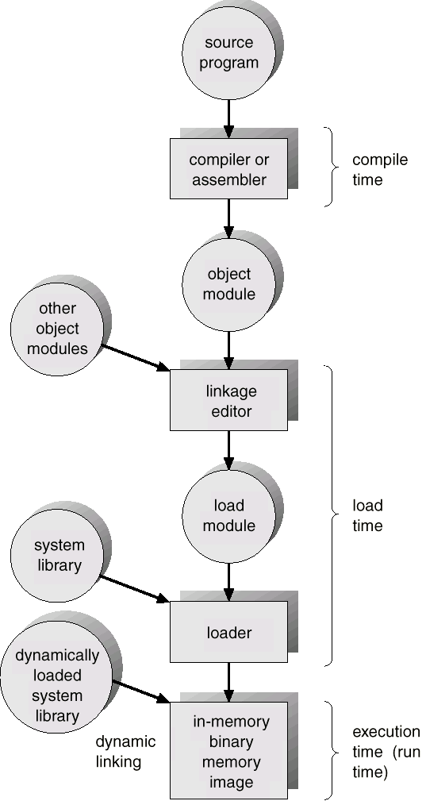
Address Binding
Compile time: Code is fixed to an absolute address. Recompilation is necessary if the starting location changes. (MS-DOS .COM format )
Load time: Code can be loaded to any portion of memory. (Relocatable code)
Run time: Code can be move to any portion of memory during its execution.
CSS430 Memory Management

Slide 3

Logical vs. Physical Address Space
Physical address: The actual hardware memory address.
  32-bit CPU’s physical address 0 ~ 2³²-1 (00000000 – FFFFFFFF)
  1GB’s memory address 0 ~ 2³⁰-1
  (00000000 – 4FFFFFFF)
Logical address: Each (relocatable) program assumes the starting location is always 0 and the memory space is much larger than actual memory
CSS430 Memory Management

Slide 4
Dynamic Loading
Unused routine is never loaded
Useful when the code size is large
Unix execv can be categorized:
  Overloading a necessary program onto the current program.
main( ) {
f1( );
}
f1( ) {
f2( );
}
f2( ) {
f3( );
}
1. Loaded when called
memory
2. Loaded when called
3. Loaded when called
CSS430 Memory Management

Slide 5
Dynamic Linking
Linking postponed until execution time.
Small piece of code, stub, used to locate the appropriate memory-resident library routine.
Stub replaces itself with the address of the routine, and executes the routine.
Operating system needs to check if routine is in processes’ memory address
int x;
void main(){
stub = dlopen(“lib”):
f = dlsym(stub, “f1”);
f( );
}
memory
int x;
void main(){
stub = dlopen(“lib”):
f = dlsym(stub, “f1”);
f( );
}
lib.so.a
extern int x;
f1( ) {
x = 5;
}
extern int x;
f1( ) {
x = 5;
}
CSS430 Memory Management

Slide 6
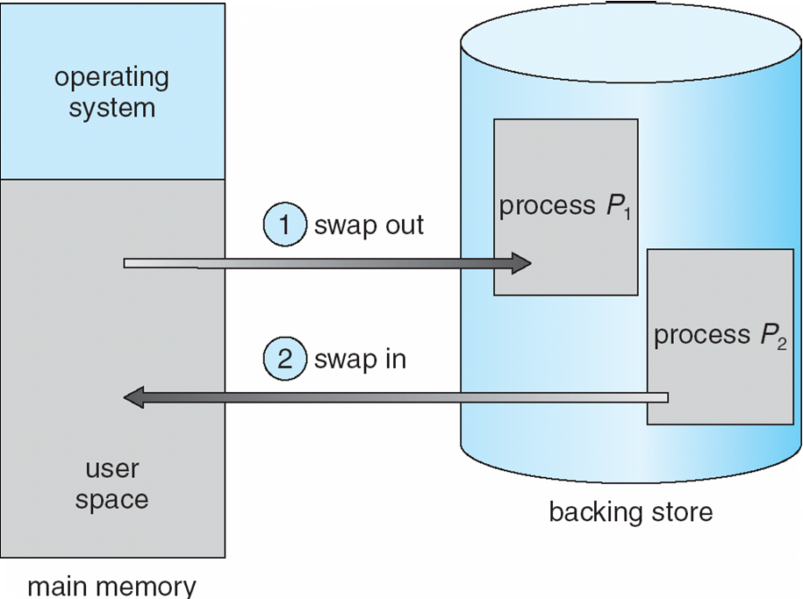
Swapping
When a process p1 is blocked so long (for I/O), it is swapped out to the backing store, (swap area in Unix.)
When a process p2 is (served by I/O and ) back to a ready queue, it is swapped in the memory.
Use the Unix top command to see which processes are swapped out.
CSS430 Memory Management

Slide 7

Contiguous Memory Allocation
MMU
(Memory Management Unit)
For each process
  Logical space is mapped to a contiguous portion of physical space
  A relocation and a limit register are prepared
    Relocation register = the starting location
    Limit register = the size of logical address space
CSS430 Memory Management

Slide 8
Fixed-Sized Partition
OS
Memory is divided to fixed-sized partitions
Each partition is allocated to a process
IBM OS/360
Then, how about this process?
process1
process2
process4
?
process3
CSS430 Memory Management

Slide 9
Variable-Sized Partitions
Whenever one of running processes, (p8) is terminated
  Find a ready process whose size is best fit to the hole, (p9)
  Allocate it from the top of hole
If there is still an available hole, repeat the above (for p10).
Any size of processes, (up to the physical memory size) can be allocated.
OS
OS
OS
OS
process 5
process 5
process 5
process 5
process 9
process 9
process 8
process 10
process 2
process 2
process 2
process 2
CSS430 Memory Management

Slide 10
Dynamic Storage-Allocation Problem
First-fit: Allocate the first hole that is big enough. (Fastest search)
Best-fit: Allocate the smallest hole that is big enough; must search entire list, unless ordered by size. Produces the smallest leftover hole. (Best memory usage)
Worst-fit: Allocate the largest hole; must also search entire list. Produces the largest leftover hole (that could be used effectively later.)
First-fit and best-fit better than worst-fit in terms of speed and storage utilization.
CSS430 Memory Management

Slide 11
External Fragmentation
Problem
  50-percent rule: total memory space exists to satisfy a request, but it is not contiguous.
Solution
  Compaction: shuffle the memory contents to place all free memory together in one large block
    Relocatable code
    Expensive
  Paging: Allow non-contiguous logical-to-phyiscal space mapping.
process1
process3
Can’t fit
Shift up
process2
CSS430 Memory Management

Slide 12

Paging
Physical space is divided in 512B~8KB-page frames (power of 2).
The logical space is a correction of sparse page frames.
Each process maintains a page table that maps a logical page to a physical frame.
CSS430 Memory Management

Slide 13
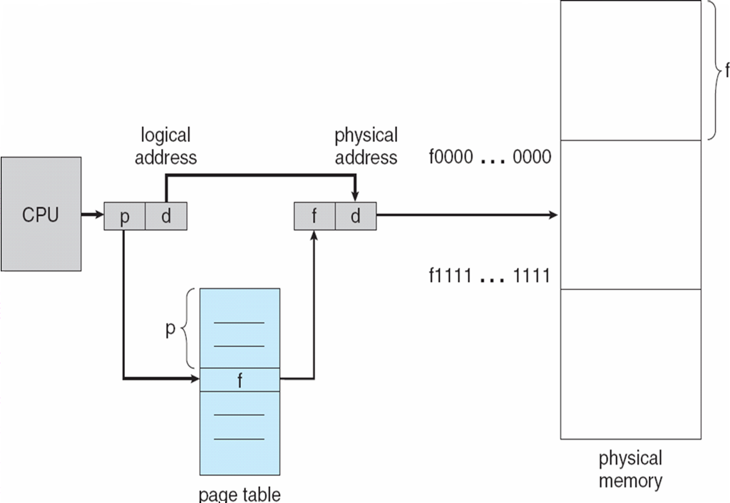
Address Translation
A process maintains its page table
  PTBR (Page Table Base Register) points to the table.
  PTLR (Page Table Length Register) keeps its length.
Logical address consists of:
  Page number (e.g., 20bit)
  Page offset (e.g., 12bit)
Address translation:
  If p > PTLR error!
  frame = *(PTBR + P)
  Physical = frame << 12 | d
PTBR
PTLR
CSS430 Memory Management

Slide 14

Paging Example
0
1
2
3
0
1
2
3
4
5
6
7
Page size
  4 bytes
Physical memory
  32 bytes
  8 frames
CSS430 Memory Management

Slide 15

Free Frames
CSS430 Memory Management

Slide 16
Internal Fragmentation
Process0
Page 0
Problem
  Logical space is not always fit to a multiplication of pages. (In other words, the last page has an unused portion.)
Solution
  Minimizing page size
  Side effect: causes frequent page faults and TLB misses
Process0
Page 1
Process0
Page 0
Page 2
unused
Process1
Page 0
Full pages!
Process3
Logical space
Process1
Page 1
Process1
Page 0
Page 2
unused
Process2
Page 1
Process2
Page 0
Page 2
unused
CSS430 Memory Management

Slide 17
Discussions 1
Discuss about the pros and cons of large and small page size.
CSS430 Memory Management

Slide 18
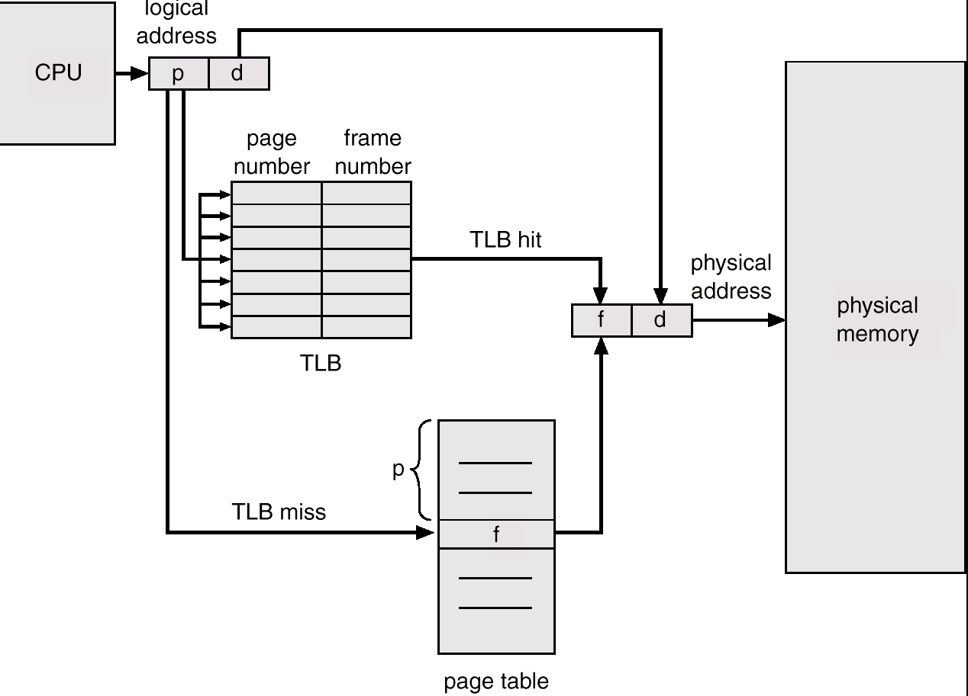
Paging Hardware with TLB
Providing a fast-lookup hardware cache
  TLB: Translation Look-aside Buffer
TLB Operations
  Refer to TLB to see if it caches the corresponding frame number
  Upon a TLB hit, generate a physical address instantly
  Upon a TLB miss, go to an ordinary page table reference.
TBL Flush
  Performed every process context switch
Two memory accesses!
CSS430 Memory Management

Slide 19
Discussions 2
How does TLB contribute to making thread context switch cheaper than process context switch?
Consider cases when TLB is not so useful.
CSS430 Memory Management

Slide 20

Memory Protection
Each page table entry has various flags:
  Read only
  Read/Write
  Valid/invalid
Why valide/invalid?
  All pages may not be loaded at once
  Only necessary pages should be loaded
  Unloaded pages’ entry must be invalid.
CSS430 Memory Management

Slide 21

Shared Pages
Shared code
  Read-only (reentrant) code shared among processes
  Shared code appeared in same location in the physical address space
Private code and data
  Each process keeps a separate copy of the code and data, (e.g., stack).
  Private page can appear anywhere in the physical address space.
Copy on write
  Pages may be initially shared upon a fork
  They will be duplicated upon a write
CSS430 Memory Management

Slide 22
Two-Level Page-Table Scheme
A logical address (on 32-bit machine with 4K page size) is divided into:
  a page number consisting of 20 bits.
  a page offset consisting of 12 bits.
  If each page entry requires 4 bytes, the page table itself is 4M bytes!
Two-level page-table scheme
  Place another outer-page table and let it page the inner page table
  the page number is further divided into:
    a 10-bit page number.
    a 10-bit page offset.
Thus, a logical address is as follows:
page number
page offset
P1: outer page index
P2: page index
D: offset in a page
p_{i}
p₂
d
10
10
12
CSS430 Memory Management

Slide 23

Address-Translation Scheme
Address-translation scheme for a two-level 32-bit paging architecture
  Outer-page table size: 4K
  Inner page table size: 4K
  If a process needs only 1K pages (=1K * 4KB = 4MB memory), outer/inter page tables require only 8K.
More multi-level paging: Linux (three levels: level global, middle, and page tables), Windows (two levels: page directory and page tables) etc.
CSS430 Memory Management

Slide 24
Segmentation
Data
Each page is only a piece of memory but has no meaning.
A program is a collection of segments such as:
  main program,
  procedure,
  function,
  global variables,
  common block,
  stack,
  symbol table
Heap
Data
Stack
Code
Stack
Heap
Code
user view of memory
logical memory space
CSS430 Memory Management

Slide 25
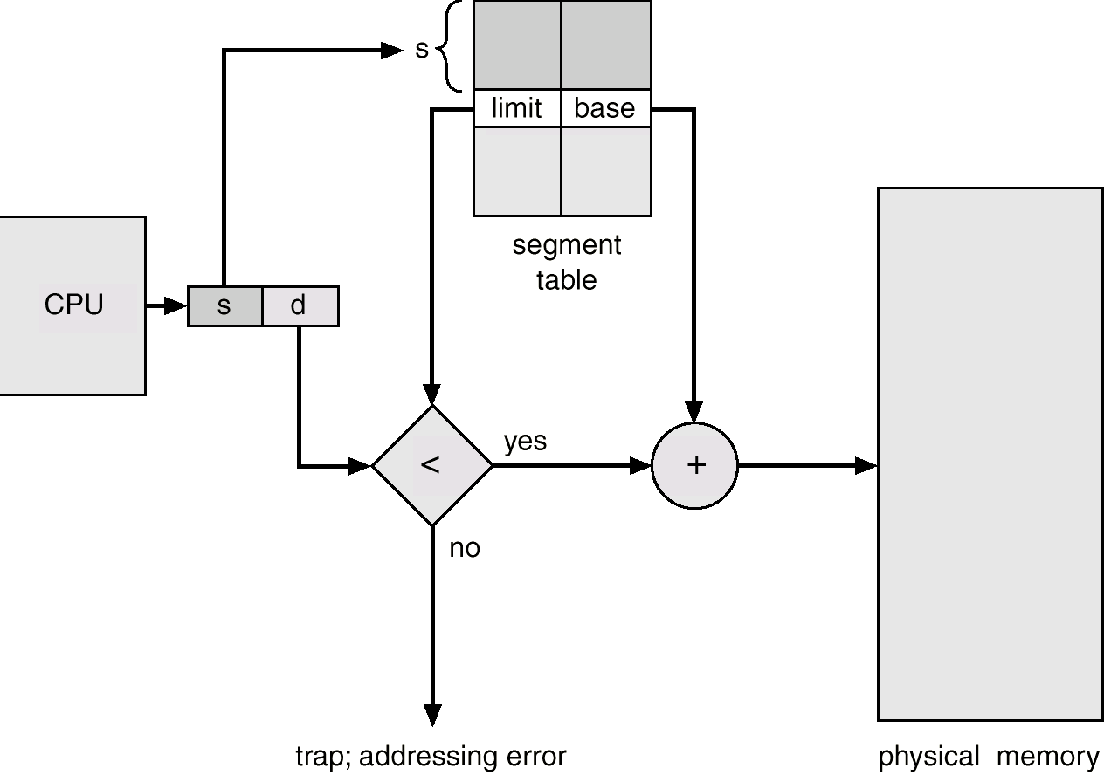
Segmentation Architecture
STBR(Segment Table Base Register)
STLR(Segment Table Length Register)
Segment length
Segment starting address
Segment S
Logical address =
<segment#, offset>
Very resemble to a contiguous memory allocation, while a process consists of several meaningful segments
CSS430 Memory Management

Slide 26
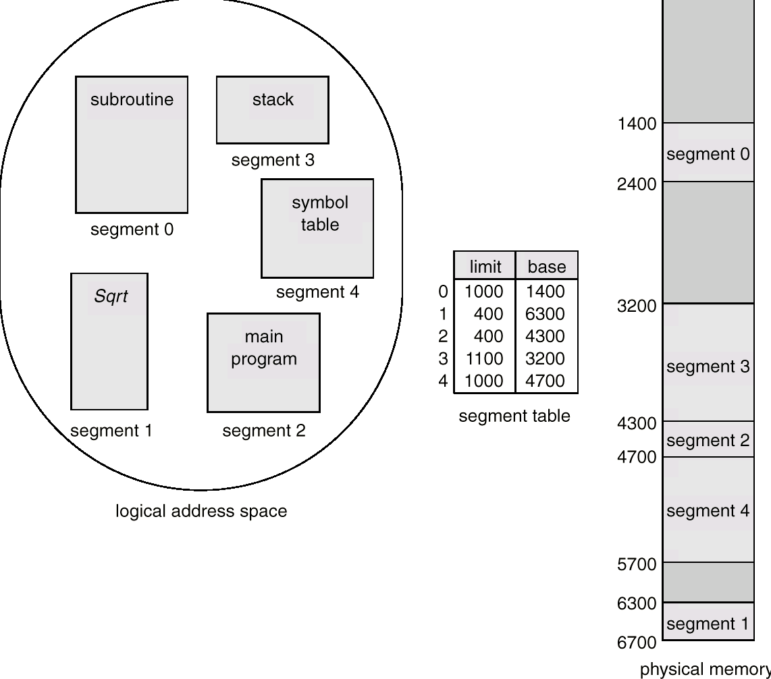
Segmentation Example
offset d2
offset d1
SP
d1
used
Currently executed
PC
d2
Stack top
used
CSS430 Memory Management

Slide 27

Segment Protection and Sharing
Segment protection can be achieved by implementing various flags in each segment table entry:
  Read only
  Read/Write
Unlike a page, a segment has an entire code.
Thus, sharing code is achieved by having each process’ code segment mapped to the same physical space.
CSS430 Memory Management

Slide 28
Segmentation with Paging
Segmentation
  Is very resemble to a contiguous memory allocation
  Causes External fragmentation
Introducing the idea of paging
  Assuming
    The segment size is 4G bytes, and thus the segment offset is 32 bits
    a page is 4K bytes, and thus the page offset requires 12 bits.
  Logical address = <segment#(13bits), segment_offset(32 bits)>
  If segment# > STLR, cause a trap.
  If offset > [STBR + segment#]’s limit, cause a segmentation fault.
  Liner address = <[STBR + segment#]’s base | segment_offset>
  Decompose liner address into <p1(10 bits), p2(10 bits), page_offset(12 bits)>
  The first 10 bits are used in the outer page table to page the inner page table
  The second 10 bits are used in the inner page table to page the final page
  Physical address = <[PTBR + p2]’s frame# << 12 | page_offset>
CSS430 Memory Management

Slide 29

Segmentation with Paging – Intel Pentium
Segment#(13bits),
Gbit(1bit) global(Shared) or local segment,
Protection(2bits)
4GB(32 bits)
Segment table
<limit, base>
base | offset
P1(10bits)
(12bits)
P2(10bits)
CSS430 Memory Management

Slide 30
Exercises (No turn-in)
Consider a system with 4200 bytes of main memory using variable partitions. At a certain time, the memory will be occupied by three blocks of code/data as follows:
  Starting Address Length
  1000 1000
  2900 500
  3400 800
  When loading a new block into memory, the following strategy is used:
  Try the best-fit algorithm to locate a hole of appropriate size
  If that fails, create a larger hole by shifting blocks in memory toward address zero; this always starts with the block currently at the lowest memory address and continues only until enough space is created to place the new block.
  Assume that three new blocks with respective sizes 500, 1200, and 200 are to be
  loaded (in the order listed). Show the memory contents after all three requests
  have been satisfied.
Solve Exercise 8.23 of your textbook.
CSS430 Memory Management

Slide 31
Exercises Cont’d (No turn-in)
Q3
Let’s assume that you got a single-processor PC whose specification is given below:
CPU instructions: (All one-byte instructions)
OPCODE 001: LOAD MEM REG reads data from address MEM into register REG.
OPCODE 010: ADD MEM REG reads data from address MEM and adds it to REG.
OPCODE 011: SUB MEM REG reads data from address MEM and subtracts it from REG
OPCODE 100: STORE REG MEM writes REG’s content to address MEM.
OPCODE 111: HALT stops the execution.
CPU registers: (All one-byte registers)
R0 the general register for computation
STBR (or R1) the segment table base register (containing physical address)
PTBR (or R2) the page table base register (containing physical address)
- Both segmentation and page tables are fixed to a page. Thus, the processor has no
STLR and PTLR.
Memory:
- Addressing is based on segmentation with paging.
- The page size is 4 bytes.
- The physical memory is 32 bytes, thus 8 pages.
CSS430 Memory Management

Slide 32
Exercises Cont’d (No turn-in)
| Bit 4 | Bit 3 | Bit 2 | Bit 1 | Bit 0 |
Segment# (0 or 1) offset (0 – 15)
- Each segmentation table entry needs two bytes: the first byte points to the
segmentation base address, and the second defines the segment length (in bytes).
- The segmentation table needs 1 page, (i.e., 4 bytes) and thus includes 2 entries.
- Each process can have two segments: segment #0 for code and segment #1 for data.
- Each page table entry needs one byte to specify the corresponding page frame number.
Q3-1. Suppose this PC has started a new process with STBR=16 (10000) and PTBR=4 (00100).
Given the following physical memory map, fill out the segments #0 and #1 of this process.
CSS430 Memory Management

Slide 33
Exercises Cont’d (No turn-in)
Physical Memory Map
Frame# | Address | Contents |  | Frame# | Address | Contents
0 | 0 (00000) | 12 (0000 1100) |  | 4 | 16 (10000) | 12 (0000 1100)
 | 1 (00001) | 4 (0000 0100) |  |  | 17 (10001) | 4 (0000 0100)
 | 2 (00010) | 0 (0000 0000) |  |  | 18 (10010) | 0 (0000 0000)
 | 3 (00011) | 12 (0000 1100) |  |  | 19 (10011) | 12 (0000 1100)
1 | 4 (00100) | 12 (0000 1100) |  | 5 | 20 (10100) | 14 (0000 1110)
 | 5 (00101) | 20 (0001 0100) |  |  | 21 (10101) | 13 (0000 1101)
 | 6 (00110) | 8 (0000 1000) |  |  | 22 (10110) | 12 (0000 1100)
 | 7 (00111) | 24 (0001 1000) |  |  | 23 (10111) | 11 (0000 1011)
2 | 8 (01000) | 11 (0000 1011) |  | 6 | 24 (11000) | LOAD 6 R0 (0010 0110)
 | 9 (01001) | 12 (0000 1100) |  |  | 25 (11001) | ADD 8 R0 (0100 1000)
 | 10 (01010) | 13 (0000 1101) |  |  | 26 (11010) | STORE 3 R0 (1000 0011)
 | 11 (01011) | 14 (0000 1110) |  |  | 27 (11011) | HALT (1110 0000)
3 | 12 (01100) | 12 (0000 1100) |  | 7 | 28 (11100) | LOAD 0 R0 (0010 0000)
 | 13 (01101) | 20 (0001 0100) |  |  | 29 (11101) | SUB 7 R0 (0110 0111)
 | 14 (01110) | 8 (0000 1000) |  |  | 30 (11110) | STORE 9 R0 (1000 1001)
 | 15 (01111) | 24 (0001 1000) |  |  | 31 (11111) | HALT (1110 0000)
CSS430 Memory Management

Slide 34
Exercises Cont’d (No turn-in)
Code Segment (Segment #0) Data Segment (Segment #1)
Page# | Address | Contents
0 | 0 (0000)
 | 1 (0001)
 | 2 (0010)
 | 3 (0011)
1 | 4 (0100)
 | 5 (0101)
 | 6 (0110)
 | 7 (0111)
2 | 8 (1000)
 | 9 (1001)
 | 10 (1010)
 | 11 (1011)
3 | 12 (1100)
 | 13 (1101)
 | 14 (1110)
 | 15 (1111)
Page# | Address | Contents
0 | 0 (0000)
 | 1 (0001)
 | 2 (0010)
 | 3 (0011)
1 | 4 (0100)
 | 5 (0101)
 | 6 (0110)
 | 7 (0111)
2 | 8 (1000)
 | 9 (1001)
 | 10 (1010)
 | 11 (1011)
3 | 12 (1100)
 | 13 (1101)
 | 14 (1110)
 | 15 (1111)
CSS430 Memory Management

Slide 35
Exercises Cont’d (No turn-in)
Q3-2. When this process completes a HALT instruction, which physical memory address will
be updated? What new value is stored in that address? Note that the operand address in each
instruction belongs to the data segment, (i.e. segment #1).
Physical memory address | New contents
CSS430 Memory Management

