Slide 1
CSS430 Protection
Textbook Ch14
These slides were compiled from the OSC textbook slides (Silberschatz, Galvin, and Gagne) and the instructor’s class materials.
CSS430 Protection

Slide 2
Goals of Protection
Reasons:
  Prevent mischievous or intentional access violation of user programs
  Protect computer components
Goal:
  Provide a mechanism for policy enforcement governing resource use.
  Give users just enough privileges to perform their tasks. (Principle of least privilege)
Policies
  What will be done
  Policies depend on applications and change over time.
Mechanism
  How policies will be enforced
CSS430 Protection

Slide 3
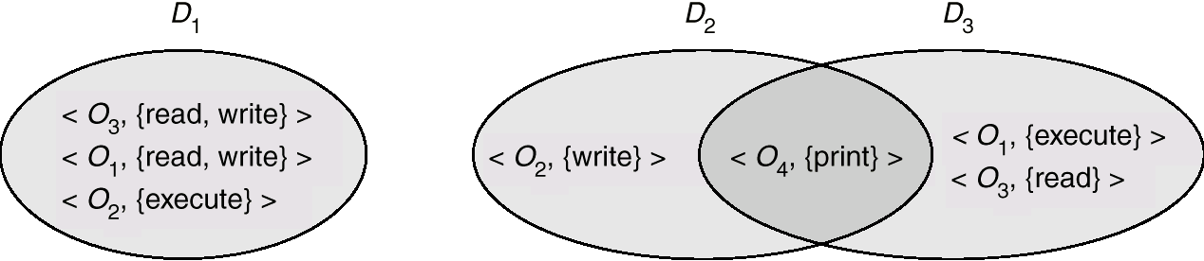
Domain Structure
Objects = H/W and S/W computing resources
Need-to-know principle = A process should be allowed to access only objects necessary for its computation
Access-right = <object-name, rights-set>
Rights-set is a subset of all valid operations that can be performed on the object.
Domain = set of access-rights
Each process is statically or dynamically associated with a domain.
Phase 1
Phase 2
P1
P2
transfer
CSS430 Protection

Slide 4
Domain Example
Processes move back and forth between user mode, (i.e., user domain) and kernel mode, (i.e., kernel domain).
Unix setuid
User mode
Kernel mode
process
real user id = 201
effective user id = 201
execvl(“shell”)
shell
owner=100
setuid bit=0
load
real user id = 201
effective user id = 201
execvl(“a.out”)
a.out
owner=100
setuid bit=1
load
100
CSS430 Protection

Slide 5
Discussions 1
In what situation or applications do we have to use Unix setuid?
CSS430 Protection

Slide 6
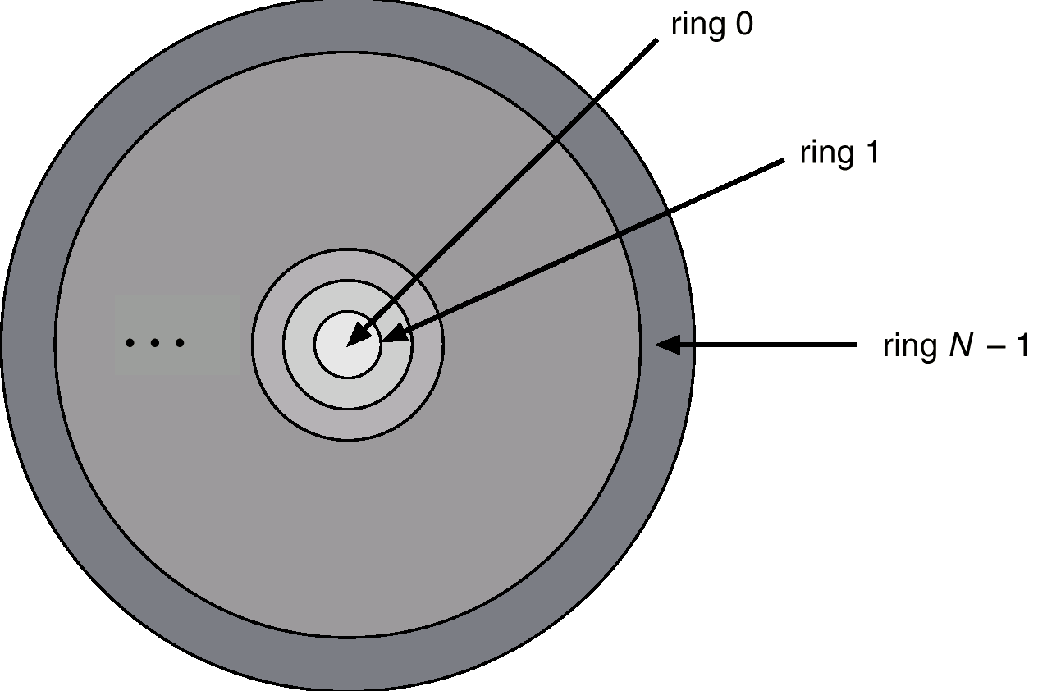
Domain Implementation in Multics
Let D_{i} and D_{j} be any two domain rings.
If j < I ⇒ D_{i} ⊆ D_{j}
Disadvantages:
  Too complicated
  Violating need-to-know principle
Procedure
(Library)
Allowed only if process has a permission
Gatekeeper
Process
Ring i
parameters
copied
Procedure
(Library)
Procedure
(Library)
Allowed anytime
CSS430 Protection

Slide 7

Access Matrix
Operation examples:
  A process running D1 (in row 1) can read F1 and F3, (i.e. access(1,1) and access(1,3))
Merit:
  A variety of polices can be specified
Objects
Domains
CSS430 Protection

Slide 8
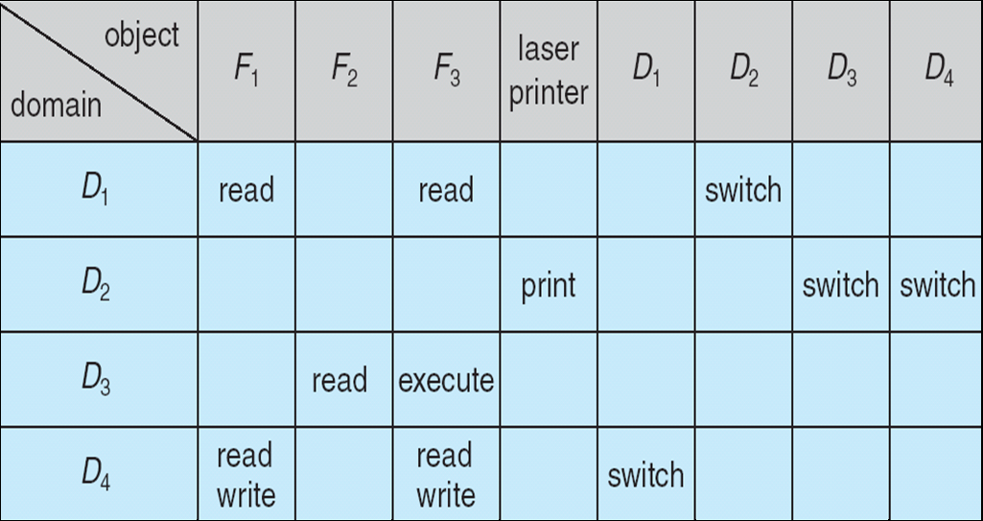
Access Matrix with Domains as Objects
D1
D2
D3
D4
P
CSS430 Protection

Slide 9

Access Matrix with Copy Rights
Process running D2
  Has a copy right of F2
  Can copy a read operation to D3
CSS430 Protection

Slide 10
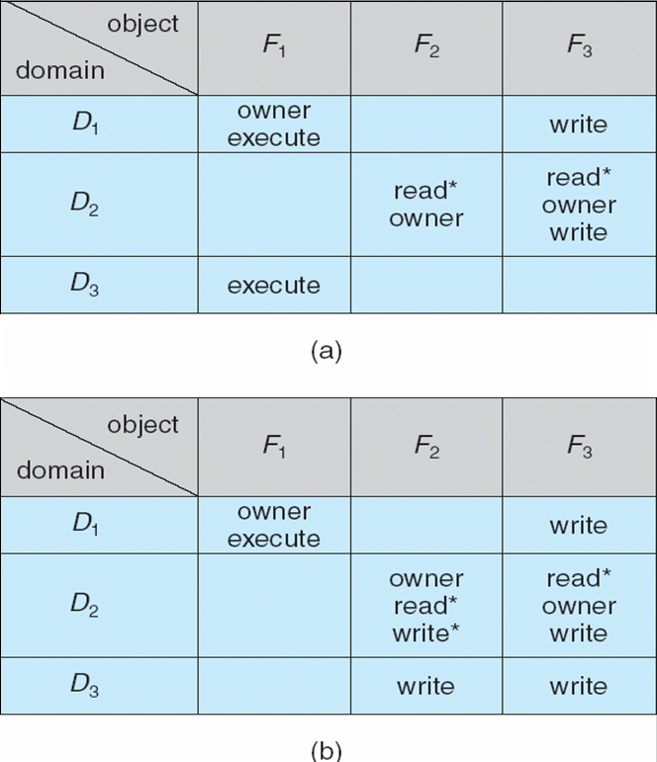
Access Matrix With Owner Rights
Process running D2
  Owns F2
  Can add and remove any access right on F2 in D1 and D3
CSS430 Protection

Slide 11

Access Matrix with Control Rights
Process running in D2
  Has a right to modify all access rights in D4
read
read
CSS430 Protection

Slide 12
Implementation of Access Matrix
Global Table
  Triple <Di, Oj, Rk>: Domain i has an access Right k for Object j.
  Table is too large to fit to memory.
Access Lists for Objects
  Each object has Tuple <Di, Rk>
  Empty entries are discarded or assumed to have a default access rights.
  Example: Unix file protection
  User must determine domains allowed for his/her new object.
  Access lists must be scanned every access.
Capability Lists for Domains
  Each domain has Tuple <Oj, Rk>
  Object has a capability tag (to denote if it is a capability list or data).
  Program carries a capability list only accessible by OS
  Revocation requires to examine all capability lists.
CSS430 Protection

Slide 13
Lock-Key Mechanism
Lock
Process
Object
A compromise between access lists and capability lists.
Lock: Object has a list of bit patters
Key: Process receives a list of bit patterns from Domain
OS: allows a process if key matches lock.
1001
Key
1001
Object
0011
Only OS can check
the key with each lock
Object
0101
Object
1001
CSS430 Protection

Slide 14
Language-Based Protection
Motivation
  Comprehensive access validation incurs considerable overheads
  Satisfying all protection goals is difficult
  Policies for resource use may vary
Merits
  High-level description of policies for use of recourses
  Software support when hardware supports are not available
  Generating calls on whatever underlying protection system is provided
Solution:
  Use of a software capability that could be used as an object of computation
  Stack inspection
CSS430 Protection

Slide 15
Stack Inspection
Simple Inspection
Real Inspection in Java
X | system | file.open(cache) |  |  | system | file.open(local)
 | system | url.open |  |  | system | url.open
 | untrusted | applet.main |  |  | untrusted | applet.main
Flag | Principal | Method |  | Flag | Principal | Method
X | etwork | open(a) |  |  | network | Open(b)
X | URL loader | doPrivilaged{ open(“a”); } |  |  | URL loader
 | untrusted applet | gui.get(url) |  |  | untrusted applet | gui.open(“b”)
F | Principal | Method |  | F | Principal | Method
Thread A’s stack
passes
Thread B’s stack
fails
Thread A’s stack
passes
Thread B’s stack
fails
Based on http://www.securingjava.com/chapter-three/chapter-three-6.html
From Textbook
CSS430 Protection

Slide 16
Exercises (No Turn-In)
Solve Exercise 14.12 in your textbook.
Solve Exercise 14.13 in your textbook.
Solve Exercise 14.21 in your textbook.
CSS430 Protection

Slide 17
Exercises (No Turn-In)
Consider the LAB320’s file protection policy. Assume that the user “mickey” belongs to the “student” group. He created and gave some access permissions to three new files as shown below:
Fill out the following access matrix that enforces the protection policy for those three files and six domains.
File name | Access permission
/tmp/a.out | rwx r-x --x
/tmp/b.java | rw- r-- ---
/tmp/c.class | rw- r– r--
 | a.out | b.java | c.class | su | mickey | faculty | student | staff | universe
su
mickey
faculty
student
staff
universe
CSS430 Protection

