Slide 1
CSS430 CPU Scheduling
Textbook Ch5
These slides were compiled from the Applied OSC textbook slides (Silberschatz, Galvin, and Gagne) and the instructor’s class materials.
CSS430 CPU Scheduling
Notes:
Hello! Everyone,
My name is Shinya Kobayashi. Today, I am going to present our paper titled “Inter-Cluster Job Coordination Using Mobile Agents” on behalf of the first author, Munehiro Fukuda. Munehiro was hoping to show up and present the paper at AMS2001, however he got to wait in Japan until he will get an H1B visa. Since I received the presentation materials from him quite recently, please allow me to present this paper using this script.
I can respond to your questions as far as I know, however you can also ask Munehiro by email. His email address is on the title page of our paper.
(time 1:05)

Slide 2

Histogram of CPU-burst Times
CSS430 CPU Scheduling

Slide 3

CPU-I/O Burst Cycle
Process B
Process A
CSS430 CPU Scheduling

Slide 4
CPU Scheduler
Selects from among the processes in memory that are ready to execute, and allocates the CPU to one of them. (Short-term scheduler)
CPU scheduling decisions may take place when a process:
  1. Switches from running to waiting state (by sleep).
  2. Switches from running to ready state (by yield).
  3. Switches from waiting to ready (by an interrupt).
  4. Terminates (by exit).
Scheduling under 1 and 4 is nonpreemptive.
All other scheduling is preemptive.
CSS430 CPU Scheduling

Slide 5
Scheduling Criteria
CPU utilization – keep the CPU as busy as possible
Throughput – # of processes that complete their execution per time unit
Turnaround time (TAT) – amount of time to execute a particular process
Waiting time – amount of time a process has been waiting in the ready queue
Response time – amount of time it takes from when a request was submitted until the first response is produced, not output (for time-sharing environment)
CSS430 CPU Scheduling

Slide 6
Discussions 1
Can OS satisfy all those metrics: CPU utilization, throughput, TAT, waiting time, and response time?
CSS430 CPU Scheduling

Slide 7
First Come First Served Scheduling
Example: Process Burst Time
P₁ 24
P₂ 3
P₃ 3
Suppose that the processes arrive in the order: P₁ , P₂ , P₃
Suppose that the processes arrive in the order: P₂ , P₃ , P₁ .
Non-preemptive scheduling
Troublesome for time-sharing systems
  Convoy effect short process behind long process
P₁
P₂
P₃
Waiting time for P₁ = 0; P₂ = 24; P₃ = 27
Average waiting time: (0 + 24 + 27)/3 = 17
0
24
27
30
P₂
P₃
P₁
Waiting time for P₁ = 6; P₂ = 0; P₃ = 3
Average waiting time: (6 + 0 + 3)/3 = 3
0
3
6
30
CSS430 CPU Scheduling

Slide 8
Shortest Job First Scheduling
Example: Process Arrival Time Burst Time
P₁ 0 7
P₂ 2 4
P₃ 4 1
P₄ 5 4
Non preemptive SJF
Average waiting time = (0 + 6 + 3 + 7)/4 = 4
P₁
P₃
P₂
P₄
0
2
4
5
7
8
12
16
P₁‘s wating time = 0
P₂‘s wating time = 6
P₃‘s wating time = 3
P₄‘s wating time = 7
P₁(7)
P₂(4)
P₃(1)
P₄(4)
CSS430 CPU Scheduling

Slide 9
Shortest Job First Scheduling
Cont’d
Example: Process Arrival Time Burst Time
P₁ 0 7
P₂ 2 4
P₃ 4 1
P₄ 5 4
Preemptive SJF
Average waiting time = (9 + 1 + 0 +2)/4 = 3
P₁
P₂
P₃
P₂
P₄
P₁
0
2
4
5
7
11
16
P₁‘s wating time = 9
P₂‘s wating time = 1
P₃‘s wating time = 0
P₄‘s wating time = 2
P₁(7)
P₁(5)
P₂(4)
P₂(2)
P₃(1)
P₄(4)
CSS430 CPU Scheduling

Slide 10


Shortest Job First Scheduling
Cont’d
Optimal scheduling
Preemptive SJF is superior to non preemptive SJF.
However, there are no accurate estimations to know the length of the next CPU burst
Estimation introduced in Textbook:
CSS430 CPU Scheduling

Slide 11
Priority Scheduling
A priority number (integer) is associated with each process
The CPU is allocated to the process with the highest priority (smallest integer ≡ highest priority in Unix but lowest in Java).
  Preemptive
  Non-preemptive
SJF is a priority scheduling where priority is the predicted next CPU burst time.
Problem ≡ Starvation – low priority processes may never execute.
Solution ≡ Aging – as time progresses increase the priority of the process.
CSS430 CPU Scheduling

Slide 12
Round Robin Scheduling
Each process is given CPU time in turn, (i.e. time quantum: usually 10-100 milliseconds), and thus waits no longer than ( n – 1 ) * time quantum
time quantum = 20
Process Burst Time Wait Time
P₁ 53 57 +24 = 81
P₂ 17 20
P₃ 68 37 + 40 + 17= 94
P₄ 24 57 + 40 = 97
P₁
P₂
P₃
P₄
P₁
P₃
P₄
P₁
P₃
P₃
0
20
37
57
77
97
117
121
134
154
162
P₁(53)
P₁(33)
P₁(13)
57
24
P₂(17)
20
P₃(48)
P₃(28)
P₃(8)
P₃(68)
37
40
17
P₄(24)
57
40
P₄(4)
Average wait time = (81+20+94+97)/4 = 73
CSS430 CPU Scheduling

Slide 13

Round Robin Scheduling
Typically, higher average turnaround than SJF, but better response.
Performance
  q large ⇒ FCFS
  q small ⇒ q must be large with respect to context switch, otherwise overhead is too high.
CSS430 CPU Scheduling

Slide 14

Turnaround Time Varies With The Time Quantum
TAT can be improved if most processes
finish their next CPU burst in a single
time quantum.
CSS430 CPU Scheduling

Slide 15
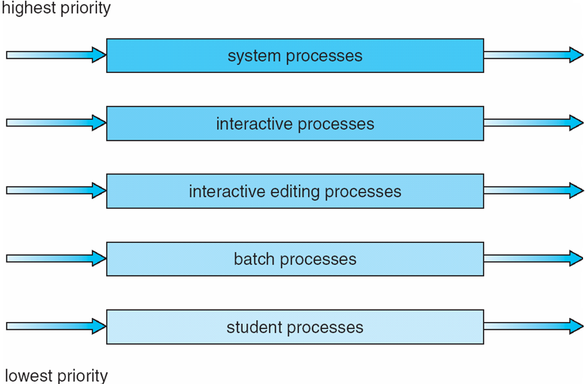
Multilevel Queue Scheduling
Each queue has its own scheduling algorithm,
  foreground (interactive) – RR, 80% CPU time
  background (batch) – FCFS, 20% CPU time
CSS430 CPU Scheduling

Slide 16
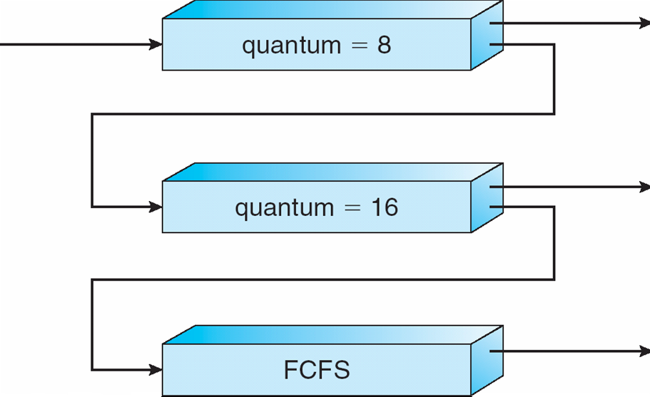
Multilevel Feedback-Queue Scheduling
A new job enters queue Q₀ which is served FCFS. When it gains CPU, job receives 8 milliseconds. If it does not finish in 8 milliseconds, job is moved to queue Q₁.
At Q₁ job is again served FCFS and receives 16 additional milliseconds. If it still does not complete, it is preempted and moved to queue Q₂.
CSS430 CPU Scheduling

Slide 17
Discussions 2
What is the main problem in MFQS?
How can you address this problem? Briefly think about your own scheduling algorithm?
CSS430 CPU Scheduling

Slide 18
Cooperative multithreading in Java
A thread voluntary yielding control of the CPU is called cooperative multitasking.
Thread.yield( ) is OS-dependent.
  Linux does not care about it.
  Solaris allows a thread to yield its execution when the corresponding LWP exhausts a given time quantum.
Conclusion: Don’t write a program based on yield( ).
public void run( ) {
while ( true ) {
// perform a CPU-intensive task
…
// now yield control of the CPU
Thread.yield( );
}
}
CSS430 CPU Scheduling

Slide 19
Java-Based Round-Robin Scheduler (Naïve Example)
public class Scheduler extends Thread
{
public Scheduler( ) {
timeSlice = DEFAULTSLICE;
queue = new CircularList( );
}
public Scheduler( int quantum ) {
timeSlice = quantum;
queue = new CircularList( );
}
public void addThread( Thread t ) {
t.setPriority( 2 );
queue.addItem( t );
}
private void schedulerSleep( ) {
try {
Thread.sleep( timeSlice );
} catch ( InterruptedException e ) { };
}
public void run( ) {
Thread current;
this.setPriority( 6 );
while ( true ) {
// get the next thread
current = ( Thread )queue.getNext( );
if ( ( current != null ) && ( current.isAlive( ) ) {
current.setPriority( 4 );
schedulerSleep( );
current.setPriority( 2 );
}
}
}
private CircularList queue;
private int timeSlice;
private static final int DEFAULT_TIME_SLICE=1000;
}
CSS430 CPU Scheduling

Slide 20
Test program
public class TestScheduler
{
public static void main( String args[] ) {
Thread.currentThread( ).setPriority( Thread.MAX_PRIORITY );
Scheduler CPUScheduler = new Scheduler( );
CPUScheduler.start( );
// uses TestThread, although this could be any Thread object.
TestThread t1 = new TestThread( “Thread 1” );
t1.start( );
CPUScheduler.addThread( t1 );
TestThread t2 = new TestThread( “Thread 2” );
t2.start( );
CPUScheduler.addThread( t2 );
TestThread t3 = new TestThread( “Thread 3” );
t3.start( );
CPUScheduler.addThread( t3 );
}
}
CSS430 CPU Scheduling

Slide 21
Why not work?
Java: runs threads with a higher priority until they are blocked. (Threads with a lower priority cannot run concurrently.)
  This may cause starvation or deadlock.
Java’s strict priority scheduling was implemented in Java green thread.
In Java 2, thread’s priority is typically mapped to the underlying OS-native thread’s priority.
OS: gives more CPU time to threads with a higher priority. (Threads with a lower priority can still run concurrently.)
If we do not want to depend on OS scheduling, we have to use:
  Thread.suspend( )
  Thread.resume( )
CSS430 CPU Scheduling

Slide 22
Multiprocessor Scheduling
OS code and user process mapping:
  Asymmetric multiprocessing
  Symmetric multiprocessing (SMP)
Scheduling criteria:
  Processor affinity
  Load balancing
Thread context switch:
  Coarse-grained software thread
  Fine-grained hardware thread
CSS430 CPU Scheduling

Slide 23
Exercises
Programming Assignment 2:
  Check the syllabus for its due date.
No-turn-in problems:
  Solve Exercise 5.5
  Solve Exercise 5.12
  Solve Exercise 5.14
CSS430 CPU Scheduling

