Slide 1
CSS430 File-System Interface
Textbook Ch10
These slides were compiled from the OSC textbook slides (Silberschatz, Galvin, and Gagne) and the instructor’s class materials.
CSS430 File System

Slide 2
File Concept
Nonvolatile storage unit
Logically contiguous space
Attributes
  Name, Type, Size, Protection, Time, Date, and User ID
  Location
    Directory from a user’s point of view
    Disk location from the OS view point
File format
  A sequence of bits from the OS view point
  Meaningful information from each application view point
    Types identified by a file suffix
CSS430 File System

Slide 3
File Attributes
Name – used for a user to reference a file.
Type – needed for an application to identify if it is reading correct file information.
Location – Directory path (and disk location).
Size – current file size.
Protection – controls who can do reading, writing, executing.
Time, date, and user identification – data for protection, security, and usage monitoring.
Directory (or folder) provides a user with such file information
CSS430 File System

Slide 4
File Operations
Operations | Descriptions | Unix | Our ThreadOS
Create | Create a file with its attribute. | creat(filename,mode) | N/A
Open | Open the specified file. (Create it if mode specified and necessary) | open(filename,flag,mode) | SysLib.open(filename,mode)
Read | Read from a file. | read(fd, buf, size) | SysLib.read(fd, buffer)
Write | Write a file. | write(fd, buf, size) | SysLib.write(fd, buffer)
Seek | Reposition a file access point. | lseek(fd, offset, origin) | SysLib.seek(fd, offset, whence)
Close | Close the file specified with fd. | close(fd) | SysLib.close(fd)
Delete | Destroy the specified file. | remove(filename) | SysLib.delete(filename)
Truncate | Erase the file contents but remain its attribute, (e.g. name) | truncate(filename, length) | N/A
Status | Returns the specified file status. | stat(fd, statbuf) | SysLib.fsize(fd)
Format | Format the disk. | N/A | SysLib.format(files)
CSS430 File System

Slide 5
Seek
Seek( int fd, int offset, int whence )
whence == 0 (SEEK_SET)
whence == 1 (SEEK_CUR)
whence == 2 (SEEK_END)
EOF
offset
A new file seek pointer position
EOF
offset
The old file seek pointer position
A new file seek pointer position
EOF
A new file seek pointer position
Offset (< 0)
CSS430 File System

Slide 6
File Locking
Exclusive/Shared Locks
Unix flock
Java Filelock
Lock a portion of
a random access file object
include <sys/file.h> /* for flock(2) */
include <sys/stat.h> /* for S_* constants */
include <string.h> /* for strerror(3) prototype */
include <stdio.h> /* for fprintf(3),printf(3),stderr protype */
include <errno.h> /* for errno prototype */
include <unistd.h> /* for close(2) prototypes */
include <iostream> /* for C++ cin and cout */
define FILENAME "/tmp/flock.example”
using namespace std;
int main(int argc,char **argv) {
int fd; char buf;
fd = open(FILENAME,O_RDWR|O_CREAT,S_IRUSR|S_IWUSR);
if (flock(fd,LOCK_EX) == -1) /* Aquire an exclusive lock */
return -1;
cout << "Press enter to release the lock.” << endl;
cin >> buf;
if (flock(fd,LOCK_UN)==-1) /* Release the exclusive lock */
return -1;
printf("Released!\n");
close(fd)==-1
return 0;
}
import java.io.*;
import java.nio.channels.*;
public class LockingExample {
public static final boolean EXCLUSIVE = false;
public static final boolean SHARED = true;
public static void main(String arsg[]) throws IOException {
FileLock sharedLock = null;
FileLock exclusiveLock = null;
try {
RandomAccessFile raf = new RandomAccessFile("file.txt", "rw");
// get the channel for the file
FileChannel ch = raf.getChannel();
// this locks the first half of the file - exclusive
exclusiveLock = ch.lock(0, raf.length()/2, EXCLUSIVE);
/** Now modify the data . . . */
// release the lock
exclusiveLock.release();
// this locks the second half of the file - shared
sharedLock = ch.lock(raf.length()/2+1, raf.length(), SHARED);
/** Now read the data . . . */
// release the lock
sharedLock.release();
} catch (java.io.IOException ioe) {
System.err.println(ioe);
}finally {
if (exclusiveLock != null)
exclusiveLock.release();
if (sharedLock != null)
sharedLock.release();
}
}
}
Lock a file itself
(but not a file descriptor)
From: http://www.wlug.org.nz/
From: textbook
CSS430 File System

Slide 7
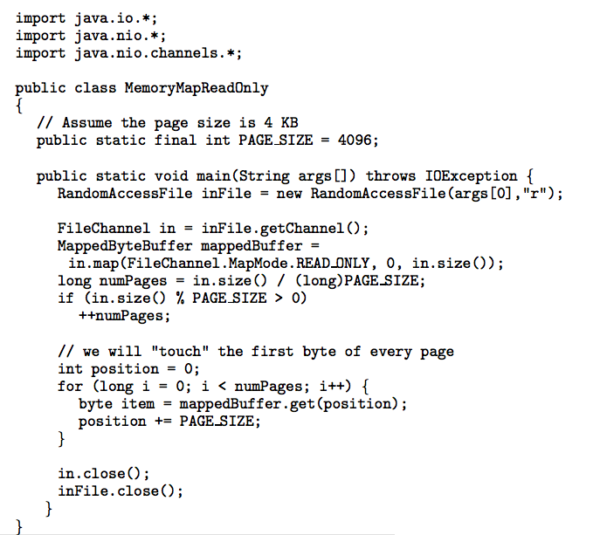
Memory Mapped files
Unix example
Java example
#include <stdio.h>
#include <fcntl.h>
#include <unistd.h>
#include <sys/mman.h>
#define PACKAGE "mmap"
int main(int argc, char *argv[]) {
int input, output;
size_t filesize;
void *source, *target;
if((input = open(argv[1], O_RDONLY)) == -1) exit(-1);
if((output = open(argv[2], O_RDWR|O_CREAT|O_TRUNC, 0666)) == -1) exit(-1)
if((source = mmap(0, filesize, PROT_READ, MAP_SHARED, input, 0)) == (void *) -1) exit(-1);
if((target = mmap(0, filesize, PROT_WRITE, MAP_SHARED, output, 0)) == (void *) -1) exit(-1);
memcpy(target, source, filesize);
munmap(source, filesize);
munmap(target, filesize);
close(input);
close(output);
return 0;
}
From: http://www.c.happycodings.com/Gnu-Linux/
From: textbook
CSS430 File System

Slide 8

File Types
CSS430 File System

Slide 9
Device Directory and Disk Partition
Device Directory
  Super block
  Layout of the file system
    File system size
    The number of free blocks
  Index of files stored on the device
    <fileName, fileDescriptorLocaiton>
Linux
/proc File System
NTFS
CSS430 File System

Slide 10
Operations Performed on Directory
Search for a file
  find dirName –n fileName –print
  whereis or where filename
Create a file
  Manual: Create a file by text editors
  Command: touch fileName … create a 0-length file
  System call: open(filename,O_CREAT,mode)
Delete a file
  rm [-fr] fileName
List a directory
  ls [-al]
Rename a file
  Command: mv oldName newName
  System call: rename( oldname, newname)
Traverse the file system
  find / -n -print
CSS430 File System

Slide 11

Single-Level Directory
All files in the same directory
Example: CPM
Problems:
  Naming: Files must have a unique name.
  Grouping: All files are visible to all users.
CSS430 File System

Slide 12

Two-Level Directory
Each user has his/her own directory
  Naming problems resolved
  Special user file directories shared among users.
  Search path needed
Example: MVS/VM
CSS430 File System

Slide 13

Tree-Structured Directories
CSS430 File System

Slide 14
Tree-Structured Directories in Unix
Grouping files
Attaching other file systems as a subdirectory
  mount and umount
Current working directory
  Files specified by a relative path
  Subdirectories created/deleted by: mkdir rmdir
Path:
  Relative path versus absolute path
  Setting PATH to let the shell search a command file.
Recursive operations
  List: ls -R
  Delete: rm -R
  Archive: tar –cvf - .
/
a
mount b at a
b
c
CSS430 File System

Slide 15

Acyclic-Graph Directories
Allow file/directory sharing which tree structure prohibits
Create a link that is a pointer to another file or subdirectory
Problems:
  Travers shared files more than once
  How to delete shared file
CSS430 File System

Slide 16
Acyclic-Graph Directories in Unix
foo
Symbolic link
  mkdir foo
  touch foo/a
  ln –s ../foo foo/testdir
  ls –l foo
  total 1
  -rw-rw-r— 1 mfukuda 0 May 7 07:07 a
  lrwxrwxrwx 1 mfukuda 6 May 7 07:07 testdir -> ../foo
  Unix provides two distinguishable functions:
    Those not following symbolic link: chown, remove, rename, unlink
      (To cut off an infinitive loop, they simply ignores symbolic links.)
    Those following symbolic link: access, creat, open, stat
  Symbolic deletion does not affect the original file.
Hard link
  Ln target_file_name link_name file only
  link() and unlink() system calls
    Super-user mode only: avoid cyclic-graph directories (not work if a super user is idiot.)
    When link count reaches 0, the corresponding file itself is removed.
a
testdir
CSS430 File System

Slide 17
Discussions 1
If an idiot super user creates a cyclic hard link, what happens to that directory when executing the following two commands?
  rm
  find
CSS430 File System

Slide 18

General Graph Directory
How do we guarantee no cycles?
  Allow only links to file but not subdirectories.
  Garbage collection to cut off anomaly cycle.
  Every time a new link is added, use a cycle detection algorithm to determine whether it is OK.
CSS430 File System

Slide 19
Access Lists and Groups
Mode of access: read, write, execute
Three classes of users
RWX
a) owner access 7 ⇒ 1 1 1
RWX
b) groups access 6 ⇒ 1 1 0
RWX
c) public access 1 ⇒ 0 0 1
Ask manager to create a group (unique name), say G, and add some users to the group.
For a particular file (say game) or subdirectory, define an appropriate access.
Attach a group to a file
chgrp G game
owner
group
public
chmod
761
game
CSS430 File System

Slide 20
Exercises
Problems (No turn-in):
  Solve Exercise 10.4.
  Solve Exercise 10.9.
  Solve Exercise 10.10.
  Solve Exercise 10.14.
CSS430 File System

