Slide 1
CSS430 Operating-System Structures
Textbook Ch2
These slides were compiled from the OSC textbook slides (Silberschatz, Galvin, and Gagne) and the instructor’s class materials.
Notes:
Hello! Everyone,
My name is Shinya Kobayashi. Today, I am going to present our paper titled “Inter-Cluster Job Coordination Using Mobile Agents” on behalf of the first author, Munehiro Fukuda. Munehiro was hoping to show up and present the paper at AMS2001, however he got to wait in Japan until he will get an H1B visa. Since I received the presentation materials from him quite recently, please allow me to present this paper using this script.
I can respond to your questions as far as I know, however you can also ask Munehiro by email. His email address is on the title page of our paper.
(time 1:05)

Slide 2

A view of OS Services

Slide 3
OS Features
Process Management Week 2-5
Main Memory Management Week 6-7
File Management Week 8-9
Secondary-Storage Management if time allows
I/O System Management if time allows
Networking CSS432
Protection System Week 10
Command-Interpreter System Today

Slide 4
Process Management
A process is a program in execution. A process needs CPU time, memory, files, and I/O devices, to accomplish its task.
The operating system is responsible for
  Process creation and deletion (= starting and terminating a program execution)
  process suspension and resumption (= letting a program wait for an I/O operation or a next turn)
  process synchronization (= letting a program wait for another program’s termination)
  process communication (= allowing a program to send/receive data from another program in execution.)

Slide 5
Memory Management
Memory is a large array of words or bytes, each with its own address.
Main memory is a volatile data storage shared by the CPU and I/O devices.
The operating system is responsible for:
  Keep track of which parts of memory are currently being used and by whom.
  Decide which processes to load when memory space becomes available.
  Allocate and deallocate memory space as needed.

Slide 6
File Management
Files represent programs (both source and object forms) and data (in free form).
The operating system is responsible for:
  File creation and deletion.
  Directory creation and deletion.
  Support of primitives for manipulating files and directories (=open, read, write, seek, and close).
  Mapping files onto secondary storage (=hard disks, tapes, etc.).
  File backup on stable (nonvolatile) storage media.

Slide 7
Other Managements
I/O Systems:
  Buffering, caching, and spooling of I/O data (I/O devices are slow.)
  Device drivers (program controlling devices)
Secondary/Mass-Storages:
  Disk management (for free and allocated spaces)
  Disk scheduling (for an optical sequence of disk accesses)
  Swap-space management (a part of disk is used as memory)
Network:
  Supporting various network protocols: tcp/ip, ftp, NFS, and http
Protection/Security:
  Authentication (password, java byte verifier)
  Access authorization (access mode, java sandbox model)
  Cryptography

Slide 8

Virtualization
(a) non-virtual machine (b) virtual machine
XP, BSD, NT
Ex. Linux
Ex. VMware
Ex. Linux

Slide 9
Discussions 1
In what particular situation have your program received a segmentation fault?
To read data from a file, why do we need to call open and close the file? In other words, why doesn’t OS allow read( filename, data, size )?
If your C++ program terminates upon an exception, it may not print out a cout statement that must have been executed before the exception. Why?

Slide 10

System Calls
All managements in slides 4-7 must be performed through a system call.

Slide 11
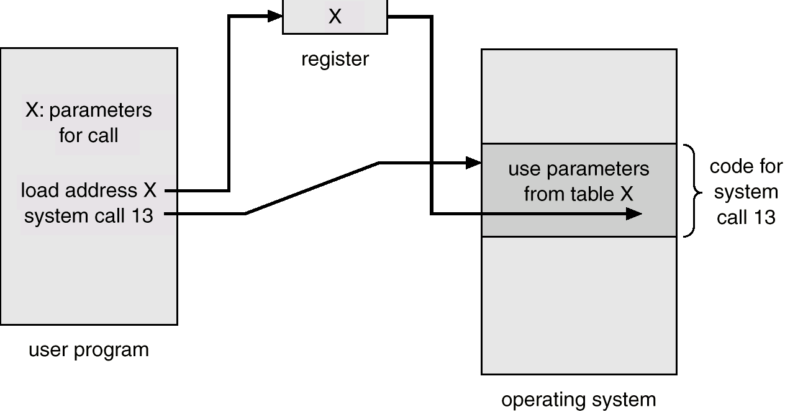
System Calls (Cont’d)
When a user program executes a special instruction like trap,
  CPU recognizes it as a (software) interrupt.
  The mode turns in kernel mode.
  Control jumps to a given vector (e.g. 13)
  The OS saves the user program status.
  It then begins to handle the system call.
  The OS resumes the registers.
  It finally returns back to a user program

Slide 12
Command Interpreters
The program that reads and interprets control statements
  command-line interpreter (in DOS)
  shell (in UNIX)
  Mouse-based window and menu system (in Macintosh, Windows, and Linux)
What control statements can you pass the command interpreter?
  Program execution: a.out, g++, emacs
  Process management: ps, kill, sleep, top, nice, pstack
  I/O operations: lpr, clear, lprm, mt
  File-system manipulation: ls, mkdir, mv, rm, chmod, [u]mount
  Communication: write, ping, mesg

Slide 13
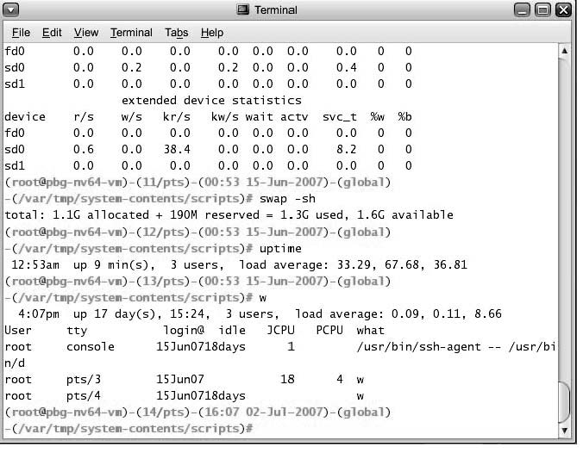
Bourne Shell Command Interpreter

Slide 14

The Mac OS X GUI

Slide 15
Shell
fork, exec, and dup are
System calls
telnetd
goodall login: mfukuda
fork, exec and wait
login
Shell
goodall[1]% (you got to type)
(1)fork & wait
(5)exit
Shell
wc
(3)fork
Shell
who
goodall[1]% who | wc -l
(4)exec
(4)exec
cin
(2)pipe
cout

Slide 16
CSS430-Unique ThreadOS
Loader.java
Shell.java
Test1.java
Other user
threads
exec, join, exit, cin, cout, rawread, rawwrite
SysLib.java
interrupt
Disk.java
Power on
addThread
deleteThread
Boot.java
Kernel.java
Initialization
read
write
Scheduler.java

Slide 17
Discussions 2
Is Windows a much more advanced OS than Linux from the following view pointers?
  Windows temporarily keeps deleted files in Recycle Bin, while Linux rm delete them instantly.
  Windows task manager allows us to kill processes with their program names, while Linux uses IDs to kill specific processes.
  Windows starts an appropriate application for a file double-clicked, while Linux needs a specific application to be typed from the command line.

Slide 18
Java Technology
Programming-language specification
  C++-like object oriented programming language
  No system-dependent descriptions
    Variable sizes are universally defined over different machines
    No system calls are supported
    Automatic memory operations: no address concept and no delete
  Multithreaded support
Application-programming interface (API)
  Various system-provided classes: graphics and I/O
Virtual-machine specification
  Interpretation of architecturally independent bytecode

Slide 19
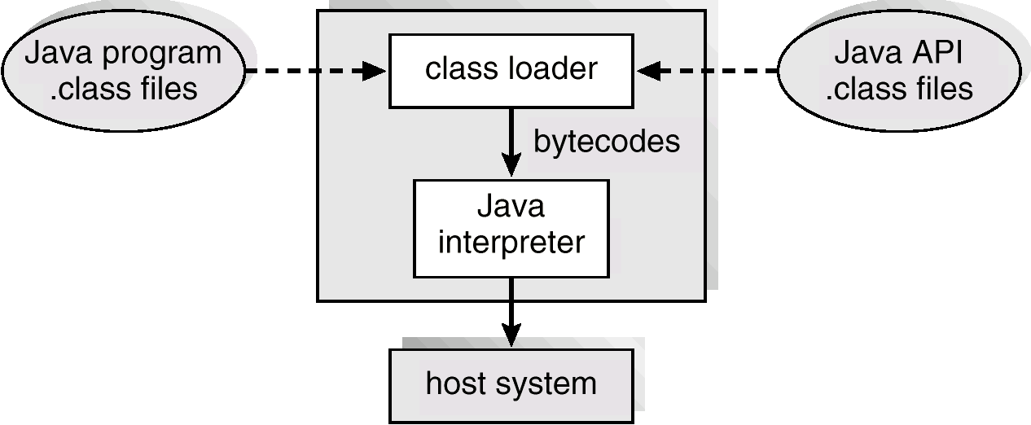
Java Virtual Machine

Slide 20
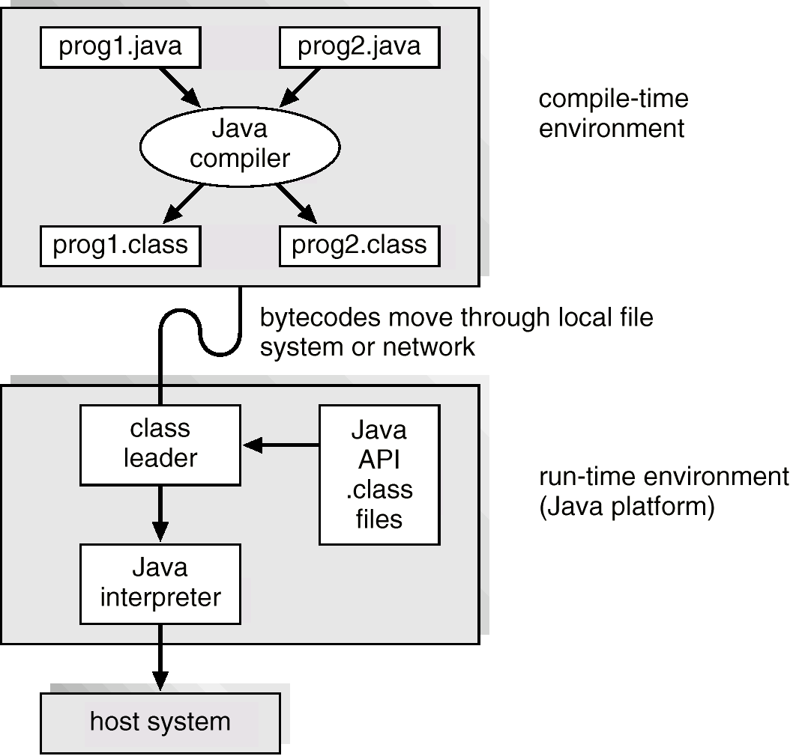
Java Development Environment

Slide 21
Java Program
In the HelloDriver.java file:
public class HelloDriver {
public static void main( String[] args ) {
Hello greeter = new Hello( “Von Neuman” );
greeter.speak( );
}
private class Hello {
private String myName;
Hello( String name ) { myName = name; }
void speak( ) {
System.out.println( “Hi! My name is ” + myName );
}
}
}

Slide 22
Names and Packages
Java
  Class names in MixedCase starting with a capital letter
  Class and the corresponding file has the same name.
  Packages predefines various useful classes.
  import omits the full package name.
  Hello.java file:
  import java.util.*;
  class Hello {
  Hello( ) {
  Random r = new Random( ); }
  }
C++
  No regulations on class names
  No correlation between class and file names
  Headers predefines various useful class interface.
  #include read the header file.
  Hello.cpp file:
  #include <cstdlib>
  class hi {
  hi( ) {
  int r = rand( ); }
  }

Slide 23
Values, Objects, and Pointers
C++
  Variables:
    bool(true or false), char(8bits),
    short(16bits), int(32bits),
    long(32bits), float(32bits), and
    double(64bts)
  Pointers: *, &, and -> operators
    class Pair { int x, y };
    Pair org;
    Pair *p, *q, *r;
    org.x = 0;
    p = new Pair;
    p->y = 5;
    q = p;
    r = &org;
Java
  Variables:
  boolean(true or false), byte(8bits), char(16bits), short(16bits), int(32bits), long(64bits), float(32bits), and double(64bts)
  Pointers: NO *, &, and ->
    class Pair { int x, y };
    Pair org = new Pair( );
    Pair p, q, r;
    org.x = 0;
    p = new Pair( );
    p.y = 5;
    q = p;
    r = org;
org
x:0
y:
x:0
y:
org
p
x:
y:5
x:
y:5
p
q
q
r
r

Slide 24
Pointers (Cont’d)
Function arguments:
  Primitive types: call by value
  Objects: call by reference (no & needed)
Garbage collection:
  No delete needed
  C++: Java:
  P = new Pair( ); p = new Pair( );
  // … // …
  delete p; p = new Pair( );
  P = new Pair( ); // The previous object is deleted by system.

Slide 25
Public, Protected, Private, Static, and Final
C++
  public
  protected
  private (default)
  Static (used as shared variables/functions)
  const
Java
  public (default)
  protected
  private
  Static (used as shared and global variables/functions)
  final

Slide 26
Arrays and Strings
C++
  Array name
    Points to the address of the 1st element.
  Array size
    You have to memorize how long it is.
    You cannot change the size.
  int a[], *b;
  a = new int[10];
  b = a;
  string class
Java
  Array name
    Points to the entire array object
  Array size
    Final field length returns the size.
    You cannot change the size.
  int a[];
  a = new int[10];
  int[] b = a;
  String class
    Visit java.sun.com for detials

Slide 27
Constructors and Overloading
C++
  Object construction using new
    No parentheses needed if no arguments given
  Multiple constuctors
    Allowed
  Overloading
    Including operators
  Method bodies
    Can be defined separately using scope ::
Java
  Object construction using new
    Parentheses always needed even if no arguments given
  Multiple constuctors
    Allowed
  Overloading
    Operators are not overloaded.
  Method bodies
    Must be defined in line after their method interface.

Slide 28
Inheritance, Interfaces, and Casts
Java
  Inheritance
    class Derived extends Base { … }
    Single inheritance only (All objects are derived from Object class)
    Methods without a body can be described in an interface
      interface Runnable {
      void run( );
      }
    Multiple interfaces are inherited.
      Class Derived implements Runnable{ }
    Constructors are not inherited.
      Use super( arguments );
  Cast: (typeName)var
C++
  Inheritance
    Class Derived : public Base { … }
    Multiple inheritance allowed
    Pure virtual functions for abstract classes
      class Abstract {
      virtual func( ) = 0;
      }
    Constructors called from the base class
  Cast
    (typeName)var or typeName(var)

Slide 29
Exceptions
No core dump but exceptions occur in Java.
Some API methods request you to catch exceptions
Catching Exceptions: // my recommendation
  public Disk( int blks ) {
  try {
    FileInputStream ifstream = new FileInputStream( “DISK” );
  } catch ( FileNotFoundException e ) {
    System.out.println( e );
  }
Throwing Exceptions:
  public Disk( int blks ) throws FileNotFoundException {
  FileInputStream ifstream = new FileInputStream( “DISK” );
  }

Slide 30
Threads
Threads are independent execution entities which run in concurrent but share the same code and variables.
Definition:
  Public class ThreadName extends Thread {
  ThreadName( String[] arg ) { … }
  public void run( ) {
  …; // e.g. while(true) { … }
  }
  }
Invocation:
  ThreadName t1 = New ThreadName( “thread1” );
  ThreadName t2 = New ThreadName( “thread2” );
  t1.start( ); // without waiting t1’s termination, we can go to t2.start!
  t2.start( );

Slide 31
Input and Output
C++
  Output
    int a = 5;
    cout << “ans=” << a << endl;
  Input
    int a, b;
    cin >> a >> b;
Java
  Output
    int a =5;
    System.out.println( “ans=” + a );
  Input
    byte b = System.in.read( );
    // This is inconvenient!!
    BufferedReader in =
    new BufferedReader( new InputStreamReader( System.in ) );
    String s = in.readline( )
An efficient stream reading class
A class converting from bytes to chars

Slide 32
Vector
Vector is a list of Objects.
  Declaration:
    Vector v = new Vector( );
  Any type of objects are inserted:
    v.add( new Integer( 10 ) );
    v.add( 0, new Integer( 5 ) );
  When retrieved, they must be converted from Object to an appropriate type:
    Integer i1 = (Integer)v.get( 0 );
    Integer i2 = (Integer)v.lastElement( );
Integer, Float, Character, etc:
Classes wrapping the corresponding primitive data
parseInt( String s ), toString( ), etc…

Slide 33
Exercises:
Programming Assignment 1:
  Check the syllabus for its due date.
No turn-in problems:
  List five commands and systems calls with regard to process management, file management, and I/O management respectively. Explain each of their behaviors.
 | Process management | File management | I/O management
Commands
System calls

