Slide 1
CSS430 Process Management
Textbook Ch3
These slides were compiled from the OSC textbook slides (Silberschatz, Galvin, and Gagne) and the instructor’s class materials.
CSS430 Process Management
Notes:
Hello! Everyone,
My name is Shinya Kobayashi. Today, I am going to present our paper titled “Inter-Cluster Job Coordination Using Mobile Agents” on behalf of the first author, Munehiro Fukuda. Munehiro was hoping to show up and present the paper at AMS2001, however he got to wait in Japan until he will get an H1B visa. Since I received the presentation materials from him quite recently, please allow me to present this paper using this script.
I can respond to your questions as far as I know, however you can also ask Munehiro by email. His email address is on the title page of our paper.
(time 1:05)

Slide 2
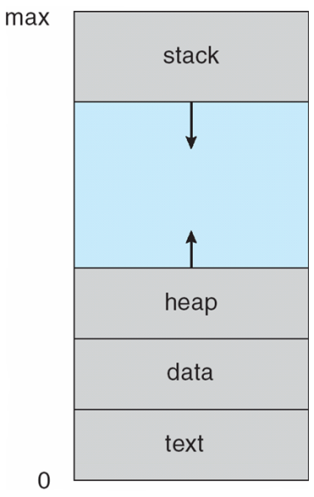
Process Concept
Process – a program in execution; process execution must progress in sequential fashion.
Textbook uses the terms job and process almost interchangeably.
A process includes:
  Program counter
  Stack (local variables)
  Data section (global data)
  Text (code)
  Heap (dynamic data)
  Files (cin, cout, cerr, other file descriptors)
CSS430 Process Management

Slide 3

Process State
CSS430 Process Management

Slide 4

Process Control Block
CSS430 Process Management

Slide 5

Context Switch
CSS430 Process Management

Slide 6

Process Scheduling Queues
CSS430 Process Management

Slide 7
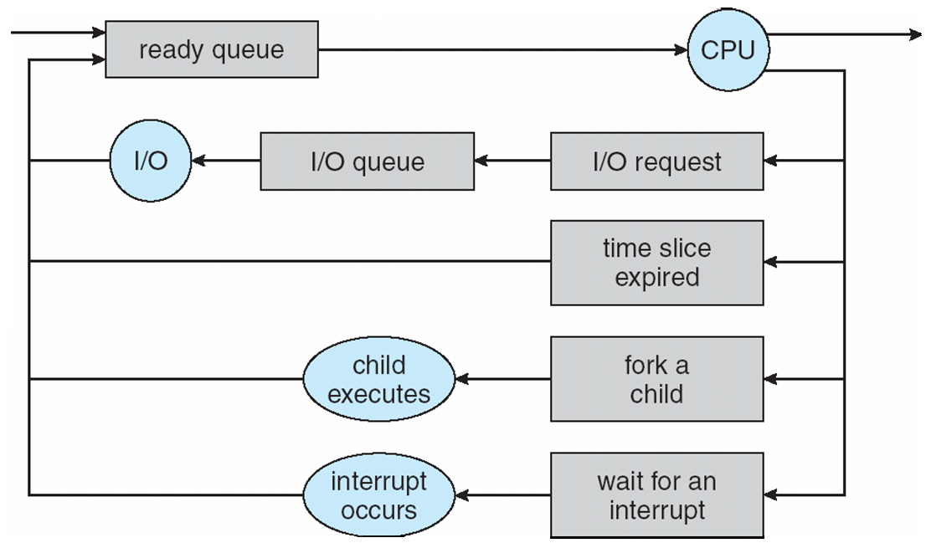
Representation of Process Scheduling
Short-term scheduler: picks up a process from
ready queue every 100ms
Long-term scheduler: swaps I/O waiting processes
in and out of memory
CSS430 Process Management

Slide 8
Process Creation
Parent process creates children processes.
Resource sharing
  Resource inherited by children: file descriptors, shared memory and system queues
  Resource not inherited by children: address space
Execution
  Parent and children execute concurrently.
  Parent waits by wait system call until children terminate.
UNIX examples
  fork system call creates new process.
  execlp system call used after a fork to replace the process’ memory space with a new program.
CSS430-unique ThreadOS: SysLib.exec and Syslib.join
CSS430 Process Management

Slide 9
C Program Forking Separate Process
parent
#include <stdio.h>
#include <unistd.h>
int main(int argc, char *argv[])
{
int pid;
/* fork another process */
pid = fork();
if (pid < 0) { /* error occurred */
fprintf(stderr, "Fork Failed");
exit(-1);
}
else if (pid == 0) { /* child process */
execlp("/bin/ls","ls",NULL);
}
else { /* parent process */
/* parent will wait for the child to complete */
wait(NULL);
printf("Child Complete");
exit(0);
}
}
a.out
child
duplicated
a.out
ls
synchronized
CSS430 Process Management

Slide 10
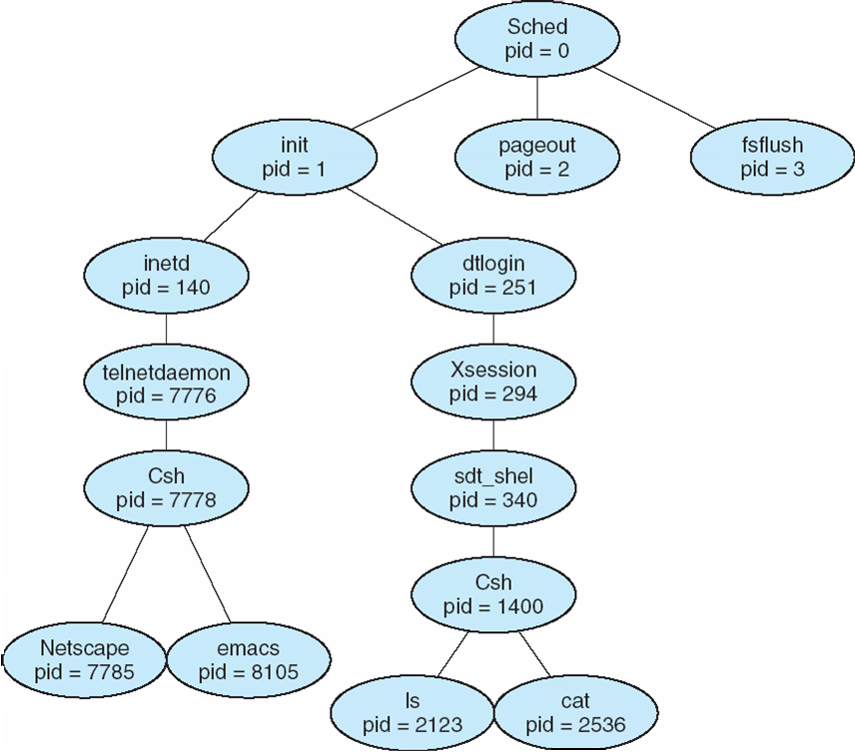
A Tree of Processes On A Typical Solaris
CSS430 Process Management

Slide 11
Process Termination
Process termination occurs when
  It executes the last statement
  It executes exit system call explicitly
Upon process termination
  Termination code is passed from child (via exit) to parent (via wait).
  Process’ resources are deallocated by OS.
Parent may terminate execution of children processes (via kill) when
  Child has exceeded allocated resources.
  Task assigned to child is no longer required.
  Parent is exiting (cascading termination).
    Some operating system does not allow child to continue if its parent terminates.
CSS430 Process Management

Slide 12
Discussions 1
List tasks required for process creation and termination in a chronological order.
Process 0 in Linux is the ancestor of all processes. Consider tasks performed by Process 0.
Upon exit( ), a child process remains as a zombie process that passes an exit code back to its parent. From a Linux shell, you can start a process with & and thus keep it running even after the logoff. What happened to this process?
The child process inherits most computing resources from its parent process. Why is it a natural idea? How can this inheritance be implemented inside the operating system?
CSS430 Process Management

Slide 13
Cooperating Processes
Process independency: Processes belonging to a different user does not affect each other unless they give each other some access permissions
Process Cooperation: Processes spawned from the same user process share some resources and communicate with each other through them (e.g., shared memory, message queues, pipes, and files)
Advantages of process cooperation
  Information sharing: (sharing files)
  Computation speed-up: (parallel programming)
  Modularity: (like who | wc –l, one process lists current users and another counts the number of users.)
  Convenience: (net-surfing while working on programming with emacs and g++)
CSS430 Process Management

Slide 14

Communication Models
Message passing
Shared memory
CSS430 Process Management

Slide 15
Shared Memory
Bounded Buffer
Communication link or media has a bounded space to buffer in-transfer data.
import java.util.*;
public class BoundedBuffer
{
public BoundedBuffer( ) {
count = 0;
in = 0;
out = 0;
buffer = new Object[BUFFER_SIZE];
}
public void enter( Object item ) { }
public Object remove( ) { }
public static final int BUFFER_SIZE = 5;
private int count; // #items in buffer
private int in; // points to the next free position
private int out; // points to the next full position
private Object[] buffer; // a reference to buffer
}
CSS430 Process Management

Slide 16
Producer and Consumer Processes
Producer Process
for(int i = 0; ; i++ ) {
BoundedBuffer.enter(new Integer(i));
}
public void enter( Object item ) {
while ( count == BUFFER_SIZE )
; // buffer is full! Wait till buffer is consumed
++count;
buffer[in] = item; // add an item
in = ( in + 1 ) % BUFFER_SIZE;
}
public object remove( ) {
Object item;
while ( count == 0 )
; // buffer is empty! Wait till buffer is filled
-- count;
item = buffer[out]; // pick up an item
out = ( out + 1 ) % BUFFER_SIZE;
}
Buffer[0] [1] [2] [3] [4]
Consumer Process
for(int i = 0; ; i++ ) {
BoundedBuffer.remove( );
}
out
in
CSS430 Process Management

Slide 17
Message Passing
Message system – processes communicate with each other without resorting to shared variables.
IPC facility provides two operations:
  send(message) – message size fixed or variable
  receive(message)
If P and Q wish to communicate, they need to:
  establish a communication link between them
  exchange messages via send/receive
Implementation of communication link
  physical (e.g., shared memory, hardware bus)
  logical (e.g., logical properties)
CSS430 Process Management

Slide 18
Direct Communication
Processes must name each other explicitly:
  send (P, message) – send a message to process P
  receive(Q, message) – receive a message from process Q
How can a process locate its partner to communicate with?
  Processes are created and terminated dynamically and thus a partner process may have gone.
  Direct communication takes place between a parent and its child process in many cases.
    Example: pipe
CSS430 Process Management

Slide 19
Producer-Consumer Problems
who | wc -l
who
pipe
wc -l
mfukuda tty1 Apr 1 14:14
stiber tty2 Apr 2 15:19
ksung tty3 Apr 2 15:30
Output:
3
Producer process:
  who produces a list of current users.
Consumer process
  wc receives it for counting #users.
Communication link:
  OS provides a pipe.
CSS430 Process Management

Slide 20
Direct Communication Example: Pipe
int main( void ) {
int n, fd[2];
int pid;
char line[MAXLINE];
if (pipe(fd) < 0 ) // 1: pipe created
perror( “pipe error” );
else if ( (pid = fork( ) ) < 0 ) // 2: child forked
perror( “fork error” );
else if ( pid > 0 ) { // parent
close( fd[0] ); // 3: parent’s fd[0] closed
write( fd[1], “hello world\n”, 12 );
} else { // child
close( fd[1] ); // 4: child’s fd[1] closed
n = read( fd[0], line, MAXLINE );
write( 1, line, n );
}
exit( 0 );
}
parent
2
child
fd[0], fd[1]
fd[0], fd[1]
3
1
4
pipe
CSS430 Process Management

Slide 21
Indirect Communication
Messages are directed and received from mailboxes (also referred to as ports).
  Each mailbox has a unique id.
  Processes can communicate only if they share a mailbox.
Processes must know only a mailbox id. They do not need to locate their partners
  Example: message queue
CSS430 Process Management

Slide 22
Indirect Communication
Example: Message Queues
struct mymesg {
long mytype;
char mtext[512];
} message_body;
int main( void ) {
int msgid = msgget( 100, IPC_CREAT );
strcpy( message_body.mtext, “hello world\n” );
msgsnd( msgid, &message_body, 512, 0 );
}
struct mymesg {
long mytype;
char mtext[512];
} message_body;
int main( void ) {
int msgid = msgget( 100, IPC_CREAT );
msgrcv( msgid, &message_body, 512, 0, 0 );
cout << message_body.mtext << endl;
}
Message queue
(id = msgid)
0
1
2
Some other process can
enqueue and dequeue a message
CSS430 Process Management

Slide 23
Buffering
Skipped: Discussed in CSS434: Parallel/Distributed Comp.
Queue of messages attached to the link; implemented in one of three ways.
  1. Zero capacity – 0 messages
  Sender must wait for receiver (rendezvous).
  2. Bounded capacity – finite length of n messages
  Sender must wait if link is full (This happens in practical world like sockets).
  3. Unbounded capacity – infinite length
  Sender never waits. (Non-blocking send)
CSS430 Process Management

Slide 24
Exercises (No turn-in)
In Unix, the first process is called init. All the others are descendants of “init”. The init process spawns a telnetd process that detects a new telnet connection. Upon a new connection, telnetd spawns a login process that then overloads a shell on it when a user successfully log in the system. Now, assume that the user types who | grep mfukuda | wc –l. Draw a process tree from init to those three commands. Add fork, exec, wait, and pipe system calls between any two processes affecting each other.
Consider four different types of inter-process communication.
  Pipe: implemented with pipe, read, and write
  Socket: implemented with socket, read, and write
  Shared memory: implemented shmget, shmat, and memory read/write
  Shared message queue: implemented with msgget, msgsnd, and msgrcv
  Which types are based on direct communication?
  Which types of communication do not require parent/child process relationship?
  If we code a produce/consumer program, which types of communication require us to implement process synchronization?
  Which types of communication can be used to communicate with a process running on a remote computers?
  Which types of communication must use file descriptors?
  Which types of communication need a specific data structure when transferring data?
CSS430 Process Management

