Slide 1
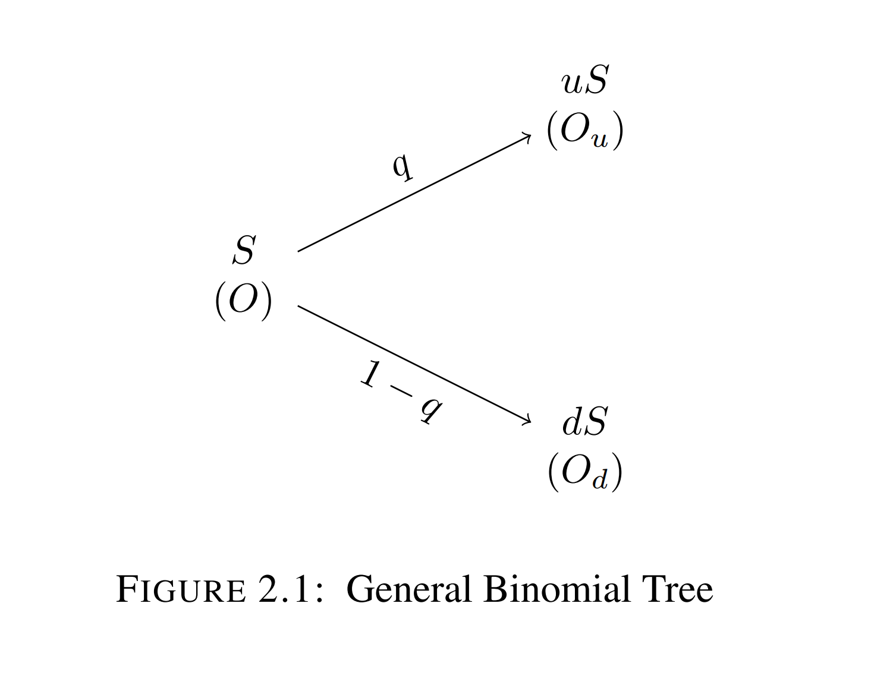
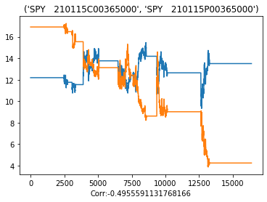

The Evaluation, Comparison, Selection, and Implementation of Derivative Pricing Methods into a Trading Algorithm
General Binomial Tree
By Jason Bohne
Faculty Supervisor: Dr. Jie Yang
Relative Error of Option Straddle Plotted against Time
Source: UIC
Notes:
The Evaluation, Comparison, Selection, and Implementation of Derivative Pricing Methods into a Trading Algorithm

Slide 2
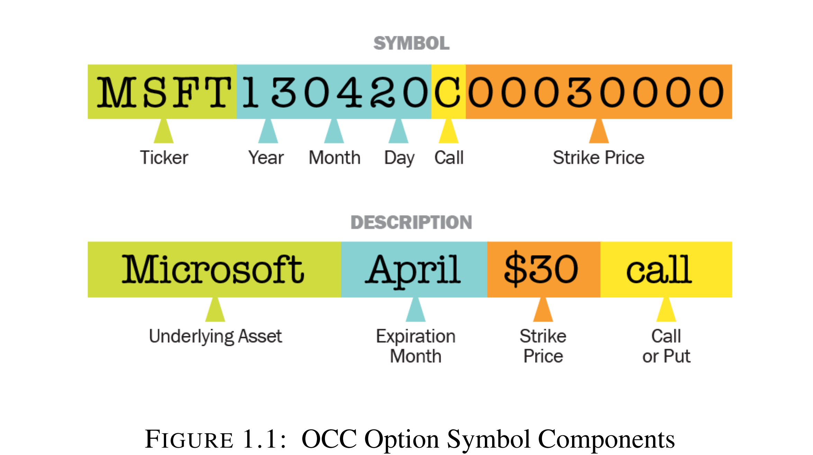
Option Contracts
Common expirations include Weeklies, Monthlies, Quarterlies and LEAPs
Each option contract has unique option symbol generated by Option Clearing Corporation (OCC)
Expressed in the format shown below option symbol includes information relevant to the contract’s underlying asset, expiration date, strike price and right.
Classified as a derivative, other derivatives include futures, interest rate swaps
Holder of the option has the right to buy or sell the underlying asset at the strike price, known as calls or puts respectively
European options can only be exercised on expiration date, American options can be exercised anytime up until expiration date
Source: Jeff Clark Option Symbol Decomposition
Notes:
Background on Options

Slide 3
Pricing Methods
Analytic Formulas
Black Scholes Pricing Formulas, 1973 (BS-PF)
Analytic Approximations
Barone-Adesi-Whaley Method, 1987 (B-A-W)
Bjerksund-Stensland Method, 1993 (B-S)
Numerical Methods
Binomial Trees
Cox-Ross-Rubinstein Binomial Tree, 1979 (C-R-R)
Jarrow-Rudd Binomial Tree, 1982 (J-R)
Crank-Nicolson Finite Difference Method, 1985 (C-N)
In the context of option pricing:
Analytic Formulas give explicit formulas for the true value of the option, which are commonly European Style
Analytic Approximations approximate the value of the option, commonly American Style, based on an underlying analytic formula
Numerical Methods such as Binomial Trees and Finite Difference Methods approximate the true value with the use of a scheme across space and time.
Notes:
Describe Three Classes of Pricing Methods, Analytic, Analytic Approximations and Numerical Methods

Slide 4
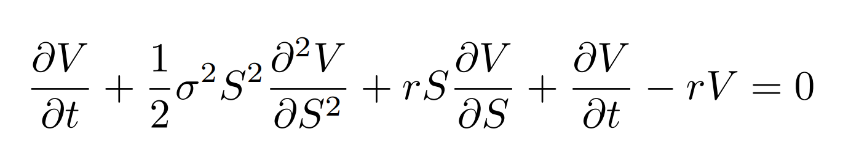
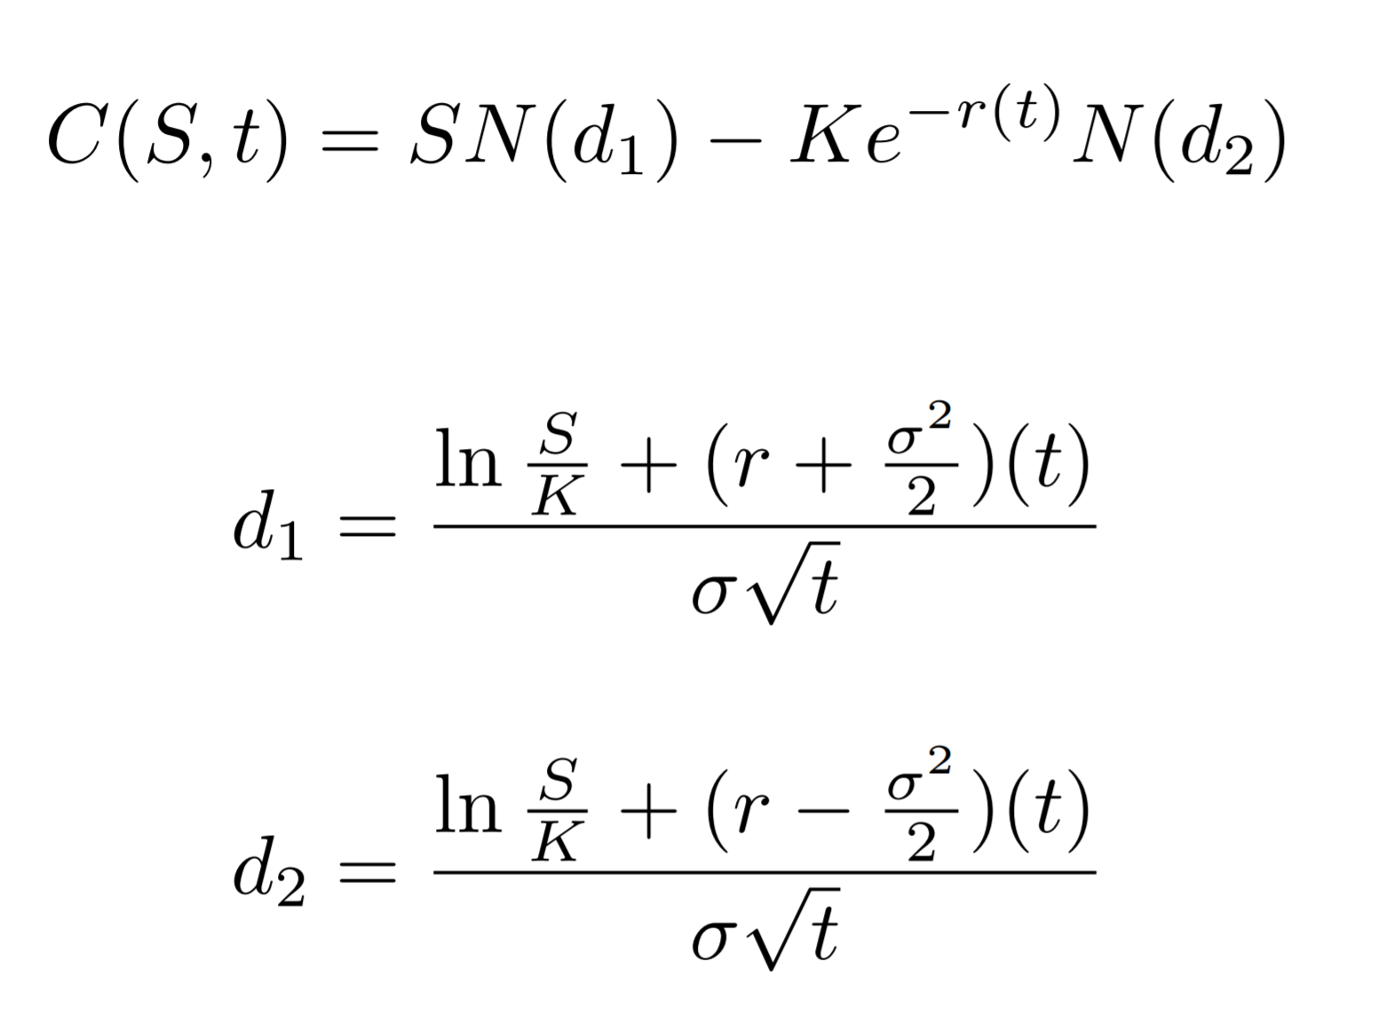
Pricing Methods
Black Scholes Partial Differential Equation
Most famous equation in option pricing is the Black-Scholes Pricing Formulas
Formulas are the solutions to the Black-Scholes Partial Differential Equation (BS-PDE)
Provide an explicit formula for value of European call or put (similar)
American calls on stock with no dividend can be valued by (BS-PF)
See Black’s Approximation, 1975
Black Scholes Pricing Formula for European Call, Put Similar Structure
Notes:
Spot Price S, Strike Price K, sigma is of underlying, time is t, r is risk free rate N() is cumulative normal distribution
American Call -> Evaluated by Black Scholes Pricing Formula for stock with no dividend , Can only establish Bound for American Put (Not explicit formula)
For Stock with one discrete dividend can use Black’s Approximation or numerically solve the pde

Slide 5
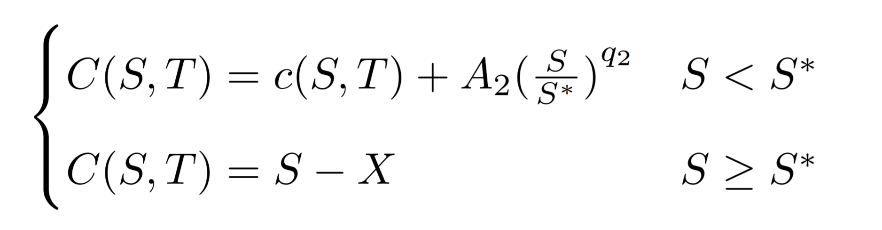

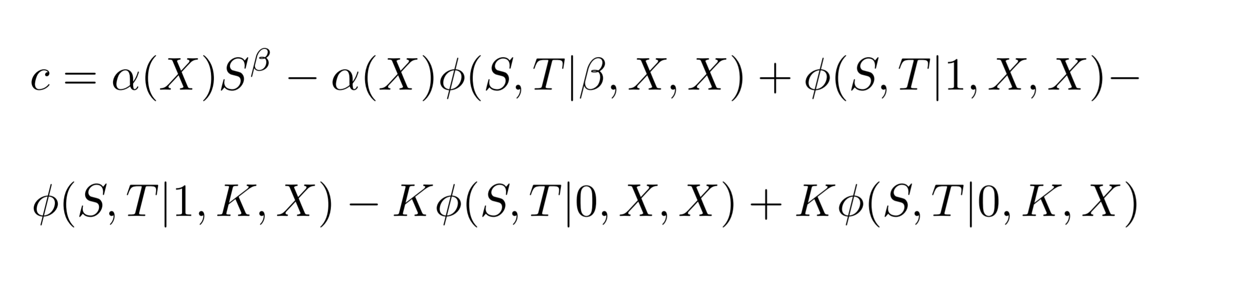
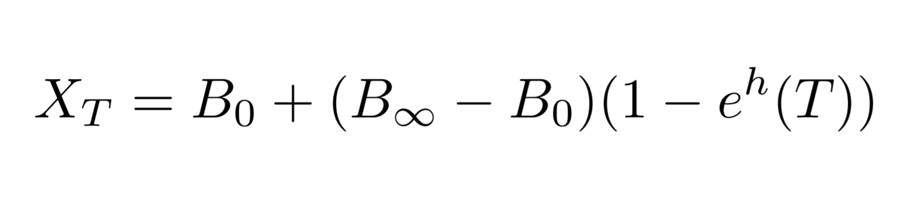
Pricing Methods
Quadratic Approximation of the American Call
Approximation Term
Barone-Adesi-Whaley (B-A-W) proposed the Quadratic Approximation of the American Call/Put
Approximating the Analytic BS-PDE, the argument assumes any early exercise premium of American option follows BS-PDE
Bjerksund-Stensland (B-S) proposed a class of general exercise strategies for American options specified by a trigger price
One way to calculate the trigger price is with a time weighted average between infinite lived and an infinitesimal lived American Option
Approximation of American Call given a General Exercise Strategy
Time Weighted Average Trigger Price
Notes:
Barone-Adesi-Whaley argue that assuming the BS-PDE applies to American Options, then it must apply to any early exercise premium of said option
C(S,T) is American Option, c(S,T) European, A_2 is correction term which classifies as the quadratic approximation, where S is spot price S* is critical spot price, q1, q2 is roots of ode, b is cost to carry, r is risk-free rate, T time to expiration, N() is cumulative normal distribution, d1, d2 defined with BS PDE
S-X is exercisable proceeds
Second term can just be thought of as the effect of a European option being transformed into an American Option
Bjerksund-Stensland define a class of general exercise strategies for American Options,
Phi(x) defines the expected payoff conditional on the spot price never be greater than the strike price (including final) intuitively makes sense bc if not we would exercise then and we would not have a payoff at expiration
Each exercise strategy demands a trigger price X_t which we will exercise the American Option at. The example they provide which we will also use is the average between an infinite and an infinitesimal lived American Option Contract (time weighted average)

Slide 6
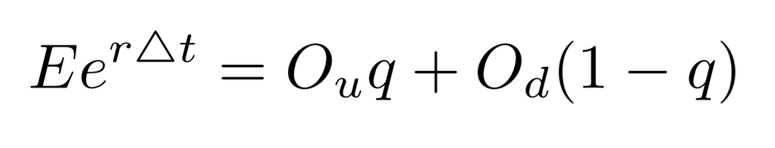
Pricing Methods
Black Scholes Partial Differential Equation
Finite Difference Methods are often used in option pricing such as implicit, explicit, and Crank-Nicolson
Performing central approximations in both time and space results in the following scheme
Binomial Trees represent different moves the underlying asset can take
Variations occur when restricting probability or magnitude of move
Price of option is solved backward in time given payoffs at expiration
Crank-Nicolson Finite Difference Scheme for Black-Scholes Partial Differential Equation
General Binomial Tree
Expected Value of Option at Previous Node
Notes:
Perform central approximation in time, central approximation in space for first and second derivative, combine discretization's get above scheme
We know from a stability analysis Crank Nicolson is stable for any space and time step and provides second order accuracy in both space and time
At each time step solve a matrix implicitly
General Binomial Trees start with the current stock price and construct a lattice of possible moves. Moves to which the underlying asset can move to are determined by either probabilities or size steps.
Once the underlying asset tree is constructed one can example the payoffs at expiration and work backward to solve option values at time t-1. Inductively can solve all the option values all the way back to t=0 where we have the current value of the option -> European
For American options compare the option value to exercisable proceeds at each node. Whenever the proceeds are greater than the value we exercise and mark that node as the values of the proceeds.

Slide 7
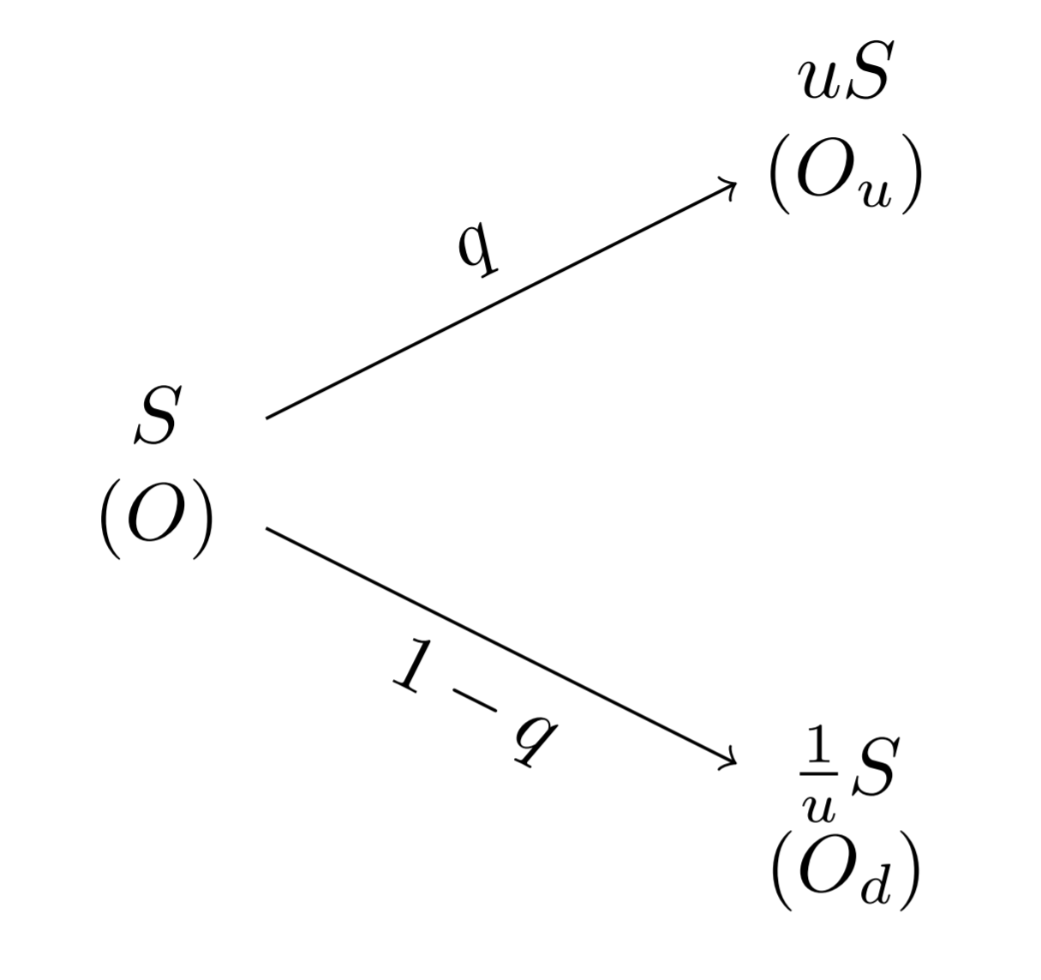
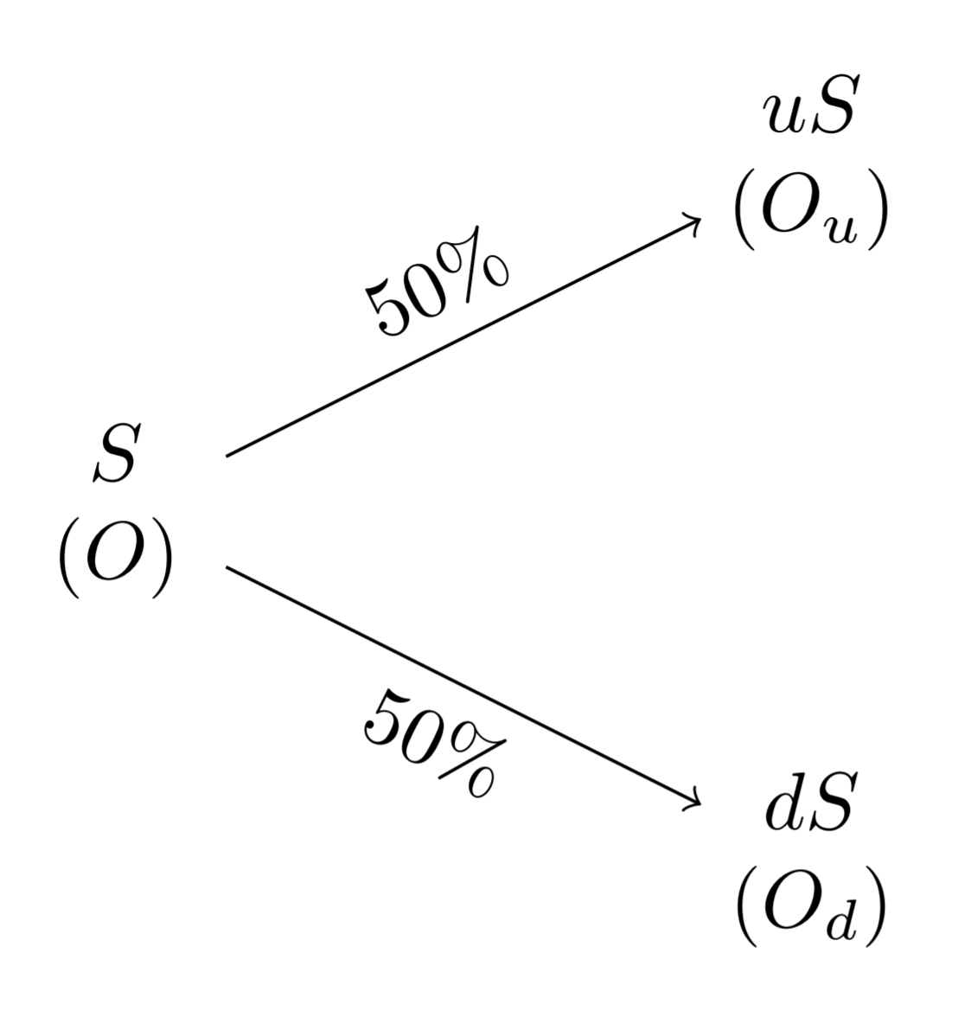
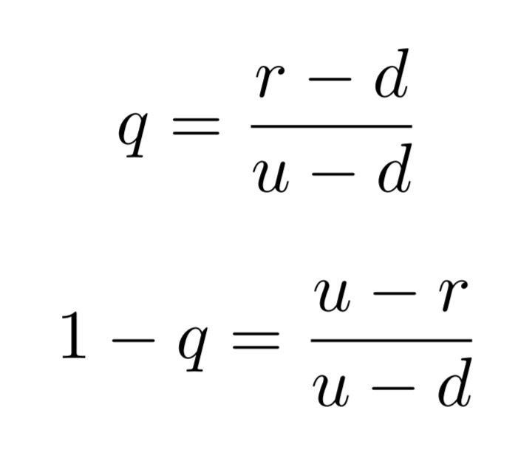
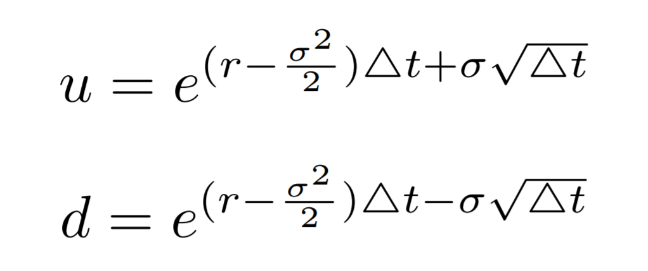
Pricing Methods
General Equal Jumps Binomial Tree
General Equal Probabilities Binomial Tree
Cox-Ross-Rubinstein (C-R-R) proposed an Equal Jumps Binomial Tree where each node underlying asset can move up or down the same ratio with probabilities (q, 1-q)
Jarrow-Rudd (J-R) proposed an Equal Probabilities Binomial Tree where each node underlying asset can move up or down with equal probabilities; the ratio of the moves can differ
Both Trees converge to the Black Scholes Solution as number of steps goes to infinity.
(J-R) Step Size Formulas
(C-R-R) Probability Formulas
Notes:
Two of most common Binomial Trees include Cox Ross Rubinstein : Equal Jumps Binomial Tree which specifies probabilities from risk free rate , 1979
Jarrow-Rudd Binomial Tree: Equal Probabilities Binomial Tree which specifies step sizes , 1982
Some other include Tian Binomial Tree, Cox +Jarrow With drift -> when a contract is very OTM
All of the above converge to the Black-Scholes Solution as time steps -> infinity however convergence is not smooth
Leisen Reimer provided a binomial tree with an improved convergence rate
It is worth noting there are also trinomial trees

Slide 8
Our Experiment
Goal:
Evaluate the accuracy of chosen pricing methods across a variety of market condition to determine whether there is a significant difference between each methods results
Chosen Pricing Methods:
Barone-Adesi-Whaley Analytic Approximation (B-A-W)
Bjerkseud-Stensland Analytic Approximation (B-S)
Crank-Nicolson Finite Difference Method (C-N)
Cox-Ross-Rubinstein Binomial Tree (C-R-R)
Jarrow-Rudd Binomial Tree (J-R)
Notes:
High-Level Description of our Experiment
Did not choose Black-Scholes as one cannot evaluate American Style Options-> reference Black’s Approximation

Slide 9




Software Infrastructure
LEAN is the Algorithmic Trading Engine used for the research and back-testing environment
Algoseek Provides the Option Data
QuantLib Provides Implementations of the Derivative Pricing Engines.
Sources: https://www.algoseek.com/company.html ; https://github.com/QuantConnect/Lean ; https://www.quantlib.org/
Notes:
Software Infrastructure for experiment setup
Describe High level features of all
Data Caching and analysis wrt research notebook, backtesting platform in QC
Pricing Engines in Quantlib

Slide 10
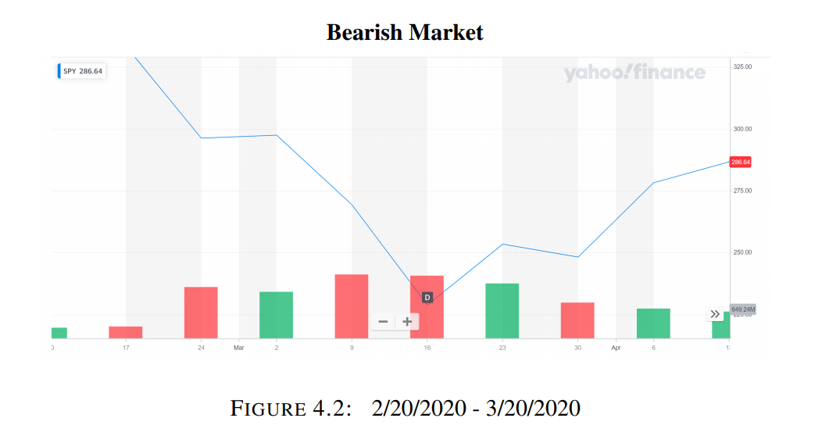
Universe
Tests on accuracy will occur across three different time frames characterized by market conditions
Stable Market: 9/20/2019 - 10/18/2019
Bearish Market: 2/20/2020 - 3/20/2020
Bullish Market: 7/20/20 - 8/21/2020
Source: Yahoo Finance
For an option contract to be in our universe it must have the following:
Underlying asset must be SPY
American-style
Expiration type is monthly
Expiration date occurs in the last month of each chosen time frame
Strike price within two standard deviations of the stock price at the start of the period
Notes:
We need to specify the universe of option contracts we will be analyzing the accuracy of option contracts over
Define three time frames
SPY options have the most volume so require those are the underlying asset
SPY are all American Style; SPX are European (limited by data) so American-Style
For ease define monthly expirations along with requiring they expire in the month of timeframe
As we do not want to have illiquid contracts require strike is within two standard deviations

Slide 11
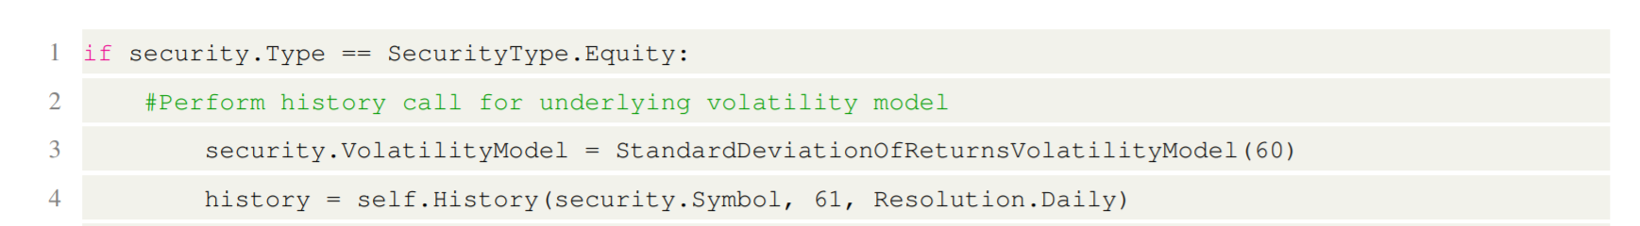
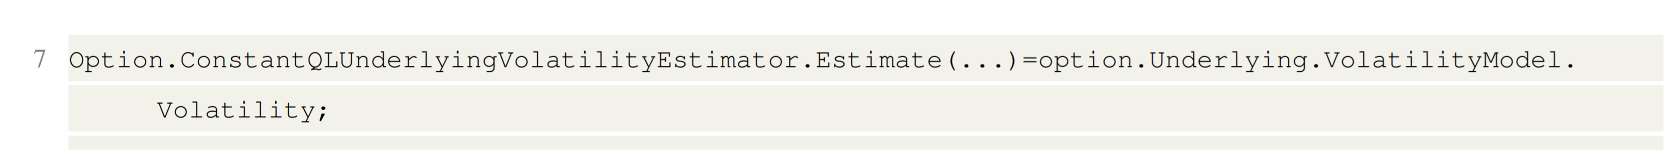
Pricing Methods
Above we Perform Necessary History Call to Populate our Underlying Volatility Estimator
Initialize our Underlying Volatility Estimator
Each pricing method requires the following estimators
Underlying Asset Volatility (60 Day Standard Deviations)
Dividend Yield (Constant=0)
Risk-Free Rate (Constant=0.01)
Estimators are set in LEAN which are then passed to the pricing engines in QuantLib
Initialize our Dividend Yield Estimator
Initialize our Risk-Free Rate Estimator
Notes:
We need to warm up our pricing methods with estimators
Specify volatility estimator is 60-day standard deviation of returns
Dividend/risk free rate estimators as constant
Estimators are passed in as parameters in QuantLib’s pricing engines

Slide 12
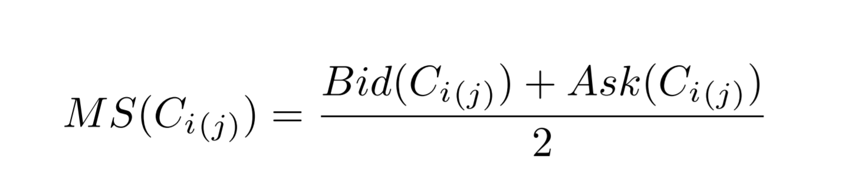
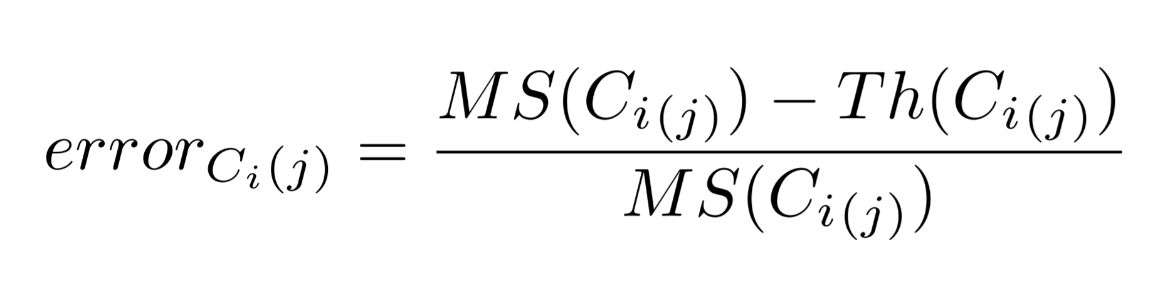
Real Data Evaluation
Mid-Spread Calculations from Bid and Ask of a given Option Contract
We run a backtest in LEAN over each time frame calculating the mid-spread (from quote data) and theoretical value (from pricing engine) each jth minute
To standardize we calculate relative error for each contract in our universe
Volume was also cached over the time frame
Relative Error Calculation between Mid-Spread and Theoretical Value
Notes:
Run simulation by completing a backtest where each jth minute we pull Level 1 Bid, Ask to find Mid-spread, We also use the QuantLib Pricing Engine for theoretical value so we can calculate error
~12,000 data points per time frame

Slide 13
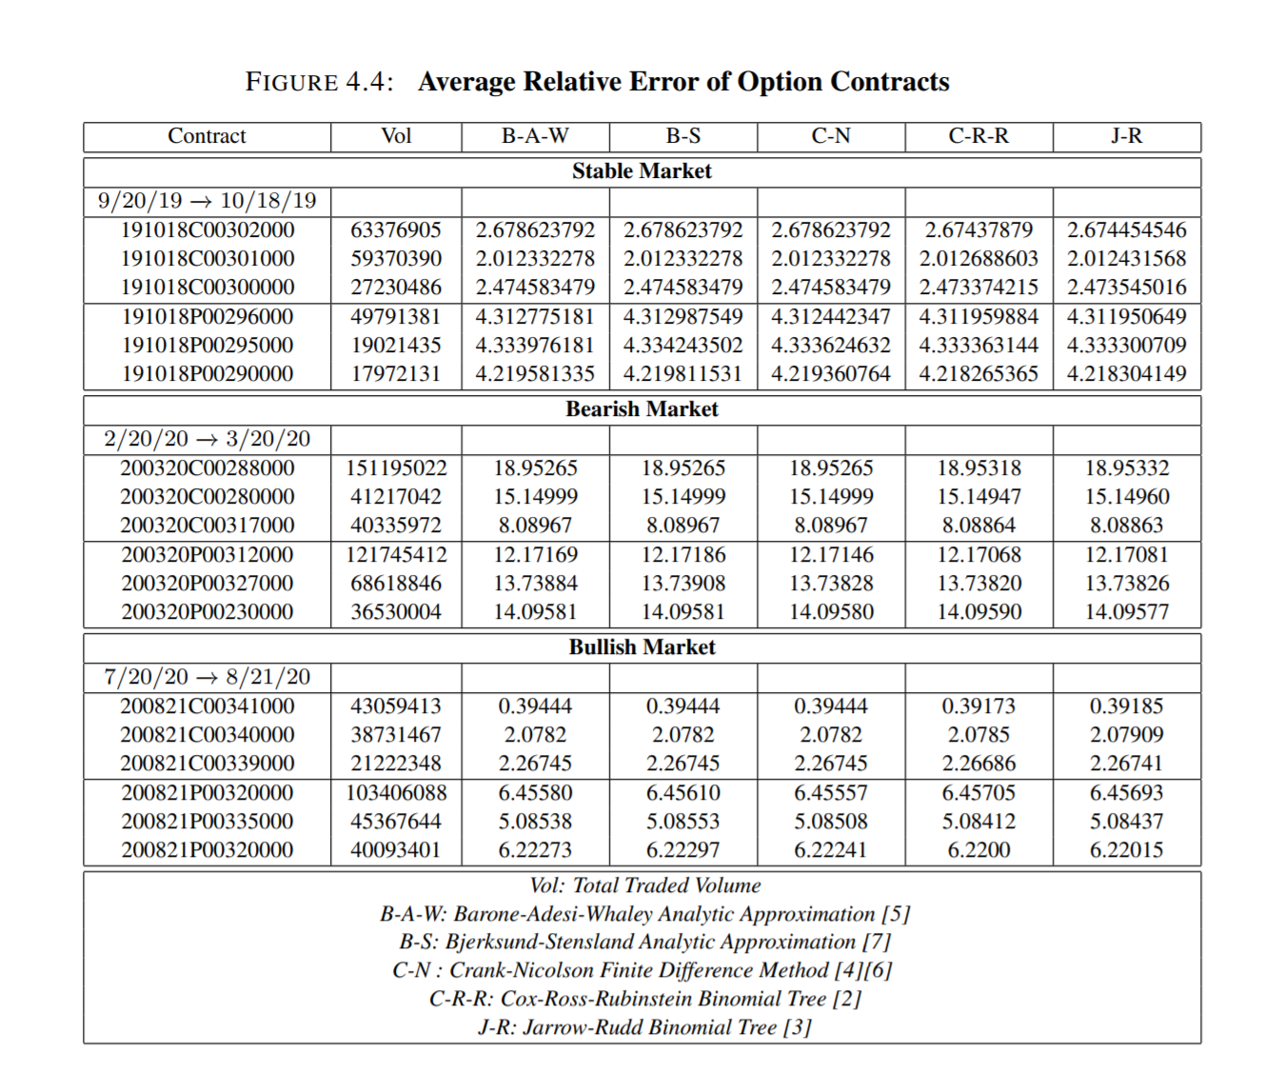
In Sample Results
Average relative error of option contracts across Stable, Bullish, Bearish time frames
Notes:
Note how we have a downward Bias in all of our errors, error seems to be most off in Bearish Market

Slide 14
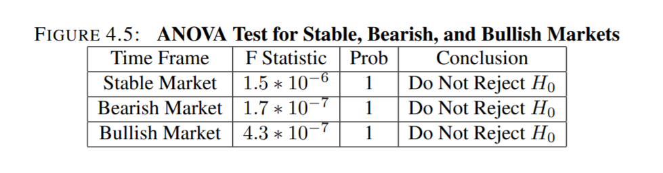
In Sample Results
One Way ANOVA Test where the Null Hypothesis is no true difference exists between the accuracy of the pricing methods
Note the F-Statistic and Probability lead us to not reject Null Hypothesis in any of our time frames
Notes:
Completed a one-way ANOVA test to determine if there was any true difference in the average relative errors of each pricing method
Make Sure to explain ANOVA Test in more detail: Analysis of Variance compares the means of two or more independent groups in order to determine whether there is statistical evidence that the associated population means are significantly different

Slide 15
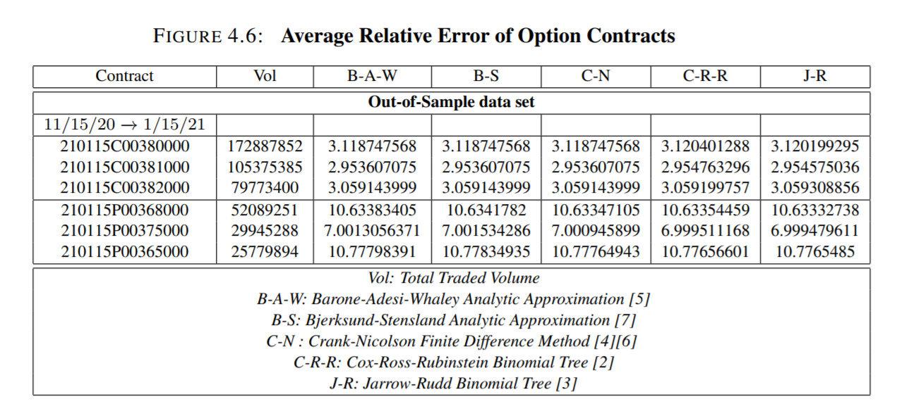
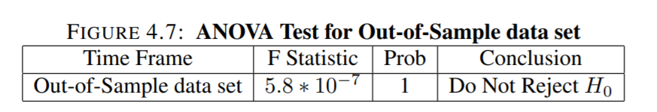
Out of Sample Results
Average relative error of option contracts across Out-of-Sample time frame
Like before we do not reject the Null Hypothesis of the pricing methods having no true difference in accuracy
Trading Algorithm would consistently buy options in universe due to downward bias
Notes:
Performed a slightly longer test out of sample where we repeated our previous findings
~24,000 data points
Same results as before with one way ANOVA test
Note that any trading algorithm would consistently buy the options as theoretical price is lower than mid-spread -> not profitable a our universe consists of both puts and calls of varying strikes

Slide 16
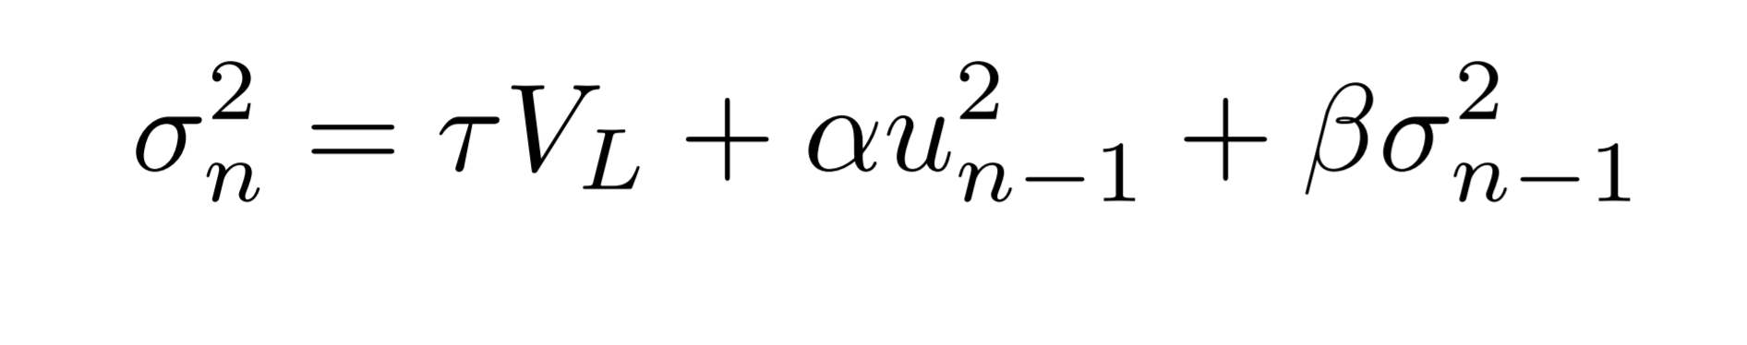
Conclusion
Next Steps: Improved Estimators
Encountered a significant downward bias in error values across all the pricing methods and time frames
Perhaps one way of decreasing bias is incorporating more realistic estimators
Stochastic processes, GARCH models, EWMA models for underlying volatility estimator
Presentation Topics:
Introduced options
Discussed pricing methods theoretically
Performed an experiment to see the accuracy of pricing methods
Concluded there is not a significant difference between the following pricing methods across the chosen contracts and time frames
GARCH (1,1) Model
Notes:
First Discuss follow of presentation
Methods which we tested along with results
Barone-Adesi-Whaley Analytic Approximation (B-A-W)
Bjerkseud-Stensland Analytic Approximation (B-S)
Crank-Nicolson Finite Difference Method (C-N)
Cox-Ross-Rubinstein Binomial Tree (C-R-R)
Jarrow-Rudd Binomial (J-R)
Improved Estimators as we experienced a downward bias
Stochastic Processes, EWMA Models, GARCH Models which calculate the variance as a combination of long-run average rate along with some weightings (alpha, beta) of the percent change of day n-1 and variance rate from day n-1
Extending the GARCH model to GARCH (p,q) we calculate some weighting of the last p days percent change along with last q days of variance rate combined with long term average
EWMA: Exponentially Weighted Moving Average -> Special Case of GARCH Models
GARCH: Generalized Autoregressive Conditional Heteroskedasticity

Slide 17
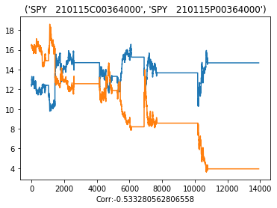
Final Note
Option straddles consist of a call and put contract on the same underlying with the same strike and expiration
Surprisingly, we discovered inverse relationships in the relative error of option straddles
Observation persisted across market conditions and contracts of varying liquidity
We believe it relates to level of market volatility
Times of lower volatility prices of puts and calls are balanced
Times of higher volatility, more uncertainty, reflected in prices of puts and calls
Average Relative Error of Option Straddles
Notes:
End off with the final note on inverse relationships in option staddles -> Option Straddle is an option trading strategy where one buys both the put and call and therefore profits in times of high volatility, can execute one or the other, while loses in times of lower volatility, cannot execute either
If we take the straddle (same underlying, strike, expiration) and plot average relative error we note inverses -> stronger inversion in times of lower volatility, weaker inversion (sometimes even positively correlated ) in times of higher volatility
We believe this makes sense -> Relative error can be rescaled to prices of put and calls -> In times of lower volatility prices of puts and call are more balanced leading to inverted relationships while in time of higher volatility more uncertainty and therefore reflected in prices either not be related or positively related, both are increasing in price i.e. take GME

Slide 18
References
[1] Fischer Black and Myron Scholes. ‘The Pricing of Options and Corporate Liabilities’. In: Journal of Political Economy 81.3 (1973), pp. 637–654. ISSN: 00223808,1537534X. URL: http://www.jstor.org/stable/1831029.
[2] John C. Cox, Stephen A. Ross and Mark Rubinstein. ‘Option pricing: A simplified approach’. In: Journal of Financial Economics 7.3 (1979), pp. 229–263. ISSN: 0304-405X. DOI: https://doi.org/10.1016/0304- 405X(79)90015- 1.URL: https://www.sciencedirect.com/science/article/pii/0304405X79900151.
[3] Robert Jarrow and Andrew Rudd. ‘Approximate option valuation for arbitrary stochastic processes’. In: Journal of Financial Economics 10.3 (1982), pp. 347–369. ISSN: 0304-405X. DOI: https://doi.org/10.1016/0304- 405X(82)90007- 1.URL: https://www.sciencedirect.com/science/article/pii/0304405X82900071.
[4] Robert Geske and Kuldeep Shastri. ‘Valuation by Approximation: A Comparison of Alternative Option Valuation Techniques’. In: The Journal of Financial and Quantitative Analysis 20.1 (1985), pp. 45–71. ISSN: 00221090, 17566916. URL: http://www.jstor.org/stable/2330677.
[5] Giovanni Barone-Adesi and Robert E. Whaley. ‘Efficient Analytic Approximation of American Option Values’. In: The Journal of Finance 42.2 (1987), pp. 301–320. ISSN:00221082, 15406261. URL: http://www.jstor.org/stable/2328254.
[6] John Hull and Alan White. ‘Valuing Derivative Securities Using the Explicit Finite Difference Method’. In: The Journal of Financial and Quantitative Analysis 25.1(1990), pp. 87–100. ISSN: 00221090, 17566916. URL: http://www.jstor.org/stable/2330889 . 28 BIBLIOGRAPHY 29
[7] Petter Bjerksund and Gunnar Stensland. ‘Closed-form approximation of American options’. In: Scandinavian Journal of Management 9 (1993), S87–S99. ISSN: 0956-5221. DOI: https://doi.org/10.1016/0956- 5221(93)90009- H.URL: https://www.sciencedirect.com/science/article/pii/095652219390009H .
GitHub Repository
Software Licenses:
LEAN Algorithmic Trading Engine
QuantLib
Major sources listed, for a full extensive list please see the reference page in paper
Notes:
Reference Page with GitHub Repo link, software licenses and partial reference list

Slide 19

Q&A
Thank you for your time, please reach out to jbohne3@uic.edu with any remaining questions!
Notes:
High-Level Description of our Experiment
Did not choose Black-Scholes as one cannot evaluate American Style Options-> reference Black’s Approximation

