Slide 1
KETEL ONE BOTANICAL
MICROSITE
1
CLIENT: Diageo CONTENT: Site copy DATE: 2.15.18
VERSION: 1
NAV
HOME [Ketel One Botanical ART]
MAIN HOMEPAGE HEADLINE: Real botanicals. Fresh taste.
NEW! Introducing Ketel One Botanical Discover a New Alternative
A Groundbreaking Product Launch
Botanical Trends
PRODUCT DETAILS
Pack Design
Flavors
Claims
SUPPORT & ACTIVATION
Commercial Support
Off Premise
On Premise
Recipes
BENEFITS OF PROPOSITION
A Better Shopping Experience Upsell Opportunities
Perfect for the Mindful Consumer
LOGISTICS
Specs Bottle UPC
Shopper SCC

Slide 2
2
HOME PAGE
Real botanicals. Fresh taste.
NEW! Introducing Ketel One Botanical
FIRST SECTION
Discover a New Alternative
Made with Ketel One Vodka, distilled with real botanicals and infused with natural flavors, the new Ketel One Botanical is a unique and artfully-infused alternative to wine.
A Groundbreaking Product Launch
First vodka to enter the emerging botanical space, supported with $20 Million investment
High purchase intent – 95% of consumers said they would buy!
Launch date May, 2018
Botanical Flavor Trends
Top Purchase Considerations
Ketel One Botanical addresses a consumer need and booming industry trend.
Natural ingredients and no added sugar are both top-5 purchase considerations when choosing an alcoholic beverage.*
According to Whole Foods, florals are the #1 food and beverage trend of 2018*
Botanical beverages are the latest “back to nature” cocktails that are changing consumer perceptions about mixed drinks*
Sources: 1. Forbes Food & Beverage Trends March 2016 2. Business Insider, December 2017

Slide 3



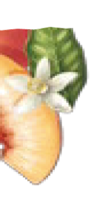
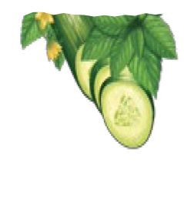





3
Product Details
Mindfully Crafted, Inside and Out with a Flavor for Everyone
Distinct Packaging with a unique die-cut design that brings each flavor to life.
Maximize consumer appeal with all 3 flavors
ADD BOTTLE IMAGES INSTEAD
Made with non-gmo grains
& natural flavors
40% fewer calories than a glass of wine
BRING TO LIFE WITH IMAGERY THAT REFLECTS THESE OCCASIONS
Occasion
Any occasion is the right one for Ketel One Botanical. Brunch, happy hour, poolside or farm-to-table dining.

Slide 4
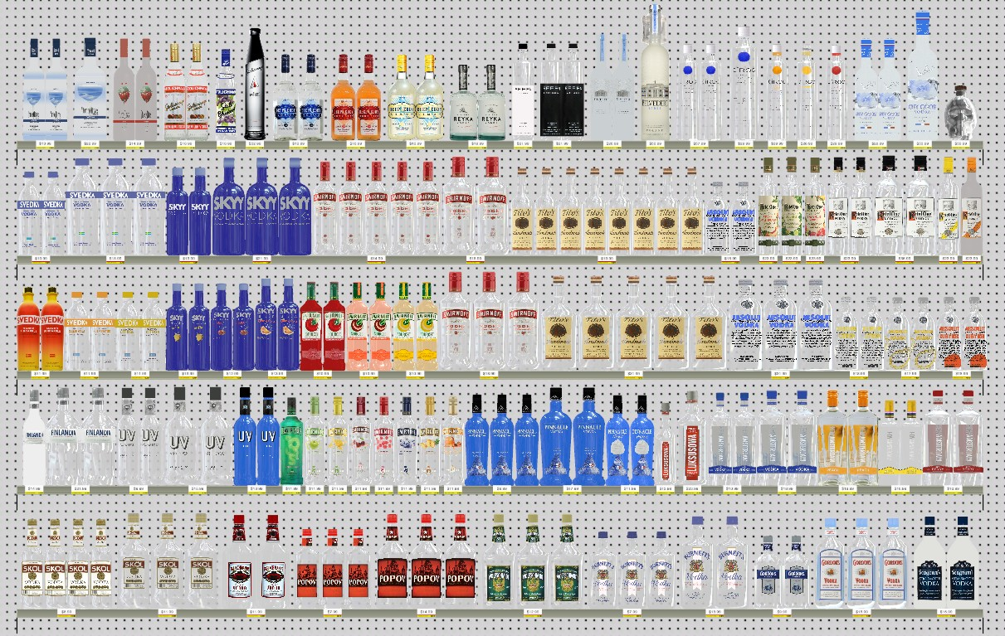
5
THIRD SECTION
ACTIVATION & SUPPORT (4 sections)
Commercial Support
$20 MILLION IN SUPPORT
$10 MILLION dedicated to heavy media support to drive awareness and education
Launch will also be supported with sampling and tools to drive trial and conversion
Off-Premise Strategy
Display
Attract consumers with eye-catching displays
in & out of section leveraging thematic shippers
Cross-merchandise strategies in
produce section (Grocery)
Shelf
Place 3 SKUs of Ketel One Botanicals to the left
of Ketel One base
Add Shipper Images to Off Premise Strategy Section
On-Premise Strategy
Menus
- Include “NEW” callouts above or below wines by the glass to highlight Ketel One Botanical
Lead Serve
Ketel One Botanical & Soda in a stemmed white wine glass
6
Back Bar
Feature the Ketel One Botanical series POS (all 3 variants). The product should be front and center in the vodka section, to the left of Ketel One base
Add Drink Images to On Prem Strategy
Recipes
Ketel One Botanical & Soda (across all three flavors)
1.5 oz. Ketel One
3 oz. Soda

Slide 5
FOURTH SECTION Benefits of Ketel One Botanicals
A Better Shopping Experience
52% of consumers said having Ketel One Botanicas in the Wine section enhanced their shopping experience
Upsell Opportunities
57% of Ketel One Botanical purchases are incremental to wine when displayed in the Wine section
In general, Ketel One drives 70% higher basket rings than Wine
Perfect for today’s mindful consumer
40% LESS CALORIES THAN A GLASS OF WINE
Source: Diageo Insider Panel December 2017
FIFTH SECTION Logistics
Specs
Here’s everything you need to know about Ketel One Botanical.
Specs chart
Scannable UPCs
[code images]
Scannable SCCs
[code images]

