Slide 1

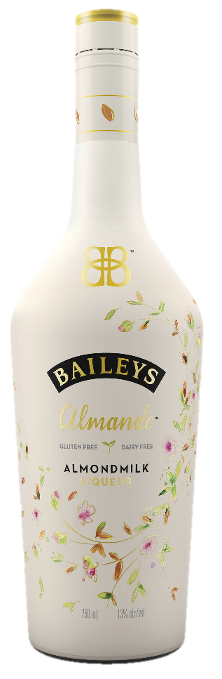



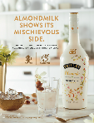








APRIL – JUNE 2018
$2.3MM Indulgent Messaging
MEDIA REACHING
36MM WOMEN 25-54
DIGITAL/SOCIAL/SEARCH | $1.96MM
Almande
Dairy-free and light indulgence messages on Instagram, Facebook, Pinterest with video on Hulu
Original Irish Cream
Year-round indulgence using dessert recipe videos on Food Envy & VT inspiring consumers
Minis
“mini” moments on Instagram, Facebook & Twitter inviting consumers to enjoy a small treat
Paid Search to surround drinking occasions such as Mother’s Day, through search terms including “Mother’s Day Cocktails”, Mother’s Day Recipes”, etc.
PRINT | $300 THOUSAND
Almande
Placement of Almande in leading women’s life and health print publications, Glamour, Women’s Health
PLEASE DRINK RESPONSIBLY
BAILEYS Irish Cream Liqueur. 17% Alc/Vol. Imported by Paddington, Ltd., Norwalk, CT.
Source: 1 – CARAT Media investment as of 1/12/18, Reach based on estimate

