Slide 1



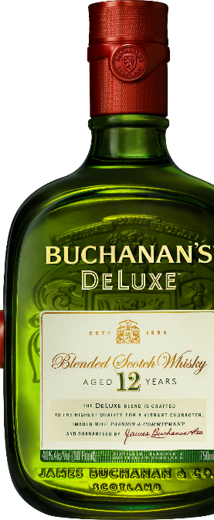
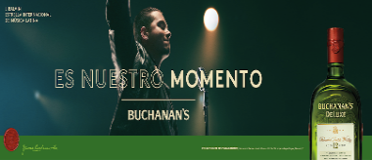








APRIL-JUNE 2018
$961 THOUSAND
MEDIA REACHING
9.8 MILLION
HISPANIC MALES 21-54
DIGITAL/SOCIAL/SEARCH | $938 THOUSAND
Es Nuestro Momento messaging and content featuring
J Balvin across social media and digital music partners such as Spotify and Soundcloud
Paid Search around Latin Billboards, J Balvin and seasonal drinking occasions (e.g “2018 Latin Billboards” “Cinco de mayo cocktails”, “best summer scotch cocktails)”
Support Buchanan’s through media partnerships activating around Soccer
PRINT | $23 THOUSAND
Reinforce award winning liquid credentials in popular trade publications with insertions in the April Market Watch issue and the Summer Whisky Advocate issue
Please Drink Responsibly
BUCHANAN’S Blended Scotch Whisky. 40% Alc/Vol. Imported by Diageo, Norwalk, CT.
Source: CARAT Media as of 7/20/17, media subject to change, esti. reach

