Slide 1


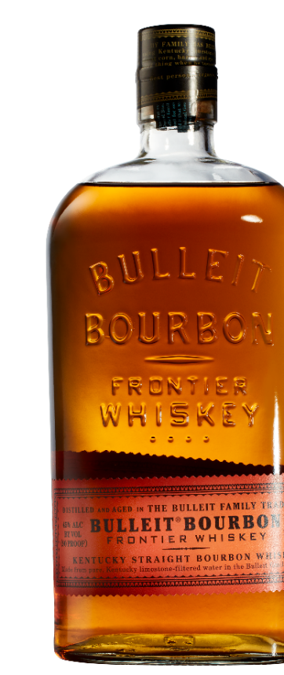





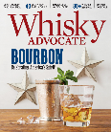

APRIL-JUNE 2018
$600 THOUSAND
Driving Brand Awareness
through Seasonal Occasions & Frontier Works initiative
MEDIA REACHING
8.1 MILLION
Consumers 21-44
DIGITAL/SOCIAL/SEARCH | $578K
FRONTIER WORKS Targeted Facebook/Instagram campaign supporting the new exciting Frontier Works initiative called Bottle Rubbing, where artists will be commissioned to repurpose the iconic bottle in a way that has never been done before
PAID SEARCH AROUND:
Kentucky Derby
Keywords such as ‘summer bourbon cocktails’, ‘Drinks for Kentucky Derby’
Summer
PRINT | $23 THOUSAND (+171% vs.LY)
DRIVING BRAND AWARENESS AND AFFINITY WITH INSERTIONS IN:
-Whisky Advocate
-Market Watch
- Whiskey Fest DC
*Media Subject to Change, Estimated Reach
Please Drink Responsibly.
The Bulleit Distilling Co., Lawrenceburg, IN.
Source: CARAT Media as of 7/20/17

