Slide 1
Model Deployment in CAT

Slide 2
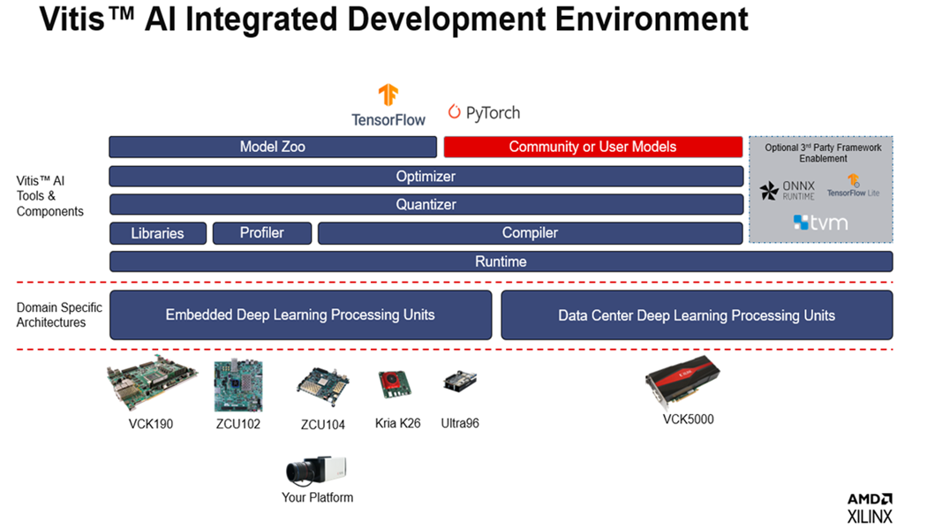
Model trained in Tensorflow/Pytorch will be FP32 precision

Slide 3
Model

Slide 5
What is a DPU

Slide 6
Steps to takes to deploy to DPU and why it is necessary

Slide 7
Quantization is most Important why and what are the current trend → per-channel quantization

Slide 8
Integration to DPU
What to do after model quantized- > compile model per hardware to generate instruction

Slide 9
How to integrate DPU into custom design
Vitis vs Vivado

Slide 10
Vitis flow process

Slide 11
Vivado process

Slide 12
Resnet50 experiment on quantization

Slide 13
Resnet 50 on integration

Slide 14
Vitis flow resnet 50

