Slide 1
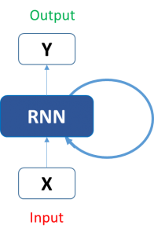
Objective:
An agent that
1) learns how daily limit(budget) to be set in order to optimize ads performance as well as ads pacing; — RNN LSTM learning algorithm for time-series data
2) satisfies that daily limit as a constraint by incorporating the trained solutions from the model that serves well as a continuous feeds to automate the whole budget allocating processes — customized algorithm to meet business needs

Slide 2
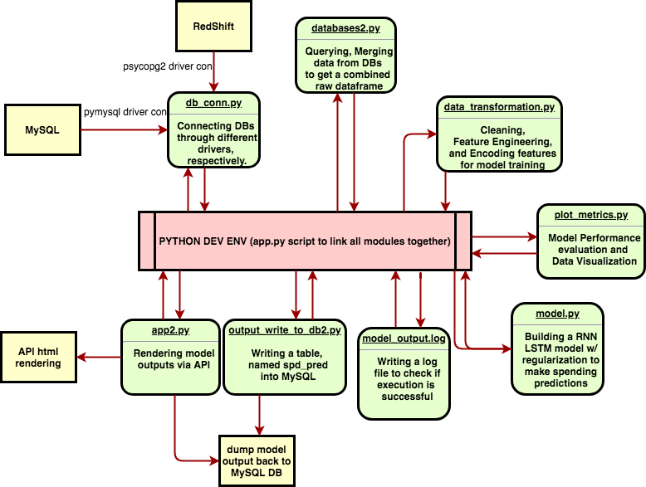
Budget Agent Status Update: 7/ 10
Tasks :
1) Model Training, Logging, Scheduling to full automation

Slide 3
Budget Agent Status Update: 7/ 10
Tasks :
2) customized algorithm write-up:
i) the logic of the procedure:
Check the daily limit, compare it w/ predicted spending, impose the checkpoints(#4-10), sum up to the monthly level, and adaptively adjust spending accordingly
ii) data study:
a) campaign currently running: 391 & lasting at least 30days: 309; campaign-wide, we’ve trained cids about 309/391(~=80%)
b) client currently running: 92 & fully trained on clients: 63 & partially trained on clients: 29; client-wide, we’ve trained bids about 63/92(~=70%)
iii) the approach to deploy:
a) conservative approach: limit spending to +- 15% of daily limit regardless of predicted spendings
b) adaptive(hybrid) approach: apply predicted spds and regularly adjust at checkpoints
c) aggressive approach: play aggressively, let the model fly w/o adjusting
iv) target to go alive: targeting to deploy solutions on 63 clients by refreshing the next several days spendings by next Monday, 7/16, no later than 7/19

Slide 4
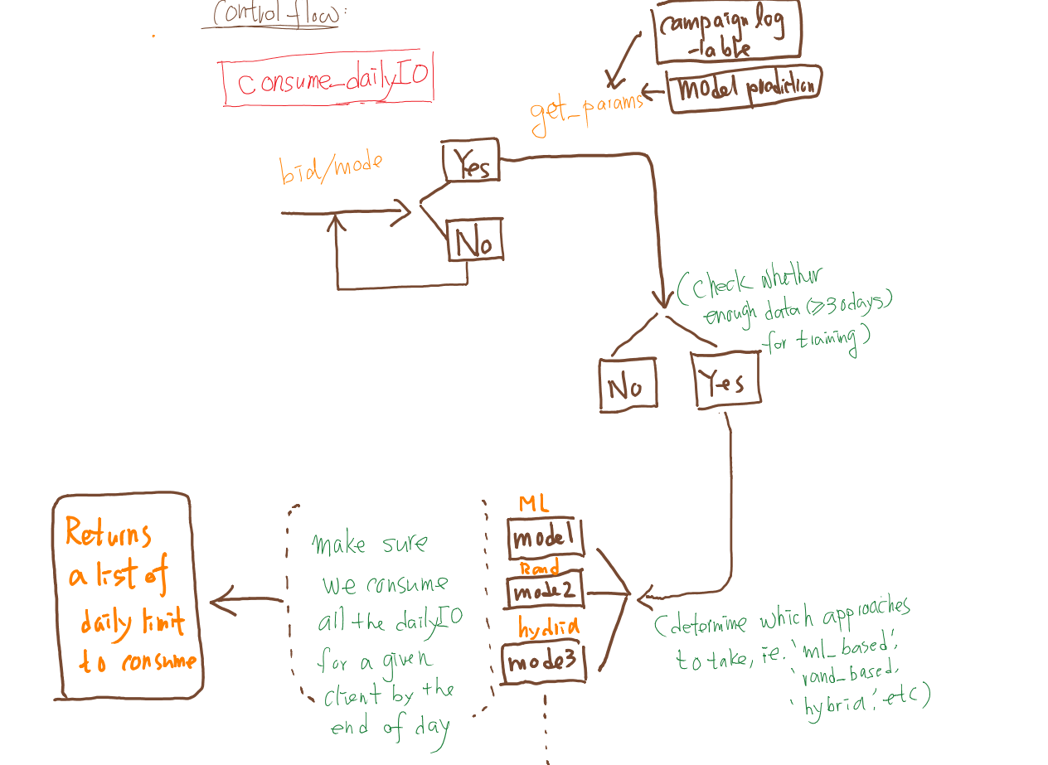
Budget Agent Status Update: 7/ 12
1) the logic of the customized algorithm
2)let’s discuss and check how it works!

