Slide 1
Hermes
9/29/23

Slide 2
Agenda
Business Case
Approach
Mechanics
Reporting
Roadmap

Slide 3
Business Case
Existing state:
Predefined sequences (CUBS Letter/Text strategies) or manual processes (VoApps).
Contact channels managed separately.
Generally, sequences are client-specific.
Difficult to predict spend.
Business is looking to:
Unify channels to determine best (most profitable) contact(s).
Generalizes contact sequence; client-specific reqs become exception based.
Increase control on maximum spend ➔ set hard limits, change often, change quickly.
Create less work for IT.

Slide 4
Approach
Business is looking to:
Unify channels to determine best (most profitable) contact(s).
Generalizes contact sequence; client-specific reqs become exception based.
Increase control on maximum spend ➔ set hard limits, change often, change quickly.
Create less work for IT.
Problem #1: What is the question to answer?
What is the value of a given account?
What is the value of a given contact?
Problem #2: How do we structure so we can easily maintain?
Configuration Based
Modular Programming
Exception-based customizations

Slide 5
Problem #1 – What is the question to answer?
Old Approach: What is the value of a given account?
Gave general direction on where to invest effort.
Packet | Account | Account Score
X | A | 10
X | B | 9
X | C | 7
Y | D | 6
Y | E | 5
Z | F | 1
Packet | Account | Account Score | Prev Contact
X | A | 10 | 4
X | B | 9 | 4
X | C | 7 | 4
Y | D | 6 | 0
Y | E | 5 | 0
Z | F | 1 | 1
However, lacked specificity. Questions left unanswered:
Would a text be as effective as a letter?
Should I send a 5th contact to a high-score account, or the 1st contact to a mid-score account?
What action should I take?

Slide 6
Problem #1 – What is the question to answer?
New Approach: What is the value of a given account contact?
Best option per Account…
Best option per Account…
Packet | Account | Account Score
X | A | 10
X | B | 9
X | C | 7
Y | D | 6
Y | E | 5
Z | F | 1
Packet | Account | Letter (69c ea) | Text (3c ea) | VoApp (6c ea)
X | A | $0.99 | $0.73 | $0.86
X | B | $0.49 | $0.23 | $0.16
X | C | $0.59 | $0.33 | $0.26
Y | D | $2.09 | $0.83
Y | E | $1.59 | $1.03
Z | F | $0.00 |  | $0.00
Packet | Account | Best Action | Best Value (Profit)
X | A | VoApp | $0.80
X | B | Text | $0.20
X | C | Text | $0.30
Y | D | Letter | $1.40
Y | E | Text | $1.00
Z | F | VoApp | ($0.06)
Packet | Account | Account Score
X | A | 10
X | B | 9
X | C | 7
Y | D | 6
Y | E | 5
Z | F | 1
Best option per Packet…
If we had a cost constraint of only sending 1 contact…
Packet | Best Account | Best Action | Best Value
X | A | VoApp | $0.80
Y | D | Letter | $1.40
Z | F | Nothing | $0.00
Packet | Best Account | Best Action | Best Value
Y | D | Letter | $1.40

Slide 7
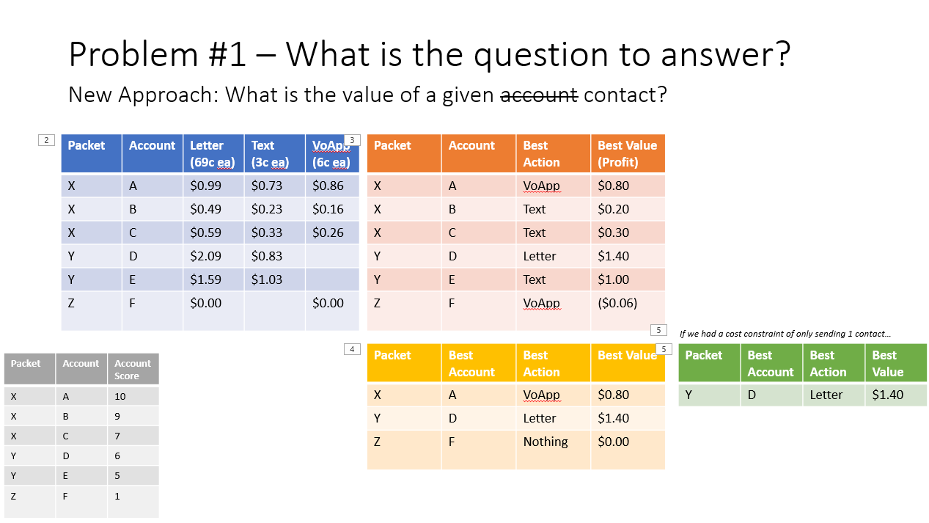
Problem #2 – How do we structure so we can easily maintain?
Standardized:
One selection process applied against all clients
Client customizations are limited and occur pre-Pool.
Configs:
Quick adjs for spend limits
Quick adjs for client activity preferences.
Configs
Config Tables
Max Global Spend
Min Client Activity
…
Snowflake
Compliance Rules
Compliance Tables
Pass Validation?
Good Contact (phone, add)?
…
Pool
Scores
Proposals
Business Rules Tables
Pass Placement Age?
Pass Packet Balance?
…
Who is score-able?
Scoring process
Selection Optimization
Business Rules
Problem #2: How do we structure so we can easily maintain?
Configuration Based
Modular Programming
Exception-based customizations
Modular:
One place to adjust balances for all
One place to adjust validation logic for all
One place to… for all

Slide 8
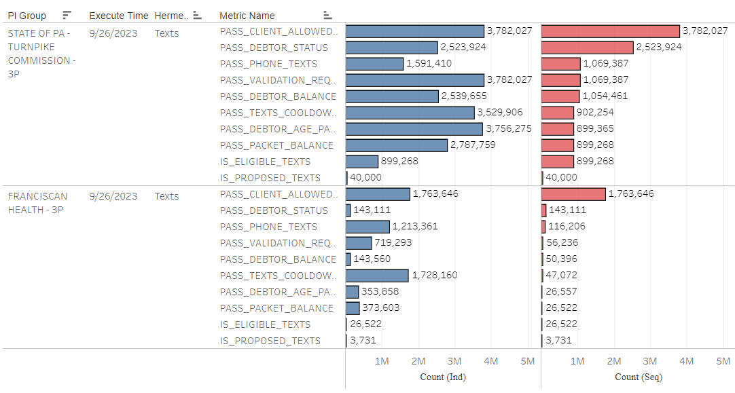
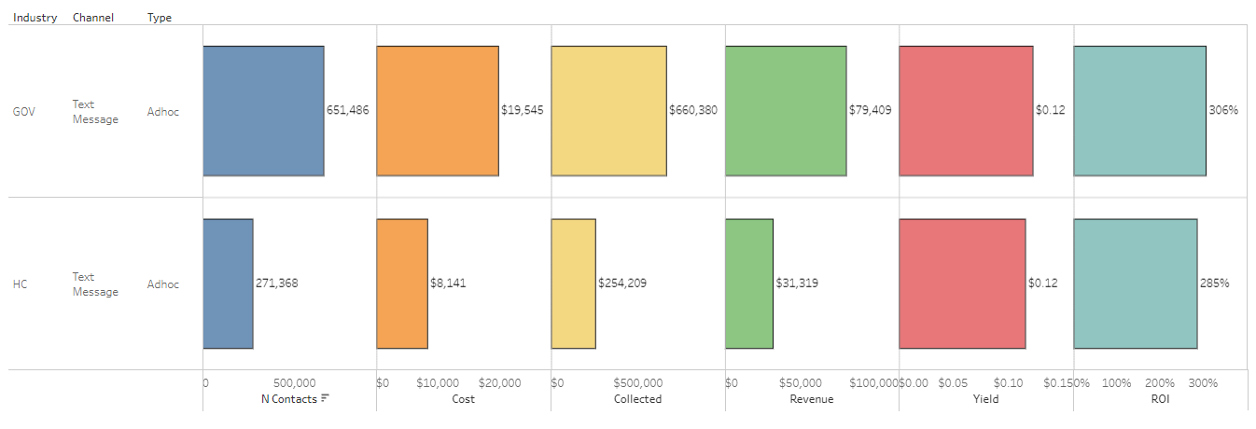
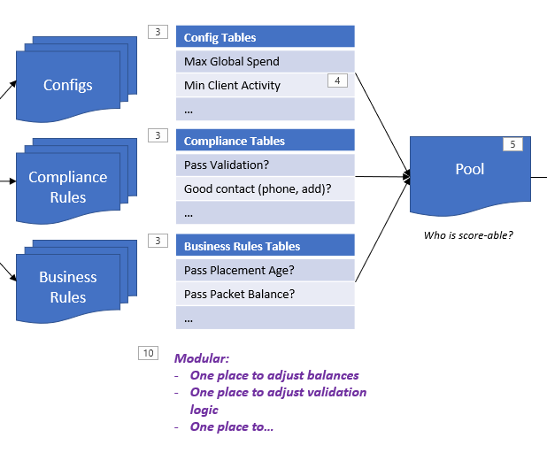
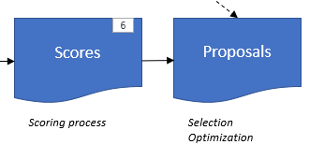
Reporting
Eligibility Funnel: What knocks out accounts from scoring and/or selection?
Returns: Is the scoring working? Is the selection optimization working?

Slide 9
Roadmap
Increase contacts, Increase clients
Channel | Ad-hoc only, some clients | Ad-hoc only, all clients | All contacts, some clients | All contacts, all clients
Text Messages
VoApps
Letters
Emails
Dialer
Channel | Ad-hoc only, some clients | Ad-hoc only, all clients | All contacts, some clients | All contacts, all clients
Text Messages | ✓ | ✓ | 1 | 2
VoApps | ✓ | ✓ | 5 | 6
Letters | ✓ | ✓
Emails
Dialer | – | – | 3 | 4
Increase channels

