Slide 1
Hermes Dialer File – IT
2024-01-08

Slide 2
Agenda
High level review of logic to generate proposed calls.
Feedback of current output format.
How to scrub against CUBS for compliance?

Slide 3
Logic Overview
Specify who to call, what phones, and (roughly) when.
Choose Best Phone Number per Packet
Choose Best Packets
Choose Call Time
Determine Selection Chance based on history actions
Good: RPCs, IBs, Immediate Payment
Bad: Carrier Errors on Texts/VoApps
Neutral: No Answer on Dialer, Sent Text/VoApp but no payment
Preference for CLTAUTH, CLTIPA, LAND
Calculate score
Set volume target by Team
Take N best scores (packets)
Rank options (5 DOW x 5 Hour-Windows) and match to Ranked Calls
Add Jitter
Rotation introduced to control for self-fulfilling prophecies (e.g., Monday 1PM looks best because we always call best scores there)

Slide 4
Output – Directory Format
TEAM_DOW-HOURWINDOW_PHONETYPE, e.g. HEALTHCARE_1MON-1000_CLTIPA
TEAM: See Next Slide
DOW: 1Mon, 2Tue, 3Wed, 4Thu, 5Fri
HOURWINDOW: 0700, 1000, 1200, 1300, 1600
PHONETYPE (any of): CLTAUTH, CLTIPA, DOAUTH, DOIPA, DOLAND, LAND

Slide 5
Output – Directory Format
TEAM
Carol
DC
COC Parking
Toll (IL, MD, ERC, PA Turnpike, San Diego)
Municipal (Conduents, COC EMS, Det EMS, OKC Parking, Philly Parking/Water/Misc, Seattle, SF MTA/EMS)
UTL (CE 3P, DTE 3P, Evergy, Nicor)
DTE EOP
Greg
Fran PP
MDA
Everything Else
Fatima
State
County

Slide 6
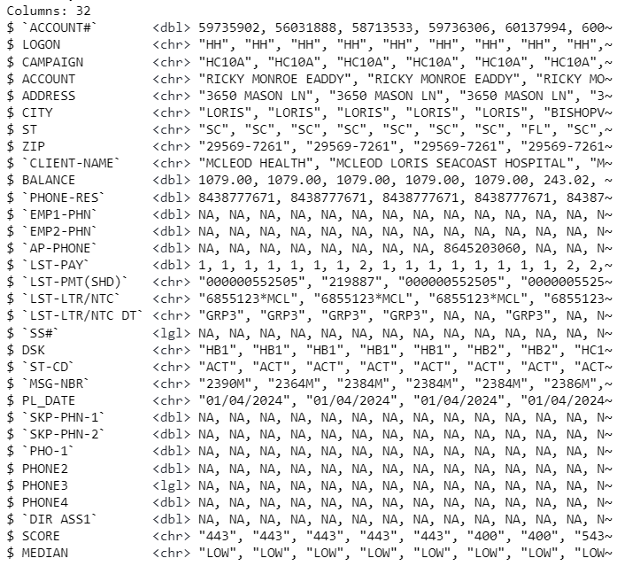
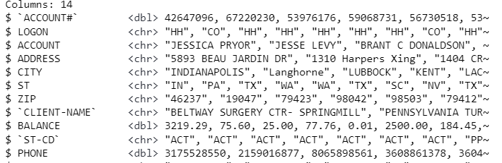
Output – File Format
One row per proposed call. 1 file will contain given phone max once.
Effectively, 1 row per unique phone (in designated fields) per packet.

Slide 7
CUBS Scrubs
Proposal – Import 1 file per logon that contains final export name.
Filter based on scrubs
Check phone type is correct
Write file per export name

Slide 8
Hermes Dialer File – Ops
2024-01-08

Slide 9
Logic Overview
Specify who to call, what phones, and (roughly) when.
Choose Best Phone Number per Packet
Choose Best Packets
Choose Call Time
Determine Selection Chance based on history actions
Good: RPCs, IBs, Immediate Payment
Bad: Carrier Errors on Texts/VoApps
Neutral: No Answer on Dialer, Sent Text/VoApp but no payment
Preference for CLTAUTH, CLTIPA, LAND
Calculate score
Set volume target by Team
Take N best scores (packets)
Rank options (5 DOW x 5 Hour-Windows) and match to Ranked Calls
Add Jitter
Rotation introduced to control for self-fulfilling prophecies (e.g., Monday 1PM looks best because we always call best scores there)

Slide 10
Output – Directory Format
TEAM_DOW-HOURWINDOW_PHONETYPE, e.g. HEALTHCARE_1MON-1000_CLTIPA
TEAM: See Next Slide
DOW: 1Mon, 2Tue, 3Wed, 4Thu, 5Fri
HOURWINDOW: 0700, 1000, 1200, 1300, 1600
PHONETYPE (any of): CLTAUTH, CLTIPA, DOAUTH, DOIPA, DOLAND, LAND

Slide 11
Output – Directory Format
TEAM
Carol
DC
COC Parking
Toll (ERC, PA Turnpike, eventually OTA too)
Municipal (Conduents, OKC Parking, Philly Parking/Water/Misc, Seattle, SF MTA)
COC EMS
EMSs (Det, SF EMS)
UTL (CE 3P, DTE 3P, Evergy, Nicor)
DTE EOP
Greg
MDA
State of NY (WCMC, Columbia Doctor & Dental , Mount Sinai)
Everything Else
Fatima
State
ASH List - KDOR
HH List – everyone else
County (minus Vegas 1P)
Vegas 1P
Outsourcing – Carle OBs
DE

