Slide 2
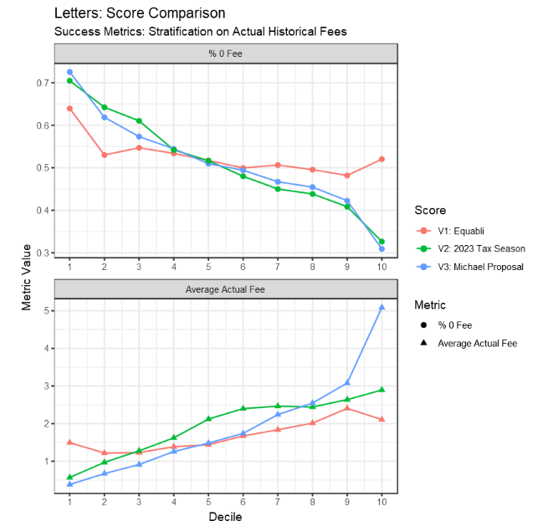
Scoring: Letters

Slide 3
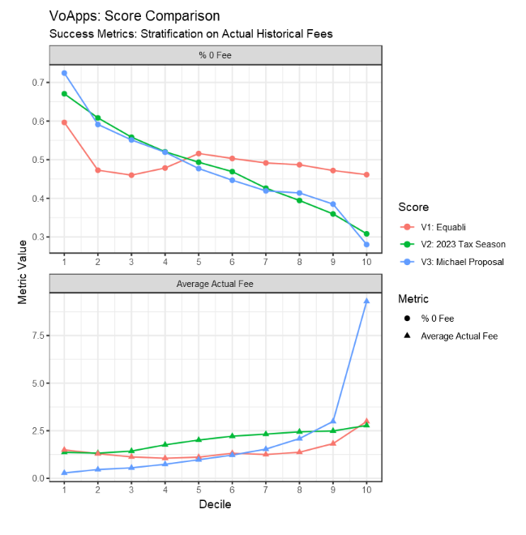
Scoring: VoApps

Slide 4
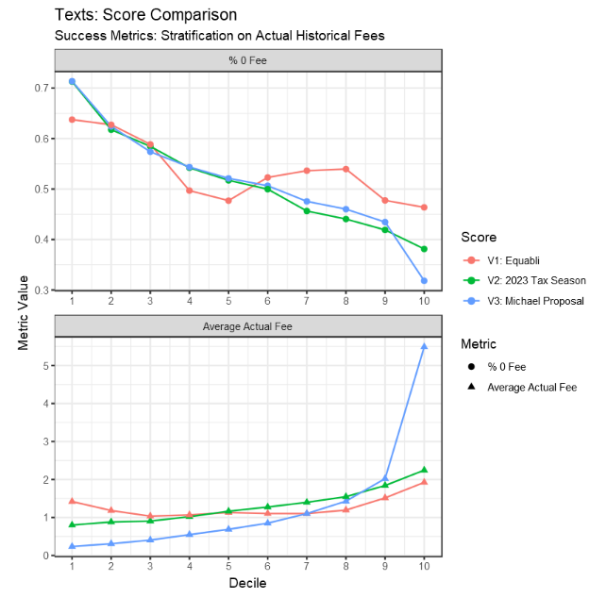
Scoring: Text Messages

