Slide 1
Progress Overview
Major progress:
IMU (sensor) signal pre-processing:
Extracted signals of each trial (aka. a series of movements repeated for several times) from the entire time-series signal.
Organized extracted signal into a user-friendly data structure.
Built algorithm to estimate the pelvis 3D tilting based on measured angular rate (pelvis 3D tilting ⇔ IMU 3D orientation)
Dancer performance evaluation:
Visualized improper pelvis tilting of inexperienced dancers.
Built machine learning algorithm to automatically classify dancer’s performance (good or not good).
Explored and studied other machine learning methods.

Slide 2
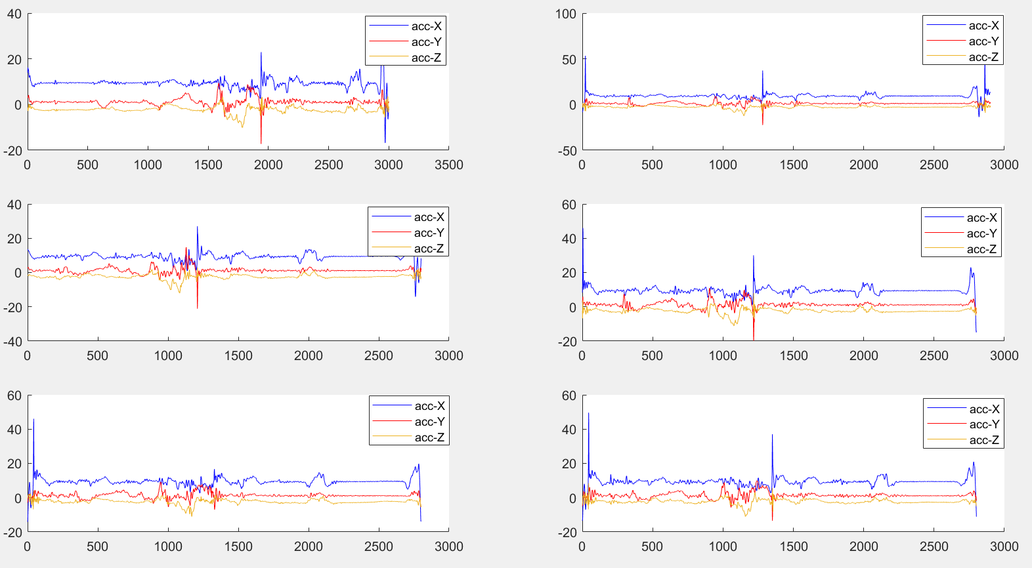
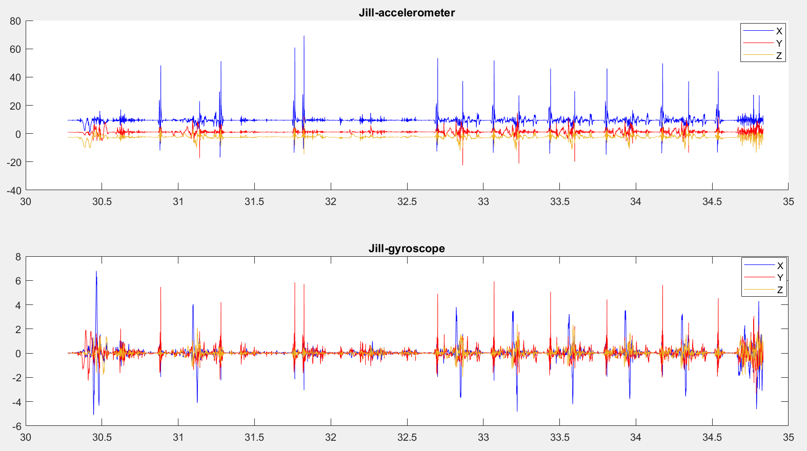
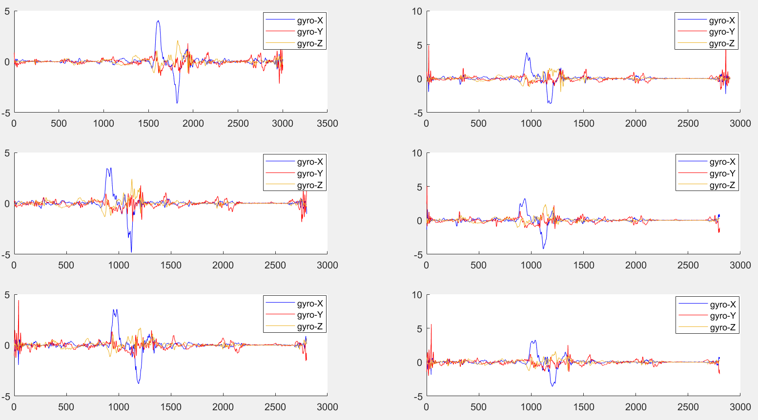
1.1 IMU (sensor) signal pre-processing -- Signal extraction
Extracted 3D acceleration trials
X points up, gyro +x means turning left
Y points right, gyro +y means pelvis tilts back (opposite of bow)
Z points front, gyro +z means yaw (+left hip rotating towards above right hip: “tilt right”)
Raw acceleration
6x 3D trail
Preparation session
Extracted 3D gyroscope trials
Raw gyroscope
6x 3D trail
Preparation session
Raw data in one-piece time series

Slide 3

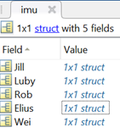
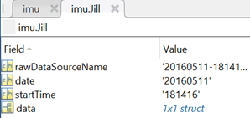


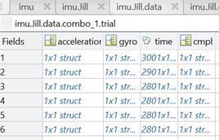
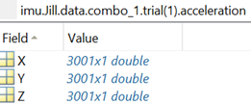
1.2 IMU (sensor) signal pre-processing -- A user-friendly data structure
A library data structure
Use (matlab) command to access data: imu.(dancer_name).data.(combo_id).(calibration/trial).(sensor_frame/navi_frame).(signal_type).(axis)
e.p.: imu.Jill.data.combo_1.trial.sensor_frame.kalman_angle.X

Slide 4
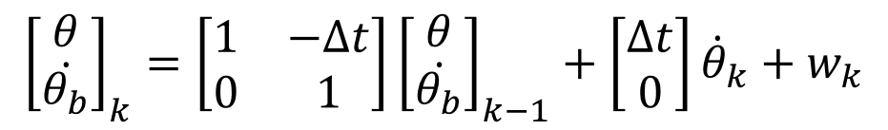
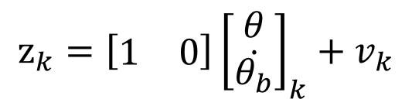

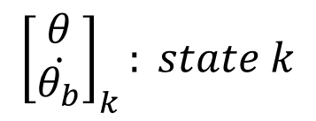

1.3 IMU (sensor) signal pre-processing -- Pelvis orientation estimation
Model of Kalman filtering
*
Extracted raw data
Z_{k} = angles calculated from acceleration data
Gyroscope (angular rate)
Kalman filtering
Processed data
To be used in further dancers performance evaluation
Accelerometer
(accel of linear & angular motion & gravity)
Pelvis tilt angles: yaw, pitch, roll (w/o. drift)
* Orientation estimation needs to be performed for data in each axis individually.

Slide 5
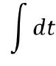
1.4 IMU (sensor) signal pre-processing -- Other processed data
Gyroscope (angular rate)
Pelvis tilt angles: yaw, pitch, roll (w. drift)
Complementary filtering
Pelvis tilt angles: yaw, pitch, roll (w/o. drift)
Accelerometer
(accel of linear & angular motion & gravity)
Gravity removal
Magnetometer (magnetic fields)
Madgwick filtering
Pelvis orientation: yaw, pitch, roll w.r.t. navigation frame (w/o. drift)
Represented in sensor frame
Represented in navigation frame

Slide 6
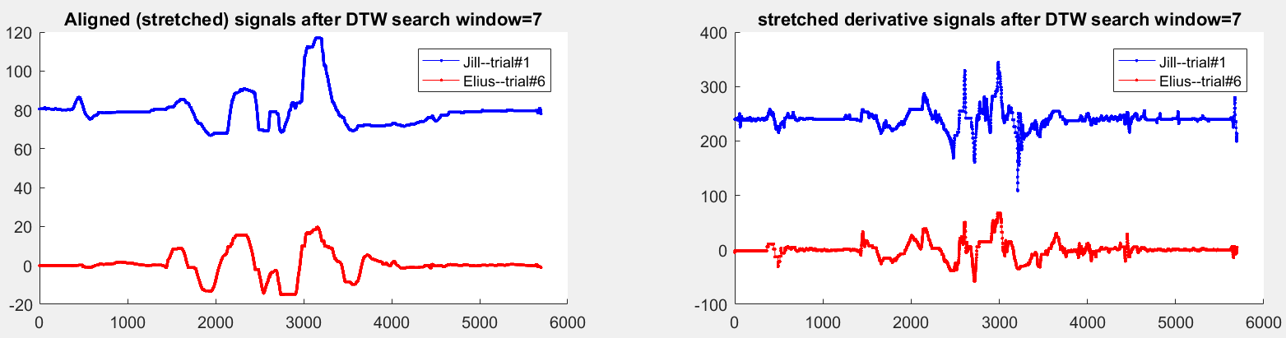
2.1 Dancer performance evaluation -- Visualization of improper pelvis tilting
Improper pelvis tilting (in direction pointing forward)
Hard to observe in raw angular rate signal
Example improper pelvis tilting of Elius (compared against Jill’s signal)
IP data: one trial data of inexperienced dancer;
EP data: one trial data of experienced dancer
Align IP data and EP data using dynamic time warping (DTW)
Find extra peaks (positive or negative) by comparing IP data against EP.

Slide 7
2.2 Dancer performance evaluation -- Binary determination of dancer performance (1)
Basics:
Data are of 5 different dancers. Each dancer has 6 trials. Assume all the trials are independent regardless of dancers.
Consider Jill’s data as “gold-rule”. Data of the other dancers are testing samples (24 trials in total) to be determined.
Generate signal signatures (features) of each trial, including Jill’s trials.
Cluster each trial into two groups (good or not good) based on dissimilarity measure (differences) between the features of testing trials against those of Jill’s trials.
Determine certain dancer’s overall performance based on percentage of “good” trials in all the trials performed by him/her (majority vote).
Difficulties:
Dataset is very small. Overfitting is hard to avoid.
Performance of the proposed binary clustering method depends on the accuracy of orientation estimation done in pre-processing steps.
The proposed method might not be robust.

Slide 8
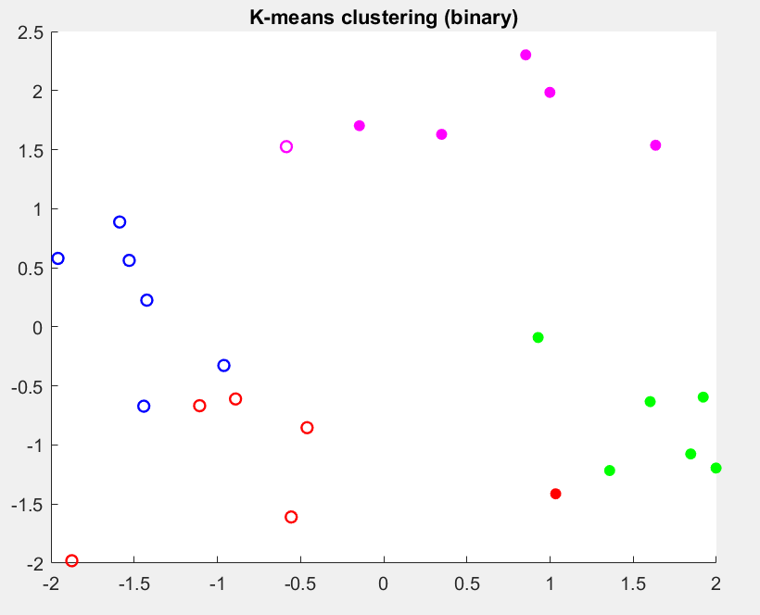
2.2 Dancer performance evaluation -- Binary determination of dancer performance (2)
Compensate the delay between the k^{th} trial of Jill and the k^{th} trial of any other dancer (by minimizing euclidean distance)
“Good”
“Not good”
Generate feature vectors for each dancer: (1) L1 difference of 3rd level Haar wavelet coeff. in X, Y, Z against Jill’s data ; (2) DTW distance in X, Y, Z against Jill’s data; (3) exp(-similarity), where similarity is inner product in X, Y, Z between each dancer and Jill’s data. Form feature matrix.
Luby (red); Rob (blue); Elius (green); Wei (pink)
Perform principal component analysis (PCA) to the feature matrix to project the data to be separable in a low-dimensional space (2D).
Use K-means to cluster each trial into either “good trial” or “not good trial” group based on L1 distance in the low-dimensional space formed from PCA.
Determine the overall performance of a certain dancer using majority vote of “good” or “not good” trials.
Clustering in projected 2D-space from PCA.
Based on majority vote, performance of Luby and Rob are determined as “good”, while performance of Elius and Wei are “not good”.

Slide 9
3. Plans and future work
Under construction...

