Slide 1

Local Coffee Outlet Recommender Based on Yelp data

Slide 2

Problem Statement & Proposed Solution
SPOILT FOR CHOICE
So many possible outlets to check out!
So many reviews to read!
So little time!
PROPOSED SOLUTION
Recommendation System!
Limits your options to just the TOP 5!

Slide 3
Project Pipeline
Data Cleaning, Feature Engineering, Pre-processing, & Exploratory Data Analysis (EDA)
Content-based Filtering & Evaluation
Collaborative Filtering with Alternating Least Squares (ALS) & Evaluation
Data Scraping
Model Limitations & Potential Improvements
Simple Trial of Hybrid Recommendation System
Hybrid Recommendation System Evaluation
Conclusions & Future Plans

Slide 4
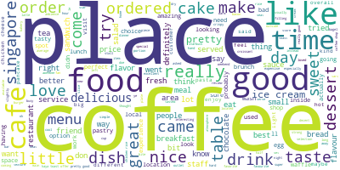
Data Scraping
From Yelp:
987 local outlets | 6,292 reviews | 7,076 ratings using BeautifulSoup
Word Cloud from reviews

Slide 5
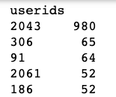
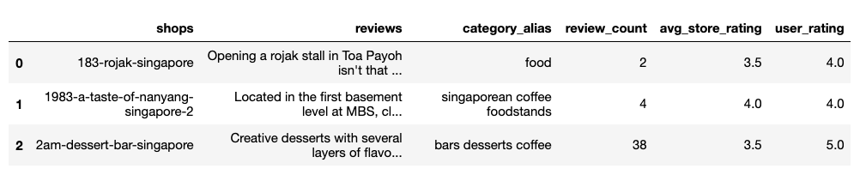
Data Cleaning, Feature Engineering, Pre-processing, & EDA
Ideal Content-based Filtering with Modeling: 1 model for each user
For this project: Time constraint → 1 model for 1 sample user (userid 2043) to test
Why userid 2043?
Outlet features for Content-based Filtering…

Slide 6
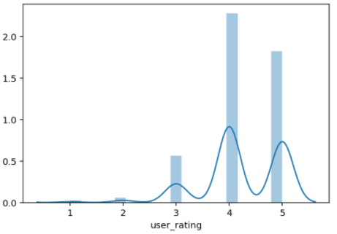
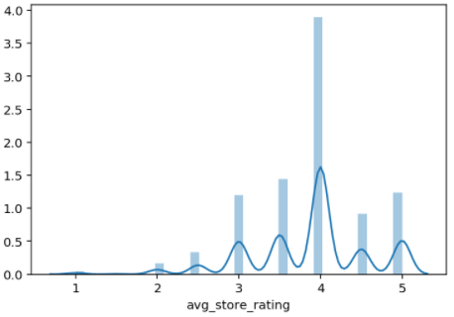
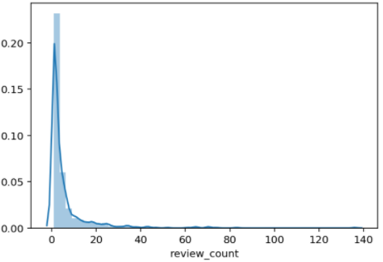
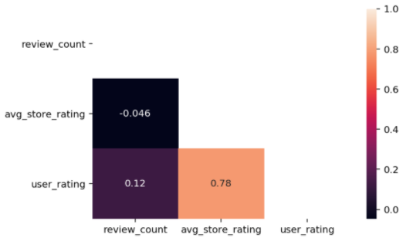
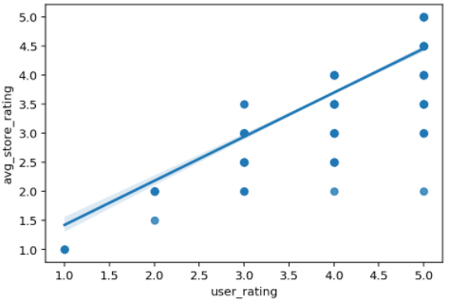
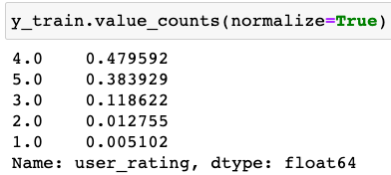
Data Cleaning, Feature Engineering, Pre-processing, & EDA
Userid 2043 – rather
Imbalanced rating classes…
Avg_store_rating slightly left-skewed…
Outlets' review counts are severely right-skewed
Moderate correlation between user_rating & avg_store_rating
Baseline accuracy is 0.48

Slide 7
Content-based Filtering
...where a user is recommended items similar in terms of item characteristics such as item category, item review count etc. to the items once liked or rated highly by user.
Model Perspective:
Make predictions of user ratings by learning user coefficients based on outlet characteristics such as outlet category, outlet review count etc. and ranking them in descending order for top recommendations

Slide 8
Content-based Filtering & Evaluation
ROC AUC (weighted by prevalence)
Model | Accuracy | Micro-Avg Precision | Micro-Avg Recall | Micro-Avg F1 | Micro-Avg ROC AUC
LogReg w Tfidf | 0.81 | 0.81 | 0.81 | 0.81 | 0.88
LogReg w Tfidf w PCA | 0.50 | 0.50 | 0.50 | 0.50 | 0.65
DecisionTreeClassifier w Tfidf | 0.85 | 0.85 | 0.85 | 0.85 | 0.94
DecisionTreeClassifier w Tfidf w PCA | 0.43 | 0.43 | 0.43 | 0.43 | 0.62
RandomForestClassifier w Tfidf | 0.61 | 0.61 | 0.61 | 0.61 | 0.92
0.71
0.57
0.90
0.47
0.81

Slide 9
Model-Based Collaborative Filtering
Decomposes user-item interaction matrix into user and item latent factors; dot product of these latent factors will predict user ratings

Slide 10
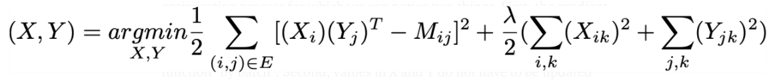
Algorithm: Alternating Least Squares (ALS) (via pyspark)
Why?
Popularized by the Netflix prize
Let’s see how it performs on this Yelp dataset
Hold your breath…
How?
Matrix Factorization technique
Alternates between fixing user or item latent factors to solve for the other via gradient descent at each iteration in the process of minimizing loss
Matrix Factorization Loss function:
User latent factor
Item latent factor
Matrix Factorization Loss function:

Slide 11
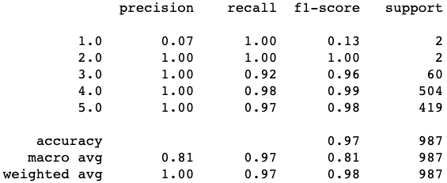
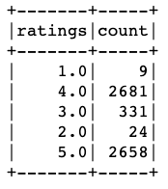
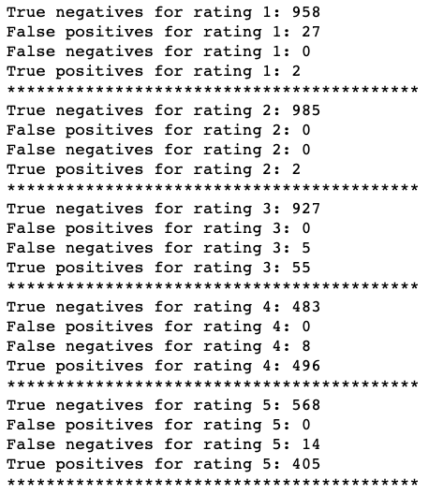

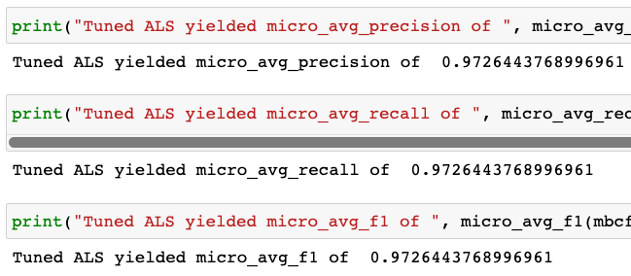
Collaborative Filtering with Alternating Least Squares (ALS) & Evaluation
Rating 1:
Rating 2:
Rating 3:
Rating 4:
Rating 5:
Accuracy: 0.97
Micro-Avg Precision: 0.97
Micro-Avg Recall: 0.97
Micro-Avg F1 Score: 0.97
Overall still low on mis-classifications
Baseline for ALS is 2,681/5,703 = 0.47

Slide 12
Hybrid Recommender
Best of both worlds

Slide 13
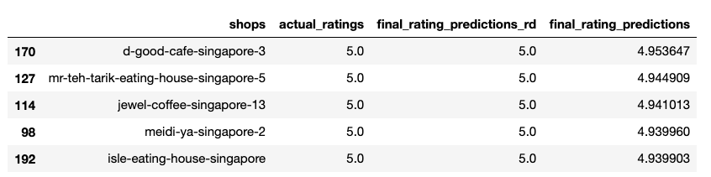
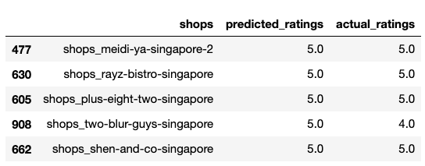
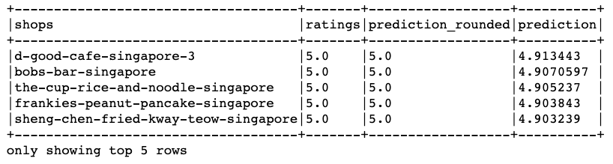
Hybrid Recommendation System Evaluation
Best of both worlds indeed!
Hybrid top 5 recommendations for userid 2043:
Combination of User-Centric Content-based Filtering & Model-based Collaborative Filtering
How?
Weighted sum of respective predictions
Baseline accuracy for Hybrid recommender: 0.48
Content-based Filtering’s top 5 recommendations for userid 2043:
Model-based Collaborative Filtering’s top 5 recommendations for userid 2043:

Slide 14
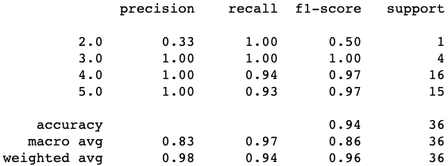
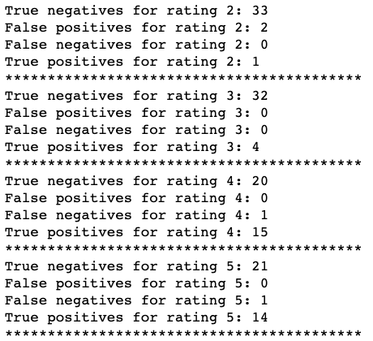
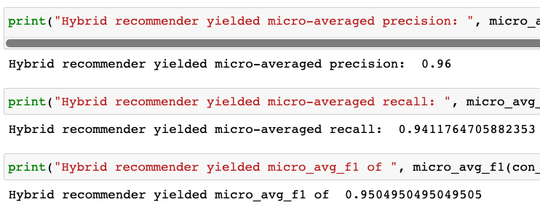
Hybrid Recommendation System Evaluation
Rating 1: No sample-unable to predict
Rating 2: Higher False Positives…
Rating 3:
Rating 4:
Rating 5:
Accuracy: 0.97
Micro-Avg Precision: 0.96
Micro-Avg Recall: 0.94
Micro-Avg F1 Score: 0.95
Overall still low on mis-classifications

Slide 15
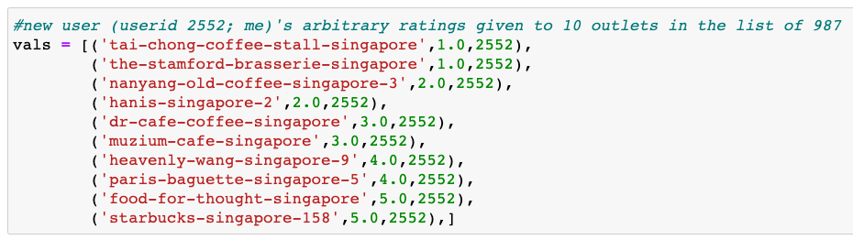
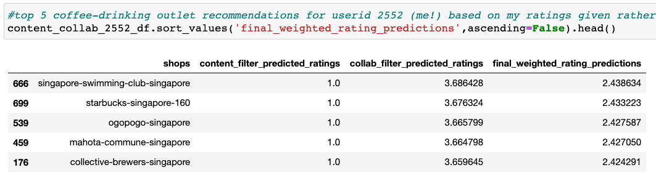
Simple Trial of Hybrid Recommendation System
Trial: 10 ‘arbitrary’ ratings fed in as userid 2552→
Content-based Filtering
Collaborative Filtering
Hybrid Recommender /
Top 5 outlets recommended for userid 2552 (me!)
All 1s for content-based
Collaborative compensated
Overall
OK

Slide 16

Model Limitations & Potential Improvements
Content-based Filtering Model trained on 1 sample user
One model for each user
Include all userids and rows
Include most userids and limit rows to unique shops and userids
Tune model with each new user input of ratings
Include implicit data?
TfidfVectorizer and PCA not tuned
Mean Normalization of ratings could be considered
Scraped data quality
ALS is a regressor, output was “tweaked” for classification→ incorporate logistic/sigmoid function (f(x)):
Adapt to neural networks for state-of-the-art recommender
Notes:
Content-based Filtering Model trained on 1 sample user
One model for each user (but time consuming, computationally expensive)
Include all userids and rows (but same shop appearing more than once in final recommendations)
Include most userids and limit rows to unique shops and userids (but hard to split into train and test sets and stratify by userid → majority of users gave 1-2 reviews and ratings per user)
Tune model with each new user input of ratings (but Kfolds cannot be more than no. of samples in each rating class→users need to provide a lot of ratings first→few users will spare the time)
Current data only uses explicit data, can perhaps consider incorporating implicit data to further strengthen the recommender
TfidfVectorizer and PCA not tuned
Mean Normalization of ratings could be considered
Scraped data quality – a few ratings and userids not aligned→affects quality of recommendations
ALS is a regressor, output was “tweaked” for classification to align with Content-based Filtering→some predicted ratings fell into novel classes→incorporate logistic function (f()):
With the above, matrix factorization can be extended and adapted to neural networks & deep learning for state-of-the-art recommenders.

Slide 17

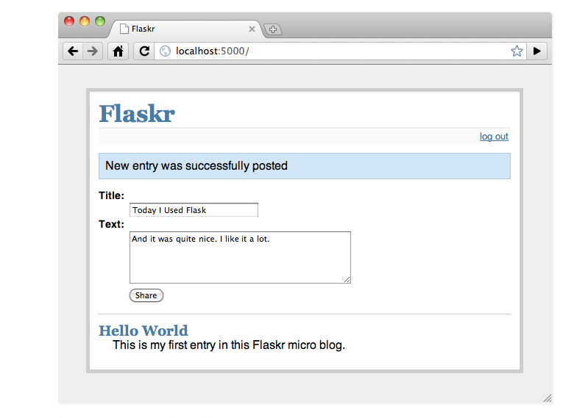

Conclusions & Future Plans
- Tune GradientBoostedClassifier & XGBoost to boost content-based filtering performance Long term steps: - Configure user input, database synchronization-interaction on Flask and Heroku for deployment -A/B Testing to gauge actual users’ feedback

